Slide 1
openEAS Template
A New Users Implementation Guide

Slide 2
EAS – Extended Analytics Service
This service is designed to read data from a database, run analysis on this data, and output the results of this analysis back to the database.
The analysis done with this service will be specific to each application and will have to be coded on a per application basis.
This service can be used stand-alone where the service will process data and return it to your database or in conjunction with PQDashboard for easy access to data in the form of web tables.

Slide 3
Demonstration
To demonstrate the installation process for openEAS we will be using a common theme with a fictional service that we want to create called MyAnalysisService.
This will show you how to set the service up except for the code that you will use to analyze your data.

Slide 4
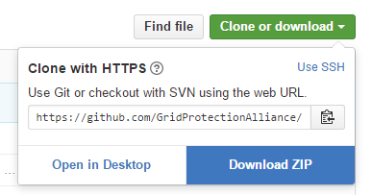
Step 1: Download the needed files.
Start by downloading the files from our GitHub account
Navigate to https://github.com/GridProtectionAlliance/openXDA/tree/sdbx
Click the Clone or download button
Click the DownloadZIP button
Feel free to save the zip file wherever
you like, but the default location will
probably be in your downloads folder.

Slide 5
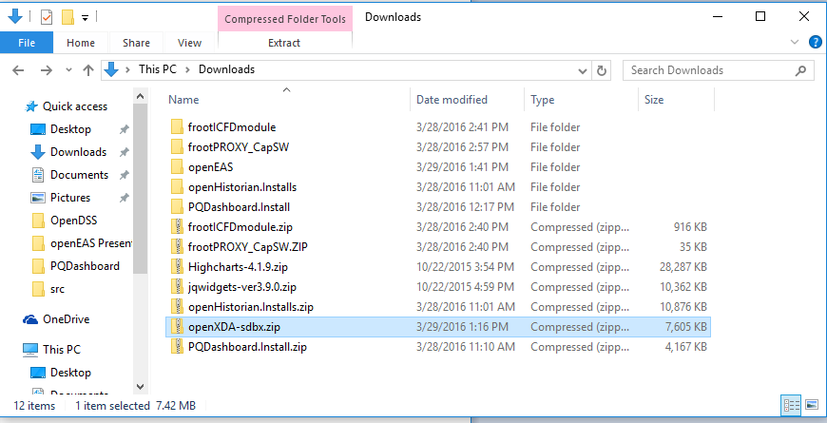
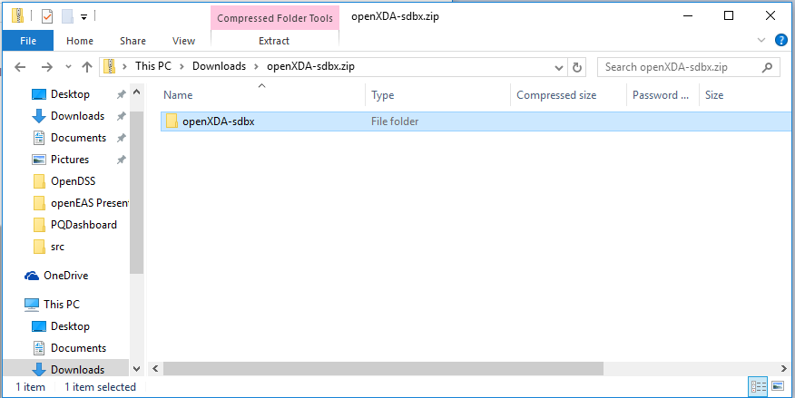
Step 2: Open downloaded file
Next you will want to navigate to your new files
Move to the folder you
downloaded openXDA-sdbx.zip
into
Double click openXDA-sdbx.zip
Double click openXDA-sdbx

Slide 6
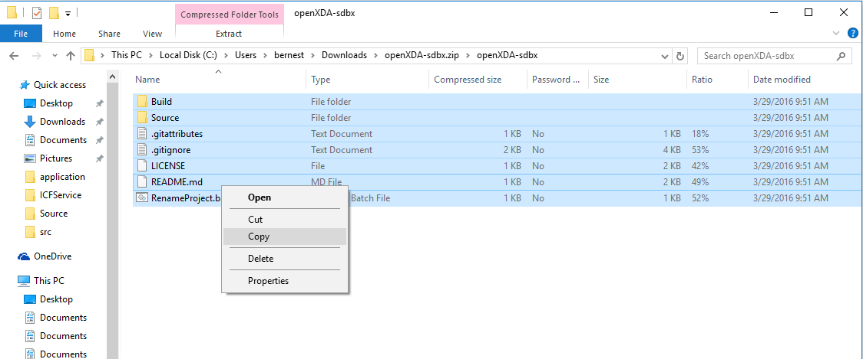
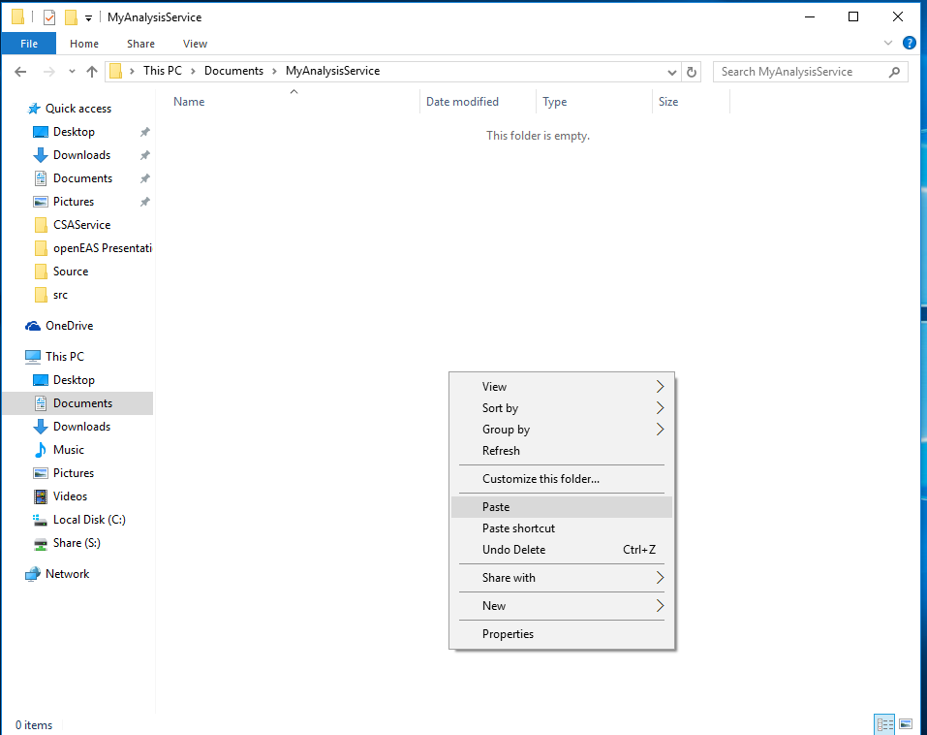
Step 3: Setup Workspace
Copy files into a project folder named for what you want your service to be called. I will call my folder MyAnalysisService.

Slide 7
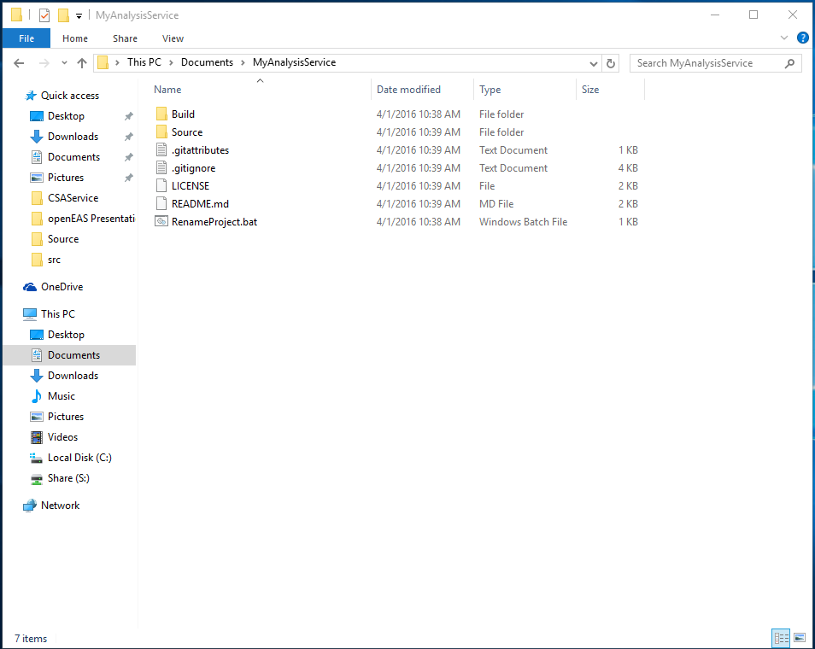
Step 3: Setup Workspace (cont.)
This will give you the workspace needed to customize your service to your own needs using Visual Studio.

Slide 8
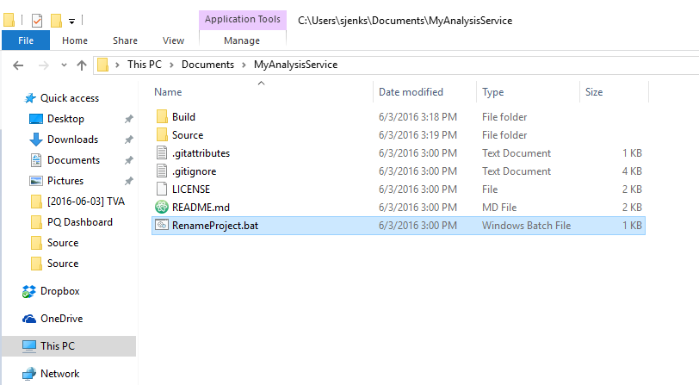
Step 4: Rename project files
Next we want to rename all our project files to the name we want to call our service. We have included a tool that will automatically do this for you named RenameProject.bat. I will be renaming my project files to MAService, for MyAnalysisService.
In your workspace directory you will see a file named RenameProject.bat.
Double click on it.
If a security dialog box pops up, click run.

Slide 9
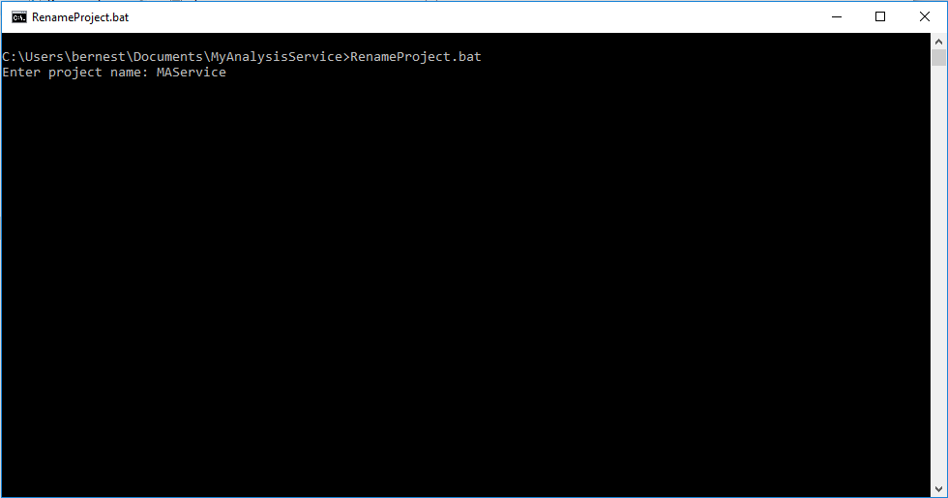
Step 4: Rename project files (cont.)
Type the name you have chosen for your service and press the enter key.

Slide 10
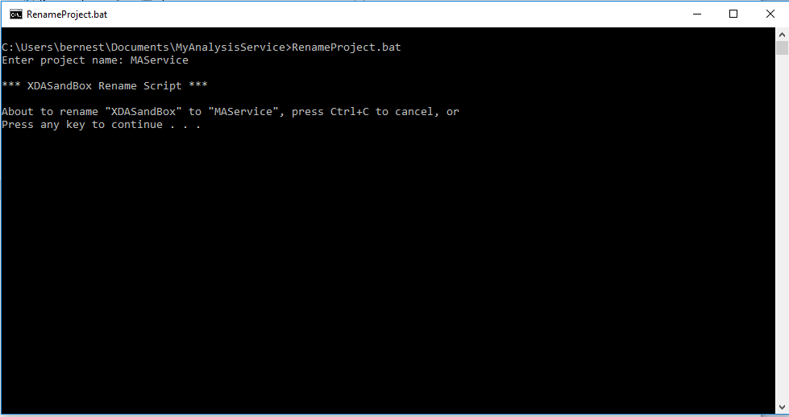
Step 4: Rename project files (cont.)
If you like the name and want to continue press a key, or hold the control key and press c at the same time to close the window and restart over at the beginning of step 4.

Slide 11
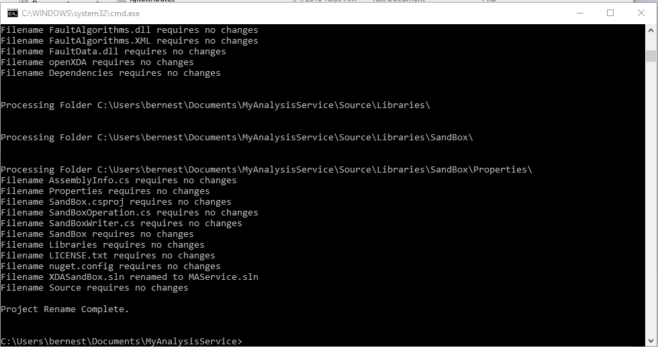
Step 4: Rename project files (cont.)
You will see a lot of data flash before your eyes in the command prompt. This is normal. When it stops, look for the Project Rename Complete statement at the end. This will tell you that it executed normally and you are ready to go the next step. If you have made any errors you can delete everything in your directory and beginning over again at step 3.

Slide 12
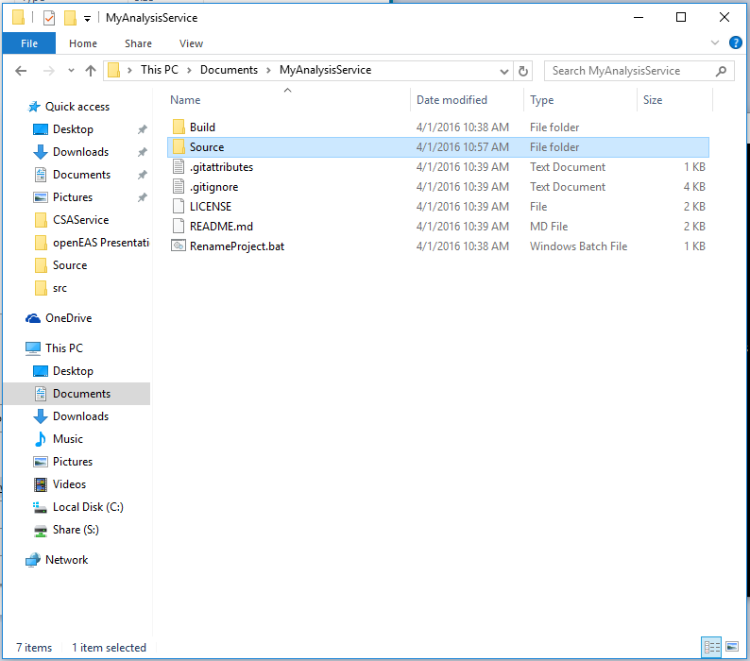
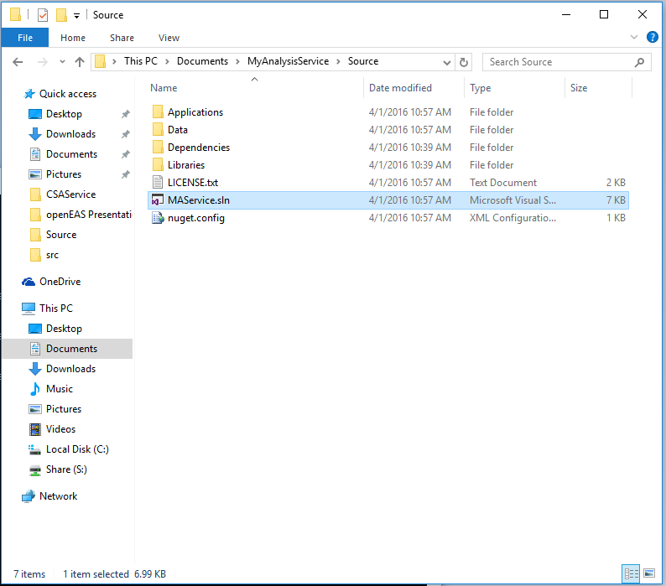
Step 5: Open Your Project
Your service is now ready to be customized to your application. To customize the service you will need to obtain a copy of Visual Studio. Once you have obtained Visual Studio we are ready to begin.
Double click the Source folder in your directory.
Now open the project by clicking your .sln file. It will be named the name you created in step 4. For example, mine is name MAService.sln.

Slide 13
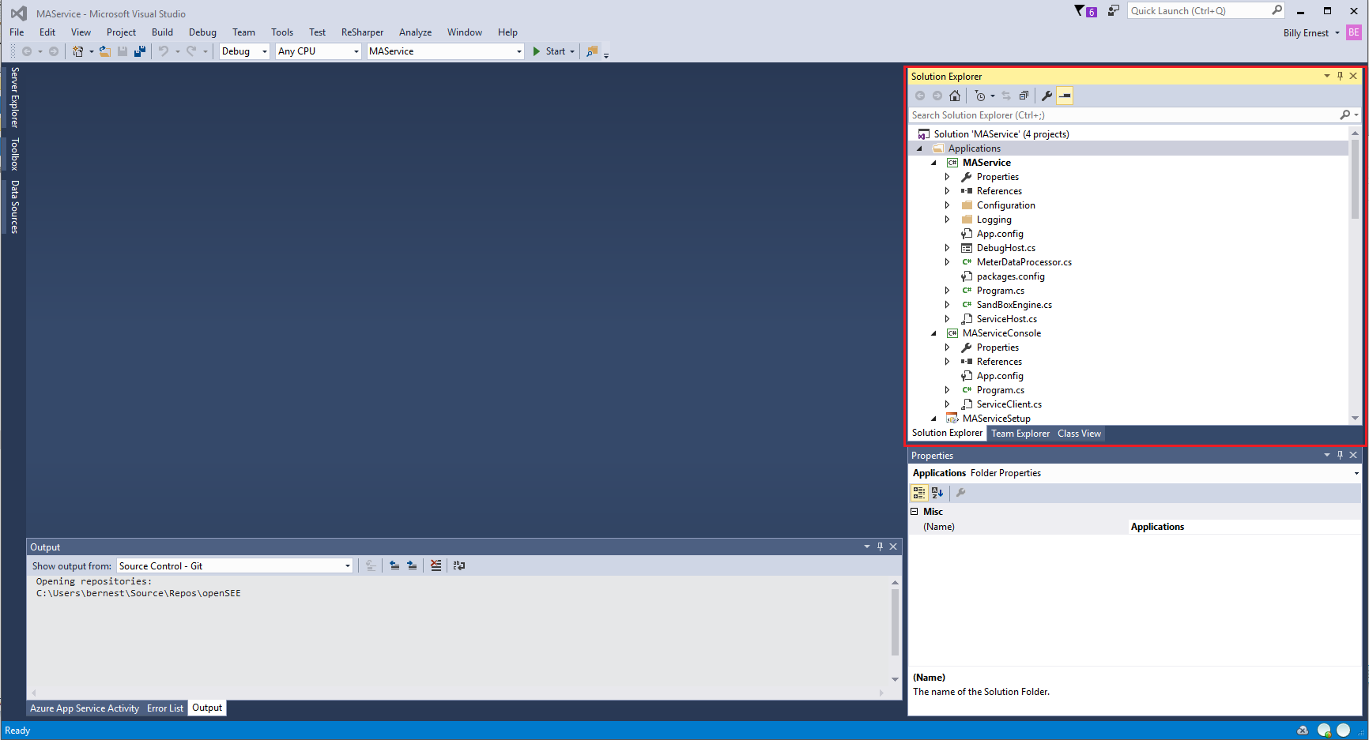
Step 5: Open Your Project (cont.)
Your solution is now ready to be customized using Visual Studio. We will make references to the Solution Explorer window multiple times in this demonstration, so note the location. I have placed a red box around it in the image below. If you can’t find it, click on view->solution explorer.

Slide 14
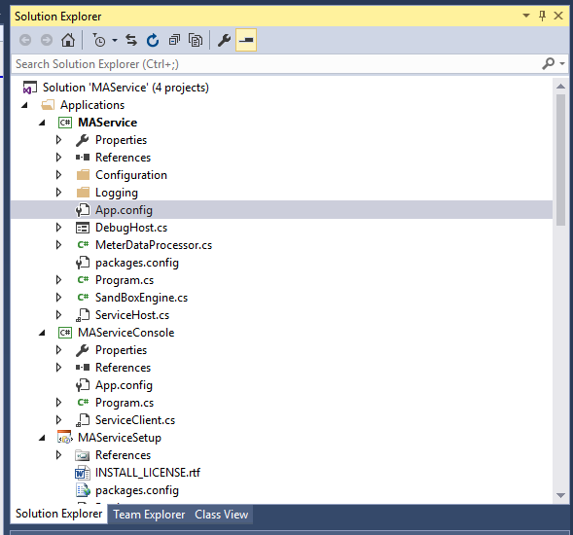
Step 6: Update Port Information
This step only needs to be performed by anyone that has already built one service and wants to build and run another services from this same framework. An example might be if I designed and ran MyAnalysisService and I wanted to design and run MySecondAnalysisService. Running both of these services will cause a port conflict unless it is addressed, which can be done in this step. If you are not running multiple services move on to step 7. From the Solution Explorer, find and double click on App.config underneath your solutions directory tree.

Slide 15
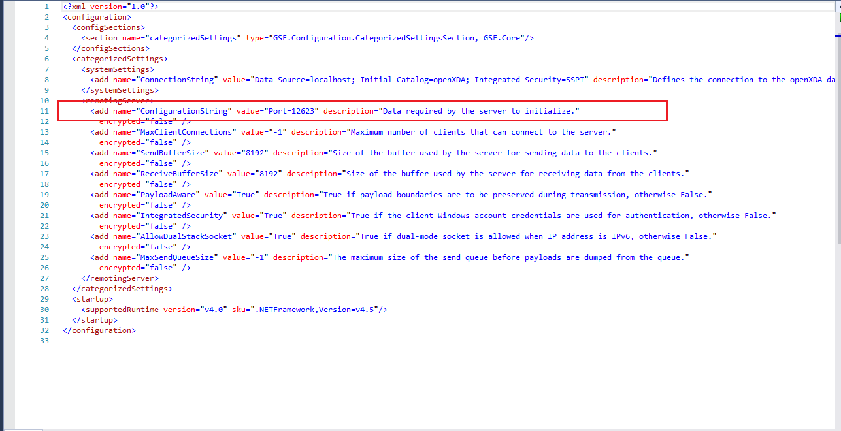
Step 6: Update Port Information (cont)
This will open up the file in the main window for editing. Bring your attention to line 11. Find the sequence of text that says “Port=12623”. Enter the port you would like to use. For example, if I want to use port 12345 I will replace 12623 so the text will look like “Port=12345”. You only need to change the numbers.

Slide 16
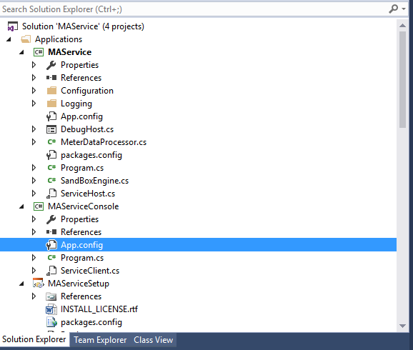
Step 6: Update Port Information (cont)
Now in the Solution Explorer, double click on App.config file underneath the Service Console tree. In my solution the name of this directory will be MAServiceConsole and yours should follow the naming convention we used earlier concatenated with Console.

Slide 17
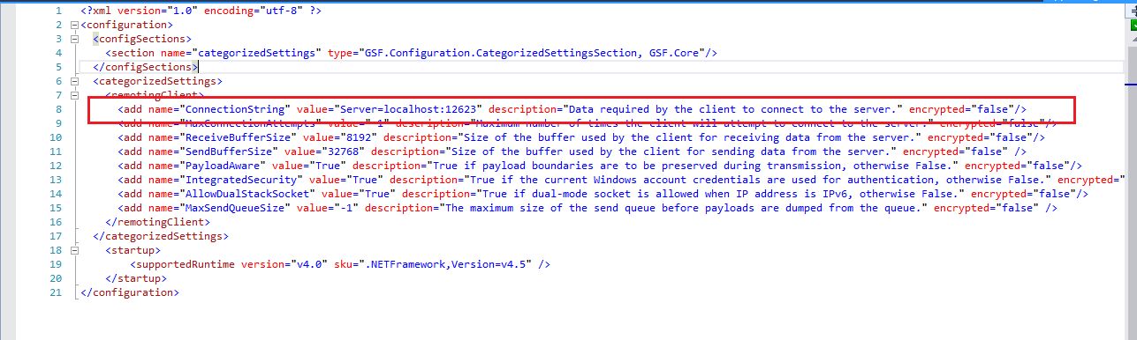
Step 6: Update Port Information (cont)
Look in the App.config file you just opened and find line 8. On line 8 find the following text – value=“Server=localhost:12623”. Change the numeric value, here 12623, to the number you changed the port value to a moment ago. For example, had I changed the port number to 12345 I would set the value above to value=“Server=localhost:12345”. You only need to change the numbers here.

Slide 18
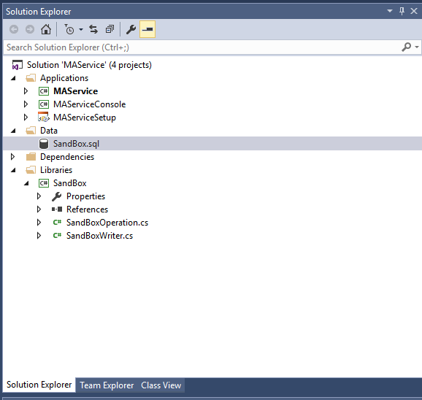
Step 7: Update Sandbox.sql file
Double click SandBox.sql, under the Data tree in the Solution Explorer. In this file we will set up the data base table for your output data. There are optional steps that need to also be taken in this file if you plan to use PQDashboard.

Slide 19
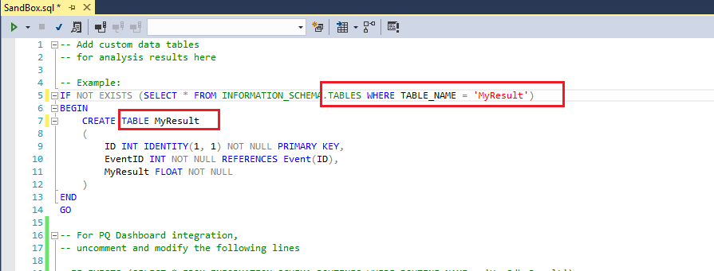
Step 7: Update Sandbox.sql file (cont)
In the main window look at the statement CREATE TABLE SandBoxResult on line 7. SandBoxResult can be changed to any table name that you want. For example, In my code I want to call it MyResult. Look up two lines and change the statement that looks like WHERE TABLE_NAME = ‘SandBoxResult’ to reflect the name you used on line 7. Mine would be WHERE TABLE_NAME = ‘MyResult’. Also look at your external dll and figure out what your outputs are and add any additional fields that are necessary to your table. If you are not using PQDashboard, skip over the next few pages to step 8.

Slide 20
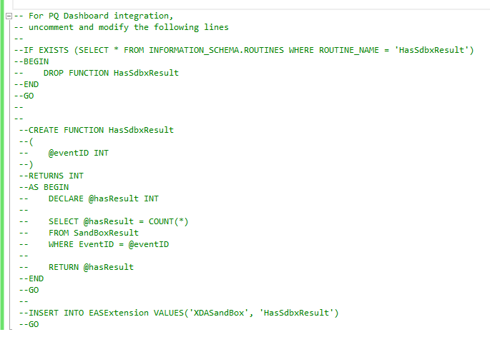
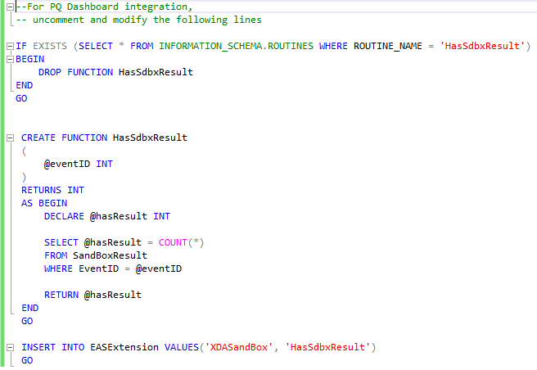
Step 7: Update Sandbox.sql file (cont.)
Next we need to set up your stored function that is used to flag your data when searching for events. The function can be used as is or can be modified to return a value based on some other event criteria that you are interested in. Uncomment the function by deleting all the ‘--’ from the beginning of each line as shown below.

Slide 21
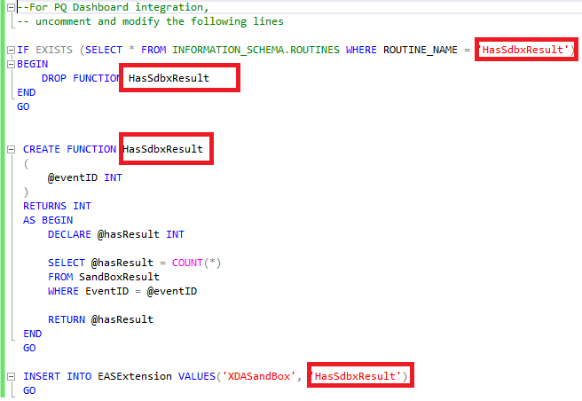
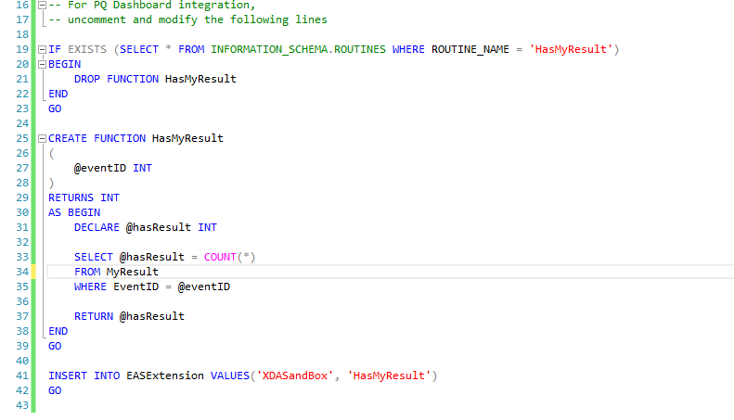
Step 7: Update Sandbox.sql file (cont)
If you changed the name of the output table two slides ago, go in and change the name of the stored procedure in the four placed marked below with a red square. My example shows how I updated the function with HasMyResults as the function name.

Slide 22
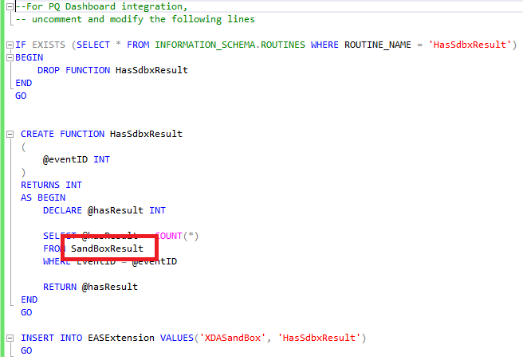
Step 7: Update Sandbox.sql file (cont)
Update SandBoxResult name to reflect name you named your output table earlier in the step. I changed mine to be MyResults.

Slide 23
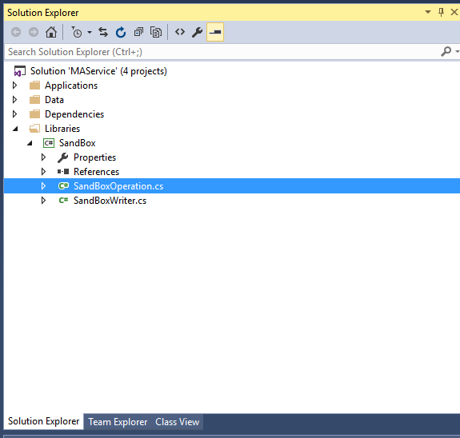
Step 8: Code Analysis
Go to SandBoxOperation.cs under the Libraries tree. This is where you will enter the code for processing using your functions or external dlls and output your data back to the database.

Slide 24
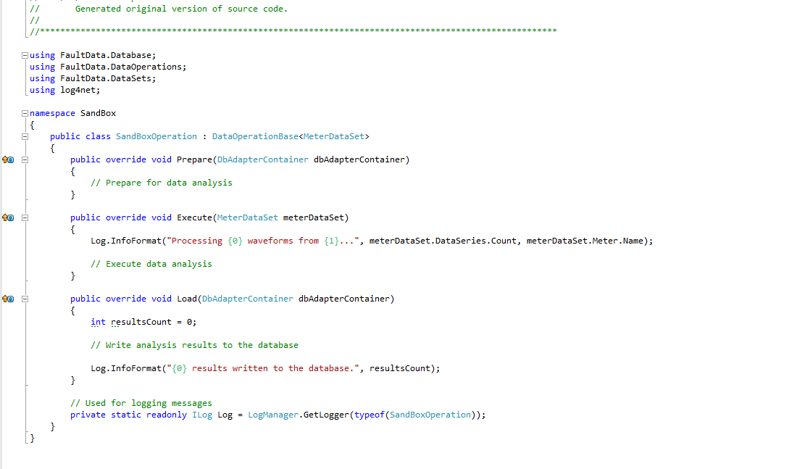
Step 8: Code Analysis (cont)
This file is fairly bare and will be your responsibility to implement. This will be where you call your external dll and load the results back into the database.

Slide 25

Step 8: Code Analysis (cont)
The prepare statement is generally used to prepare the connection to the database for the subsequent loads.

Slide 26
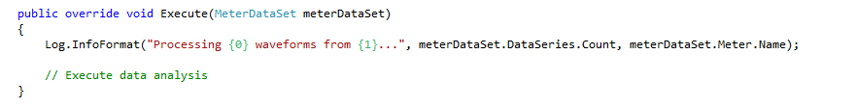
Step 8: Code Analysis (cont)
The Execute function is where you will take your input data, which will be passed in as the meterDataSet, and process it through an external dll, or it can be an internal function, and then set the resulting data up to be loaded using the next function.

Slide 27
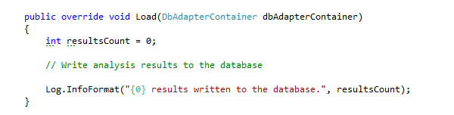
Step 8: Code Analysis (cont)
The Load function will load the data processed in the execute function to the database that was referenced in the prepare function.

Slide 28
Finished!
At this point your openEAS service should be completely implemented and working as desired. If you would like to link your service to PQDashboard then additional steps are needed to configure your PQDashboard system and create a web table to display your data.
PQDashboard Users
All additional steps only need to be performed if you are a PQDashboard user and want your data to be available for display from within PQDashboard.
If you are not a PQDashboard user, your data will be in your database and available to be used as you see fit.
No other steps are required for openEAS to function as intended.

Slide 29
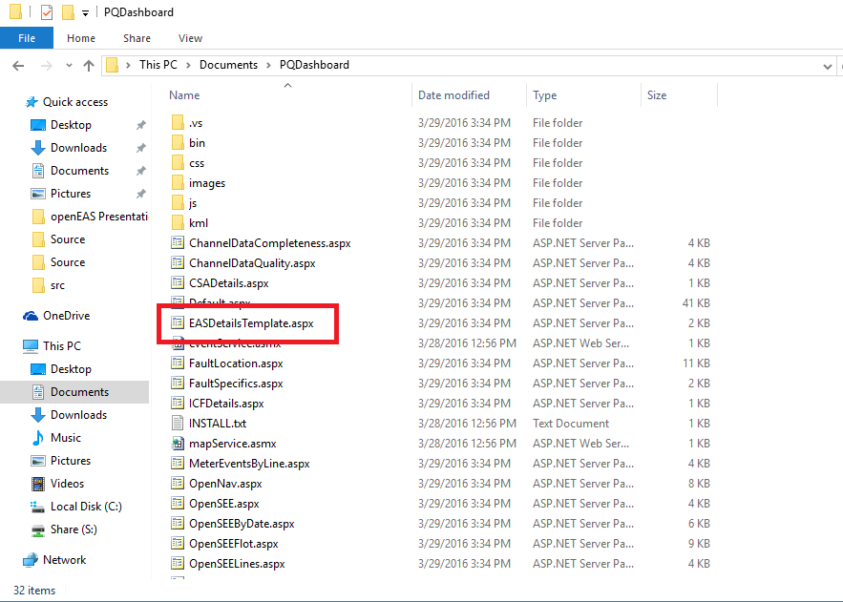
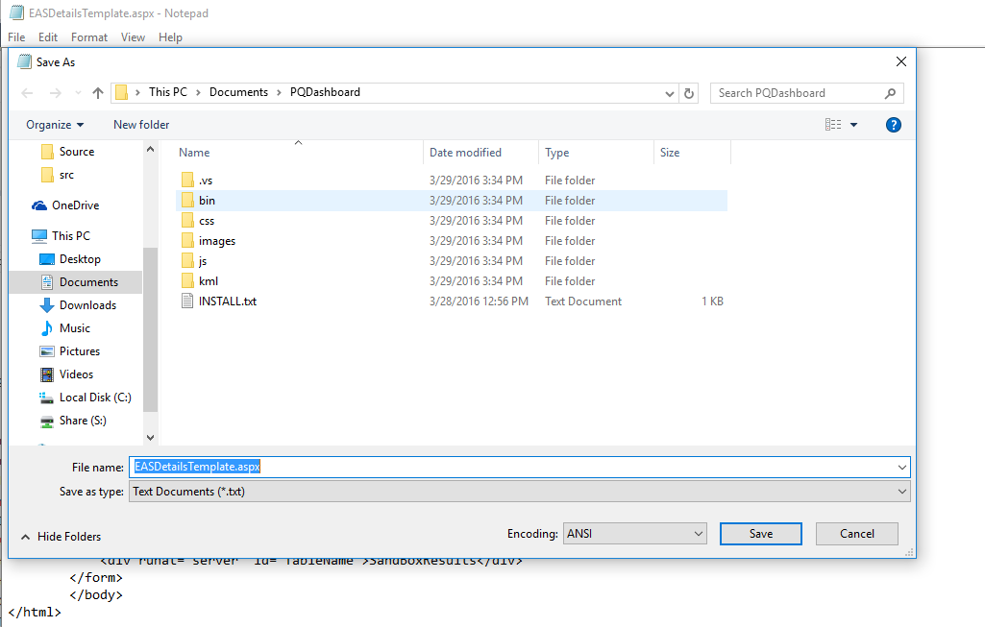
Step 9: Create Webpage for Your Data
Go to the PQDashboard folder where PQDashboard is installed( Default would be C:\inetpub\wwwroot\PQ Dashboard). Open EASDetailsTemplate.aspx in any text editor and save as (YourServiceAcronym)Details.aspx. For example I would make a web page named MASDetail.aspx

Slide 30
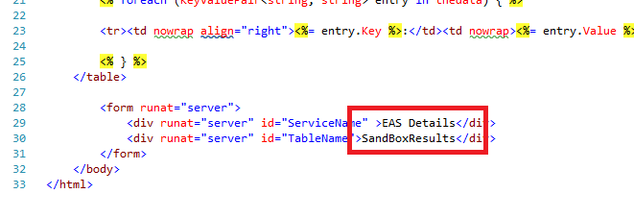
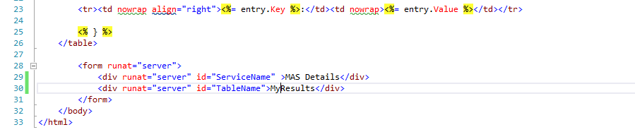
Step 10: Update Info in Webpage
In your new .aspx file you just created in Step 9. Change the values EAS Details and SandBoxResults on lines 29 and 30 to (YourAcronymHere) Details and the name of your Output table you created in Step 6. Shown below, I have changed the values to MAS Details and MyResults.

Slide 31
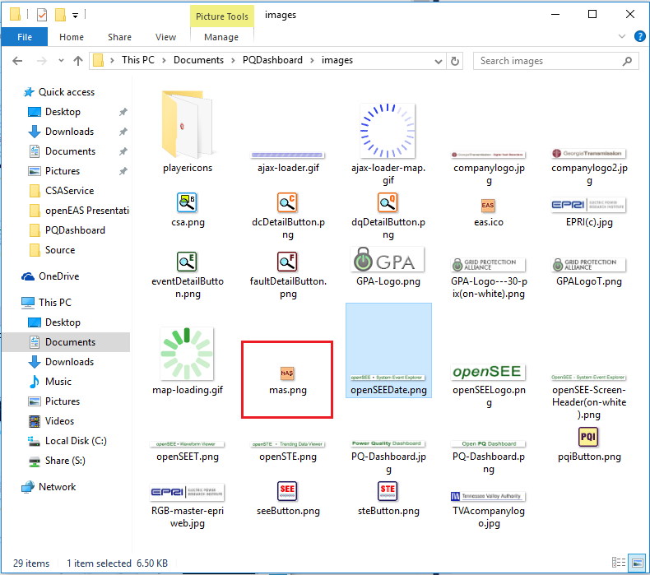
Step 11: Place Icon in Image Folder
Go to the PQDashboard\images folder where PQDashboard is installed( Default would be C:\inetpub\wwwroot\PQ Dashboard\images). Drag and drop an image file that you want used as the PQDashboard button for your service. In our example I created a little button and name it mas.png. Note the image file name, it will be used again.

Slide 32
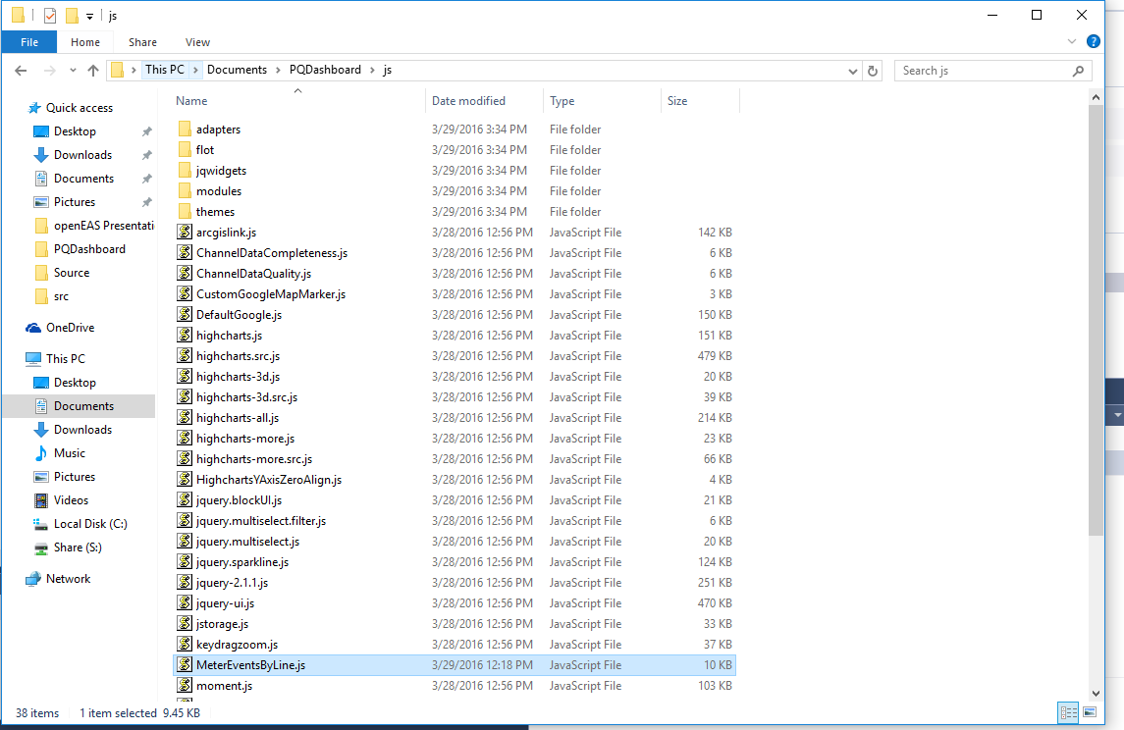
Step 12: Go to Javascript File
Go to the PQDashboard\js folder where PQDashboard is installed( Default would be C:\inetpub\wwwroot\PQ Dashboard\js). Open MeterEventsByLine.js in your editor.

Slide 33
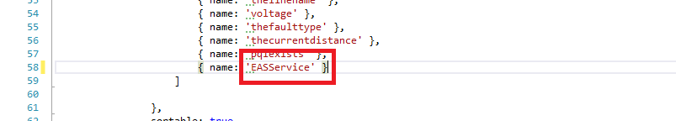
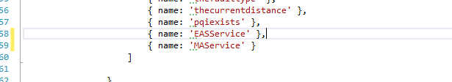
Step 13: Update Datafield name in JS file
Copy Line 58 and Paste it directly below and Change EASService to (YourAcronym)Service and add a comma to the end of line 58. Our example shows us placing MSAService in the datafield below EASService.

Slide 34
Step 14: Update Columns in JS file
The next step require multiple changes but is essentially very simple, my example is the second image
Copy Lines 82 through 85 and Paste them it directly below on line 86.
Change EASService.aspx to the page you created in Step 9.
Change eas.ico to file you provided in step 11
Change EAS to your acronym
Update 300 to width that reflects data table
Update 200 to height that reflects data table
Change dataField to the value you updated in step 13

Slide 35
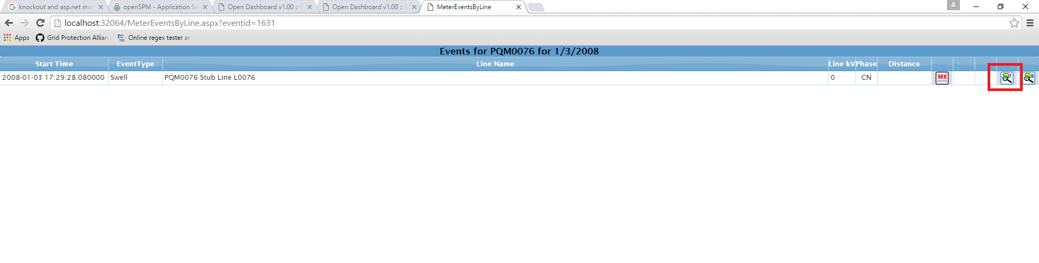
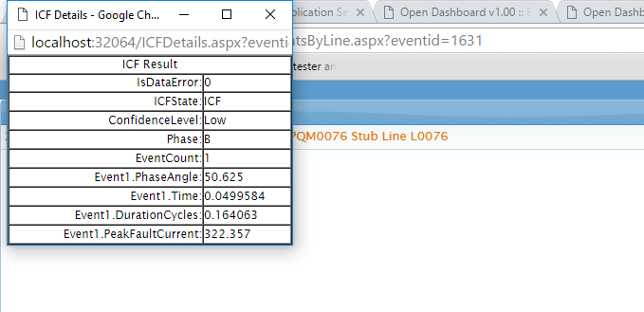
Finished!
Your service is now fully functional with data available for viewing through PQDashboard. You can get to this data from the screen that lists MeterEventsByLine. The button will be on the right and the pop up window will resemble the one shown below.

