Slide 1

A Practical Approach to Streaming Point-On-Wave Data
NASPI Meeting
J. Ritchie Carroll
April 17, 2019
DOE FOA 1492
DE-OE-859

Slide 2
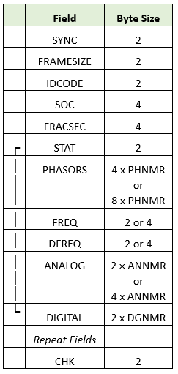
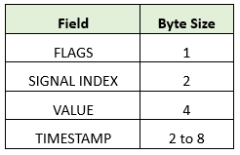


Protocol Difference: Frames vs Atomic Packets
IEEE C37.118 / IEC 61850-90-5
STTP – IEEE 2664
Individual Measurements
MTU Fragment
MTU
Measurements in one packet may differ from another
Synchronized Frame of Measurements
with Fixed Configuration
MTU Fragment
1 Packet, Several Unsynchronized Measurements
MTU
MTU Fragment
IEEE 2664

Slide 3
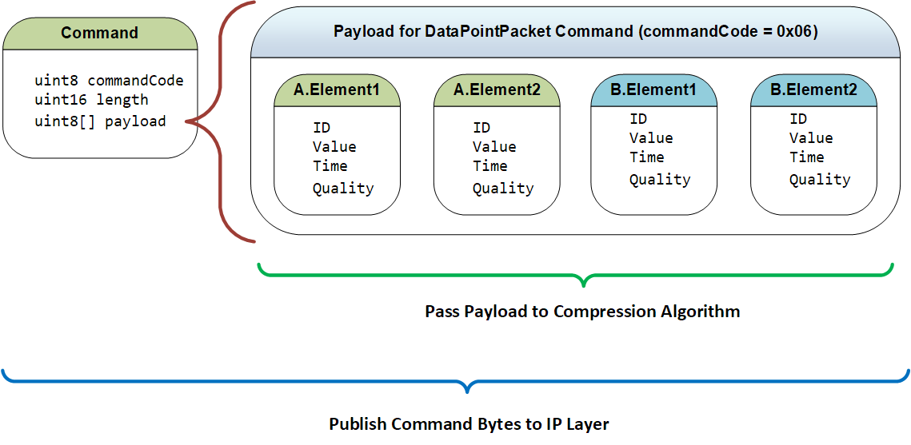
Protocol Difference: Data Packets Allow for Compression
STTP Commands
Pass Payload to Compression Algorithm

Slide 4
DFR Sampling Rates
Digital Fault Recorders (DFRs) capture and analyze point-on-wave data
Sampling rates often range from 5 to 15kHz
GPA’s tool suite includes software for analyzing captured data

Slide 5
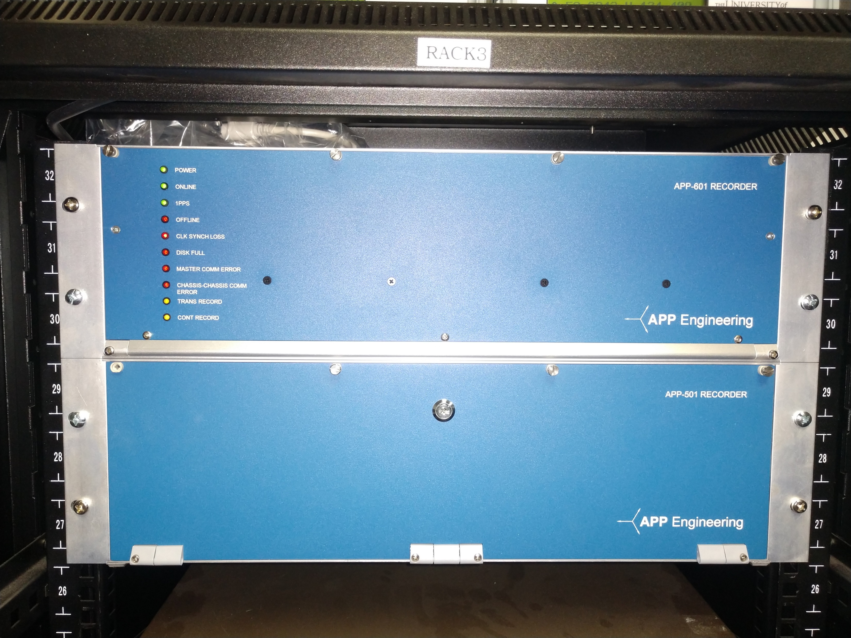
APP DFR in GPA Test Rack

Slide 6
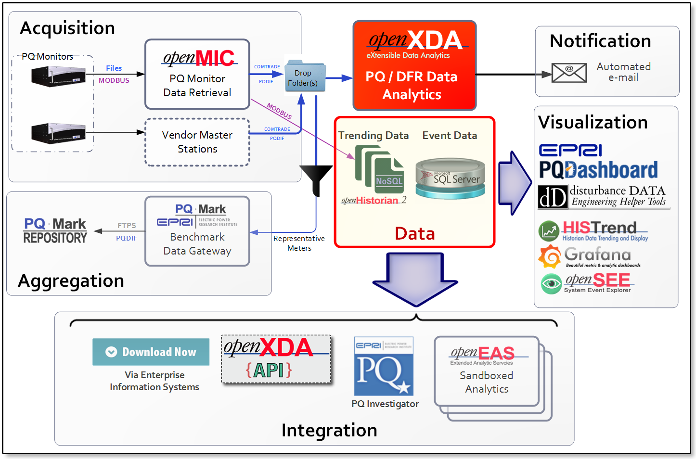
GPA’s Disturbance Monitoring Tool Suite
Notes:
I do what to mention our disturbance tool suite – that fully automates the process of downloading and analyzing DFR data
Only what you want
Used most by TVA, SOCO & GTC.
Development largely sponsored by EPRI
openXDA is the core.
Includes analytics – all 5 IEEE single ended fault location methods, plus doubled ended.
Breaker timing

Slide 7
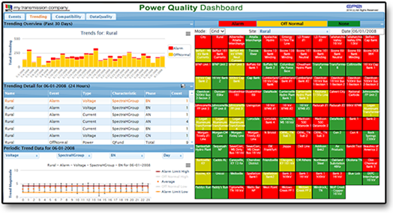
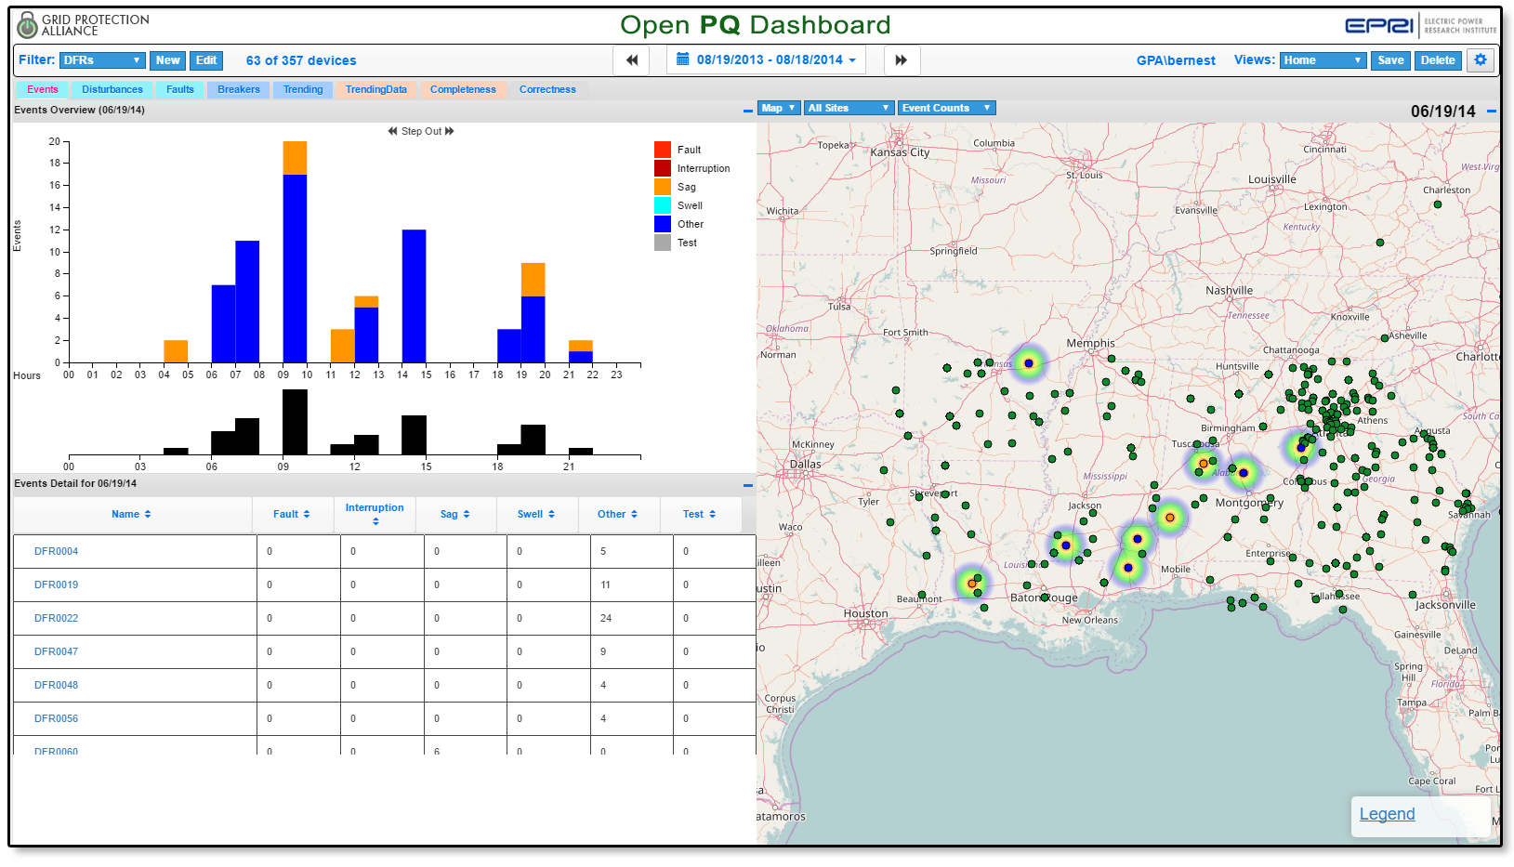
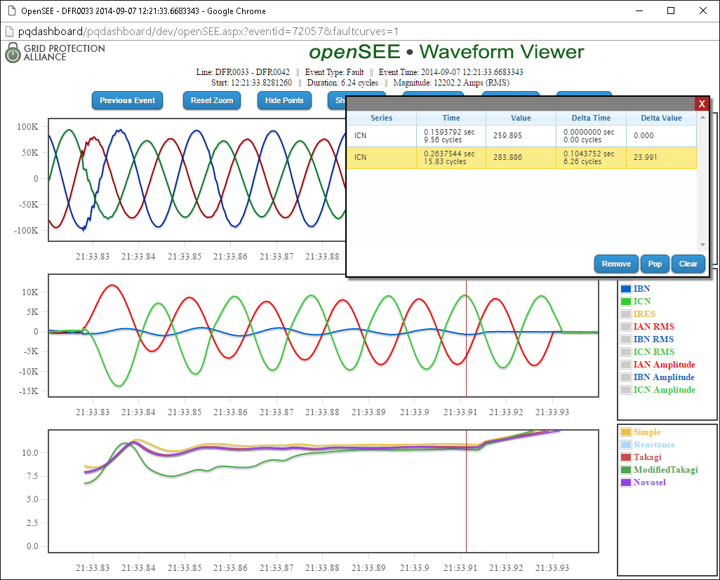
Open PQ Dashboard
Recent Improvements
Features
Ability to manually override automated results and add notes
The display layer for openXDA data
Drill-down from wide-area data displays all the way to waveforms
Complements traditional vendor-provided waveform analysis tools

Slide 8
Using STTP for High-Resolution Data Transfer
Synchrophasor and SCADA
  Example: Recent EIDSN Testing
88kSPS Range (44kHz * 2 signals, ~155 PMUs)
  Example: CD Quality Music
300kSPS Range (~525 PMUs)
  Example: Demodulated Radio Frequency

Slide 9




STTP over EIDSN Demonstration
Purpose
To compare STTP protocol performance to IEEE C37.118
Approach
  Use the EIDSN as the transport layer
  Use GPA’s secure gateway, SIEGate as the test application
  Test performance at differing data volumes
New version with STTP deployed at both SPP and TVA
Metrics Captured
https://www.osti.gov/search/semantic:1504742
https://github.com/sttp/dotnetapi
Publisher
Subscriber
Metrics Captured
IEEE 2664

Slide 10

Lossless compression enables greater STTP throughput
EIDSN Demonstration Test Results
IEEE 2664
1,700
1,200
Points Per Mbps of Bandwidth
IEEE C37.118
Number of Measurements at 30 points/sec

Slide 11
Lossless compression requires more CPU cycles
EIDSN Demonstration Test Results
1,020
IEEE C37.118
Measurement Points per CPU Percent Use
IEEE 2664
650
Number of Measurements at 30 points/sec

Slide 12

CD Quality Audio (~88kSPS)

Slide 13
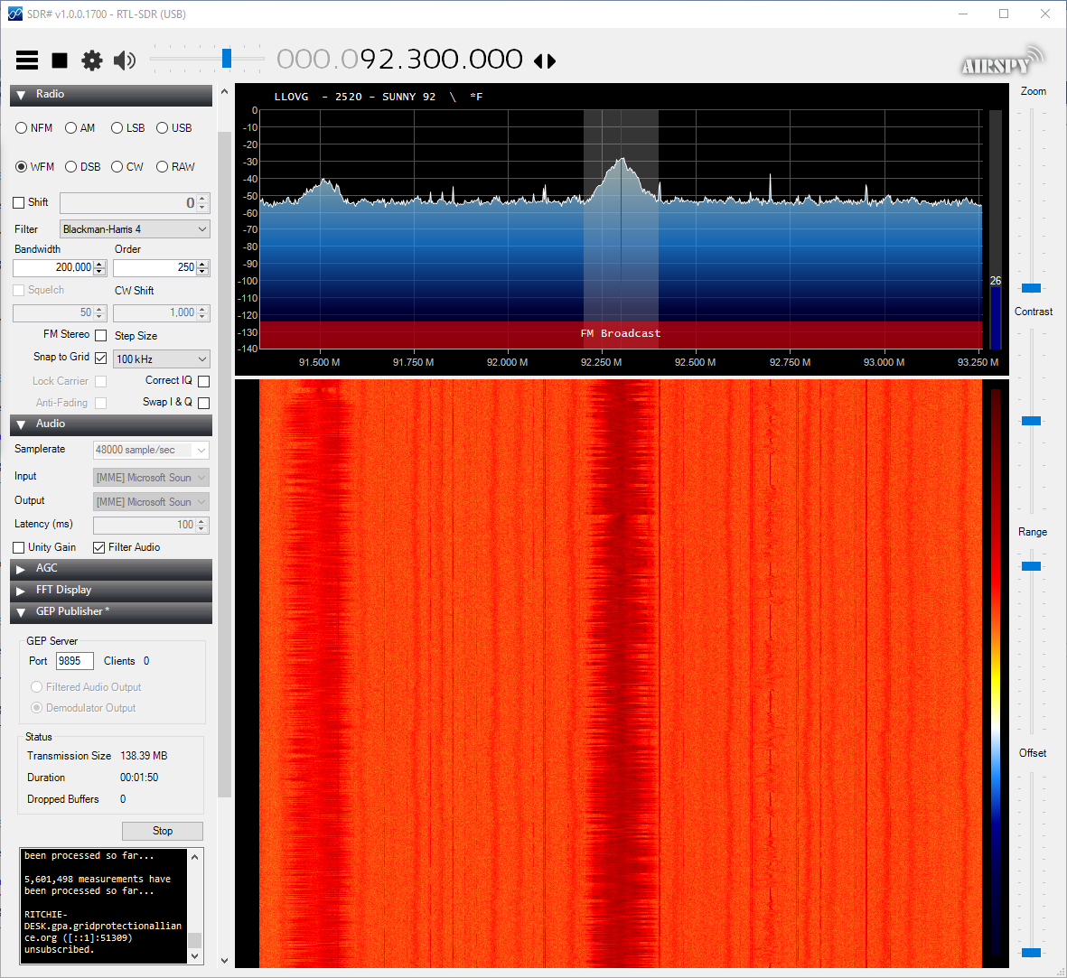
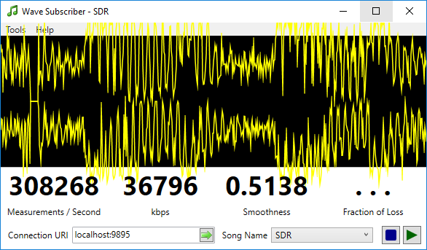
Demodulated Radio Frequency (~300kSPS)

Slide 14
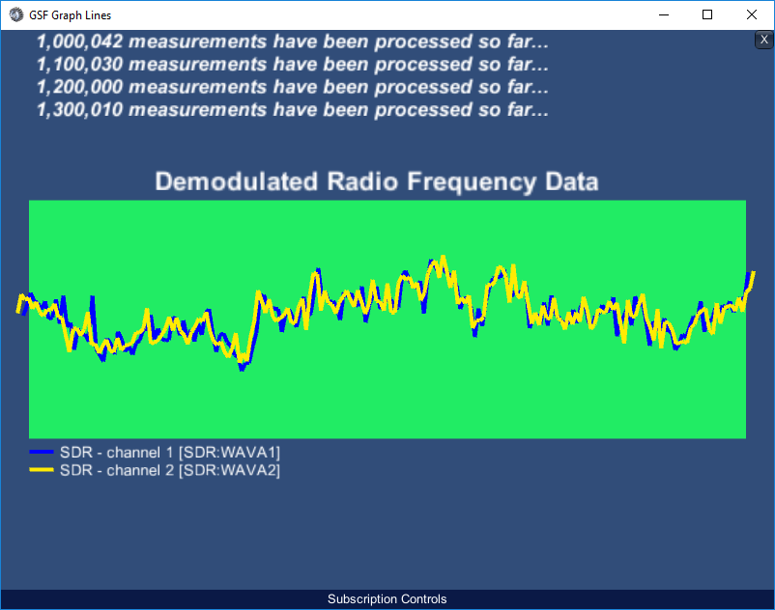
High Speed Graph

Slide 15

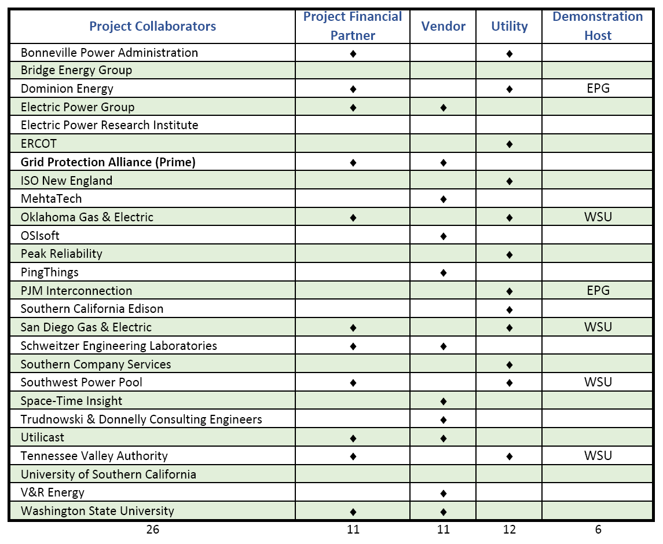

Project Partners
IEEE 2664

