Slide 1
Open Source
Share, and be rewarded tenfold …

Slide 2
Definition of Open Source Software
Free re-distribution without royalties or licensing fees
Source code must be made available for no more than the cost of distribution
Modification of the software or the development of derivative products is allowed

Slide 3
Open Source Myths
Less Secure
Low quality and low performance
Most developers are college students
Unsupported
Open Source is no cost

Slide 4
Open System vs. Open Source
An open system employees a modular design and uses consensus based standards for its key interfaces
Open systems are critically necessary to support interoperability
Open Systems and Open Source Software are dovetail strategies for reducing vendor dependencies
They are not the same thing.
From David A. Wheeler Presentation, 11/4/2009

Slide 5
Open Source Value (development)
External knowledge base
Early engagement of experts
External technical support and code review
Many eyes find bugs quickly
External development resources
Voluntary
Cost-share partnerships

Slide 6
Why DOD creates OSS
Thorough community evaluation lowers risk (especially security risk) and improves quality
Lower development costs
Agility improved to quickly adapt software to new threats or DOD priorities
Lower TCO
Control – Freedom from vendor lock in
From David A. Wheeler Presentation, 11/4/2009

Slide 7
Why should “vendors” use OSS
Competitive Advantages – innovation, time, quality and lower costs.
Creates a focus on meeting marketplace needs rather than lower level issues
First-mover advantage – First one in defines the architecture

Slide 8
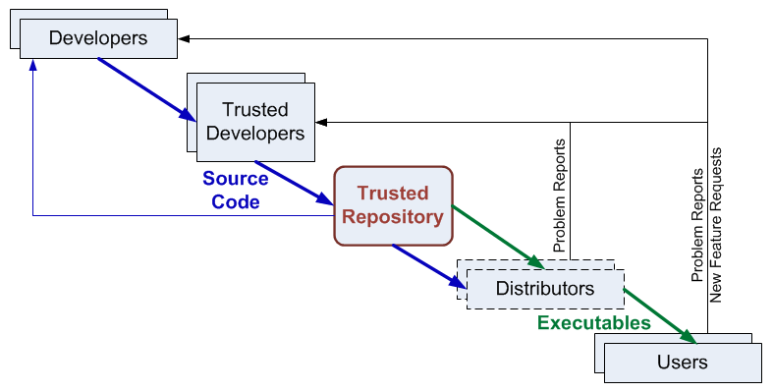
OSS Development Model
(includes users
as developers)
Goal: Active Community
Development
From David A. Wheeler Presentation, 11/4/2009

Slide 9
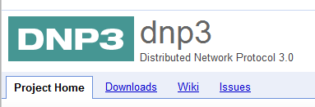
Some OSS communities

