Slide 1
GPA User’s Forum 2011 – Atlanta, Georgia
GPA Product Roadmap
September 7, 2011
Russell Robertson

Slide 2
Grid Protection Alliance
GPA is a not-for-profit company that builds collaborative efforts among government, regulators, vendors, grid owners and grid operators.
Mission – to improve the reliability and resiliency of the electric grid
Purpose – to advance the technology of the electric grid by providing services and systems that create lasting value for electric energy producers, transmission & distribution companies, and consumers.

Slide 3
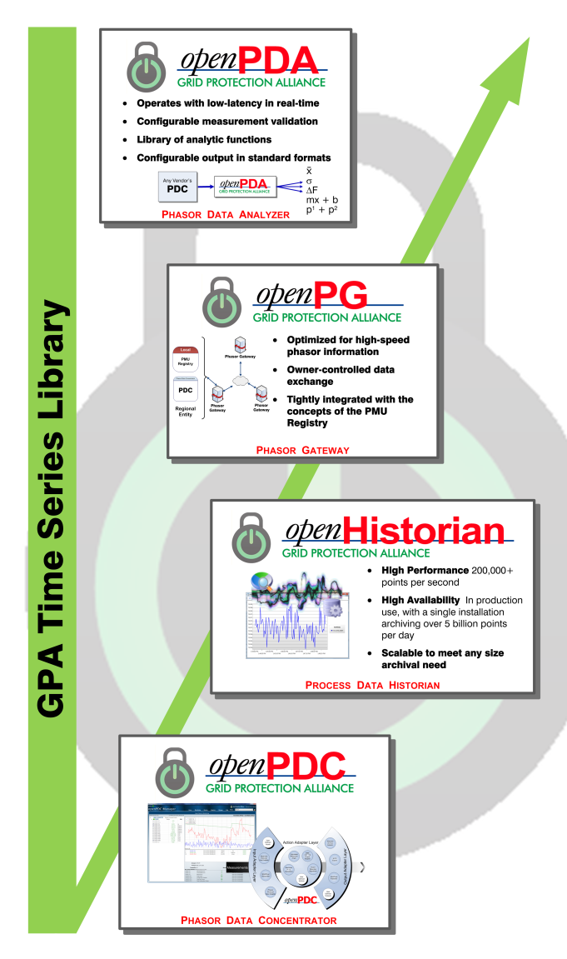
GPA’s Open Source Products
openPDC – Major performance improvements provided with Version 1.4 SP1
openPG – A phasor gateway. Alpha version released in June 2011.
PMU Connection Tester – The standard for phasor system testing and turn-up.
____________
openPDA– A phasor data analyzer, targeted for 2012
openHistorian – An expansion of a component of the openPDC
SIEGate – A DOE Project to deliver an enhanced gateway in late 2013.

Slide 4
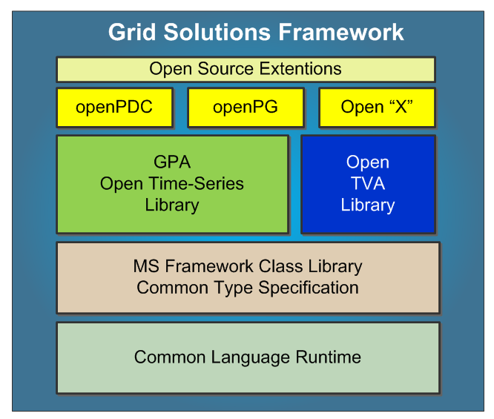
GPA’s Development Framework

Slide 5
openPG Development Schedule
openPG – Alpha Version (June 2011)
________ Plans
openPG – Beta Version (September 2011)
openPG 1.0 (January 2012)
EntergyPG Security Testing (2012)
openPG 1.1 (June 2012)
openPG 1.2 (January 2013)

Slide 6
openPDC Focus Areas
2010
  Installation streamlining
  Configuration tools
2011
  Performance improvement
  Integration features
  Improved alarming
  Features targeted for TOs/ TOps
2012
  TSF restructuring and security testing
  Customer-driven improvements
  New protocols

Slide 7
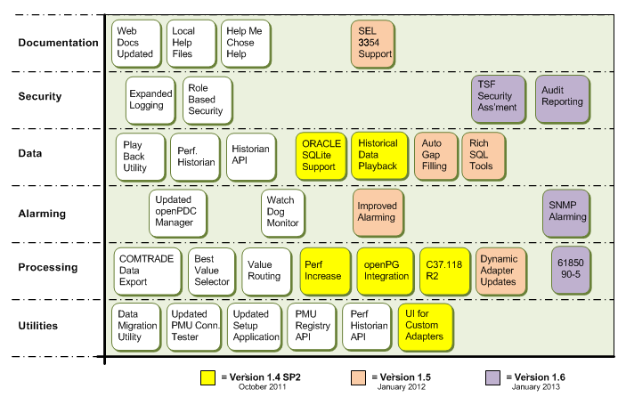
openPDC Roadmap

Slide 8
So, what’s the difference in the openPDC and openPG?
The openPDC is a general purpose system.
The openPG is a special purpose system that is purposely limited in functionality to optimize performance and ensure good security.
The openPDC includes a gateway.
The openPG does not include a PDC.

Slide 9
Secure Information Gateway for Electric Grid Operations
DOE Project – 2011 through 2013
Project Partners – GPA, UIUC, PJM,
Alstom Grid, PNNL
Benefits
  Improved security posture for control centers
  Reduced configuration and operating
  Closed technology gap by providing a gateway for all types of data exchange to support real-time grid operations

Slide 10
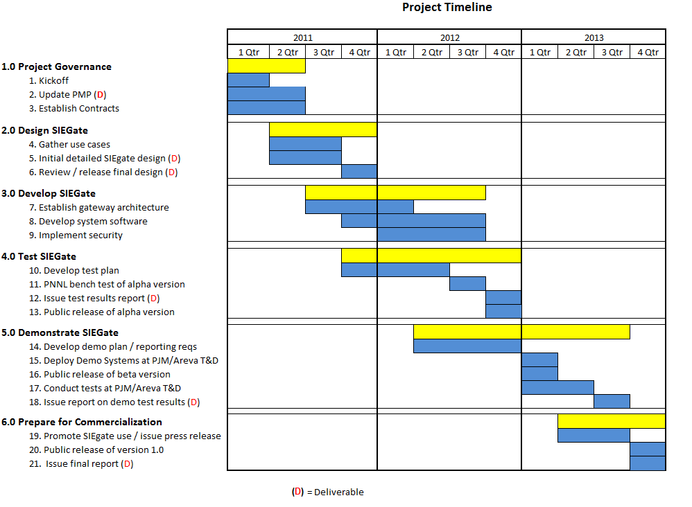
Schedule

Slide 11
SIEGate Design Considerations
Driven by Use Cases – what are the data and the data exchange requirements.
Mitigating Security Threats
  “Who” NIST 800-82 (from amateur hackers to nation states)
  “How”
Providing Real-Time Performance
Documentation of Vulnerabilities

Slide 12
SIEGate High Level Requirement Categories
Operational
  Data Classes
  QoS/Performance
  Availability
  Scalability
System Integration
  Data Interfaces
  Secure Logging
  Alarming and Notifications
  Interoperability
Security
  Compliance
  Administrator Access
  Data Security
  Key Management
  Failure Management
Administrative
  Configuration
  Monitoring
  Backup and Restore

Slide 13
SIEGate Data Classes
Real-Time Measurements
  Phasor Data
  SCADA Data
Batch Data
  Disturbance Data
  Planning Data
Alarm Data
  SIEGate status and security alarms
  Alarm data from other system

Slide 14
openPDA
Purpose
  An implementation of the time-series framework to provide a
  real-time calculation platform for phasor data that would include fundamental calculation functions
  Would include an equation parser
Status
  A proposal seeking a sponsor

Slide 15
openHistorian
Background
  Based on TVA’s simple historian system
  In use at TVA generation facilities since the late ‘90s
Status
  An archiver and simple data extraction tool released as part of openPDC
  Looking for sponsors to create a open source project
    Development of a server component
    Ability to support more fundamental data types

