Slide 1
GPA User’s Forum 2011 – Atlanta, Georgia
openPG
September 7, 2011
Russell Robertson

Slide 2
A Phasor Gateway
Creates a hardened security buffer between critical internal systems and external ones
Provides encryption to protect the confidentiality of reliability and market sensitive BES data
Facilitates and reduces the cost of phasor data exchange -- both the phasor data itself and the configuration information for this data
openPG development is funded
by NERC in 2011 and 2012.

Slide 3
PDC vs. Phasor Gateway
Distinguishing Features
PDC – optimized for time-alignment of many inputs
  Accepts inputs from PMUs and other IEDs using the broadest range of formats and protocols
  Provides time-alignment of data
  Allows implementation of adapters that require rapid access to time-aligned data
  Publishes multiple time-concentrated streams
  Reports and alarms on quality of measurements (signals) and input device status
Phasor Gateway – optimized for directed data transfer of granular information that facilitates a security-layered network design
  Manages asynchronous communication of specific measurements (signals) with other gateways
  Can effectively manage the joining of two semantic models
  Reports and alarms on status of communication of data with other gateways

Slide 4
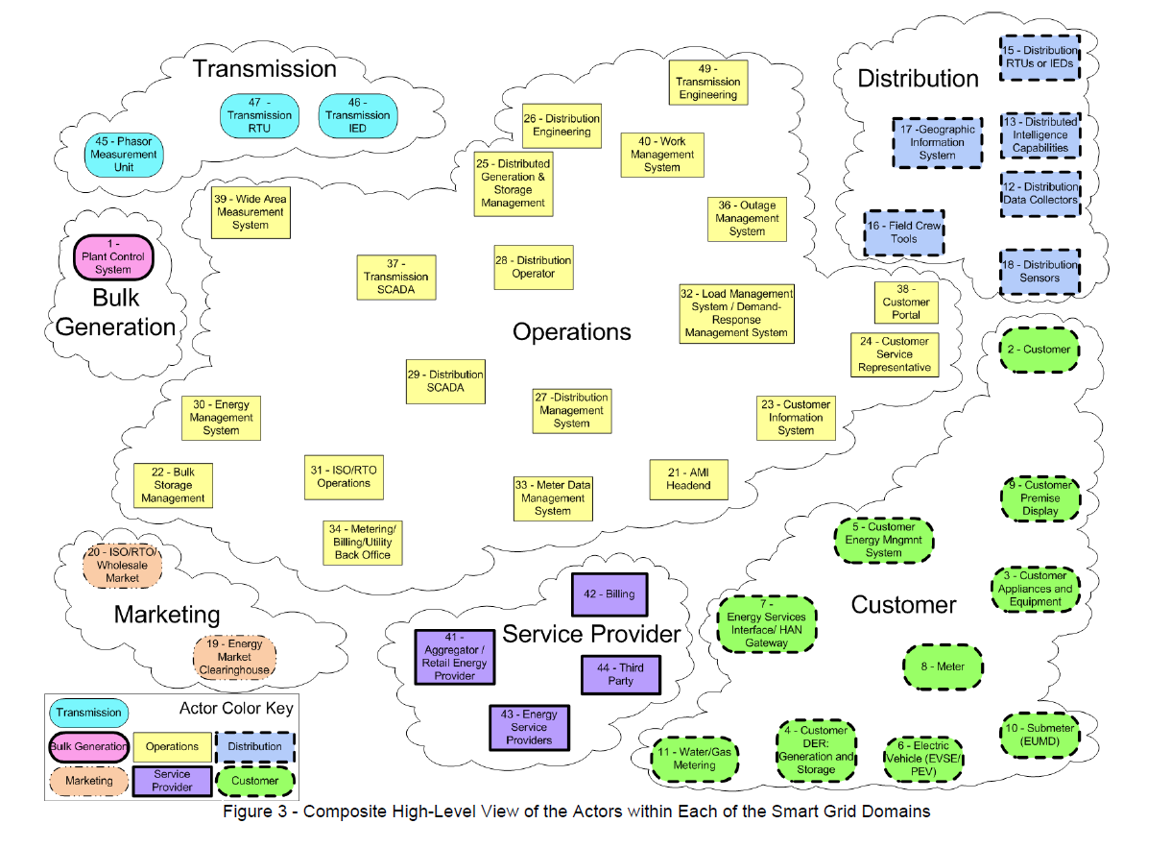

openPG Use Cases – NISTIR* Context
for security assessment
39. Wide Area Measurement
30. Energy
Management
Systems
29. Distribution SCADA & DMS
31. ISO/RTO Operators
37. Transmission SCADA & Advanced Apps
*NISTIR 7628, August 2010
Notes:
7628, August 2010 Interfaces 6 and 19

Slide 5
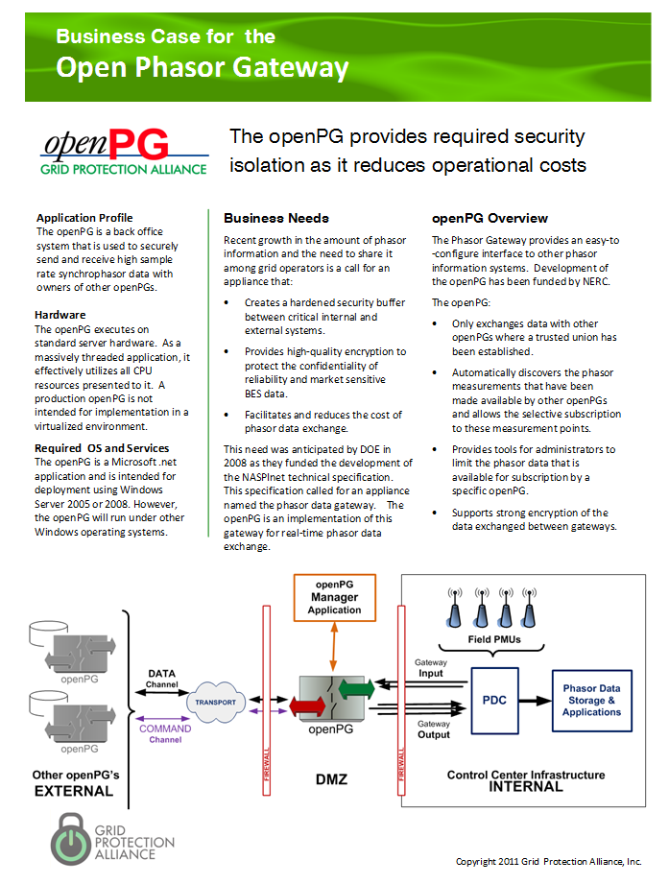
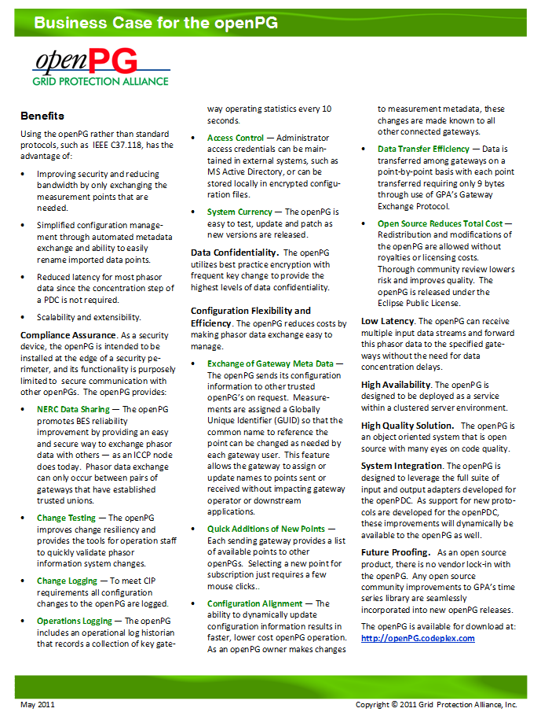
openPG Business Case
An edge device for the security perimeter
Lowers the cost of configuration management
See: openPG.codeplex.com for a copy.
Notes:
Why would you want a gateway?

Slide 6
openPG Value for NERCnet
Lower cost – purchase only capacity needed
  Subscription to points can be dynamic
  Avoids having to exchange all points all the time
Network use enforcement
  openPG can enforce maximum subscription limits
    By gateway association
    In total.
Fair billing with low administrative costs
  openPG provides billing metrics

Slide 7
The openPG is “Registry” Indifferent
Recognition that each entity needs the option to operate within its own name space.
openPG allows easy exchange of phasor meta data among entities without the need for a common naming schema
Redundant measurements can be published and subscribed
openPG can easily be integrated with enterprise or vendor modeling systems – or a regional naming service (the NASPInet vision)

Slide 8
C37.118 Does Not Scale Well
In theory, C37.118-2005 can scale to the 64K UDP packet limit.
In practice, UDP has been found to frequently be throttled to 16K packet sizes – around 130 PMUs.
61850-90-5 is likely to hit this limit sooner
Solution
  Add configuration complexity through use of multiple output streams
  Implement the openPG which has been designed for very-high volume phasor traffic

Slide 9
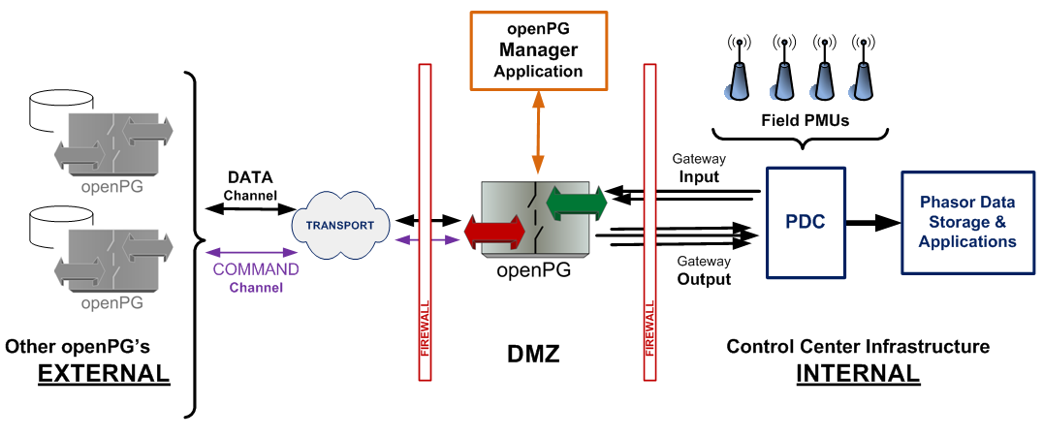
Typical application of the openPG

Slide 10
openPG - High Level Functionality
Reliably exchange high-sample rate signal values and timestamps (measurements) with other gateways so that this information moves between each owner’s Phasor Data Concentrators with minimum time delay.
Enable gateway administrators to easily select the measurement points which are to be made available to owners of other gateways.
Enable gateway administrators to easily select the points that they chose to consume (i.e., the subset of the points made available to them) from other gateways.

Slide 11
openPG - High Level Functionality
Detect, log and alarm on communications issues.
Be implementable as a high-availability solution that can meet NERC CIP compliance requirements.
Support encrypted communication among gateways as well as minimize bandwidth requirements for gateway-to-gateway data exchange.
Utilize standard communications, networking and server hardware.
Be easily extensible to support the development of custom interfaces to the gateway owner’s internal infrastructure and/or new phasor data protocols.

Slide 12
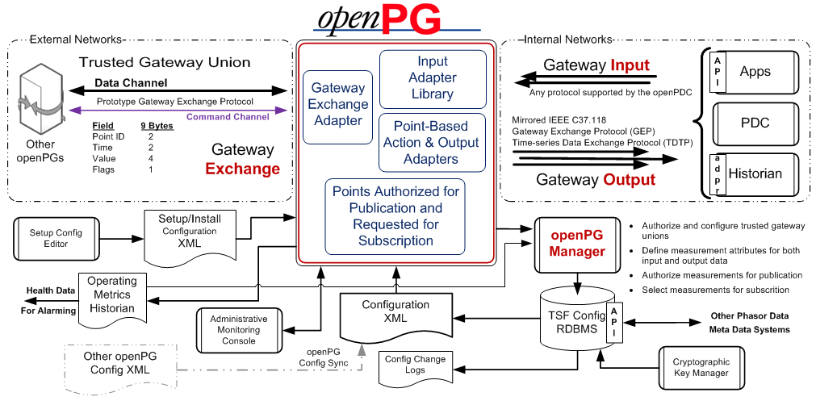
openPG Architecture

Slide 13
openPG Data Exchange
GPA’s Gateway Exchange Protocol
Includes a TCP command channel and an UDP data channel.
Command Channel
  Authenticates other gateways
  Exchanges metadata on points
  Requests points for subscription
Data Channel
  Protocol is a 9-byte packet for phasor data
    Point ID, Time, Value, and Quality Flags
Data exchange efficiency is among the most important design considerations for a phasor gateway.

Slide 14
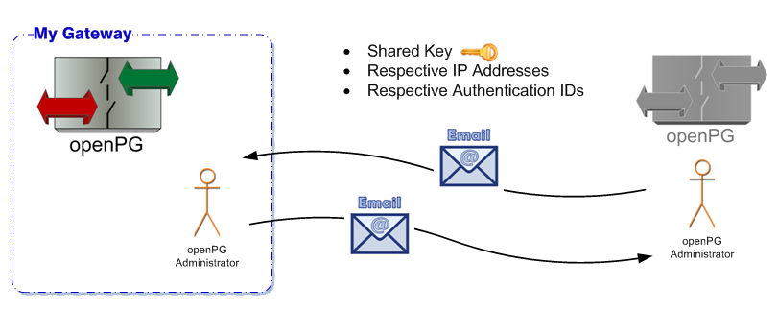
Subscription Process – Setup
(OpenPG 1.0)

Slide 15
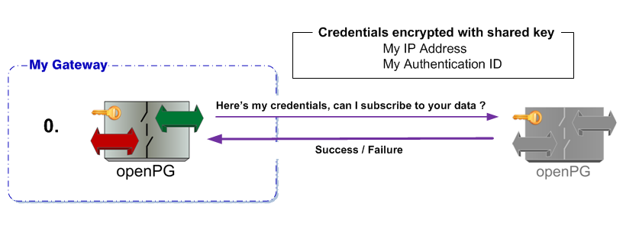
Subscription Process – Step 0

Slide 16
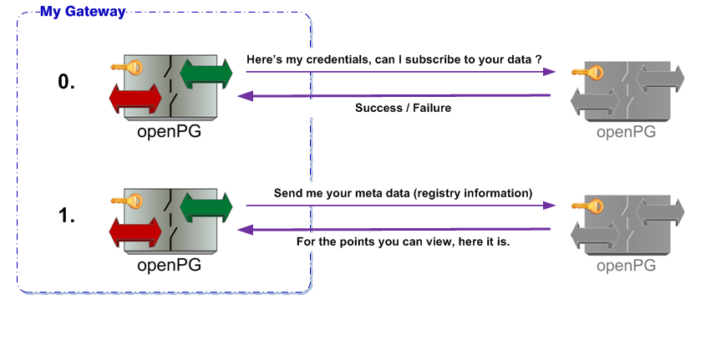
Subscription Process – Step 1

Slide 17
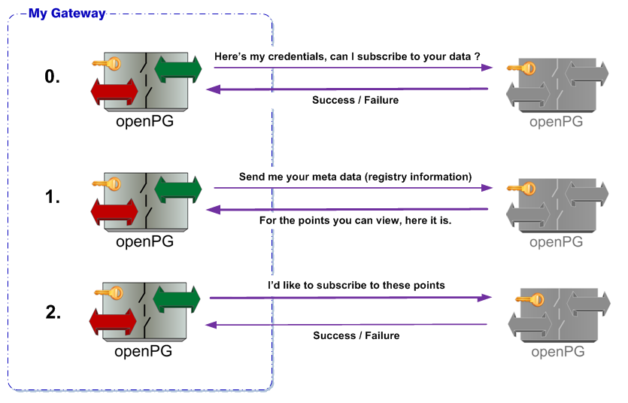
Subscription Process – Step 2

Slide 18
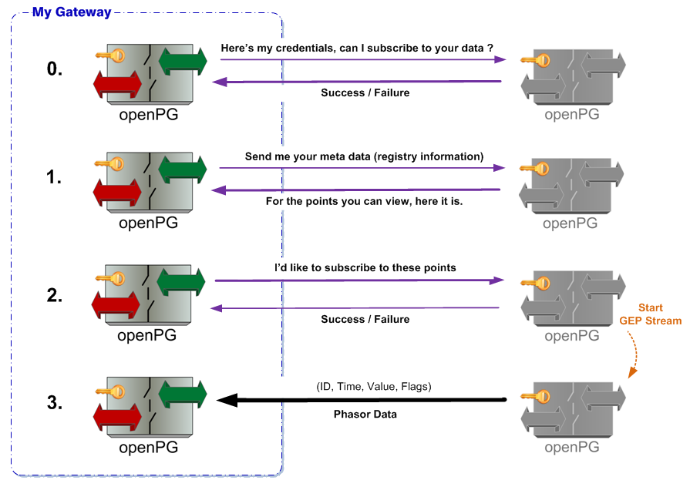
Subscription Process – Step 3
Phasor Data Stream Established.

Slide 19
openPG Inputs
All the inputs of the openPDC, including:
  Frame-based Protocols
    IEEE C37.118 up to 120 samples per second
    IEEE 1344
    BPA Stream
    Macrodyne
    SEL Fast Message
    Point-based Protocols
    GPA’s Time-series Data Transport Protocol (TDTP) used for PDC to PDC communication
    GPA’s Gateway Exchange Protocol (GEP)

Slide 20
openPG Outputs
Point Based Data
  Time-series Data Transport Protocol (TDTP)
  Gateway Exchange Protocol (GEP)
ADO adapter for MS SQLserver
Mirrored C37.118
API for development of custom interfaces
Typically a gateway is paired with a Phasor Data Concentrator that
time-aligns gateway data with internal phasor data.
Version 1.5 of the openPDC will be able to consume both TDTP and GEP.

Slide 21
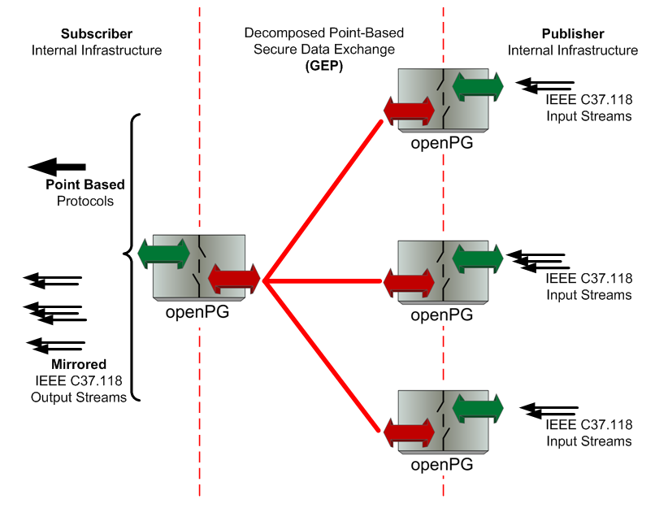
Mirrored C37.118 Output
Outputs can be produced both in both point based protocols (or accessed via an API) or as a reconstituted C37.118 stream.
Administrator
authorizes an input Device Group for subscription.
Pros
Allows the openPG to be quickly integrated with any phasor device at any level in the infrastructure
Cons
Can result in the transfer of more measurements than necessary
More complex network/firewall configuration

Slide 22
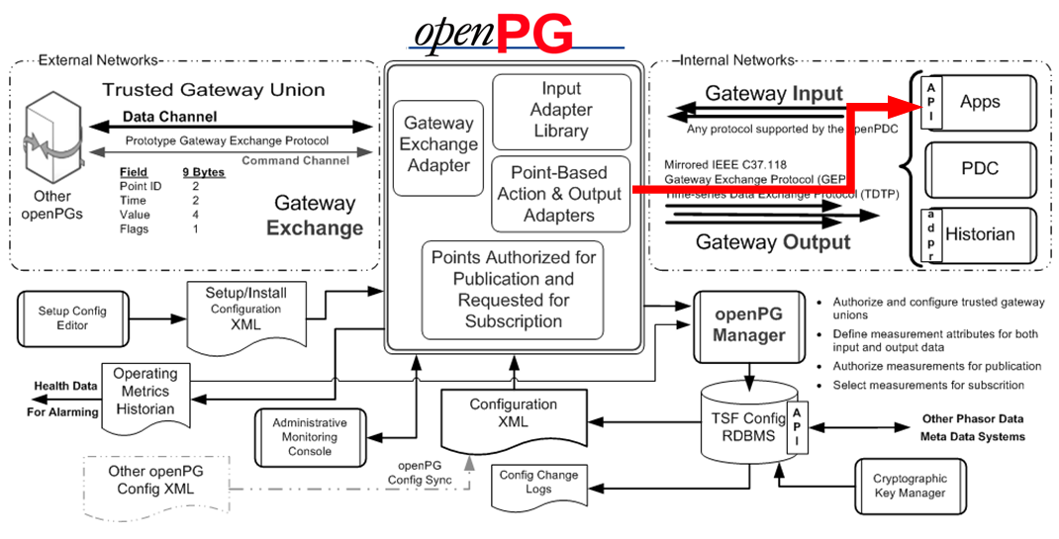
The Output (Subscriber) API
Problem – The need for an application to import phasor data directly from the openPG.

Slide 23
The Output (Subscriber) API
Solution 1 – Use the openPG API to allow the application to consume GEP data
Solution 2 – Use the openPG adapter template to develop a custom output or action adapter
Attach to events
Initialize
Connect to openPG
Get metadata
Provide openPG list of desired points
Subscribe (get data)
Provide data to application
Read configured list of desired points
(provided by openPG Manager extension)
Points are received by adapter on change
Provide data to a service and port in custom format

Slide 24
openPG Security Profile
Availability – HIGH
Integrity – HIGH
Confidentiality – MODERATE

Slide 25
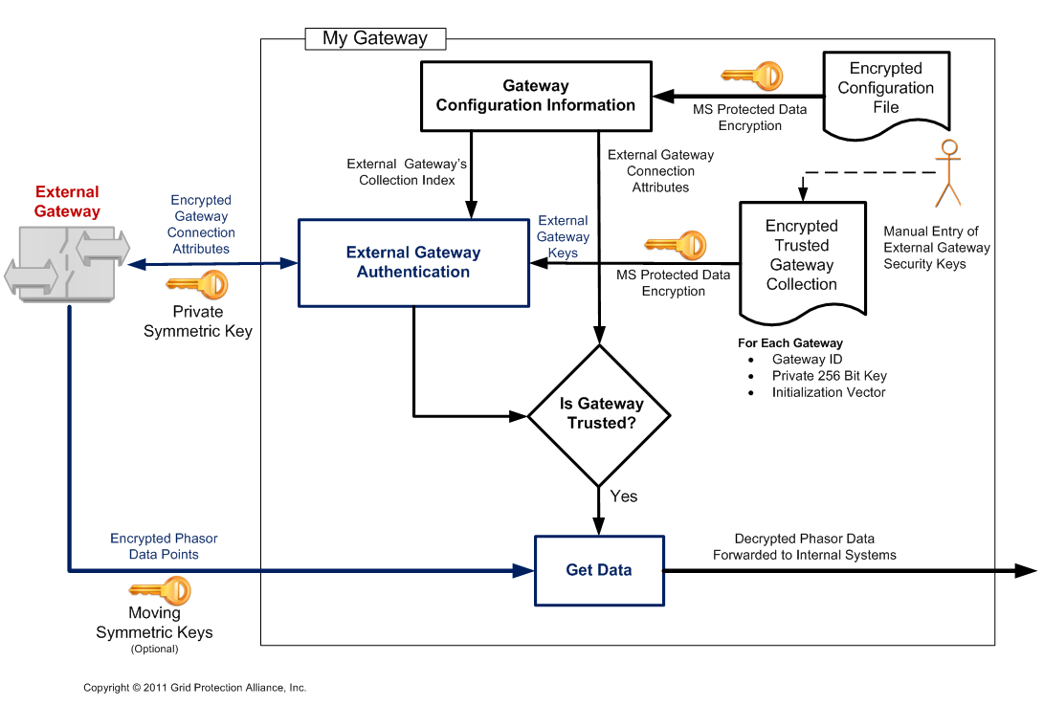
openPG Encryption
(openPG Version 1.1)
The openPG will be security tested by the University of Illinois Information Trust Institute in early 2012

Slide 26
openPG Throughput Exercise

Slide 27
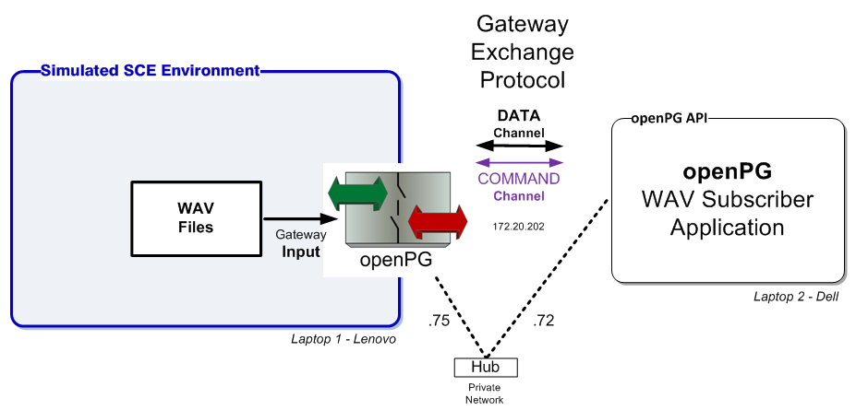
The Demonstration Setup openPG API & Throughput Demo

Slide 28
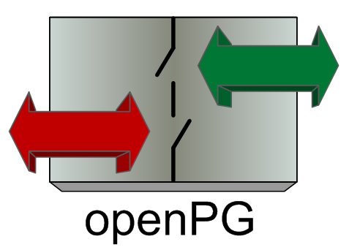
openPG as Publisher
Gateway Client
Gateway Client
1 Song @44.1Khz with 2 channels =
88,200 values / sec , or
~ 150 PMUs @ 30 samples / sec
Gateway Client
Song 
Gateway Client
■
■
■
Gateway Client
Gateway Exchange
Protocol

Slide 29
openPG as Subscriber
Song 
Song 
1 Song @44.1Khz with 2 channels =
88,200 values / sec, or
~ 150 PMUs @ 30 samples / sec
Song 
Song 
Song 
Gateway Clients
Gateway Clients
Gateway Clients
■
■
■
Song 
Gateway Exchange
Protocol

Slide 30
Raw openPG Capability
Publication Only
Gateway Client
CPU Bound to 3.5 million values / sec
with 1 Input Song and 40 Clients, or
~ 5,800 PMUs @ 30 samples / sec
Gateway Client
Gateway Client
Song 
Gateway Client
■
■
■
Gateway Client
Gateway Exchange
Protocol
Test Hardware
Intel i5 – 64bit OS, 2.6 GHz

Slide 31
Raw openPG Capability
Subscription Only
Song 
Song 
CPU Bound to 2.6 million values / sec
with 30 Input Songs and 5 Clients, or
~ 4,400 PMUs @ 30 samples / sec
Song 
Song 
Song 
Gateway Clients
Gateway Clients
Gateway Clients
■
■
■
Song 
Gateway Exchange
Protocol
Test Hardware
Intel i5 – 64bit OS, 2.6 GHz

