Slide 1
GPA User’s Forum 2011 – Atlanta, Georgia
Time-series Framework Tutorial
September 6, 2011
J. Ritchie Carroll
Notes:
I would like to welcome you today to the time-series framework tutorial and openPDC overview
I am extremely honored to have so many of you turn out today to learn about these tools that are being widely applied in the power industry
You showed up despite the remnants of Tropical Depression Lee drenching the area with around 8 inches of rain
I also know many of have traveled very far, even internationally from different sides of the globe, to make this event
This helps remind me that the work we are trying to do has very far reaching effects and that the problems we are trying to solve are not solely a technology issue – but a human one.
So with that
I would like to take a moment to thank and recognize Southern Company for hosting this inaugural event, we certainly appreciate their continued support for these activities through offering their time and facilities to make events like this possible.
Today, although I have an agenda, I want this session – our first official training session – to meet you needs. A such I want this to be a dynamic session:
If you don’t understand something, stop me so we can all get on the same page
If you have a question, ask it, and we’ll temporarily deviate from the course and explain
My goal for you at the end of the day, is that you have a more complete understanding of these tools and the benefits they provide
You are all here for a purpose, I assume by being here that you all want to understand more about the Time-series Framework and how it’s being applied on the industry
But for some of you, I know you have a very specific goal in mind – so let’s take a moment to introduce each other and talk about what your goals are for being here.
I’m going to have Andrew to take notes on your goals, desires and potential questions as we go around the room to each person and get your name, your company, and your desired goals for this training.
If your goal is just to learn, that’s OK, but if you have something specific, please let us know so we can make sure that topic gets covered
And I’ll start with myself, my name is James Ritchie Carroll, I am the senior system’s architect at the Grid Protection Alliance, my goal for today is to make sure you leave here understanding more about the Time-series Framework and the applications that are built on top of it, such as the openPDC and open Phasor Gateway.

Slide 2
The Multiple Open Source Projects
The TVA Code Library
http://tvacodelibrary.codeplex.com/
The Time-series Framework
http://timeseriesframework.codeplex.com/
The Open Source Phasor Data Concentrator (openPDC)
http://openpdc.codeplex.com/
The PMU Connection Tester
http://pmuconnectiontester.codeplex.com/
The Open Source Phasor Gateway (openPG)
http://openpg.codeplex.com/
Notes:
When we first released the openPDC as open source from TVA, everything came as one very large open source project under the openPDC umbrella.
Even then, however, the code was segregated into several major solutions, each with many, many projects representing assemblies as executables or DLL’s.
After a while, we realized that other people were starting to dissect and use the code more widely – many times very specific parts of the code.
So we went ahead and broke the code up into multiple open source projects to help people using the code be able to target specific areas for development.
To date the open source projects are as follows:
The TVA Code Library
The Time-series Framework
The openPDC
The PMU Connection Tester
and now also the open Phasor Gateway
Note that these are listed in dependent order, that is, each project listed depends on the prior.
For example, the PMU connection tester depends on code in the openPDC, the openPDC is built on the time-series framework and all code depends on the TVA code library.
Each of these open source projects are hosted on CodePlex, one of the many sites dedicated to freely hosting open source code. We’ll talk a little later about all the benefits this brings to the developers as well the community using the open source projects.
I’ll take a moment and talk about each project, starting with the TVA Code Library.
This particular project contains very fundamental, low-level components used to simplify and speed development for most any .NET based project.
The library is very extensive and as open source projects go, extremely very well documented.
The components included contain items to abstract and speed complex development of things like sockets, multi-threading, encryption and compression – just to name a few.
To give you a sense of scale, we had been developing the TVA Code Library from within TVA for over seven years. The openPDC used so much of this library, it didn’t make sense to only open source the parts that openPDC used, so end the end we open sourced the entire project.
Not to pick on Matt, especially since he wasn’t the only one to ever ask this question, but he was the first since PNNL had preliminary access to the open source code for review - one of the most common questions asked about the code library is why does it contain a media library for reading and writing WAV files as well as producing songs?
The simple answer, again, is that this library contained “everything” we used inside TVA, as well as it was a holding place for a lot our personal coding interests – in this case, a personal one for me, since this code was an experiment in the representation of energy as waves.
The only requirement for code to go into this library was that it had to be component level code that could easily be reused elsewhere.
Even so, just so you know, I am happy to report that media code in the library was finally put to good use in testing throughput for the new open phasor gateway – and we’ll demonstrate that tomorrow for you around lunch time.
To this day, TVA still maintains the code library as an independent open source project that’s used for all new code development from within TVA.
TVA has representation here today and they’ll be talking more about the code library in tomorrow’s user forum, but I will add this – this library code and the openPDC as well as the other open source projects listed here have a very firm foundation in operational code.
This code was intended for use in production environments that had demanding 24x7 uptime requirements, the standard 5 nines of reliability – that is 99.999% of uptime. I’ll pick on Andrew here, my human calculator – do you know what that comes out to be in minutes per year?
The other thing that happens when you make a project open source is that you are forced to make sure the exposed code is of the highest quality because if there are any serious flaws, people will move on and do something different. There is little tolerance for code that does not work - the code has to be useful or people will find another way to accomplish their goals.
The second project is the Time-series framework – one of the reasons you are here today. To sum this project up in one sentence: the time-series framework open source project is intended to manage time-series data in real-time. Just that simple. It is “the” foundational layer for all other systems being developed by GPA.
I know for many of you, this is the code layer that’s being utilized to expand your own synchrophasor projects within your infrastructures – and I am anxious to hear about many of those in tomorrow’s user’s forum.
This library contains the infamous “Input”, “Action” and “Output” interfaces – which we’ll discuss in more detail after while. It also contains a full API library for publication and subscription of time-series values that can consumed in real-time by other applications.
The next project is the openPDC. We have tried to narrow this project down over the past couple of years to code that is “specific” to synchrophasors. If you are looking for something that used to be in the project but is no longer there, start navigating up the chain.
Then there is the PMU connection tester, a very widely used application used to test connectivity to PDCs and PMUs.
The newest project on this list the open phasor gateway. This project is being developed to exchange signal-level data between controls centers.

Slide 3
Benefits of CodePlex Hosting
Team Foundation Server project source control
This directly integrates with Visual Studio
Project contributor forks or patches
This allows contributors to suggest formal code updates
Project release downloads
This allows us to control major releases and track downloads
Discussion forums & mailing lists
This allows users to help users and request community help
Wiki and documentation pages
This allows up-to-date online documentation
Bug and feature request tracker
This allows users to post issues for resolution
Notes:
CodePlex is Microsoft's open source project hosting web site.
Anyone can use CodePlex to create new projects to share with the world as well as join others who have already started their own projects.
It’s primary function is allow uploads and downloads of open source software and an allow for community feedback.
CodePlex currently hosts over 20,000 projects and is one of the fastest growing and most popular open source project hosting sites.
But they are not the only one, we had several very good open source hosting sites to choose from, but here are some of the reasons we chose CodePlex:
Team Foundation Server project source control
This directly integrates with Visual Studio for check-in and check-out of code, code conflict resolution and the ability to “shelve” code ideas or work without breaking the build.
<Click over to visual studio and show how “editing code” changes icon from locked to checked-out – right click and show one would check-in and then undo check-out>
This nice thing is that all of this happens “on the cloud” so you can check-in and check-out code from anywhere.
<Now click over to CodePlex and demonstrate browse code showing all the source code history>
Project contributor forks or patches
This feature allows contributors to suggest formal code updates even if they don’t have check-in rights. Even so, GPA very methodically analyzes each code check in – all code is code reviewed for accuracy and consistency both in function and style.
To date, GPA is the primary code contributor and most code suggestions come in from the lively discussion boards – but we hope that as others being using the code more heavily, more user code level contributions will flow in.
Project release downloads
This CodePlex feature allows us to control major releases and track downloads – as simple as this may sound, it is very important for users to be able to come to the site and download the latest recommended build without having to download all the source code and build it for themselves.
<Click over to CodePlex and show released and recommended downloads, then show how to access planned release downloads>
<Click over to home page and show how you can access nightly builds link at any time so you can installation binaries from last night>
Of course, please use the nightly builds at your own risk. Unlike the official release builds, these may not be fully tested.
Discussion forums & mailing lists
This allows users to help users and request community help
<Click over to show the activity on this board, how to post new questions and answer other user’s queries>
Wiki and documentation pages
This allows up-to-date online documentation – we’ll go over this in a little more detail on the next slide since this is very critical in your ability to find help.
Bug and feature request tracker
This allows users to post newly discovered issues for resolution as well as to post new feature requests.
<Click over to show detailed tracking and show all the items that have been resolved>
We really do pay attention to this list – we also take note of the “votes” on certain items to help use realize user importance of features and issues.

Slide 4
Accessing Online Documentation
All online documentation is continually updated by both GPA and contributors.
Typically you need only go the project’s CodePlex site in question and click the “Documentation” tab to get started with system documentation.
Here is the openPDC Documentation Link - on this page you can navigate to:
Getting Started
Frequently Asked Questions
Major Component Overviews
How-to Guides, etc.
Also included are links to compiled formal library documentation.
Notes:
<Make sure this slide is very interactive, taking time to navigate through many screens including the “Adapter Connection String Syntax” and clicking through to a “Help Me Choose Diagram”.>
<Take time to pull up some code, showing the formal XML documentation in a synchrophasor example – then click though the online link so user’s can see how the XML code documentation is turned into formal documentation.>

Slide 5
Setting up and using the openPDC
Go to web site: http://www.openpdc.com/
Click on “Downloads” tab
Select desired release build
Click on the “Recommended Download” link
Save zip file onto your computer (Desktop is handy)
Unzip the entire contents into their own folder
Run “Setup.exe” in the root folder
Select 32-bit or 64-bit installation
If you have no database installed locally, you can use “SQLite” or “Access”. Note that Access only works for a 32-bit install.
Notes:
Just in case some of you may not have setup and used the openPDC, I’m going walk through this process in real-time to show you how easy it is to get things up an running.
<Explain each step slowly and carefully>
<Stop on screen show installation options – explain that you can install the openPDC Service and the openPDC Manager and tools on different machines so that the management tools can be on IT operator boxes and the openPDC service running in a secured environment>
<Note carefully the database options, local installed database required for “new” databases unless you select SQLite or Access>
<Oracle is being added for the next release>
<At a high-level, explain how XML file and Web Service are available to openPDC Service but database is available to both manager and service>
<Carefully go through screens in detail explaining their purpose and functionality>
<On output stream configuration screen, stop and explain wizard, devices, renaming fields mentioning new features to accommodate spaces in acronyms to comply with EI naming convention>
<Click over to PMU Connection Tester connected to openPDC to show concentration in action>
<Make sure to end on screen for Access Control talking about AD/Ldap Integration – demo setting up Administrators auth>

Slide 6
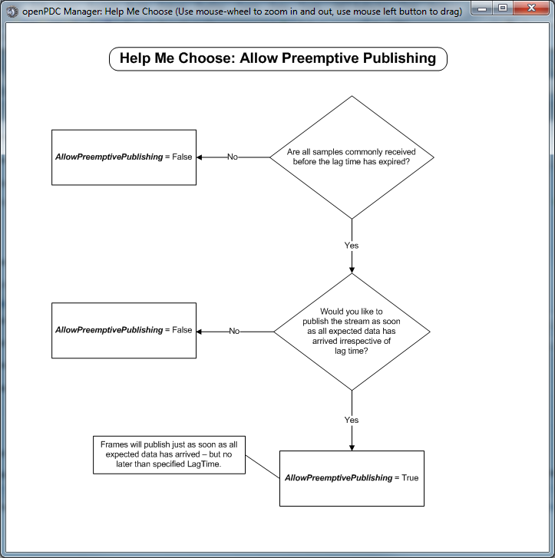
Contextual Help System
Flow chart styled help dialogs guide users through selection of more advanced options…
Notes:
<Jump back to a screen in manager to demo contextual “help me choose” dialogs>

Slide 7
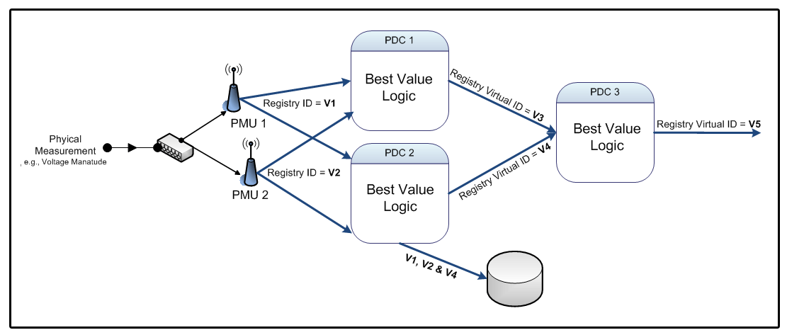
Multi-source Single-destination Configurations
The “magic A/B” switch has recently been added to the openPDC to select the “best value” in phasor data systems that incorporate source device redundancy
Notes:
<Go to output stream configuration and explain / show down-sampling options in context of multiple source connections.>

Slide 8
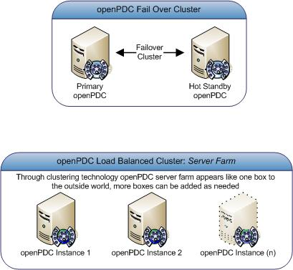
Clustered Deployments
Fail Over Cluster
Load Balanced Cluster
Notes:
Since the openPDC is installed as a Windows service, it can be easily deployed in a clustered environment.
This includes both a fail-over cluster mode as well as a load-balanced clustered mode.
The most common deployment is the “fail-over cluster”. In this mode you have two running machines running, each of the machines are “hot” but only will be “active”.
Each box has a physical unique IP, but there is a third IP which represents a “virtual IP” that will be associated with the “active” box. This is the IP used for configuration when accessing the machine.
In fail-over mode, each box will have the openPDC installed with identical configurations – again, the openPDC will only be running on one box at a time.
When you need to take one of the boxes down for maintenance, or one of the boxes has an issue or failure, the other stand-by system will take over operations. Moving from one computer to the other is called a “fail-over” operation.
The load balanced cluster configuration basically defines a “farm” of computers which can all be active at one time. In this mode any number of machines can go offline so long as the remaining boxes can service the load.
Like before, each box has a physical unique IP, but there is another IP which represents the “virtual IP” of the cluster which is used to access the “least loaded” system in the cluster.
In load-balanced mode, each box will have the openPDC installed with either identical listening mode configurations (all devices connect “to” openPDC cluster) or similar cooperative connectivity mode configurations (all openPDC’s cooperatively connect to field devices).
Actual implementation of individual openPDC configurations in this mode (such as, one node or multi-node) will depend on the desired network topology and how the field devices are deployed.
There are a variety of configurations that can be established using a load-balanced cluster to create an extremely scalable deployment – but these deployments are generally more advanced to setup and configure.

Slide 9
The Configuration Data Structure
Notes:
The Time-series Framework is database agnostic. Technically, the time-series framework doesn’t need a database to operate – it will happily use an XML file or web service for configuration.
However, the XML file and/or web service are generally created from a back end system somewhere.
It is this ability to read its configuration from an XML file that allows the openPDC or any TSF application to be able to come online using the last known good configuration when a database is offline – which can happen often in an production environment such as when a database is offline for maintenance.
<Click over to file system, navigate to openPDC configuration cache – show and open SystemConfiguration.xml – highlight schema and data instances so that it is understood that this is a serialization of the database configuration>
This is exactly the content that would be delivered when using a web service based configuration.
As mentioned during setup, although the openPDC service can run without access to a database, the openPDC Manager cannot – it expects a database for storage of configuration information.
Regardless of deployment strategy, a database normally exists somewhere in the openPDC system configuration.
The TSF and apps built off of it like the openPDC, are all designed to work with practically any modern relational database system.
As you may have noticed during the setup, scripts and/or data structures for several common databases are provided:
SQL Server
MySQL
SQLite
Access
and Oracle will be available in the next release
Scripts for PostgreSQL are being considered for a future release if there is any demand.

Slide 10
Understanding “Nodes”
In its most simple form a “Node” is an instance of an openPDC (or other Time-series Framework app)
A Node is identified by a uniquely generated Guid (a 128-bit randomly generated integer that is statistically going to be unique in the world)
One configuration database is designed to hold any number of Nodes.
The magic of “Nodes” allows a single openPDC Manager to manage any number of openPDC and TSF application instances.
Notes:
<Open SQL Server and explain the “Nodes” table>
<Make sure to refer back to prior slide to show all the “NodeID” columns in the tables>
<Open openPDC Manager and go to the nodes screen, add a new node (copy connection fields from existing node to notepad) and show operation of internode connectivity>

Slide 11
Understanding “Measurements”
A “measurement” as it is understood in the Time-series Framework has many aliases:
Signal
Point
Tag
Time-series Value
The primary components of the measurement are:
Timestamp
Value
Identification
Notes:
<Find IMeasurement in the TSF code and show the key fields>
<Discuss the adder and multiplier, how it’s used in practice and how it relates to the AdjustedValue>

Slide 12
Measurement Identification
Guid:
128-bit randomly generated integer that is statistically going to be unique in the world, examples:
7ACDEE91-661B-42A0-82C1-081090D0CA38
532863E4-8C3A-4F84-8366-0C8A4711EA6F
4E3548FD-470E-45DF-8C44-138936805BB6
Measurement “Key”:
Two part identifier represented by a “Source” string and a numeric “ID”, examples:
PPA:2
STAT:42
SHELBY:39
The best flattened representation of all measurements defined in the system can be found in the “ActiveMeasurements” view.
Notes:
There are two way measurements are identified in the time-series framework.
First, using a Guid – again, that statistically unique in the world identifier
Second, using a measurement “Key” – the measurement key is basically a string identifier consisting of a “source” for the measurement and a simple numeric ID separated by a colon.
The numeric ID is basically an auto-incremented integer, like 1, 2, 3, 4, 5.
The source can also be thought of as a destination depending on your perspective – for example, if the historian in your system which archives points is the primary interface in your infrastructure the, measurement key source can be thought of as the historian instance associated with the given point.
The Guid’s are used programmatically to uniquely identify measurements in the system, or said another way, if you are writing code that expects a certain set of measurements, used Guid’s are your lookup key – it is faster and more efficient.
On the other hand, the measurement keys are used whenever a human is interacting with the system – generally speaking Guid’s and humans don’t mix well. It’s very big number, coded in Hexadecimal, that is practically impossible to remember and annoying to copy and paste.
Measurement keys are short mnemonics that are easy to remember and have context based on their source – perfect for identification.
The real thing to remember is this:
Guid’s are for computers, measurement keys are for humans
<Click over to the TSF code and show the code for MeasurementKey – point out some key fields and how things are “optimized” with Guid relations>
On the next section, we’ll explain why this “source” is important in Synchrophasor world…
<Click over SQL Server and open the “ActiveMeasurements” view to show a full example of well defined system measurements>
In the time-series framework, measurements are everything – this table is basically the center of the universe.

Slide 13
Establishing a Distributed Archive
Notes:
We’ve stress tested the time-series framework to process over 3.5 million input measurements per second.
There’s no hard disk that exists today that archive data that fast, so in this case the disk becomes a bottleneck in a system.
Creating a “distributed archive” is the way we have overcome the “maximum” number of points that can be archived per second.
<MeasurementKey “source” describes the “destination” archive here>
<Point out how this can apply to “any” historian or archive>

Slide 14
Deploying Custom Calculations and Action Adapters
Run openPDC Manager
Navigate to “Adapters / Calculated Measurements”
Populate required fields. Pay special attention to:
Assembly Name (the DLL)
Type Name
Connection String
Set an appropriate Lag Time / Lead Time
Set appropriate “Use Local Clock as Real-time”
Check “enabled”
Save new record
Notes:
<Run the openPDC Manager and demo the deployment of an existing custom action adapter “calculation” from openPDC>
<Make sure and pull up “help me choose” dialogs to explain “lag time” and “lead time” in detail – mention that these apply to all “concentrators” such as a PDC output stream – the actual “data concentrator” of a PDC>
<Mention that the new UI layer has a new custom adapter deployment screen we will demo in a few minutes to show you how this screen is now easier to use>

Slide 15
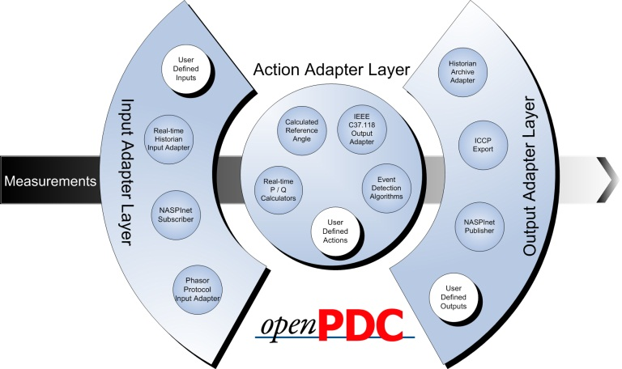
Scaling-out with Custom Adapters
Data Flow

Slide 16
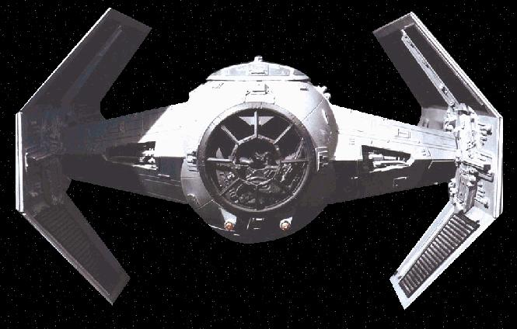
Overview of the Iaon Adapter Layer
Notes:
This is the standard diagram used to understand the Time-series framework.
This image is affectionately know as the “tie-fighter”.

Slide 17
Notes:
Here is a more technically accurate diagram of this same interface layer.
We call this the “Iaon” [yo-wan] adapter layer. I for input, A for action, O for output and n from interface.
Notice the measurement flows – simultaneous measurement deployment to multiple destinations.
<Explain how the openPDC and openPG are “instances” of the Time-series framework – other apps can be created on this same framework – the only thing that makes the openPDC a “phasor data concentrator” is its phasor protocol implementations and measurement mapping to these protocols>
The openPDC PhasorMeasurementMapper is an InputAdapter.
The openPDC PhasorDataConcentrator is an ActionAdapter.

Slide 18
Notes:
<Pull this open from image on desktop so it can be scrolled through vertically and explained slowly>
This describes the “relationship” between the adapters and the intended use cases.
Note that the “Sorted” base classes represent the desired state.

Slide 19
Developing New Adapters and Calculations
Difference between a “calculated measurement” and a basic “custom action adapter” are known “signal types” – this is specific to synchrophasors
Always refer to Iaon Overview Diagram to decide which base class is most appropriate for my custom adapter
Know when to use sorted and non-sorted base classes – “to concentrate or not to concentrate, that is the question” – no need to waste CPU sorting if it’s not needed
Applying new attributes to enhance user experience for setting up new custom adapters
Notes:
<Click open code for CalculatedMeasurementBase and show “SignalType” mapping>
<Run the openPG Manager and demo the new custom action adapter screen>
<Open simple average calculator and walk through this slowly – these are good examples of calculation cases involving instantaneous and windowed data>

Slide 20
Extended Code Level Overview of Time-series Framework
Code hierarchy and inheritance model
Navigate through projects starting at openPDC.exe
The Iaon adapter framework
Discuss connection string implementation and initialization, as well as relationship to class properties
The new extensible UI framework
Discuss how the new UI framework can be used to create your own screens and deploy them by updating Menu.xml
The new “historical access mode” of the framework
Discuss how the framework is being “extended” to support historical playback through the pub/sub API’s
The “phasor” specific code implementation
Explore the synchrophasor specific code in openPDC
Notes:
There is little code to be found in openPDC.exe – everyone begins there as an obvious starting point, but the actual code is in the base classes found in the Time-series Framework.
Everything most always goes back to the Time-series framework.

Slide 21
Formal Questions / Issues / Review
During this final free-form part of the day you are encouraged to discuss things that you still may be confused about, take time to ask questions about things you’ve wanted to know, discuss issues you may have encountered with any of the Time-series Framework related projects and simply review important issues from today’s training.

