Slide 1
MISO – Synchrophasor
GPA Users Forum
Sept 7th, 2011

Slide 2
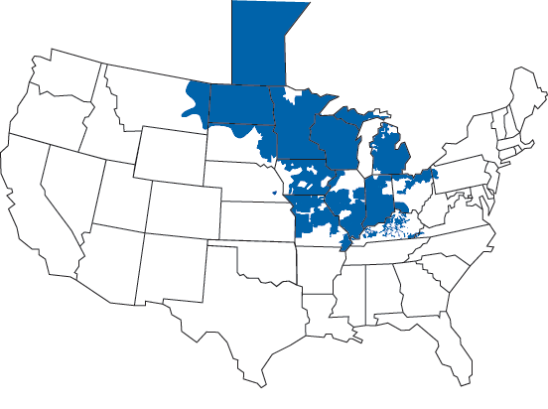
Presentation Objectives
Provide an overview of the work MISO has done to utilize synchrophasors
Share how MISO is using OpenPDC and Time Series Framework
Suggest future direction of the GPA products
Notes:
Introduction of the presenters
In this presentation we will cover 3 areas:
First we will give a high level overview of the project
Next we will get to the interesting part (how we are using GPA products)
Lastly we will share our opinions on future GPA work

Slide 3
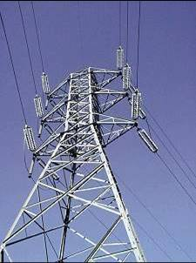
Topics
Overview
How OpenPDC and Time Series Framework are being used
Recommended Future Goals of OpenPDC

Slide 4
Topics
Overview
How OpenPDC and Time Series Framework are being used
Recommended Future Goals of OpenPDC

Slide 5
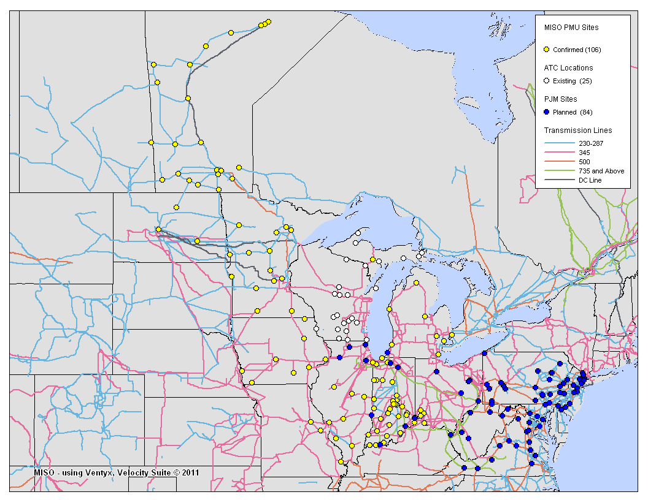
Overview - Project Background
MISO is one of the Smart Grid Investment Grant (SGIG) recipients
DOE matches MISO spend to encourage investment in synchrophasor deployment and technology
Main mission of the MISO project is to deploy devices
Secondary goal is to utilize the data in Real Time and After the Fact Analysis

Slide 6
Overview - Department of Energy SGIG Grants
Entity | Total project value ($M) | Project Description
NYISO | 75.71 | 35 PMUs, 19 PDCs
Midwest ISO | 34.54 | 165 PMUs
PJM | 27.84 | 90 PMUs
ISO NE | 8.52 | 30 PMUs
Western Electricity Coordinating Council | 107.78 | 250 PMUs
ATC | 22.89 | Fiber Optics network for PMU communications
ATC | 2.66 | 3-5 PMUs
Duke Carolinas | 7.86 | 45 PMUs
Entergy | 9.22 | 18 PMUs
TOTAL | 298.00 | 623 PMUs

Slide 7
Overview - Synchrophasor Benefits Overview
New Capability Definition | Department Time Horizon | Benefit
Wide Area Monitoring Visualization of regional, time synchronized data | Operations Real-time | Improved reliability / efficiency reduces likelihood of events
Inter-Area Oscillation Detection Alarming when insufficient damping occurs | Operations Real-time | Improved reliability / efficiency reduces likelihood of events
Phase Angle & Voltage Stability Increased awareness of real stability limits | Engineering Real-time | Increased utilization of Transmission System
Model Validation Increased accuracy in planning models | Planning After-the-fact | Increased utilization of Transmission System
Event Analysis High sampling rates improve event causation determination | Planning After-the-fact | Improved forensic analysis
Application Performance Improved State Estimation, Contingency Analysis and Real-Time Control | IT Real-time | Lower production costs and increased reliability / efficiency
Notes:
Multivariable optimization challenge

Slide 8
Overview - Application Approach
MISO will deploy a commercial phasor solution to do much of the analytics
However, commercial products are currently immature and vendors are over-subscribed with SGIG projects
Tools to “fill the gaps” are needed
MISO experience has shown that having in-house visualization tools saves money and leads to better situational awareness

Slide 9
Overview - Technology Goals of the Project
Synchrophasor data is not fundamentally different than SCADA data. Just a whole lot faster. We should utilize lessons learned
Supplement RTDMS application from EPG
Extend in-house visualization platform (Real Time Displays) in order to handle high speed synchrophasor data
Display multisource data (PI / EMS, RTDMS, PMU, …)
Eliminate or Reduce duplication of programmed business functionality
Bad Data Detection Algorithms
Calculated Points
MetaData (effective dated)

Slide 10
Topics
Overview
How OpenPDC and Time Series Framework are being used
Recommended Future Goals of OpenPDC

Slide 11
How MISO is using the OpenPDC and TSF
Facilitate enhanced visualization tools
Eliminate or Reduce duplicate coding of business logic
Bad Data Detection Algorithms
Calculated Points
Metadata (effective dated)
Build upon our Integration backbone utilizing a pub-sub model

Slide 12
MISO Synchrophasor Architecture
Replay / Extract
Oracle Phasor Data Store (PDS)
OpenPDC / Time Series Framework
RTD Client
Regional ePDC
Input
Action
Output
Comtrade
ISD
EMS
Pub / Sub
37.118
PI
Excel
Local ePDC
RTD Legacy
PDS
RTDMS Client
Comtrade
37.118
Calculation Engine
ISD
Bad Data Detection
RTDMS Server
Database
Flatline Test
Range Test
Time Stamp Test
37.118
37.118
Metadata
RTDMS Database
Events / Calculations / Results
OpenPDC and Time Series Framework process all PMU data received (from members and ISO neighbors) and push to a long term archive (Oracle Phasor Data Store)
OpenPDC also used to send data to downstream applications
Working on modifications to support retrieval of historical data with the framework
PGDA Client
Analysis Results Store
Data Extract
Planning Tools
Planning Tools
CSV
Planning Tools
Application
Data Store

Slide 13
Input Adapters
Input
Action
Output
37.118
Used to receive RT data from ePDC
Two PDC streams (local and Regional)
No modifications to the OpenPDC
PI
Used to retrieve near real time data from points that are in PI (EMS)
Also used to bring historical data from PI
Phasor Data Store
Used to retrieve historical Phasor data from MISO Oracle store
Database Real Time/Extract
Used to receive RT data from SQL data sources that are not natively streaming
*All adapters, except 37.118 use on-demand adapter functionality to only query measurements that are requested by clients
Pub / Sub
PI SDK
PDS
PDS
37.118
Calculation Engine
ISD
Bad Data Detection
Database
Flatline Test
Range Test
Time Stamp Test
37.118
Metadata

Slide 14
Action Adapters
Input
Action
Output
Bad Data Detection
There are a number of adapters that can be used to detect bad data. Will utilize for both business limits as well as IT notifications The MISO team is extending the initial adapters provided by GPA to read limits from the meta-database on initialization as well as set flags in the IMeasurement objects.
Flat Line
Identifies if a signal has stopped changing values and has likely gone stale
Pub / Sub
PI SDK
PDS
PDS
37.118
Calculation Engine
ISD
Bad Data Detection
Database
Flatline Test
Range Test
Time Stamp Test
37.118
Metadata
Range
High Low Validation of a signal to determine if the value is bad
4 levels (high, very high, low, very low)
Calculation Engine
We have initially defined three different types of calculations. The first two can be created and configured by end users. The third requires coding by IT staff
Aggregate
Allows a calculated point to be created such as sum, average, mean, min or max of selected signals
Arithmetic
This adapter will be used to perform simple math functions on one or more signals – utilized the open source NCalc package and custom equation editing screens for users to define new points
Custom
Used to implement special logic that is specific to a defined calculations that may involve more than simple math.

Slide 15
Output Adapters
Input
Action
Output
37.118 Real time
Used to Push RT to downstream Applications (e.g. RTDMS)
Will modify GPA adapters to limit data from being passed downstream when identified as bad
Phasor Data Store (PDS)
Used to Push MISO designed Oracle Store
Plan to use OCI
ISD
Used to Push data to EMS
To be purchase from Alstom
Pub \ Sub
Used to push data to non-37.118 aware applications
RT Displays
Excel
Pub / Sub
PI SDK
PDS
PDS
37.118
Calculation Engine
ISD
Bad Data Detection
Database
Flatline Test
Range Test
Time Stamp Test
37.118
Metadata

Slide 16
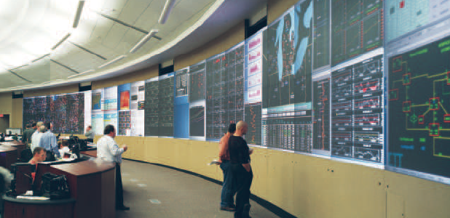
RT Displays

Slide 17
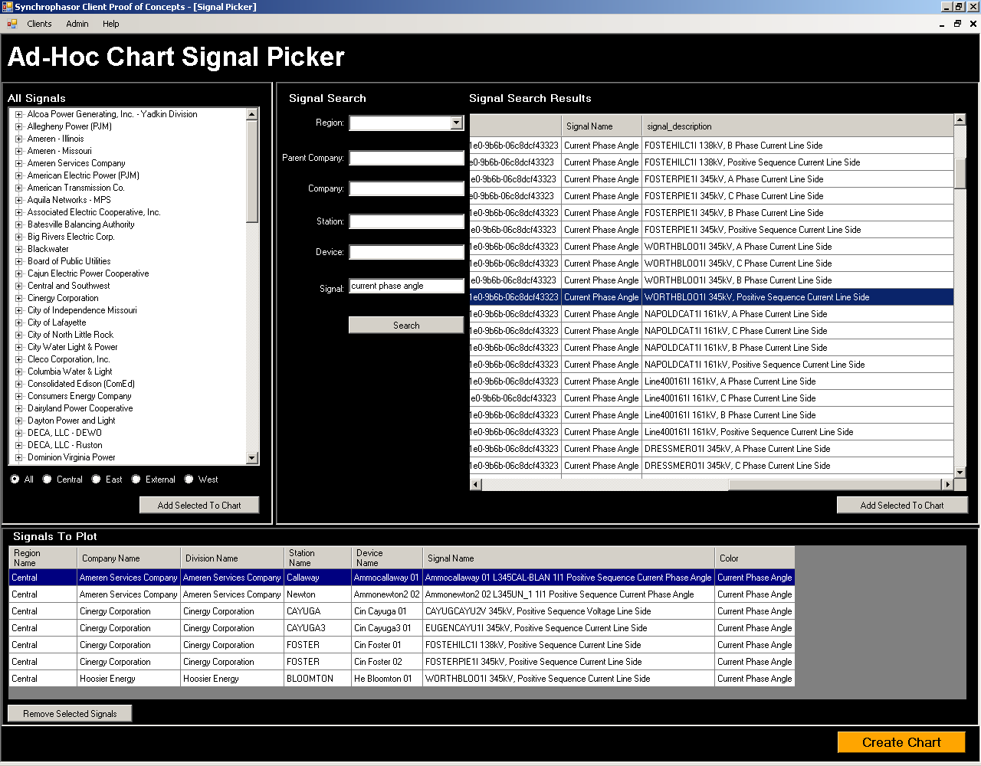

Slide 18
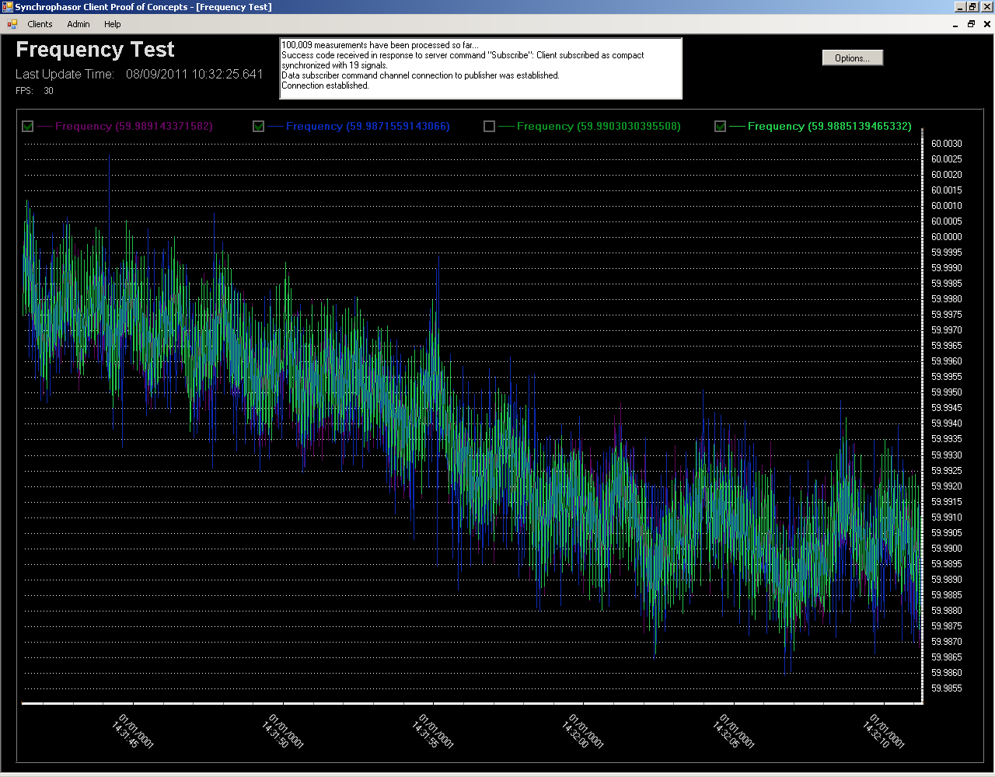

Slide 20
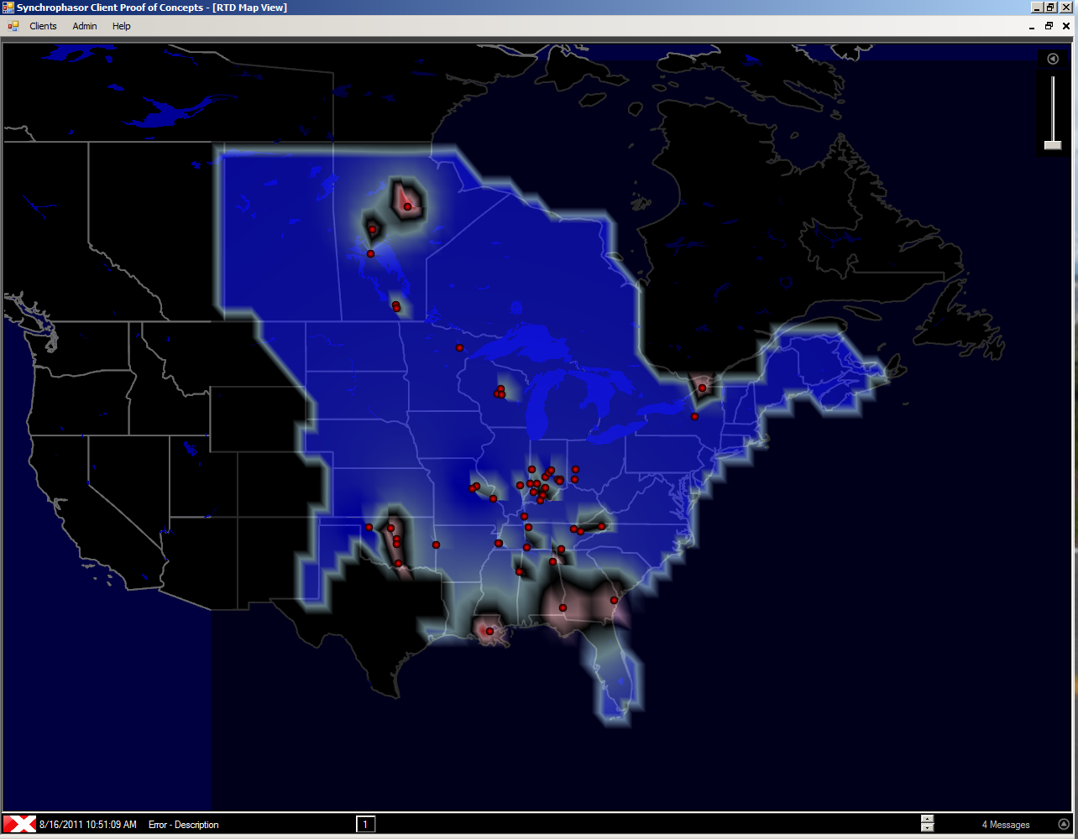

Slide 21
Topics
Overview
How OpenPDC and Time Series Framework are being used
Recommended Future Goals of OpenPDC

Slide 22
Recommended Future Goals of OpenPDC
Continue focus on Security and High Availability
Access to historical data
Allow for extension of optional metadata structures
Effective dating on metadata
Support of “standard” naming as envisioned by NERC, Data Exchange Working Group.
Up and Down Sampling algorithms

