Slide 1
TVA Code Library
Topic:
Overview
Presenter:
Pinal Patel
September 7, 2011

Slide 2
Its purpose
To provide standards.
  Standards in development make projects easier to maintain. The developer of an application may not be the same person who ends up maintaining the code.
To improve speed.
  The component model says: "It’s faster not to reinvent the wheel" (not to mention cheaper).
To increase reliability.
  Reusing battle-hardened, tested code will produce more reliable applications.

Slide 3
What’s there
Configuration API
Parsing Framework
Adapter Framework
Communications Framework
Security Framework
Windows Service Template
WCF-based Service Bus
(~100,000 Lines of code & ~40,000 Code comments)

Slide 4
Where to get it
CodePlex site
  http://tvacodelibrary.codeplex.com
NuGet packages
  Install NuGet Visual Studio extension
  Right-click project > Manage NuGet Packages
  Search for TVA
  Install packages

Slide 5
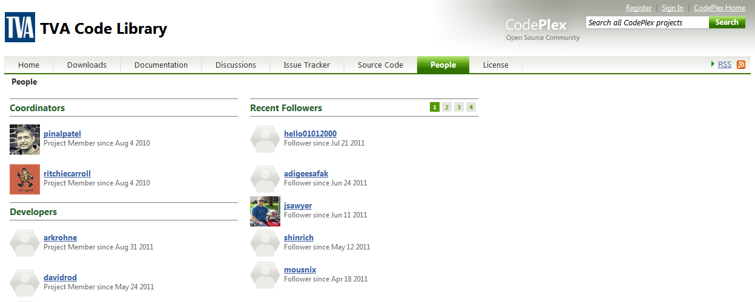
How to contribute
Open a CodePlex account
Email CodePlex login to pcpatel@tva.gov

Slide 6
Questions

