Slide 1
Overview
Power Quality Dashboard
Fred Elmendorf
August 2014

Slide 2
Dashboard vs Analytic Software
http://www.exceldashboardwidgets.com/
Analytics is the discovery and communication of meaningful patterns in data. Especially valuable in areas rich with recorded information, analytics relies on the simultaneous application of statistics, computer programming and operations research to quantify performance. Analytics often favors data visualization to communicate insight. (wikipedia)

Slide 3
Dashboard vs. Analytic Software
Dashboard
Easy to read
Single page
Graphical
Current status
Historical trends of key performance indicators
Informed decisions can be made at a glance
Analytic Software
Desktop or heavy client
Manual steps
Graphical or tabular
Historical investigation
Historical trends and details of specific events
Typically used to gather reporting information

Slide 4
Unique Values of a Dashboard
View entire fleet instantly
Primarily visual presentation
Saves time compared manual tools
Identify negative trends and take action
Measure efficiencies/inefficiencies
Present consistent view of information
Make informed decisions based on specified populations
Quickly identify data outliers

Slide 5
PQ Dashboard Beta
Background
PQ monitoring goals considered:
Quickly assimilate large quantities of data
Effectively represent a large number of sites
Integrate PQ and GIS data
Provide value from a broad context
Provide actionable information

Slide 6
PQ Dashboard Beta
Background
Challenges:
Increasing number of monitors
Large data volumes
Ineffective data distillation
Bad data

Slide 7
PQ Dashboard Beta
Background
Objectives
An OSS application
Develop OpenPQ Dashboard framework
Implement key features as a proof-of-concept
Demonstrate the value of a PQ Dashboard
Easily deployable
Easy integration with legacy systems
Extensible

Slide 8
PQ Dashboard Beta
Building on Prior OSS Work
Grid Solutions Framework (GSF) library
Approximately half a million lines of code
Highly optimized data management functions
2102 EPRI open fault location engine (openFLE)
2013 open extensible disturbance analytics (openXDA)
http://GSF.codeplex.com/
http://epriopenfle.codeplex.com/
http://openxda.codeplex.com/

Slide 9
PQ Dashboard Beta
Context
Initial displays have daily context
Map and grid display entire fleet
Default displays show yesterday’s data
30 day summary chart
Limited drill-down for some detail

Slide 10
PQ Dashboard Beta
Where we are now
TVA Test data positioned for events and simple trending
Visualization framework complete
Displays complete:
Map
Events
simple trends

Slide 11
PQ Dashboard Beta
Additional planned functions
Complex trend displays
Compatibility curves
Data quality displays
Automatic Link to PQWeb for analytic detail

Slide 12
PQ Dashboard Beta Simple Interface with Powerful Controls

Slide 13
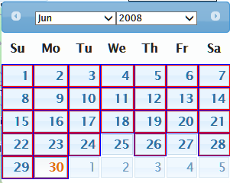
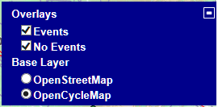
PQ Dashboard Beta
Simple Interface with Powerful Controls
Intelligent calendar control shows day selected and identifies days with events
Select base map and category of data to display

Slide 14
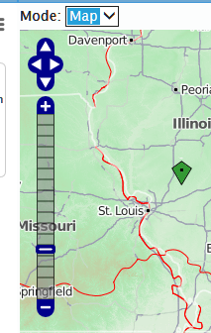
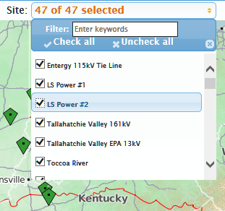
PQ Dashboard Beta
Simple Interface with Powerful Controls
Switch between map and grid
Standard map zoom and pan
Drag to zoom
Flexible site selection, list, click or drag

Slide 15
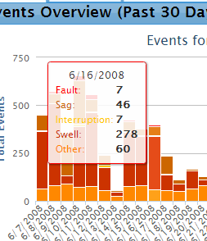
PQ Dashboard Beta
Simple Interface with Powerful Controls
Mouse-over tool tip
Click daily bar for
event detail table

Slide 16
PQ Dashboard Beta
Initial test data provided by TVA

Slide 17
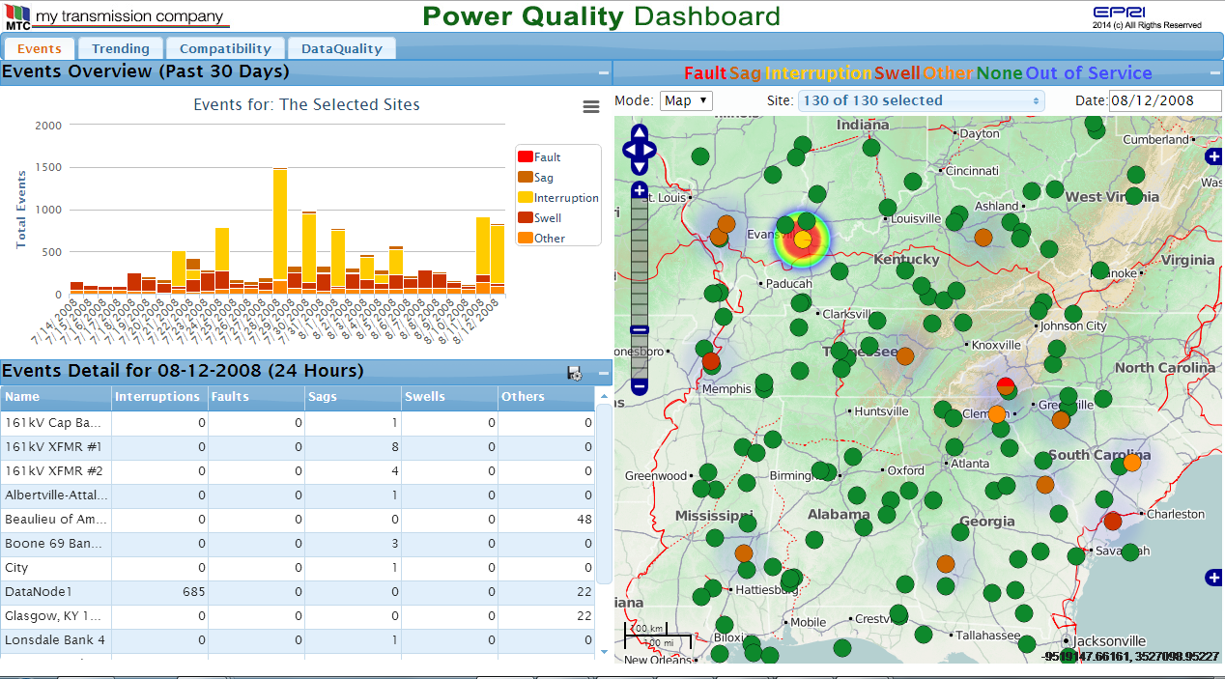
PQ Dashboard Beta
Initial test data provided by TVA

Slide 18
Conclusions
A dashboard approach for visualization brings new value to large volumes of data from a fleet perspective
OSS development strategy ensures flexibility and extensibility
Seamless integration can be accomplished with existing data sources and tools

