Slide 1
Welcome
2015 Grid Protection Alliance
User’s Forum
Atlanta, GA
August 4th and 5th, 2015
Edwin C. (Ed) Carlsen
Manager, Distribution Management Systems - Georgia Power
eccarlse@southernco.com

Slide 2
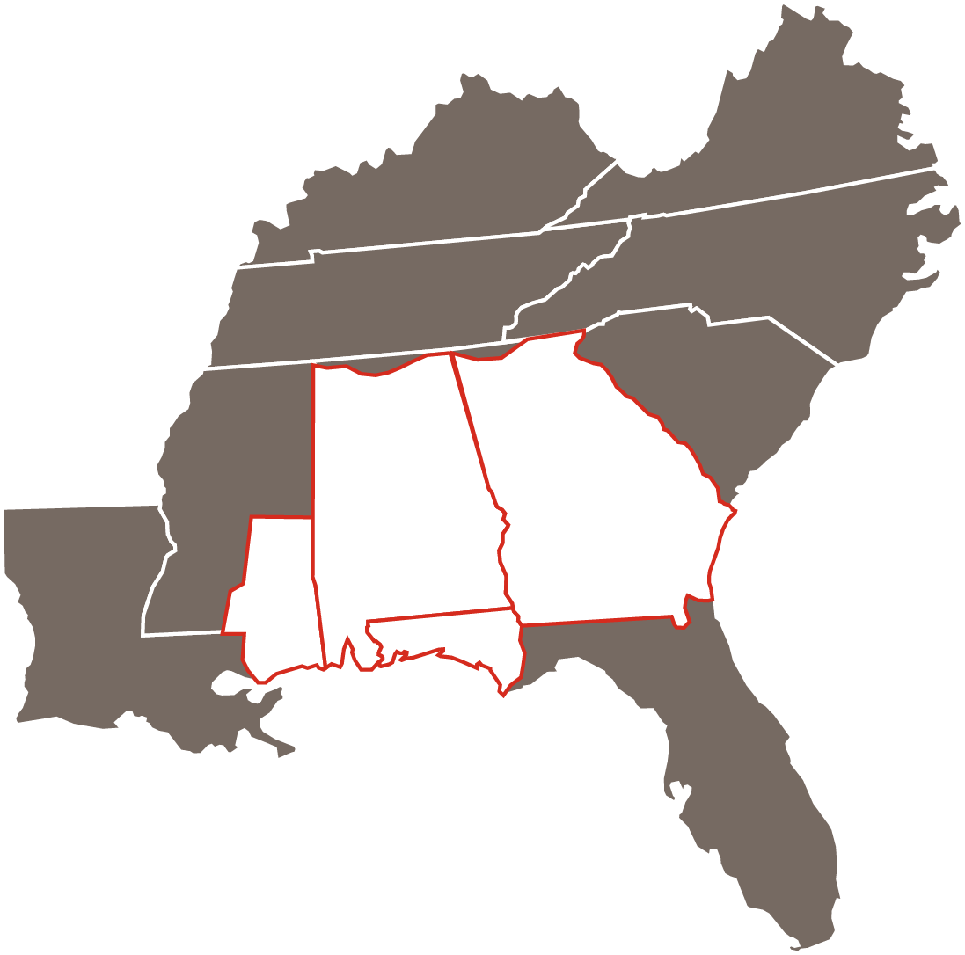
Southern Company (NYSE:SO)
Founded in 1912
One of the largest providers of electricity in the U.S.
More than 4.4 million customers
26,000 employees
120,000 square miles of territory

Slide 3
Southern Company Overview
Vertically Integrated – Generation / Transmission / Distribution
4 Electric Operating Companies
Southern Co Services (IT, HR), Southern Linc (Telecom), Southern Nuclear, Southern Power (wholesale generation)
2014 Revenue / Net Income: $18.5 billion / $1.96 billion
2014 Generation – 45,500 MW
Coal – 40% (was 78% in 2004)
Natural Gas – 40% (was 4% in 2004)
Nuclear – 16%
Hydro, Renewable – 4%

Slide 4
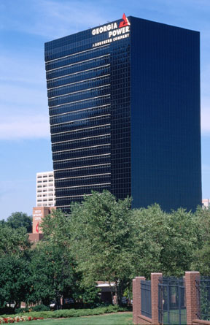
Georgia Power
Largest of four Southern Company electric utilities
Headquartered in Atlanta, GA
More than 2.4 million customers
Electric rates below the national average
Top quartile among peer utilities in customer satisfaction (as are the other sister OpCos)

Slide 5
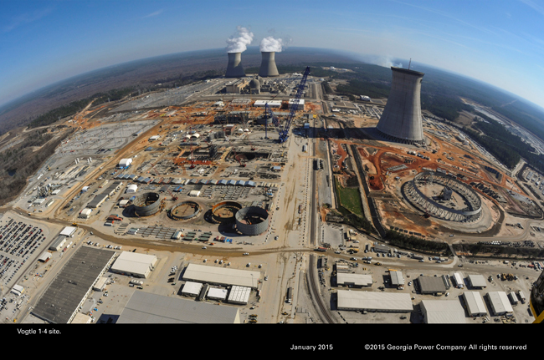
Plant Vogtle Nuclear - Units 3 & 4
Location: Waynesboro, GA
(south of Augusta)
Co-ownership:
Georgia Power: 46 %
Oglethorpe: 30 %
MEAG: 23 %
Dalton Utilities: 2 %
Design: Westinghouse “AP1000” - 1,117 MW (ea.)
5500 jobs now, 800 permanent
2019/2020 Commercial Operation
5

Slide 6
Renewable Energy
165 MW online now (July 2015)
Almost 1000 MW expected by EOY 2016
Small to Utility Scale installations
Some owned by GPC – 3x30MW at GA Military bases
Will present opportunities and challenges
6

Slide 7
Southern Company Circle of Life
Constructive
Regulation
Healthy Capital Spending
Customers
Low Prices
High Reliability
Customer Satisfaction

Slide 8
Data and Analytics
GPC before AMI
53 million
readings per year
8
Notes:
After AMI
2.2 million meters x 24 reads per day x 365 days per year x 8 readings per meter (on average) = 154 billion reads per year (not counting meter events)

Slide 9
Data and Analytics
GPC before AMI
53 million
readings per year
GPC after AMI
154 billion reads per year
+ other meter events
9
Notes:
After AMI
2.2 million meters x 24 reads per day x 365 days per year x 8 readings per meter (on average) = 154 billion reads per year (not counting meter events)

Slide 10
Distribution Operations Areas for Analytics
AMI-OMS
Fault Location Analysis
Overload / Voltage Deficiency Mitigation
Load reduction capability (Conservation Voltage Reduction)
Volt/Var Optimization
Asset Management
Work Management
etc
etc
10

Slide 11
Other Drivers
Safety – Worker and Public
Distributed Generation – Solar, wind
“Beyond the Meter” Control/Info
Regulatory (data collection/reporting)
Customer Outage Communication (growing expectations)
Everyone wants more data, more info… and wants it now!
Utilize this data to the greatest benefit… through analytics
11

Slide 12
Have a great meeting!
Enjoy Atlanta!
12

