Slide 1
Grid Solutions Framework Overview

Slide 2
GPA Products
Grid Solutions Framework
openPDC
substationSBG
SIEGate
openHistorian
openXDA
PDQTracker
Synchrophasor Stream Splitter
Project Alpha
PMU Connection Tester
GEP Subscription Tester
More…
Notes:
Although this is not a complete list, here are some of the major released GPA products.
You can navigate to our new web site for more info…

Slide 3
GPA Project Relationships
Grid Solutions Framework (GSF)
http://gsf.codeplex.com/
GSF Implementations:
openPDC / openHistorian / SIEGate
http://openpdc.codeplex.com/
Notes:
The relationship between the open source projects is very simple when compared to previous product versions. There is basically applications that are implementations of the Grid Solutions Framework with only the framework as a dependency. We generally try not to create other project dependencies when we can, but this is not always possible.

Slide 4
Multiple Open Source Projects
Grid Solutions Framework
http://gsf.codeplex.com/
Secure Information Exchange Gateway (SIEGate)
http://siegate.codeplex.com/
Open Source Phasor Data Concentrator (openPDC)
http://openpdc.codeplex.com/
Open Historian
http://openhistorian.codeplex.com/
PMU Connection Tester
http://pmuconnectiontester.codeplex.com/
FYI: We are moving projects to GitHub!
Notes:
All the GPA products are open source and hosted on Codeplex.
All source updates, product changes, bugs and fixes are logged and publically visible.
In a few minutes we’ll take some time to talk about these projects, starting with the Grid Solutions Framework.

Slide 5
Benefits of Open Source Hosting
Project source code control
This directly integrates with Visual Studio
Project contributor forks or patches
This allows contributors to suggest formal code updates
Project release downloads
This allows us to control major releases and track downloads
Discussion forums & mailing lists
This allows users to help users and request community help
Wiki and documentation pages
This allows up-to-date online documentation
Bug and feature request tracker
This allows users to post issues for resolution
Notes:
CodePlex is Microsoft's open source project hosting web site.
Anyone can use CodePlex to create new projects to share with the world as well as join others who have already started their own projects.
It’s primary function is allow uploads and downloads of open source software and an allow for community feedback.
CodePlex and GitHub currently hosts many thousands of open source repositories.
There are several very good open source hosting sites to choose from, but we choose sites based on good Visual Studio integration:
This directly integrates with Visual Studio for check-in and check-out of code, code conflict resolution and the ability to “shelve” code ideas or work without breaking the build.
<Click over to visual studio and show how “editing code” changes icon from locked to checked-out – right click and show one would check-in and then undo check-out>
This nice thing is that all of this happens “on the cloud” so you can check-in and check-out code from anywhere.
<Now click over to CodePlex and demonstrate browse code showing all the source code history>
Project contributor forks or patches
This feature allows contributors to suggest formal code updates even if they don’t have check-in rights. Even so, GPA very methodically analyzes each code check in – all code is code reviewed for accuracy and consistency both in function and style.
To date, GPA is the primary code contributor and most code suggestions come in from the lively discussion boards – but we hope that as others being using the code more heavily, more user code level contributions will flow in.
Project release downloads
This CodePlex feature allows us to control major releases and track downloads – as simple as this may sound, it is very important for users to be able to come to the site and download the latest recommended build without having to download all the source code and build it for themselves.
<Click over to CodePlex and show released and recommended downloads, then show how to access planned release downloads>
<Click over to home page and show how you can access nightly builds link at any time so you can installation binaries from last night>
Of course, please use the nightly builds at your own risk. Unlike the official release builds, these may not be fully tested.
Discussion forums & mailing lists
This allows users to help users and request community help – generally these are very active. We try answer questions here – but the community helps answer questions too…
<Click over to show the activity on this board, how to post new questions and answer other user’s queries>
Wiki and documentation pages
This allows up-to-date online documentation – we’ll go over this in a little more detail on the next slide since this is very critical in your ability to find help.
Bug and feature request tracker
This allows users to post newly discovered issues for resolution as well as to post new feature requests.
<Click over to show detailed tracking and show all the items that have been resolved>
We really do pay attention to this list – we also take note of the “votes” on certain items to help use realize user importance of features and issues.

Slide 6
Accessing Online Documentation
All online documentation is continually updated by both GPA and contributors.
Typically you need only go the project’s CodePlex site in question and click the “Documentation” tab to get started with system documentation.
For example, here is the openPDC Documentation Link - on this page you can navigate to:
Getting Started
Frequently Asked Questions
Major Component Overviews
How-to Guides, etc.
Notes:
<Make sure this slide is very interactive, taking time to navigate through many screens including the “Adapter Connection String Syntax” and clicking through to a “Help Me Choose Diagram”.>

Slide 7
GPA Development Framework

Slide 8
Grid Solutions Framework (GSF)
A software development platform that was initially created as a combination of the Time-Series Framework and the TVA Code Library with a goal to increase performance and security
Full namespace refactoring and projects targeted to compile with the Microsoft .NET 4.5 Framework. Will soon target 4.6.
New core features and improvements are only implemented in the GSF (only a few bug fixes flowed back to the original projects)
http://gsf.codeplex.com/
Notes:
The Grid Solutions Framework is a new .NET development library that was built using the original TVA Code Library and Time-series Framework.
This particular project contains very fundamental, low-level components used to simplify and speed development for most any .NET based project.
The Grid Solutions Framework has been built on .NET 4.5, and is architected into logical namespaces.
The library is very extensive and as open source projects go, extremely very well documented at a source code level.

Slide 9
Grid Solutions Framework Purpose
General purpose open source library of .NET code used by many utilities and various open source projects that contains a large variety of code useful for nearly any .NET project.
Consists of hundreds of classes that extend and expand the functionality included in the .NET Framework making more complex .NET features easier to use and adds functions not included in the .NET Framework.
Used since it provides a standard development platform, improves development speed and increases reliability.
Notes:
The components included in GSF contain items to abstract and speed complex development of things like sockets, multi-threading, encryption and compression – just to name a few.
To give you a sense of scale, we have been developing the Grid Solutions Framework for over ten years – this counts the time investments from the TVA Code Library and Time-series Framework.
The only requirement for code to go into this library is that it needs to be component level code that can easily be reused elsewhere.
To this day, many utilities depend on this open source project which is used for new code development.
This code has its roots in production environments that have demanding 24x7 uptime requirements, the standard 5 nines of reliability.
The other thing that happens when you make a project open source is that you are forced to make sure the exposed code is of the highest quality because if there are any serious flaws, people will move on and do something different.
There is little tolerance for code that does not work - the code has to be useful or people will find another way to accomplish their goals.
The Grid Solutions Framework is “the” foundational layer for all other systems being developed by GPA.

Slide 10
GSF Primary Assemblies
~70 Assemblies Spanning ½ Million Lines of Code and
Over 150K Lines of Comments
Notes:
The Grid Solutions Framework contains over 66 projects that become assemblies (i.e., a DLL or an executable tool) with nearly 330,000 lines of code with comments, and of those, about 130,000 lines being comments.
<Take time to pull up some code, showing the formal XML documentation in a code example – then click though to an online link so user’s can see how the XML code documentation is turned into formal documentation.>

Slide 11
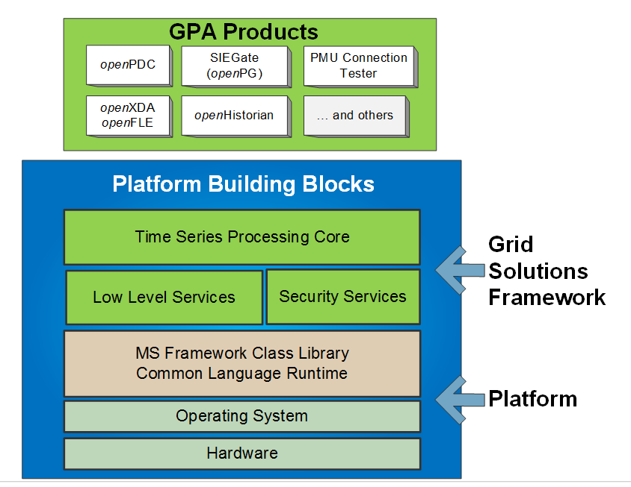
Built using GSF
Notes:
So, if I haven’t made it very clear enough – GSF is the KEY to all of the GPA product line.
Generally, if you want to understand a GPA product from a source code level – the Grid Solutions Framework is where you need to start.
Enough said.

Slide 12
GSF Time-series Library
Core collection of classes used to manage, process and respond to dynamic changes in fast moving streaming time-series data in real-time.
Allows applications to be architected as measurement routing systems using “Input”, “Action” and “Output” adapter layer.
Any application can host the framework which will allow a system to become a “real-time measurement bus”.
Notes:
As mentioned before, the Grid Solutions Framework also now contains what was the time-series framework.
The time-series portion of the Grid Solutions Framework is what is used as a basis for most of the applications that deal with streaming time-series data (e.g., the openPDC, SIEGate and the openHistorian)
The Grid Solutions Framework time-series library contains the infamous “Input”, “Action” and “Output” (Iaon) interfaces – which we’ll discuss in more detail later.
It also contains a full API library for publication and subscription of time-series values that can consumed in real-time by other applications.
I know for many of you, this is the code layer that’s being utilized to expand your own synchrophasor projects within your infrastructures – and I am anxious to hear about many of those activities in tomorrow’s session.

Slide 13
Measurements
Numeric quantities that have been acquired at a source device are often known as points, signals, events, or time-series values. Inside GSF they are known as measurements:
Examples include: temperature, voltage, vibration, location, luminosity and phasors.
Notes:
The time-series portion of the Grid Solutions Framework depends on the notion of a Measurement.

Slide 14
Understanding “Measurements”
A “measurement” as it is understood in the Grid Solutions Framework has many aliases:
Signal
Point
Tag
Time-series Value
The primary components of the measurement are:
Timestamp
Value
Identification
Notes:
<Find IMeasurement in the TSF code and show the key fields>
<Discuss the adder and multiplier, how it’s used in practice and how it relates to the AdjustedValue>

Slide 15
Measurement Structure
Unique ID
Timestamp
Value
Quality
Notes:
Generally the unique ID is a Guid globally unique identifier – a 128-bit random integer that is statistically unique in the world (hence “global”).
The other common name for these values is UUID, or universally unique identifier.
Microsoft was the one that coined the term “globally” unique identifier since they felt the computer generated values with likely to be unique on Earth by the odds of having a duplicate anywhere in the universe was too high.

Slide 16
Measurement Identification
Guid:
128-bit randomly generated integer that is statistically going to be unique in the world, examples:
7ACDEE91-661B-42A0-82C1-081090D0CA38
532863E4-8C3A-4F84-8366-0C8A4711EA6F
4E3548FD-470E-45DF-8C44-138936805BB6
Measurement “Key”:
Two part identifier represented by a “Source” string and a numeric “ID”, examples:
PPA:2
STAT:42
SHELBY:39
Notes:
There are two way measurements are identified in the time-series framework.
First, using a Guid – again, that statistically unique in the world identifier
Second, using a measurement “Key” – the measurement key is basically a string identifier consisting of a “source” for the measurement and a simple numeric ID separated by a colon.
The numeric ID is basically an auto-incremented integer, like 1, 2, 3, 4, 5.
The source can also be thought of as a destination depending on your perspective – for example, if the historian in your system which archives points is the primary interface in your infrastructure the, measurement key source can be thought of as the historian instance associated with the given point.
The Guid’s are used programmatically to uniquely identify measurements in the system, or said another way, if you are writing code that expects a certain set of measurements, used Guid’s are your lookup key – it is faster and more efficient.
On the other hand, the measurement keys are used whenever a human is interacting with the system – generally speaking Guid’s and humans don’t mix well. It’s very big number, coded in Hexadecimal, that is practically impossible to remember and annoying to copy and paste.
Measurement keys are short mnemonics that are easy to remember and have context based on their source – perfect for identification.
The real thing to remember is this:
Guid’s are for computers, measurement keys are point tags are for humans
The best flattened representation of all measurements defined in the system can be found in the “ActiveMeasurements” view.
<Click over SQL Server and open the “ActiveMeasurements” view to show a full example of well defined system measurements>
In the GSF time-series framework, measurements are everything – this table is basically the center of the universe.

Slide 17
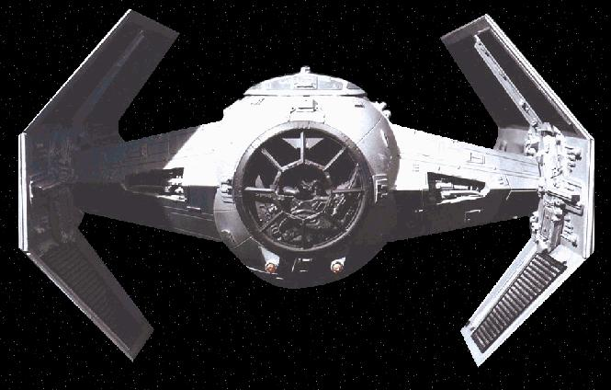
Overview of the Adapter Architecture Layer
Notes:
This is the standard diagram used to understand the Time-series framework.
This image is affectionately know as the “tie-fighter”.

Slide 18
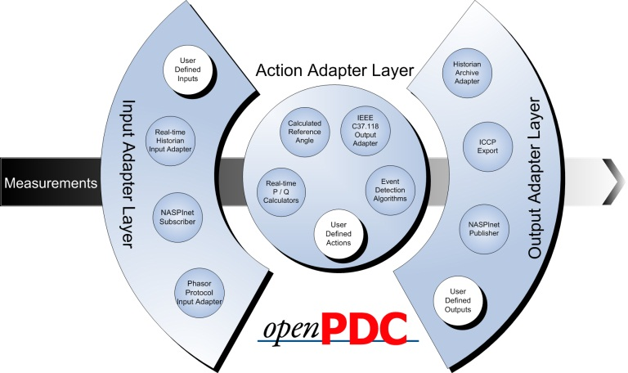
Scalable Adapter Distribution
GEP Data Flow

Slide 19
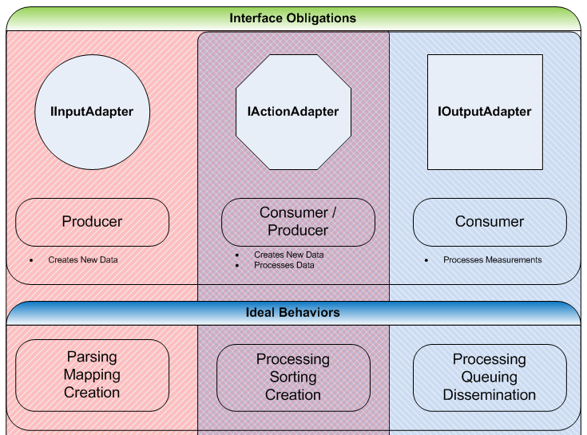

Slide 20
Input Adapters
Purpose: MAP
Collect and parse streaming data, assign incoming measurements an ID.

Slide 21
Output Adapters
Purpose: QUEUE
Queue up measurement data for transmission to archival systems.

Slide 22
Action Adapters
Purpose: SORT
Sort measurement data by time and process the data for same time-slice.

Slide 23
Concentration
Synchronized
Measurements
Device 1
Device 2
Device 3
Near by
Far
Max Lag Time
Notes:
In the synchrophasor world when a value gets measured, an exact timestamp is taken, typically using a GPS-clock for accuracy – the value, along with its timestamp, is then streamed back to a host application, e.g., the openPDC, where it can be “time-aligned” with other incoming measurements so that an action can then be taken on a complete slice of data that was all measured at the exact same moment in time.

Slide 24
The Configuration Data Structure
Notes:
The GSF Time-series library works with a variety is databases that it uses for configuration.
Technically, the library doesn’t need a database to operate – it will happily use an XML file or web service for configuration.
However, the XML file and/or web service are generally created from a back end database system somewhere.
<Click over to file system, navigate to openPDC configuration cache – show and open SystemConfiguration.xml – highlight schema and data instances so that it is understood that this is a serialization of the database configuration>
This is exactly the content that would be delivered when using a web service based configuration.
As mentioned during setup, although the openPDC service can run without access to a database, the openPDC Manager cannot – it expects a database for storage of configuration information.
Regardless of deployment strategy, a database normally exists somewhere in the openPDC system configuration.
The Grid Solution Framework and apps built off of it, like the openPDC, are all designed to work with practically any modern relational database system.
As you may have noticed during a setup, scripts and/or data structures for several common databases are provided:
SQL Server
MySQL
SQLite
and Oracle
Other databases, like post-gres-q-l, could be added easily enough.

Slide 25
GSF Implementation
Phasor Data Concentrator
Notes:
I want to briefly discuss three projects that use the Grid Solutions Framework Time-series Library just to give you context of what you can build with GSF. This will lead us into our next presentation on Project Alpha…

Slide 26
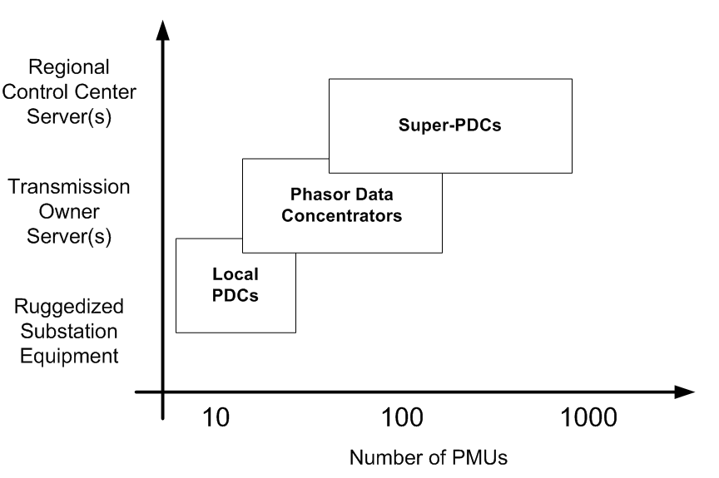
What is a PDC?
From NERC RAPIR Report Draft, June 2010

Slide 27
How is a PDC typically used?
To create a time-synchronize measurement data set
In the substation
For the Transmission Operator
For the Reliability Coordinator
To distribute phasor data to applications
To parse C37.118 for use by other systems

Slide 28
Who “touches” a PDC?
A PDC is like an RTU-Data Concentrator for a SCADA system
PDC’s are back-office tools, administered by specialists, that are likely to soon be part of critical infrastructure
For compliance and good configuration control, PDC change is tightly managed

Slide 29
Who are some PDC Vendors?
GPA – openPDC
Alstom Grid – openPDC & Psymetrix
Electric Power Group – ePDC
Schweitzer
General Electric
Kalkitech

Slide 30
openPDC is adapter based

Slide 31
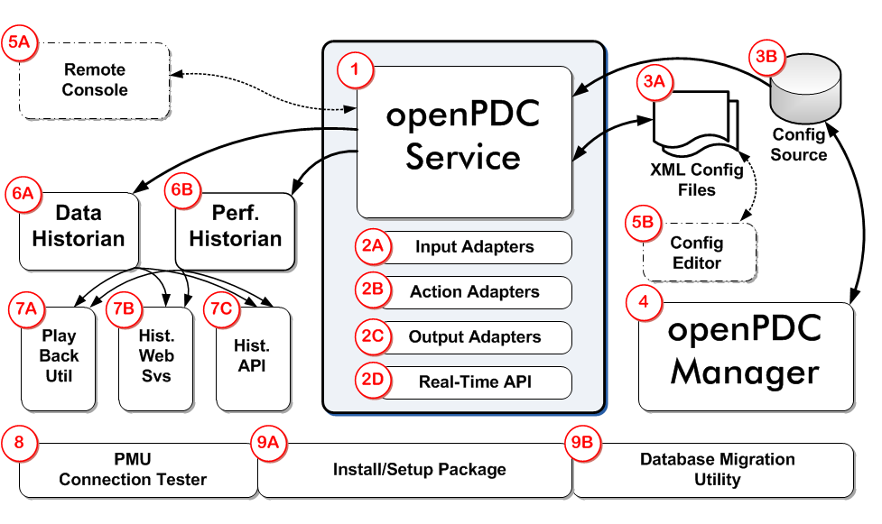
openPDC Components

Slide 32
openPDC Features
High performance for the largest of installations
Extreme configuration flexibility
Preserves data integrity of incoming data streams
Produces down-sampled real-time data streams
Independently handles real-time and archival functions
Horizontally and vertically scalable
Low-latency, preemptive frame publishing
Included performance historian logs highly granular operational statistics
Extensible through the creation of input, action or output adapters
Many instances can be remotely configured through a single configuration application
A growing and active open source community

Slide 33
openPDC Specifications
Input Protocols
IEEE C37.118-2005
IEEE C37.118-2011 (Beta)
IEC 61850-90-5
SEL Fast Messaging
Macrodyne N and G
IEEE 1344-1995
BPA PDC Stream
UTK FNET
DNP3 (Beta)
Gateway Exchange Protocol (GEP)
Output Protocols
IEEE C37.118-2005
BPA PDC Stream
Gateway Exchange Protocol (GEP)
Inter-Site Data (ISD) purchased from Alstom Grid

Slide 34
openPDC Specifications (continued)
Communications Standards
TCP – IPv4 and IPv6
UDP Unicast and Multicast, IPv4 and IPv6
Serial (input only)
Operating System
Windows Server 2008, R2 recommended
Hardware Requirements
Multi-processor / multi-core systems recommended
Tested on single core, fanless systems with as little as 2 GB of RAM
Configuration System
A relational database is recommended to house configuration data. Supported databases are:
MS SQL Server
MySQL
Oracle
SQLite
Notes:
Note that as of openPDC 2.0, only 64-bit versions are supported. This means no more Access databases – but SQLite is now available as a “no install required” local database option.

Slide 35
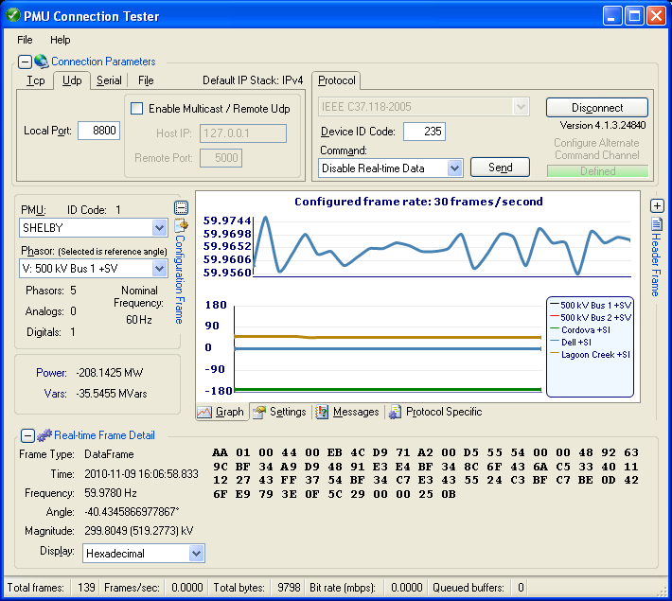
Includes PMU Connection Tester
Notes:
<SHOW IT>

Slide 36
Includes GEP Subscription Tester
Notes:
As a new tool, the Gateway Exchange Protocol (GEP) Subscription Tester is a new tool used to validate that a subscription based connection is working as expected. It can also be used to validate filter expressions that can be used to select a set of points in the openPDC and other products (e.g., SIEGate) for use as inputs or outputs for any adapter.
<SHOW IT>
This application is a simple graphical program that uses the Grid Solutions Framework Unity subscription API to display trending lines for each subscribed measurement in the specified filter expression - trend lines are updated as values are received in real-time. Mouse controls (or finger gestures) will allow rotation and zoom, arrows keys will adjust X/Y location. Clicking on the "Subscription Controls" area at the bottom of the screen will pop-up a control window to allow you to change connection information (e.g., server/port to connect to), the filter expression and even replay data if a historian is enabled.

Slide 37
Who else uses the openPDC?
In operational service at TVA since 2004
Other North American production deployments include PeakRC, OG&E Dominion, Southern Company, Duke, ISO-NE, FP&L, AESO, SDG&E, PG&E and others
Large community. There have been over 2,000 downloads of the openPDC since version 1.5 was released.

Slide 38
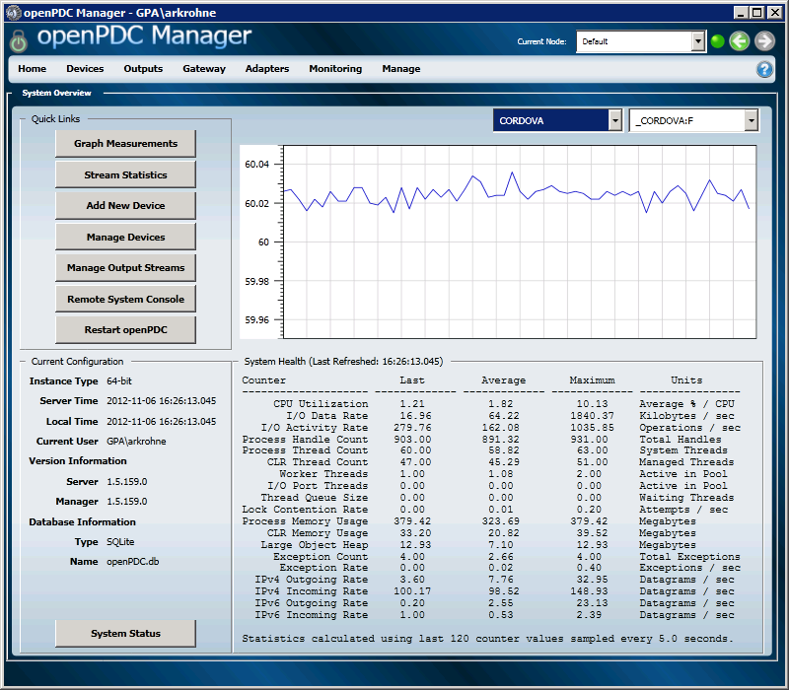
openPDC Manager Home Screen
Notes:
I am going to spend a moment showing you some basic screen shots the openPDC Manager – I won’t show these for the other products since they are very similar in most cases.
However – these will be important to you during the next session where we will build our own application with “Project Alpha” – you will get to pick and choose which of these screens you might like to include in your application.

Slide 39
openPDC Manager Home Screen
Select
Instance to Configure
Select Point to Display in Real Time

Slide 40
Connect to a Device

Slide 41
Connect to a Device
Name of Connection
Connect to another PDC
Set tolerances for Error Reporting and Reconnection Attempts

Slide 42
Input Configuration

Slide 43
Input Configuration
Click on Row to Expand
Can Edit (over-ride)
C37-118 Labels

Slide 44
Review Real Time Values

Slide 45
Review Real Time Values
Refresh Rate

Slide 46
View Real Time Data

Slide 47
View Real Time Data
Real Time
Select Points to Display

Slide 48
View Historical Data

Slide 49
View Historical Data
Review last 10 minutes
Historical
Simulated Time Frame

Slide 50
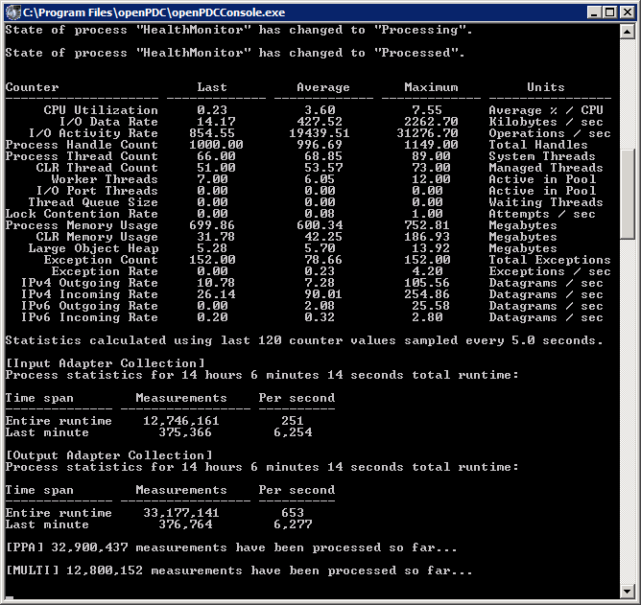
openPDC Console
The openPDC console can be used to remotely monitor the details of openPDC operation
It can be run independently of the openPDC Manager
Typical Commands
Clients Shows list of connections to service
Health Shows health report
List Displays list of devices connections
Help Displays list of commands

Slide 51
GSF Implementation
Secure Information Exchange Gateway
Notes:
SIEGate was funded by the U.S. Department of Energy and builds on the open Phasor Gateway technology.
The project team includes GPA, the University of Illinois; the Pacific Northwest National Laboratory (PNNL); PJM as a demonstration partner; and Alstom Grid as a demonstration and commercialization partner.
Work on SIEGate began in 2010 and is expected on conclude in early 2014.

Slide 52
The term “Gateway” came from NASPInet
Taken from NASPInet Specification, 2007
Notes:
In a general sense the SIEGate application can be thought of as a “Phasor Gateway” as described by the NASPInet vision.

Slide 53
What is a gateway?
Creates a hardened security buffer between critical internal systems and external ones
Protects the confidentiality and integrity of reliability and market sensitive BES data
Facilitates and reduces the cost of BES data exchange, including synchrophasor data -- both the actual data and the supporting metadata information for this data as well
Notes:
You may recall that GPA had released a product called the open Phasor Gateway – SIEGate is the next generation of the open Phasor Gateway and supersedes all existing deployments.
SIEGate does everything the open Phasor Gateway did and more.
Development of the open Phasor Gateway has ended and all efforts have been transferred to SIEGate.

Slide 54
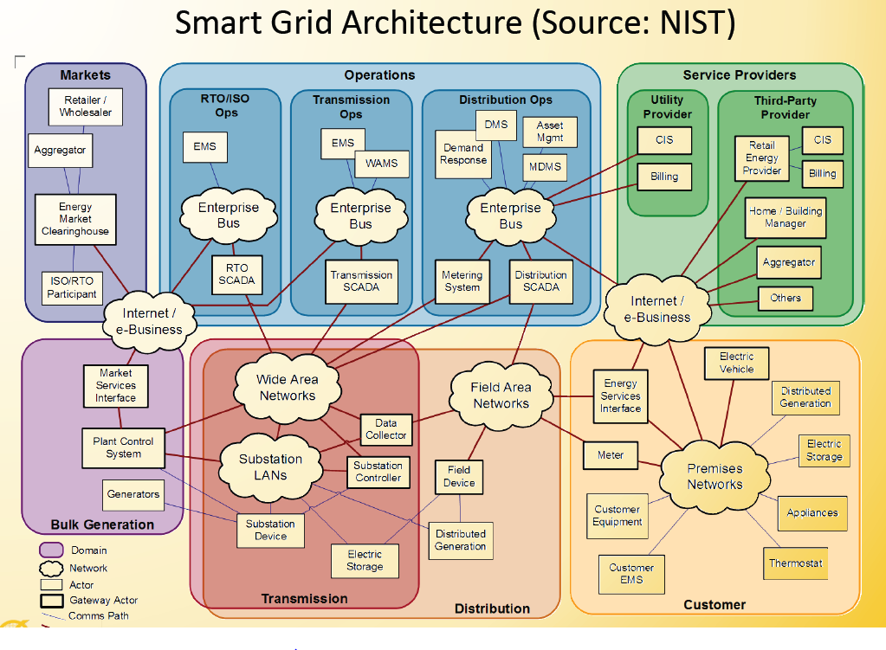
Current State of BES Data Exchange is Complex

Slide 55
PDC vs. SIEGate
PDC – optimized for time-alignment of many inputs
Accepts inputs from PMUs and other IEDs using the broadest range of formats and protocols
Provides time-alignment of data (with delays and loss after time-out)
Allows implementation of adapters that require rapid access to time-aligned data
Publishes multiple time-concentrated streams
Reports and alarms on quality of measurements (signals) and input device status
SIEGate – optimized for directed data transfer of granular information that facilitates a security-layered network design
Manages asynchronous communication of specific measurements (signals) with other SIEGate nodes
Relays data upon receipt without further delay
Can effectively manage the joining of two semantic models
Reports and alarms on status of communication of data with other gateways

Slide 56
SIEGate Objectives
To develop and commercialize a flexible appliance to enable the secure exchange of all types of real-time reliability data among grid operating entities.
SIEGate will be a security-centric edge-device that
Resists cyber attacks
Preserves data integrity and confidentiality
and that integrates and interoperates easily with existing control room technology.

Slide 57
High Level Requirements
Security Throughout
At multiple levels: hardware, OS, application
High Performance
Meet real-time requirements
Scalable to meet growing capacity needs
Support for subset of power protocols
DNP3, IEEE C37.118, IEC 61850-90-5, and Modbus

Slide 58
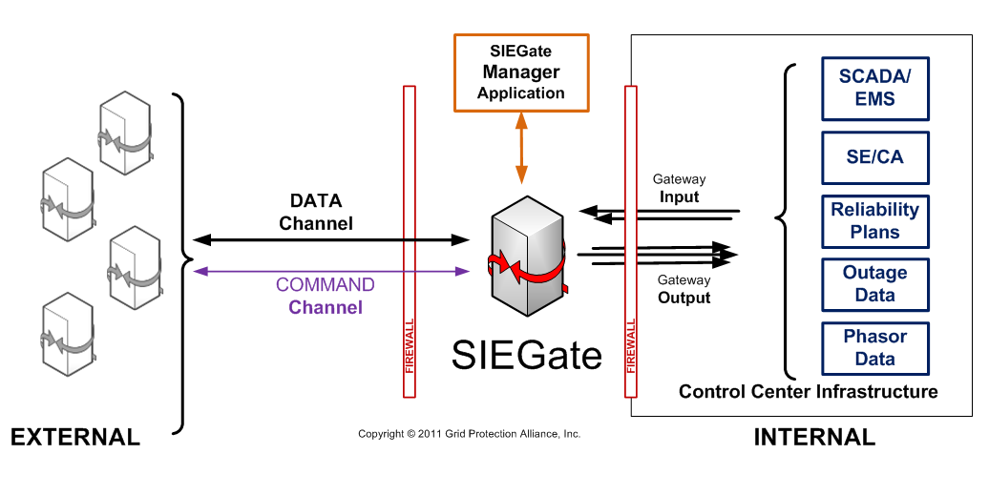
SIEGate Implementation

Slide 59
SIEGate Core Functionality
Reliably exchange high-sample rate signal values and timestamps (measurements) with other gateways so that this information moves between with minimum time delay
Enable gateway administrators to easily select the measurement points which are to be made available to owners of other gateways
Enable gateway administrators to easily select the points that they chose to consume (i.e., the subset of the points made available to them) from other gateways

Slide 60
SIEGate Core Functionality (continued)
Detect, log and alarm on communications issues
Be implementable as a high-availability solution that can meet NERC CIP compliance requirements
Support encrypted communication among gateways as well as minimize bandwidth requirements for gateway-to-gateway data exchange
Utilize standard communications, networking and server hardware
Be easily extensible to support the development of custom interfaces to the gateway owner’s internal infrastructure and/or new phasor data protocols

Slide 61
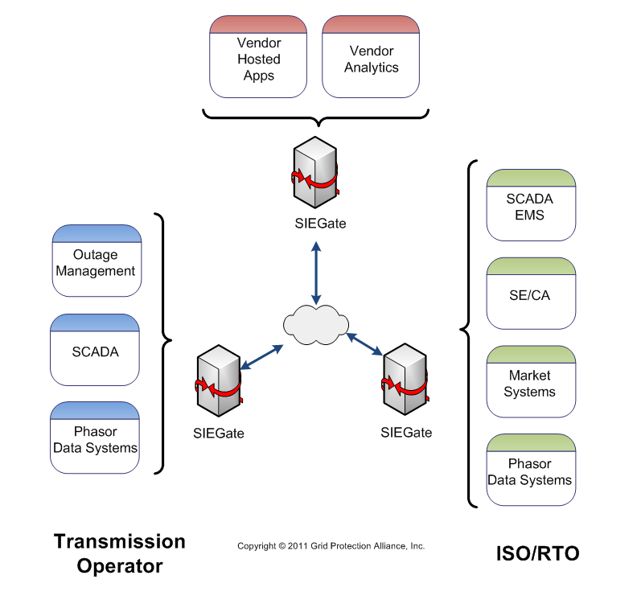
SIEGate Uses
Case 1
RC to RC
Case 2
TOp to RC
BA to RC
Case 3
TOp to Distribution Ops
BA to BA
TOp to TOp
Case 4
RC/Top/BA to Wide Area Service Provider (SANFR)

Slide 62
SIEGate Data Classes
Real Time Measurements
Phasor Data
SCADA Data
Batch Data
Disturbance Data
Planning Data
Possible Future Classes:
Emergency Data (extremely important data)
Control Commands

Slide 63
Alarming and Notifications
Bad data quality
Security exceptions
E.g., Integrity failures, connection failures, access control
Attestation failures
Configuration changes
System health

Slide 64
Who “touches” a SIEGate?
The SIEGate application is like an ICCP node in a control center
As a back-office tool, SIEGate is administered by specialists, and likely to become part of critical infrastructure
For security and compliance, change is tightly managed

Slide 65
GSF Implementation

Slide 66
What is a data historian?
A non-relational database that is optimized for handling time-based process data
Data must be in the form of (time, value)
Effectively handles very large volumes of data
High performance read/write operations
Easy migration of older data to less expensive, second tier storage media

Slide 67
Why install a historian?
Relational systems are not a good fit for phasor data
Do not scale well (record overload & retrieval responsiveness)
Cost - higher storage consumption per point
Data backup processes can be problematic (outages and network congestion)
Typical Historian uses in a Control Room Architecture
SCADA/EMS Data Storage
Primary Phasor Data Storage
Second Tier Phasor Data Storage

Slide 68
Who are historian vendors?
GPA
OSIsoft PI
eDNA
Honeywell Uniformance PHD
GE Proficicy Historian
Industrial SQL Server Historian

Slide 69
Who “touches” a data historian?
A historian is like an enterprise-wide relational system (e.g., work management) that’s just for operational, or process control, data. It requires diligent administration to enable enterprise-wide use
A historian is used as the common point for systems to consume operational data in near-real-time; i.e., within about 1second of real-time
Many engineers and analysts interact directly with a historian to obtain historical operating data

Slide 70
openHistorian 1.0 vs. 2.0
Version 1.0
Version 2.0
Two instances of the archiver are embedded in the openPDC and openPG
Data Historian
Performance Historian
Configuration managed through openPDC or openPG Manager
Includes two tools for data extraction/display
Data Extraction Tool
Data Trending Tool
Includes both archiver and server components
Completely redesigned storage engine
Broader range of data types
Greater time precision
Improved storage efficiency
Improved performance
Flexibility in implementation with integrated support for other open storage systems
Includes an integrated suite of tools for data extraction and display

Slide 71
openHistorian 2.0 Design Goals
Complete redesign of current historian to enable the openHistorian to be the nexus for operational data at all sampling rates
ACID protects data integrity Atomicity, Consistency, Isolation, Durability
High Performance
Maximum storage efficiency
High-availability
Compliant
Flexibility in deployment for rapid integration

Slide 72
Planned openHistorian 2.0 Components
Archival Services
Extraction Services and API
Administrator's Console
Web-based graphing/trending display
Engineer’s Trending Tool and Screen Builder
Operator’s Display
Alarming / Notification Services

Slide 73
openHistorian 2.0 Features
Optimized for management of process control and other time-series data
Very large volumes of data can be efficiently stored and be made available on line
Both lossless and swinging-gate compression options available
Real-time data streams can be exported for both the provided web-based display or other application needs
Horizontally scalable
Easy to install, easy to configure
Low cost of ownership
Performance logging and alarming

Slide 74
openHistorian is ACID Compliant
Atomicity - requires that database modifications must follow an "all or nothing" rule. Each transaction is said to be atomic
Consistency - ensures that any transaction the database performs will take it from one consistent state to another
Isolation - refers to the requirement that no transaction should be able to interfere with another transaction at all
Durability - that once a transaction has been committed, it will remain so
ACID protects data integrity.

Slide 75
Who else uses the openHistorian?
1.0 Implementations:
TVA has been a long term user (since 1995)
Dominion
PG&E
Entergy
Anyone hosting an openPDC
2.0 Alpha Implementations:
OG&E

