Slide 1
Working with openXDA

Slide 2
Objective
To provide a deep dive into openXDA’s components and constructs to demonstrate openXDA’s adaptability and ease of addition of new processes.

Slide 3
Overview

Slide 4
What is openXDA?
A back-office automated service to automatically process and analyze event and trending data from transmission and distribution metering – DFRs and PQ metering

Slide 5
openXDA – PQ / DFR Dualism
PQ – Largely distribution focused
Single line monitoring
Self-describing configuration in PQDIF
Data may be collected by MDM systems
Event and trending data
DFR – Largely transmission focused
Multiple lines monitored
Meter configuration information (channel mapping) required
Only event data, typically as COMTRADE files

Slide 6
openXDA Components
Installer for the openXDA service
Core service (includes File Watcher, logging and notification components)
Administrator’s remote console
Database (MS SQL Server)
Configuration management / loader tools

Slide 7
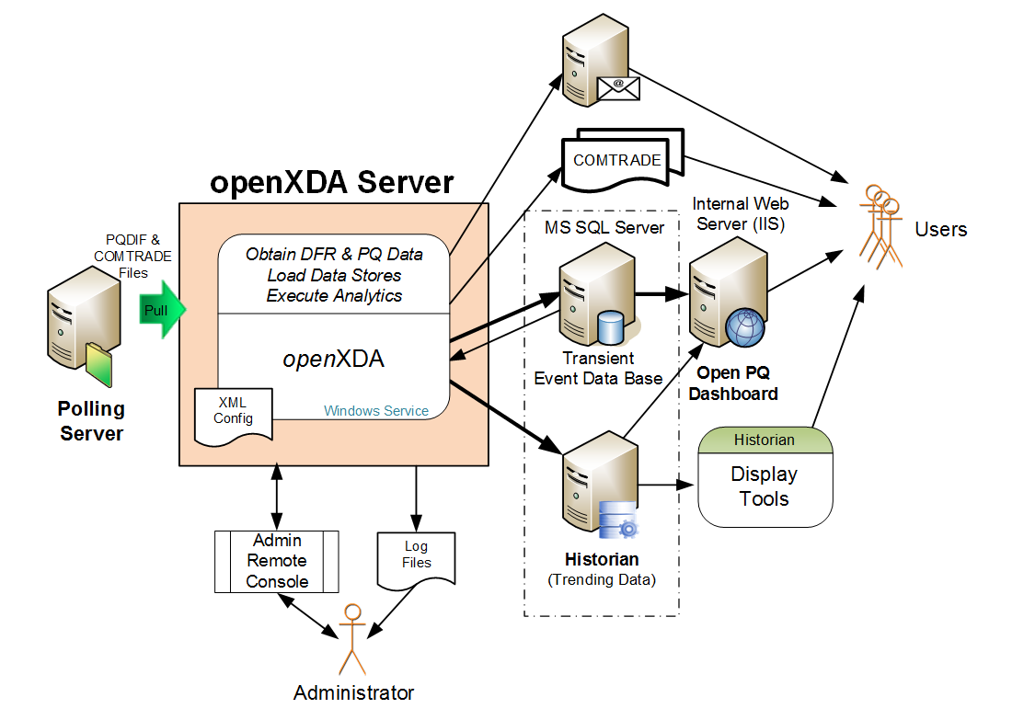
openXDA Overview
openXDA Data

Slide 8
openXDA Inputs
Configuration Data
Meter name and location
Meter channel definitions
Line parameters
Waveform Data
COMTRADE
PQDIF
EMAX (native format)
SEL .eve (SEL-251, SEL-351, Sel-421 relays)

Slide 9
Event Data
openXDA Data
Time Domain
Event attributes
Event segments attributes
Waveform
Frequency Domain
Cycle data – Full-set of RMS and synchronous component values for each full cycle of data on the waveform

Slide 10
Event Analysis Data
openXDA Data
Sags/Swells
Duration
Magnitude
Faults
Type
Inception time
Duration
Distance
Prefault current
Fault current
Postfault current

Slide 11
Trending Data
openXDA Data
Daily Values
Min, Max, Average
Hourly Values
Min, Max, Average
Full Resolution Values
Min, Max, Average

Slide 12
Trending Alarm Data
openXDA Data
Data Quality – Engineering reasonableness
Latched
Unreasonable (high/low limits)
Incongruent (max > average > min)
Off-Normal – Hour-of-week 3 sigma excursions
Custom Alarms

Slide 13
openXDA Outputs
Analytic results saved in data base
Automated notifications
COMTRADE
Line centric
Includes both input and analytics cycle data

Slide 14
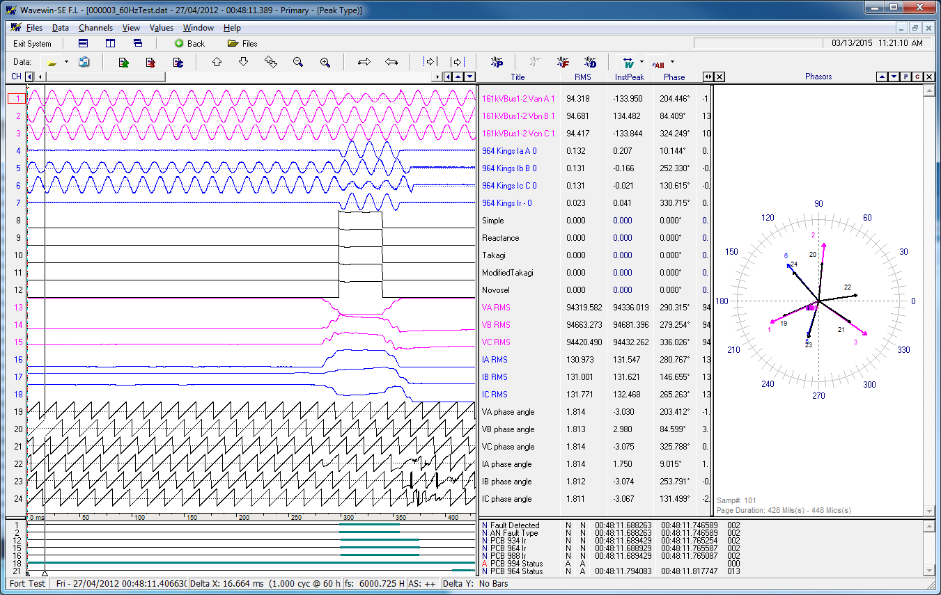
COMTRADE Output is Line Centric

Slide 15
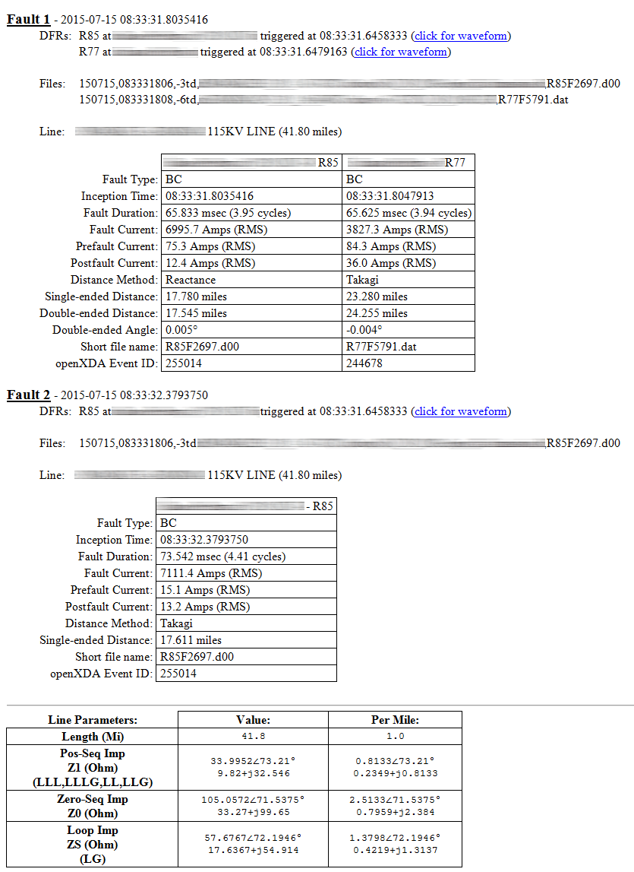
Version 1.3 Example Email

Slide 16
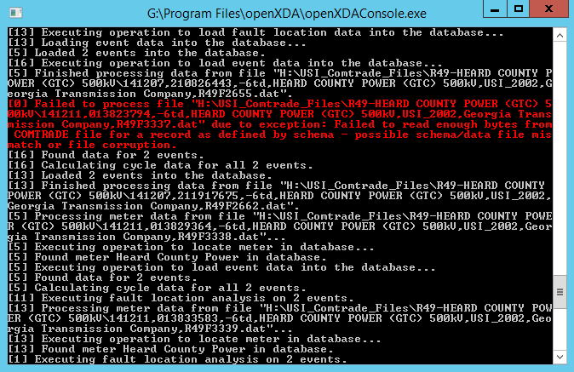
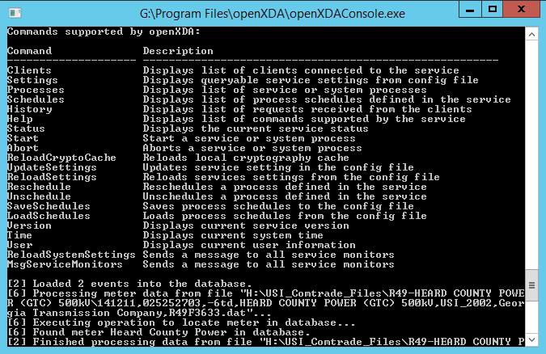
openXDA Remote Admin Console
Real-time monitoring of status log
Interact with service through commands

Slide 17
openXDA Logging
Text File-Based Logging
Status Log (key messages)
Error Log
Assembly, class, method
Stack trace
Exception type and message
Debug Log – All status, most error and copious additional messages
DB Logging
For analytics, easily searchable/reportable record of files processed and errors encountered

Slide 18
What is the open PQ Dashboard?
The presentation layer PQ data housed in openXDA.
The openPQ Dashboard has been primarily funded by EPRI with extensions and contributions provided by others.

Slide 19
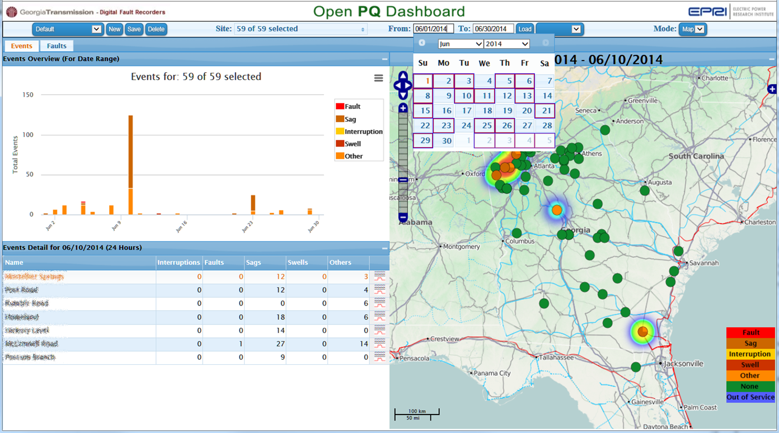
Event Data Display
Selectable
Views
Powerful Date
Controls
Event Count and
Type by Date
Event Count Heat Map
Event Type
Site Location
Event Count and
Type by Site for
Selected Date
Link to
Event Detail
Version 0.7

Slide 20
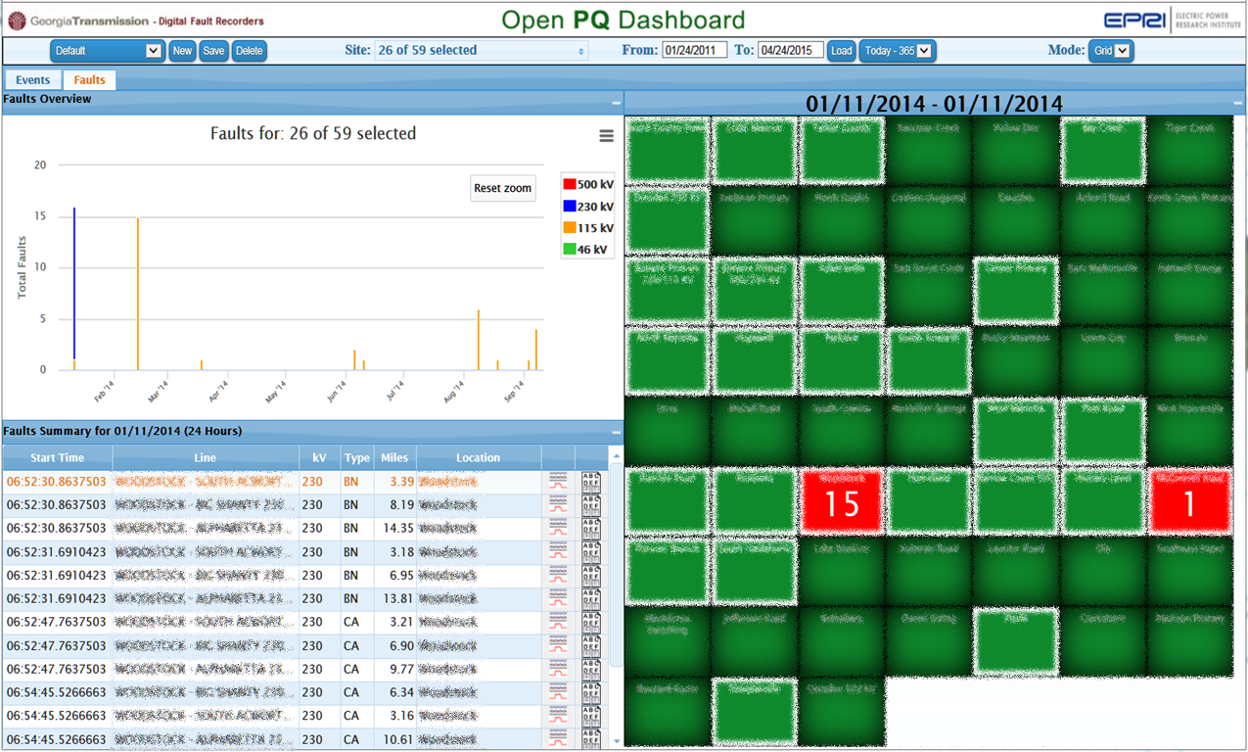
Fault Data Display
Selectable
Views
Powerful Date
Controls
Fault Count
By kV CLASS
Fault Count
By Site
Fault Summary
By Time for
Date Range
Links to
Fault Detail
Version 0.7

Slide 21
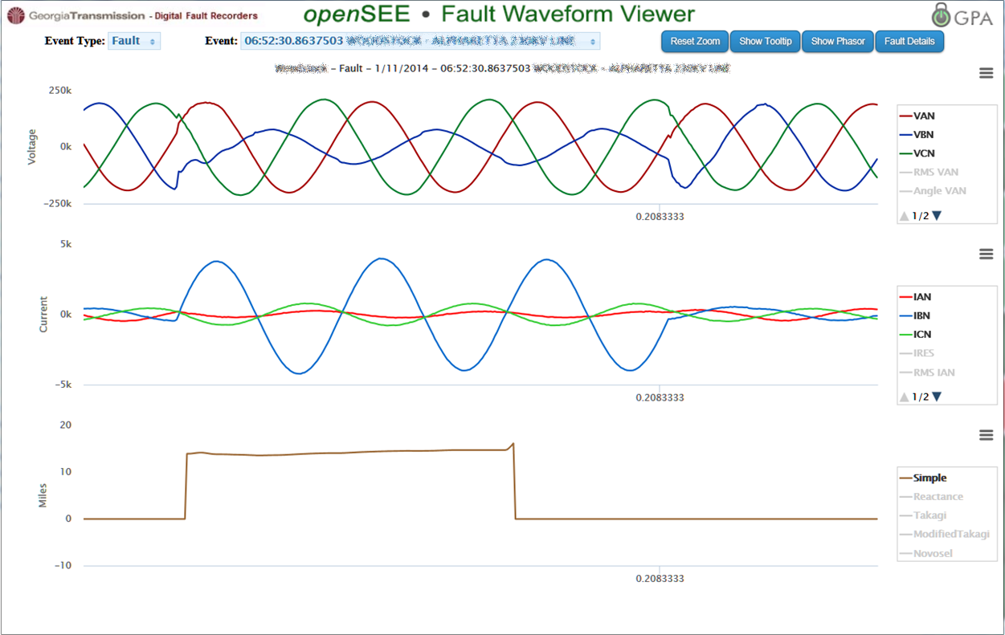
Fault Waveform Detail
Select Any Event
From Specified Date
Select Fault
And Event Time
Instantaneous,
RMS, Phasor Curves
Fault Distance Calculation
Over the entire fault
Zoom / Scroll Axis
Values Displayed at Cursor Location

Slide 22
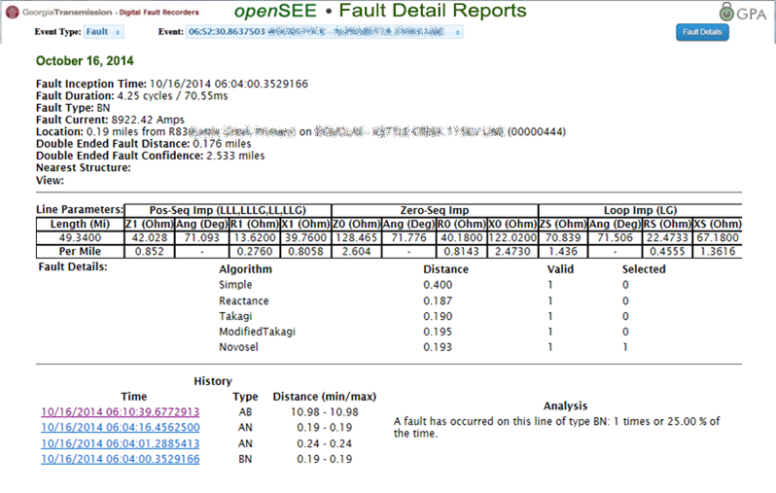
Fault Detail Report

Slide 23
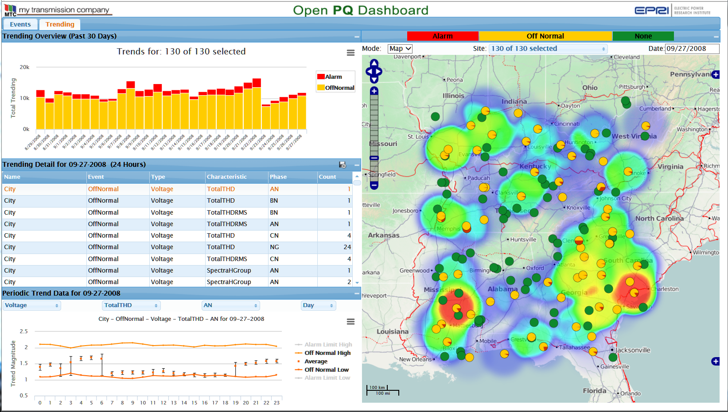
Trending Data Display
Version 0.7

Slide 24
Provides a separate Windows service platform for analytics based on the openXDA database.
Designed with integration in mind. Write analytics on another platform, such as Matlab, and integrate the results into openXDA.
Distributing analytics to separate Windows services allows for sandboxing analytics to prevent potentially unsafe code from compromising the openXDA platform.

Slide 25
PQ Investigator Integration
PQ Investigator tolerance curves indicate the failure points of equipment based on voltage magnitude and duration.
Automatically determine after an event, such as a voltage sag, what equipment might have been affected by the disturbance.
View the list of affected equipment in the PQ Dashboard.

Slide 26
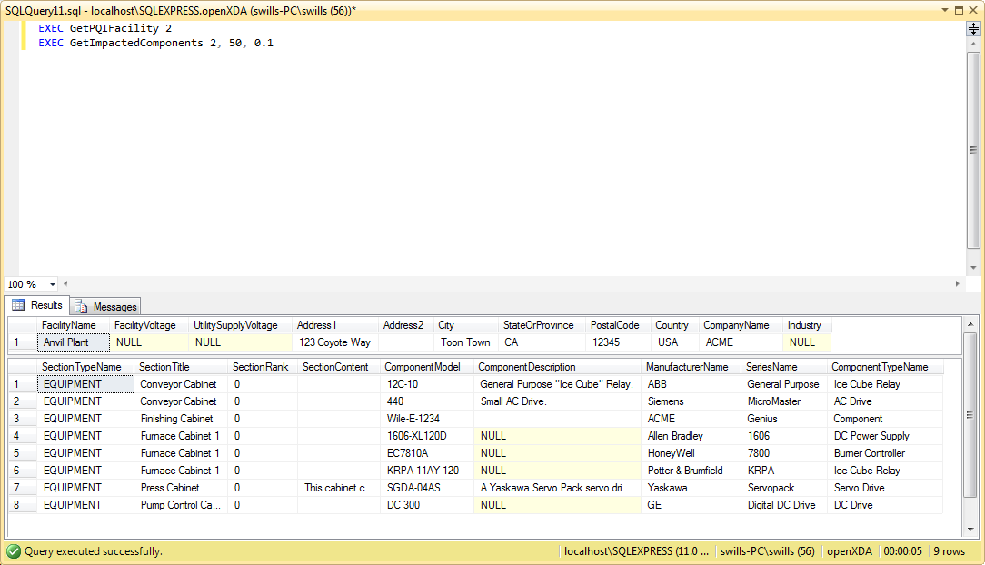
PQ Investigator Integration

Slide 27
The Deep Dive

Slide 28
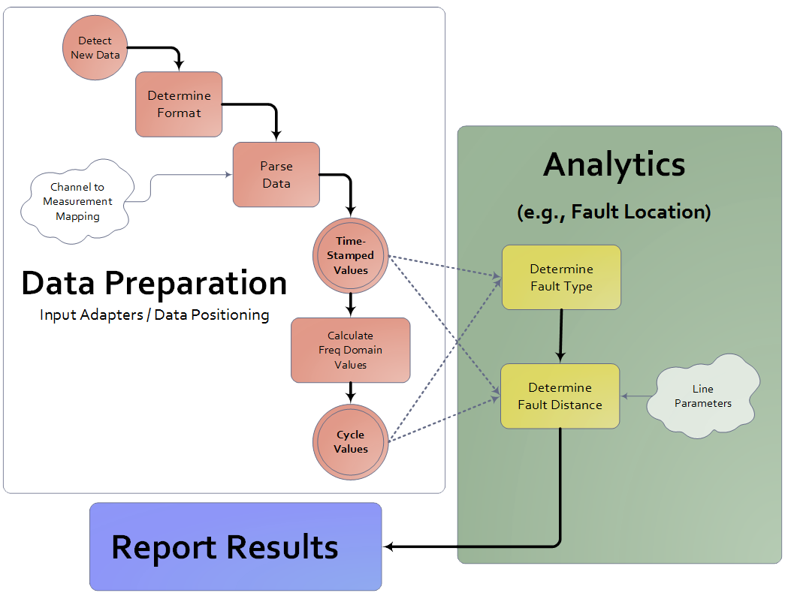
openXDA is an Automation Platform

Slide 29
Highlight 1
The processes executed by openXDA are database driven.

Slide 30
openXDA Constructs
ConfigurationLoader
Load configuration updates from configuration source
DataReader
Read data from files
DataOperation
Perform data analysis and load results into database
DataWriter
Provide results and notifications to external systems

Slide 31
openXDA Inputs
Configuration Data
Meter name and location
Meter channel definitions
Line parameters
Waveform Data
COMTRADE
PQDIF
EMAX (native format)
SEL .eve (SEL-251, SEL-351, Sel-421 relays)

Slide 32
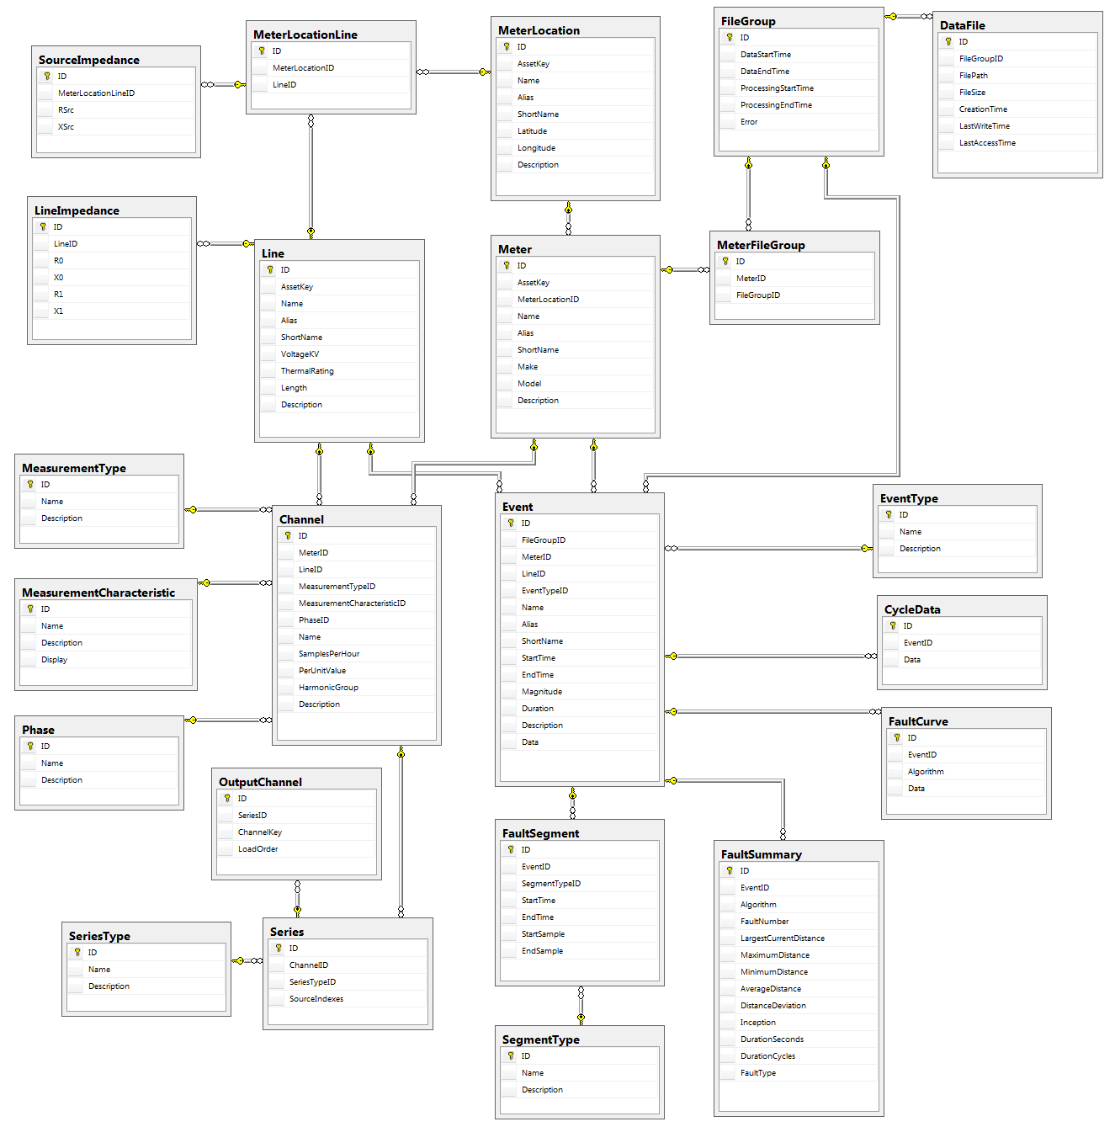
openXDA Event and Soft Configuration Data
openXDA Data
MS SQL server required (2012 or later)
Easy to understand collection of tables with procedural interface layer

Slide 33
ConfigurationLoader
The ConfigurationLoader interface allows you to…
Automatically load configuration from an external configuration data source on a timer
Manually load configuration via the remote system console

Slide 34
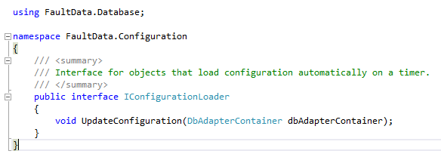
ConfigurationLoader
IConfigurationLoader interface

Slide 35
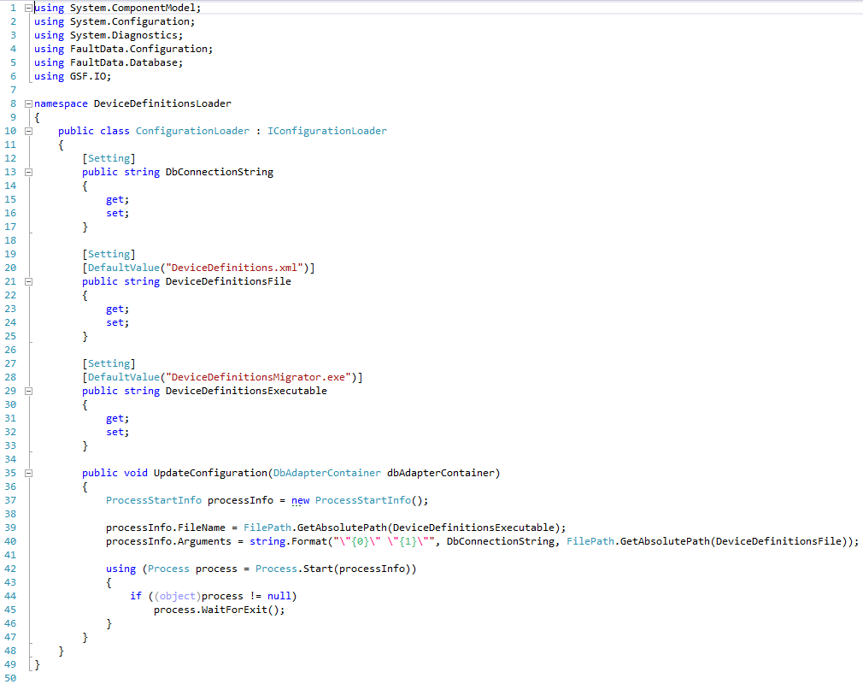
ConfigurationLoader
Example ConfigurationLoader

Slide 36
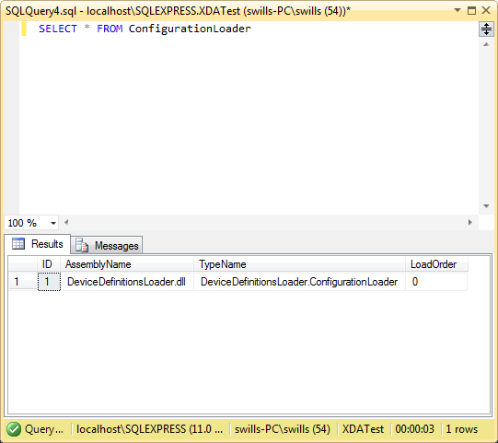
ConfigurationLoader

Slide 37
Highlight 2
A console application can be used to remotely monitor and control the openXDA service.

Slide 38
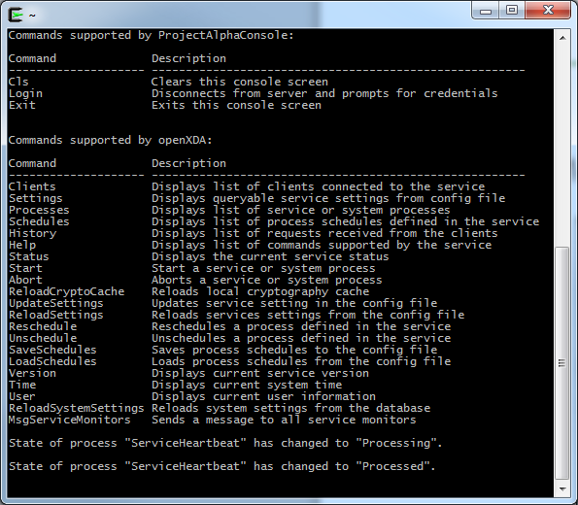
Console Commands

Slide 39
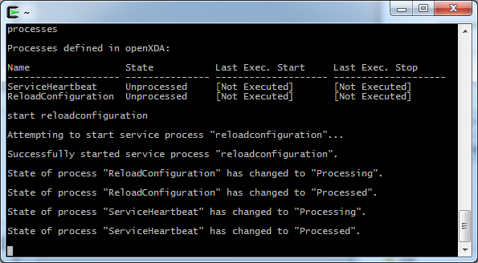
ConfigurationLoader
Manual configuration load

Slide 40
ConfigurationLoader
By default, openXDA automatically loads configuration once per day. This behavior can be modified via the remote system console. See the following link for details about the syntax for scheduling.
https://www.gridprotectionalliance.org/NightlyBuilds/GridSolutionsFramework/Help/html/T_GSF_Scheduling_Schedule.htm

Slide 41
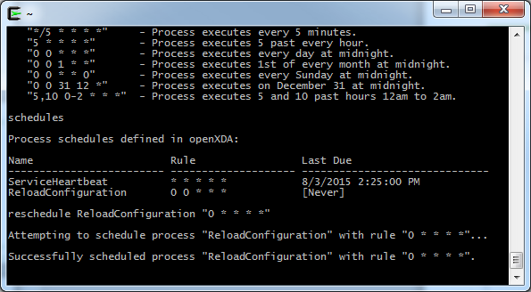
ConfigurationLoader
Reschedule automatic configuration load to once per hour instead of once per day.

Slide 42
DataReader
The DataReader allows you to transform data from a file into a MeterDataSet that can be used by openXDA analytics.

Slide 43
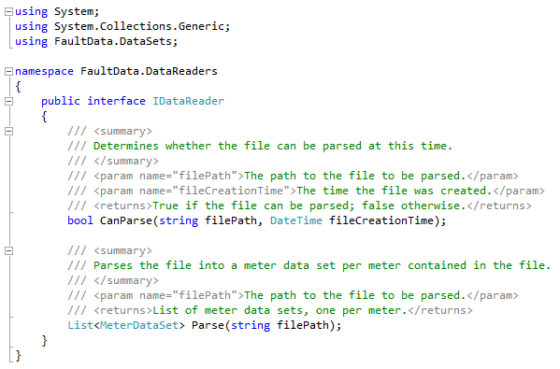
DataReader
IDataReader interface

Slide 44
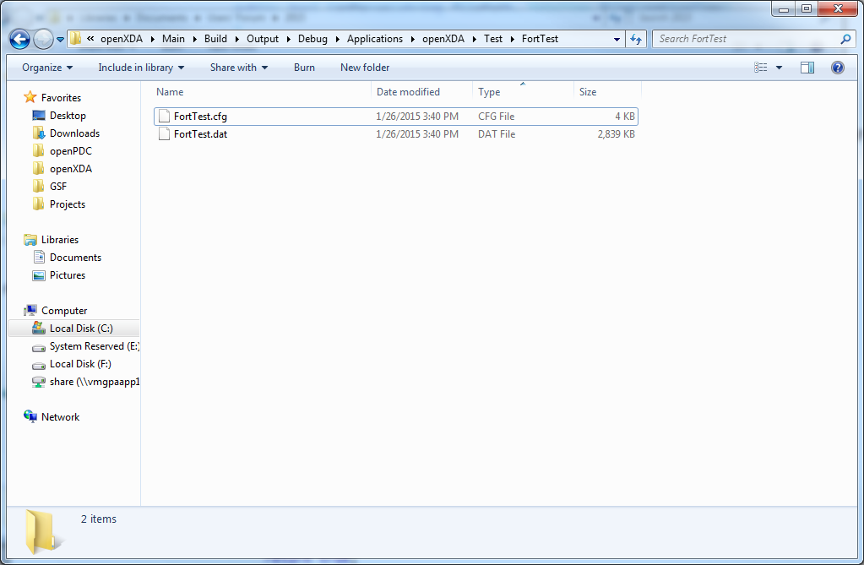
DataReader
Example COMTRADE file

Slide 45
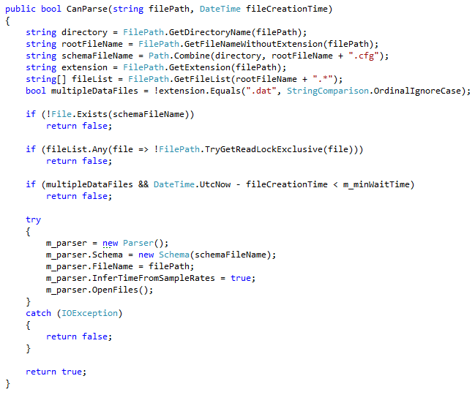
DataReader
CanParse() method (COMTRADEReader)

Slide 46
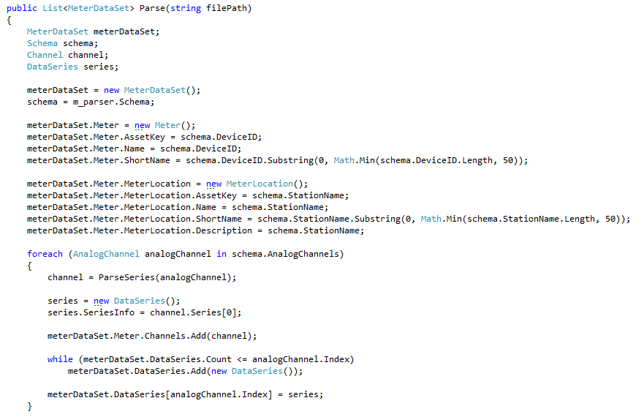
DataReader
Parse() method (COMTRADEReader)
snip...

Slide 47
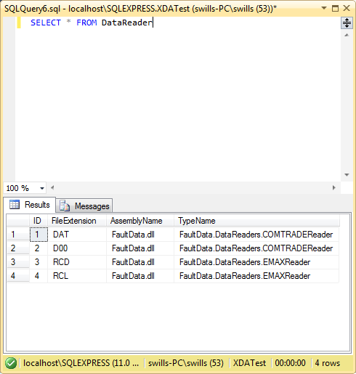
DataReader

Slide 48
Highlight 3
Robust file watcher detects new files dropped by source devices as soon as they are available.

Slide 49
DataReader
FileExtension
DataReaders are created and invoked when the file watcher detects that a file has appeared on the file system. The type of the DataReader that is created is determined by the extension of the file that is detected by the file watcher.

Slide 50
DataOperation
The DataOperation allows you to…
Analyze data from a MeterDataSet to produce meaningful results.
Load the results of analysis into the database.

Slide 51
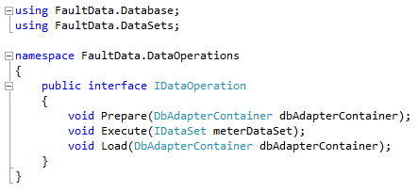
DataOperation
IDataOperation interface

Slide 52
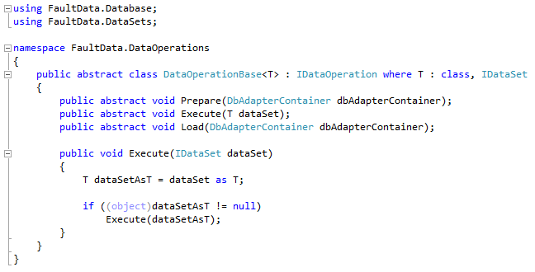
DataOperation
DataOperationBase

Slide 53
DataOperation
Prepare
Database work that needs to be done in preparation for the data operation to execute. An example would be validation of supporting database tables, such as the EventType table.
Executed outside of any database transactions so that locking of database objects can be kept to a minimum. Excessive database locking can reduce performance and increase the risk of deadlocks.

Slide 54
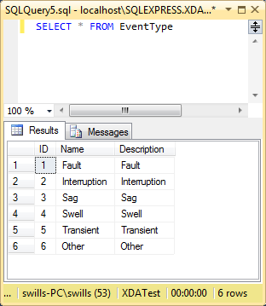
DataOperation
EventOperation prepares by loading event types into the EventType table, ensuring that all the necessary event types exist before executing the operation.
EventType table

Slide 55
DataOperation
Execute
This is where data analysis is performed, transforming the input data into results that can be loaded into the database.
No database work is actually done here. Analysis is performed and results are stored in memory in preparation for the Load method.

Slide 56
DataOperation
In the EventOperation, Events are loaded into m_eventTable, an in-memory data table that models the Event table in the database.

Slide 57
DataOperation
Load
Loads the results of analysis into the database.
This method is executed in a transaction that may or may not span multiple separate DataOperations. Keep work here to a minimum in order to reduce database locking.

Slide 58
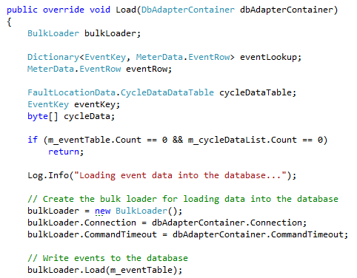
DataOperation
EventOperation uses a BulkLoader object to load Event records from m_eventTable into the database.
snip...

Slide 59
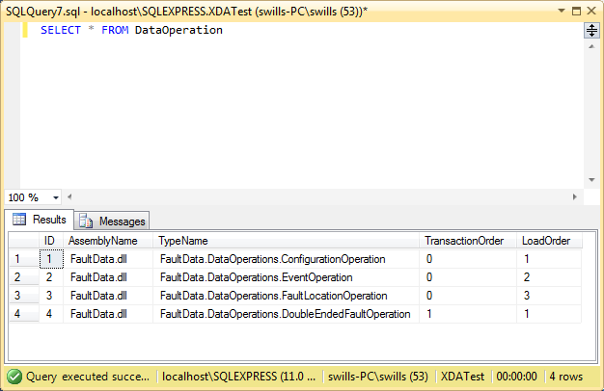
DataOperation

Slide 60
TransactionOrder
Determines the order in which groups of DataOperations will be executed.
DataOperations with the same transaction order will be executed as a group.
Each group of DataOperations shares a transaction with each other (Load method).
If one DataOperation in the group fails, all DataOperations fail!

Slide 61
LoadOrder
Determines the order in which DataOperations in the same group will be executed.

Slide 62
DataWriter
The DataWriter allows you to send the results of your analysis to external systems apart from openXDA.

Slide 63
DataWriter
IDataWriter interface

Slide 64
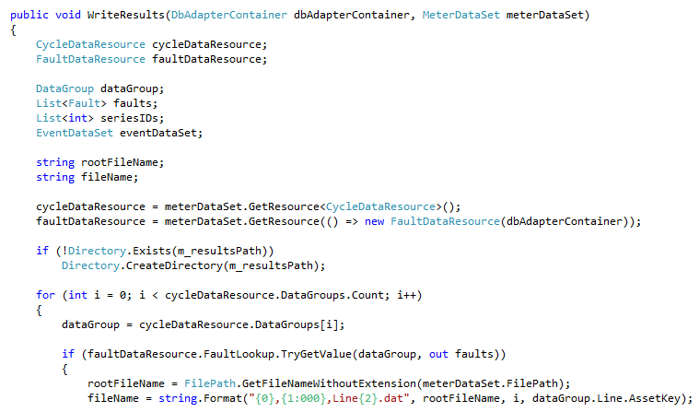
DataWriter
COMTRADEWriter
snip...

Slide 65
COMTRADE Output

Slide 66
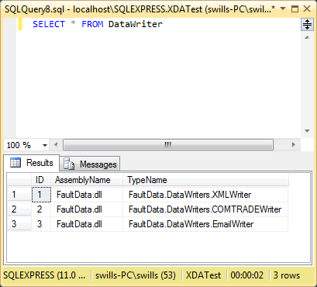
DataWriter

Slide 67
openXDA Outputs
DataOperation vs DataWriter?
DataOperation
Performs analysis
Analytic results saved in database
DataWriter
Automated notifications (e-mail, …)
File output consumable by other systems (COMTRADE, …)
…

Slide 68
DataResource
The DataResource allows you to share analytic results as well as analysis routines between DataOperations. Sharing analysis routines allows separate DataOperations to use the results of the analysis regardless of which DataOperations exist in the system.

Slide 69
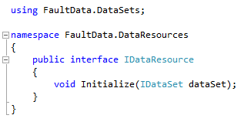
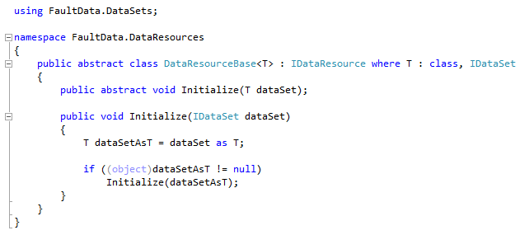
DataResource
IDataResource interface
DataResourceBase

Slide 70
DataResource
How it works:
DataOperation calls meterDataSet.GetResource().
MeterDataSet creates an instance of the DataResource and calls IDataResource.Initialize().
MeterDataSet stores the DataResource in a lookup table by type so that subsequent calls to meterDataSet.GetResource() will not run the analysis again.

Slide 71
Event Data
openXDA Data
Time Domain
Event attributes
Event segments attributes
Waveform
Frequency Domain
Cycle data – Full-set of RMS and synchronous component values for each full cycle of data on the waveform

Slide 72
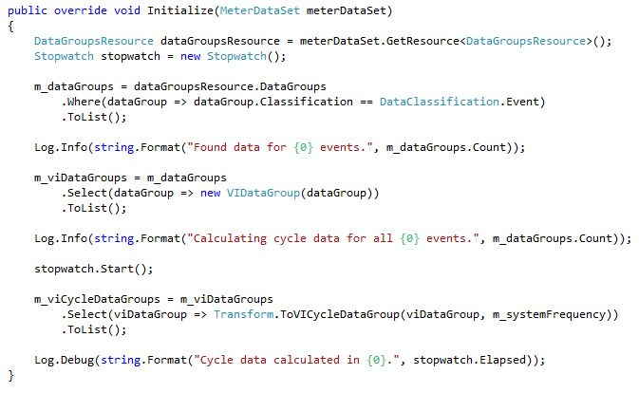
DataResource
CycleDataResource transforms the data from the frequency domain to the time domain. Any DataOperation can use the transformed data, and the analysis will only be performed once.

Slide 73
Trending Data
openXDA Data
Daily Values
Min, Max, Average
Hourly Values
Min, Max, Average
Full Resolution Values
Min, Max, Average

Slide 74
DataResource
The HourlySummaryOperation uses the TrendingDataSummaryResource to group minimum, maximum, and average values by time so that it can further group them by hour. The DailySummaryOperation does the same thing, but groups the trending data by day.

Slide 75
Highlight 4
A system settings and logging pattern makes it easy to create and configure new openXDA modules.

Slide 76
System Settings
System settings allow you to define settings in the database to configure your custom modules. System settings in openXDA are easy to use and can be changed at runtime.

Slide 77
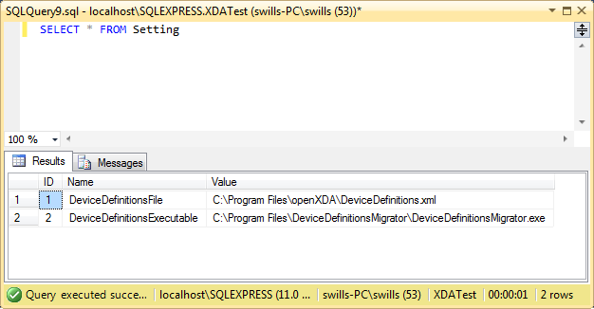
System Settings
The Setting table contains simple name/value pairs.

Slide 78
System Settings
DeviceDefinitionsLoader defines system settings via annotated properties.

Slide 79
System Settings
And that’s it!
The properties defined by the DeviceDefinitionsLoader are automatically populated based on the names of the properties, the annotations, and the data in the Setting table. This approach works with all the following constructs.
ConfigurationLoader
DataReader
DataOperation
DataWriter
DataResource

Slide 80
System Settings
Categorized settings
Settings can be placed into categories for better organization. This can help to find settings via database queries, and it can also help to consolidate settings definitions in the source code.

Slide 81
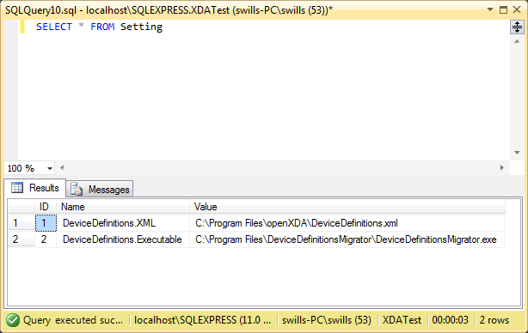
System Settings
Setting names are prefixed by their categories, separated by a ‘.’

Slide 82
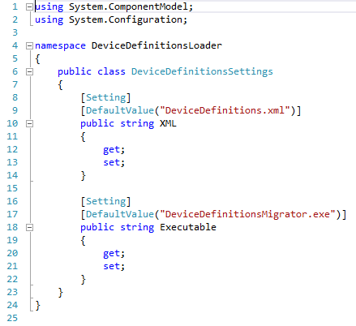
System Settings
Create a class that defines the settings category. Annotate the properties like you would with normal system settings.

Slide 83
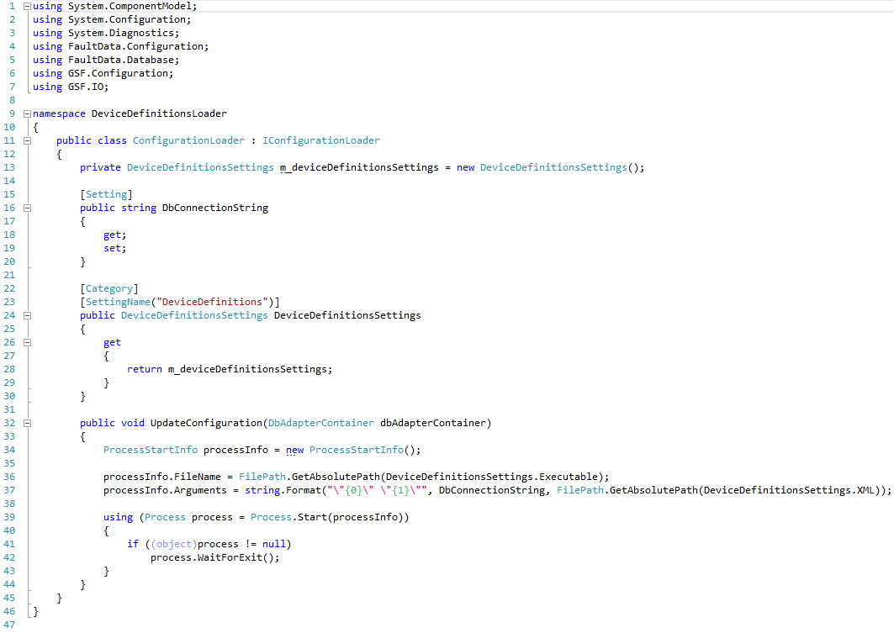
System Settings
Modify the configuration loader to annotate a property as a Category. Instantiate a member variable of the type that defines your settings category.

Slide 84
openXDA Logging
Logging allows you to provide messages back to the user for introspection into your modules’ activities.
openXDA uses log4net as its framework for generating log messages. Messages go straight to the remote system console as well as the various log files produced by openXDA.

Slide 85
openXDA Remote Admin Console
Real-time monitoring of status log
Interact with service through commands

Slide 86
openXDA Logging
Text File-Based Logging
Status Log (key messages)
Error Log
Assembly, class, method
Stack trace
Exception type and message
Debug Log – All status, most error and copious additional messages

Slide 87
openXDA Logging
Create an ILog object through which to log your messages, then call Log.Info() to log a message.

Slide 88
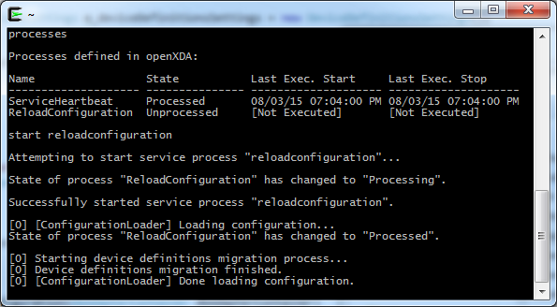
openXDA Logging
Remote system console

Slide 89
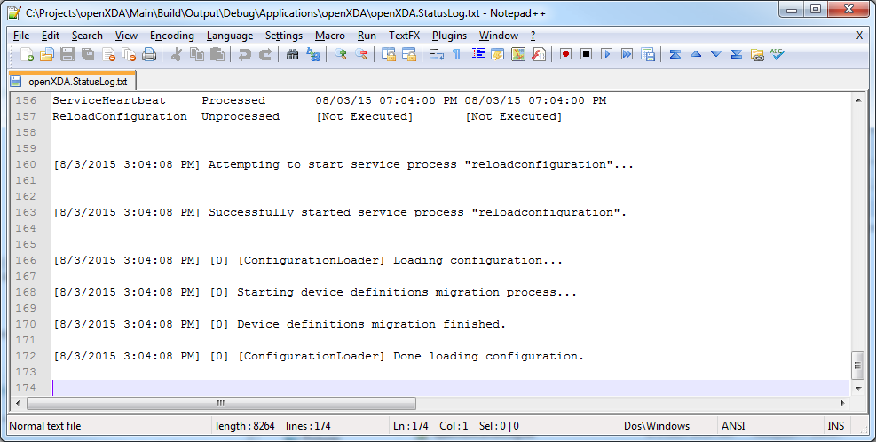
openXDA Logging
The status log logs the messages that are printed to the remote system console.

Slide 90
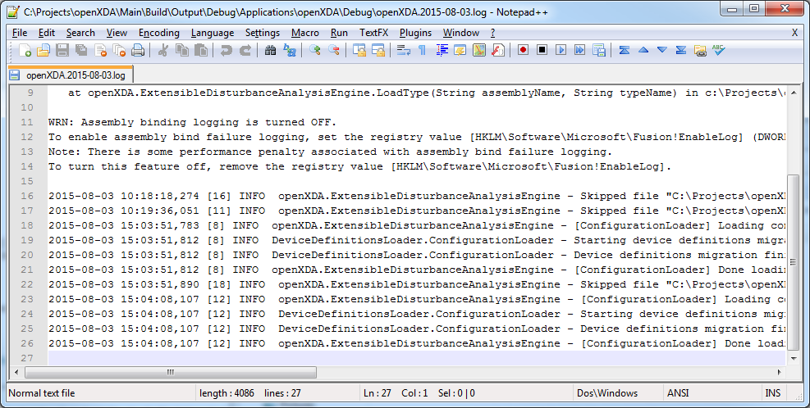
openXDA Logging
The debug log provides additional information about log messages as well as more verbose logging.

Slide 91
openXDA Logging
Log levels
log4net provides a number of log levels that can be used to log messages. Four levels are typically used by openXDA.
Log.Error() – Errors and exception handling
Log.Warn() – Warning messages
Log.Info() – Regular status messages
Log.Debug() – Debug messages
The remote system console displays different colors based on the log level.
Error = Red
Warning = Yellow
Status = White
Debug = Hidden
Debug messages only appear in the debug log.

Slide 92
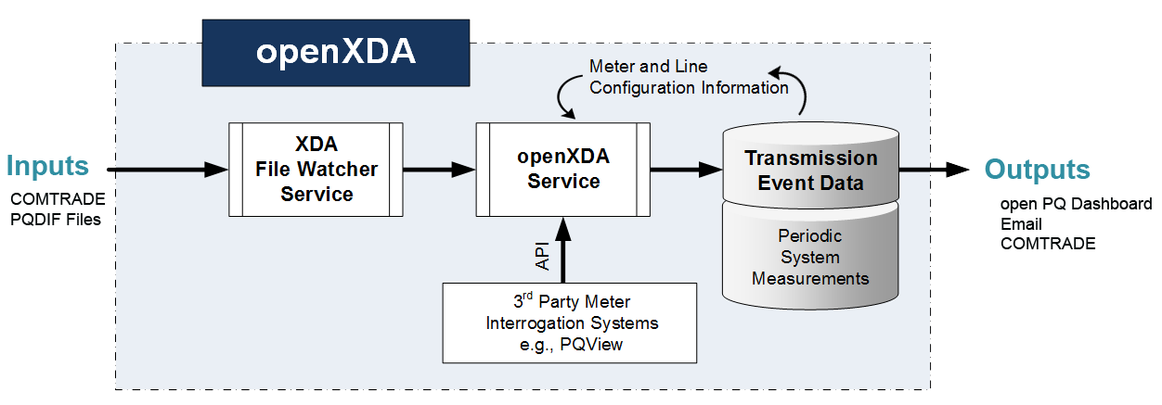
Questions ??

