Slide 1
What is GEP?

Slide 2
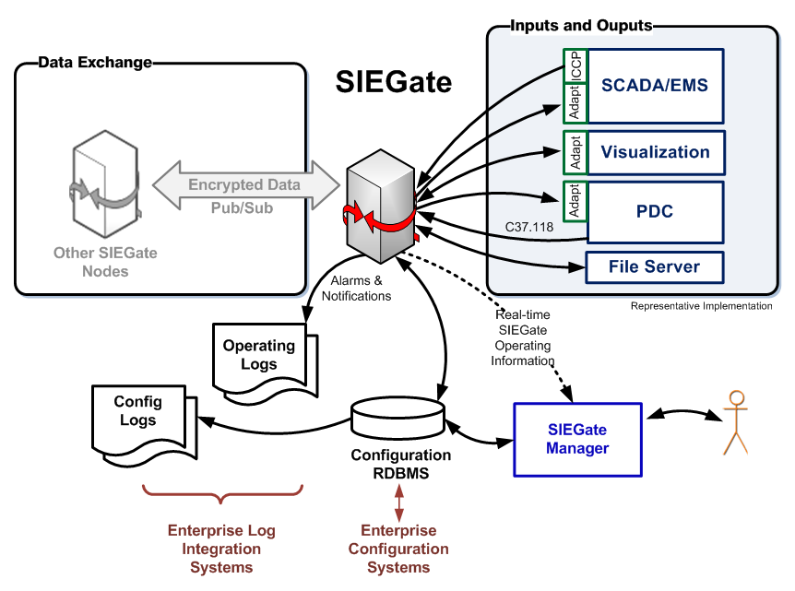
Gateway Design Challenges
Performance given system complexity
Support multiple data types efficiently and securely
Support multiple priorities
Minimize latency and maximize throughput
High availability assurance
Horizontal and vertical scalability
SIEGate stability and reliability
Graceful performance degradation
Security assurance
Maximize security performance
Minimize security breach impact
Configurable security levels
Security versus simplicity/usability tradeoff

Slide 3
Demanded a New Protocol
Highly Performant
Really fast
Really efficient
Scale to millions of points per second in a single stream
Leverage common IP transmission unit size to reduce datagram fragmentation
Non-fixed payload contents, i.e., points in one packet can be different than the next

Slide 4
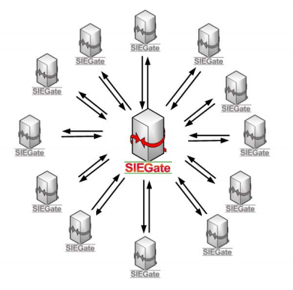
Protocol Requirements
GEP must move a continually variable set of points at low latency – to be successful, around 1 million points per second.
1 million assumes 12 associations and 100 PMUs (in and out) =
~ 0.5 M points in / sec
~ 0.5 M points out / sec
GEP supports over 4,000,000 measurements per second.

Slide 5
Gateway Exchange Protocol
Open and non-proprietary
True pub/sub, measurement-based protocol
Automated exchange of authorized metadata
Tightly-compressed, binary serialization of time-series values
ID, time-stamp, value, flags
Adapters provided in .NET, C/C++ and Java for convenient native integration in other systems
Available transports include TLS, TCP, TCP with UDP, TLS with AES key-rotated UDP, or ZeroMQ
Lossless compression is also supported.

Slide 6
Typical GEP Payload Structure*
Serialized Measurement Structure – 9 Bytes:
Unique ID 2 Bytes
Timestamp 2 Bytes
Value 4 Bytes
Quality 1 Byte
128-bit Guid ID mapped to
16-bit runtime ID
64-bit full resolution timestamp
mapped to 16-bit offset
32-bit floating point value
8-bit quality flags
Several serialized measurements are grouped together
to create a message payload. Total size is adjusted to
reduce fragmentation.
* Free form payloads also supported.
Notes:
Generally the unique ID is a Guid globally unique identifier – a 128-bit random integer that is statistically unique in the world (hence “global”).
The other common name for these values is UUID, or universally unique identifier.
Microsoft was the one that coined the term “globally” unique identifier since they felt the computer generated values with likely to be unique on Earth by the odds of having a duplicate anywhere in the universe was too high.

Slide 7
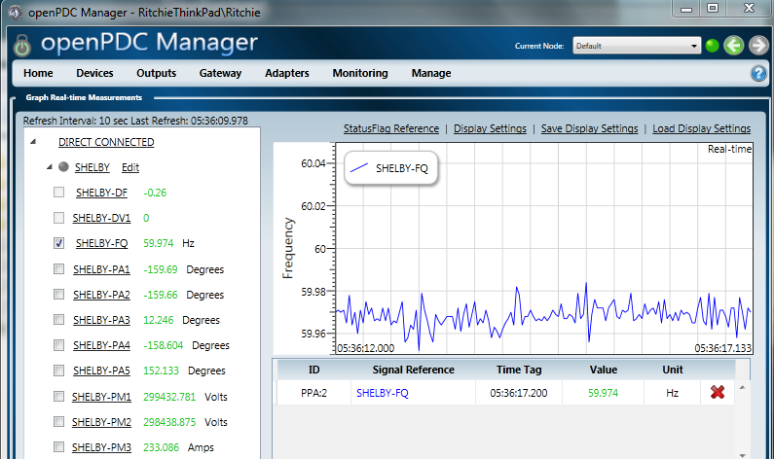
Subscribing to Measurements
Notes:
Show several screens inside openPDC where measurement “subscription” is being used.

Slide 8
Primary Data Flow
Publication APIs
Subscription APIs

Slide 9
Primary Data Flow (cont.)
Publication
APIs
Subscription
APIs
Subscription
APIs
Publication
APIs

Slide 10
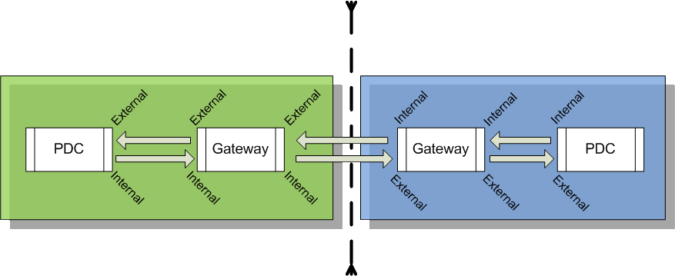
Internal/External

Slide 11
Gateway Exchange Protocol (GEP)
GEP is an extremely simple, small and fast wire format than can be used to exchange data points without a fixed predefined configuration – that is:
Points arriving in one data packet can be different than those arriving in another data packet. This can be due to each point having a different delivery schedule – or a dynamic schedule (e.g., alarms).
GEP is a signal level publish/subscribe protocol with two available channels:
Command Channel (TCP)
Data Channel (UDP or TCP)

Slide 12
Synchrophasor Data Protocol Comparisons
 | IEEE C37.118 | IEC 61850
Deployment Zones Today | Substation Control Center Inter-company | Substation Control Center
Preconfigured Data Packet Format | Yes | Yes – but client definable
Security Options | No | Yes
Signal Level Publish / Subscribe | No | Yes – but not dynamic
GEP
Control Center Inter-company
No
Yes
Yes

Slide 13
Example Interoperability Layers
Utility Layer | Example | Challenges
Inter-Reliability Coordinator | GEP | High Volume at Low Latency Dynamic Configuration
Inter-Operating Center | GEP IEEE C37.118 | Configuration Management
Control Center | GEP IEEE C37.118 | System Integration
Device / Substation | IEEE C37.118 IEC 61850 | Device interoperability Device performance

Slide 14
Simple Optimizable Structure
Measurement data is well structured and can be safely condensed into a simple data structure (per signal):
16-bit ID (established at connection)
Time (condensed where possible)
Value (32-bit real number)
Flags
A highly effective lossless data compression is optionally enabled for the time-series data:
Implements an Xor based back-tracking compression algorithm to remove repeating bytes

Slide 15
Buffer Block
Buffer block measurements define a block of data, rather than a simple measurement value
GEP can transmit buffer blocks to transfer serialized data in chunks
SIEGate uses buffer blocks for file-based transfers through GEP
Notes:
Order of data is preserved
Develop your own wire protocol on top of GEP

Slide 16
Options for Connecting with GEP
To get data “into” an application you can use GEP using a variety of API options:
C++
Java
.NET
Mono.NET
Unity 3D

Slide 17
GEP Security Modes
Transport Layer Security Mode
TCP command channel is secured using TLS – certificates exchanged out of band
Optional UDP data channel is secured using rotating keys exchanged over TLS command channel
Measurement access restricted on a per subscriber basis
Gateway-to-Gateway Security Mode
TCP command channel is secured using symmetric AES encryption – keys exchanged out of band
Optional UDP data channel is secured using rotating keys exchanged over encrypted command channel
Measurement access restricted on a per subscriber basis
Internal Access Mode (No Encryption)
Data transferred openly (ideal for internal connections or VPN transfers when connection is already encrypted)
Measurement access is unrestricted
Notes:
Back to subscriber screens to show off internal/external subscription pages

Slide 18
Steps to Exchange Data
Subscriber creates an authorization request
Generates an SRQ file
Send the SRQ file out-of-band (email, thumb drive, CD, etc.)
Publisher imports SRQ file
Authorizes subscriber to connect, but still cannot subscribe
Publisher authorizes subscriber to subscribe to measurements
Publisher can control which measurements that subscriber can see
Subscriber subscribes to measurements
Subscriber can control which measurements that subscriber needs to see

Slide 19
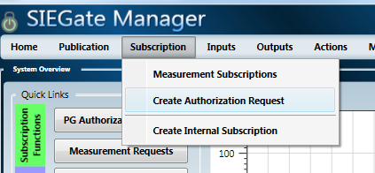
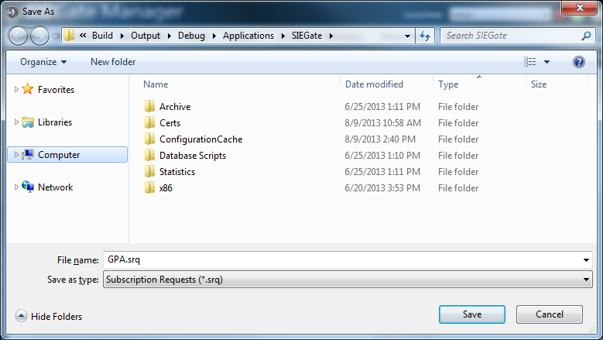
Subscriber Creates an Authorization Request
You
Me
SRQ
Email
SRQ

Slide 20
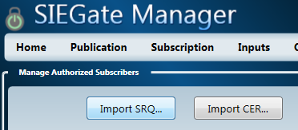
Publisher Imports SRQ File
You
SRQ

Slide 21
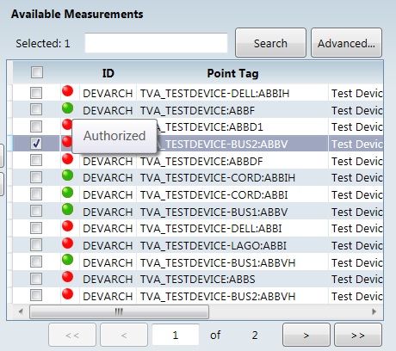
Publisher Authorizes Subscriber to Subscribe to Measurements
You

Slide 22
Subscriber Subscribes to Measurements
I’ll take the Shelby frequency, medium-rare.
You
Me

Slide 23
DataPublisher API Usage
Purpose: SEND
Initialize publisher
Attach to publisher events
Start publisher
Queue new measurements for processing

Slide 24
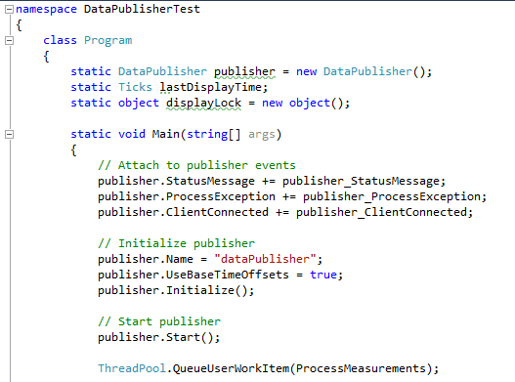
Example DataPublisher API Code
Notes:
Jump to code example in Visual Studio…

Slide 25
DataSubscriber API Usage
Purpose: Receive
Attach to subscriber events
Set up subscription info objects
Initialize subscriber
Start subscriber connection cycle
Handle new measurement data

Slide 26
Example DataSubscriber API Code

Slide 27
GEP Demo
Demonstrate GEP operation over an asynchronous .NET socket based transport using high-speed, high-bandwidth message distribution.
Notes:
GEP Subscription Tester

