Slide 1
Using ZeroMQ for GEP

Slide 2
About ZeroMQ
The “zero” in ZeroMQ
Zero Broker
Zero Latency (Low Latency)
Zero Administration
Zero Cost – Cross Platform & Open Source
Allows complex messaging exchange patterns with minimal effort
Scalable for distributed or concurrent applications
Notes:
Click on link and explore documentation…

Slide 3
ZeroMQ Benefits
Numerous language and platform integration points – all integrated and compatible
Small and light-weight with the performance to support high-volume phasor data flows
Larger variety of message patterns with a range of loss/reliability characteristics – pub/sub; client/server; brokered.
Content of the message flexible and easily accommodates phasor measurement pattern – ID, Timestamp, value, flags
In practice, ZeroMQ is used to manage the socket layer on behalf of the application
Ability to scale well is inherent in architecture -- scales easily from intra-application communication, to inter-application communication to wide-area communication

Slide 4
ZeroMQ vs. DDS
DDS
Pros: Mature "middle-ware" layer supporting mission critical apps, extensive number of options
Cons: Heavy-weight, slower, steep learning curve, no open source standards based security yet
ZeroMQ:
Pros: Many messaging patterns, extensive language implementations, fully open source with security, light-weight, faster
Cons: Lower level API, not as many features as DDS for options like discovery, delivery deadlines and QoS

Slide 5
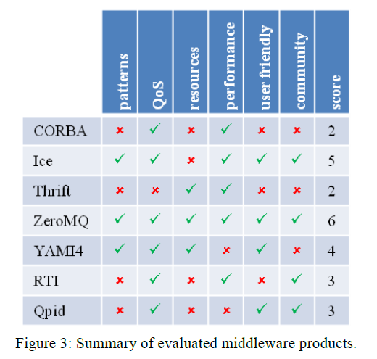
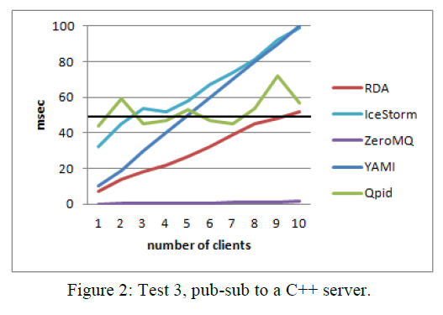
Summary of CERN* Evaluated Middleware
* A. Dworak, F. Ehm, W. Sliwinski, M. Sobczak, CERN, Geneva, Switzerland, 2011

Slide 6
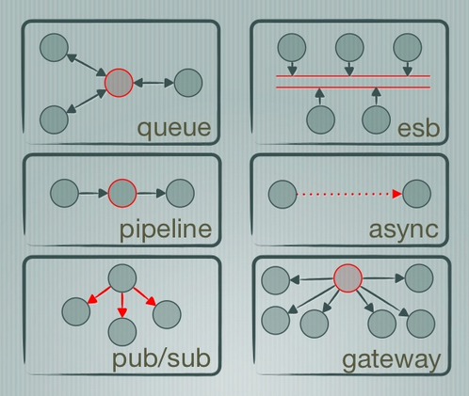
Message Patterns
PUB /
SUB
ROUTER /
DEALER

Slide 7
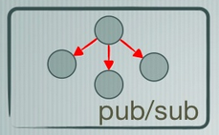
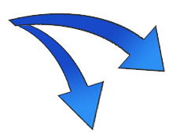
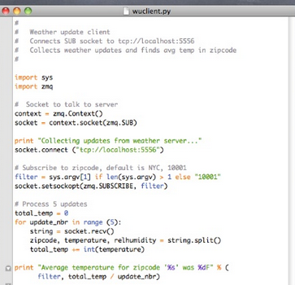
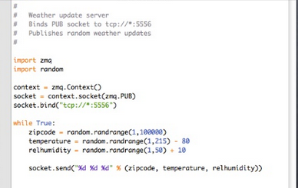
The Coding Pattern
Sub
Pub

Slide 8
GSF ZeroMQ Implementation
Implemented the ROUTER – DEALER ZeroMQ pattern as a standard client / server streaming data transfer implementation.
Allows for all support ZeroMQ transport protocols
TCP
In-Process (e.g., named pipes)
Pragmatic General Multicast (PGM)
Encapsulated PGM

Slide 9
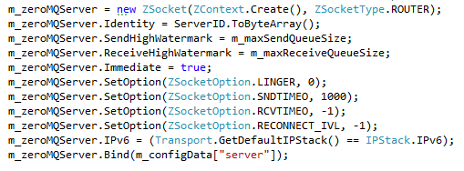
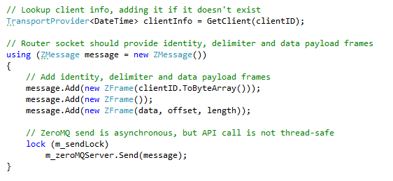
ZeroMQ Example Code (from GSF)
Setup ZeroMQ:
Route data to client:

Slide 10
ZeroMQ Observations
Excellent for distribution of simple messages
Also supports stateful-style message protocol operations, but can require extra work
Patterns and classes exist to make multi-threading with ZeroMQ simple, but API itself is not thread-safe
Security, called CURVE, is now baked-in and is easy to “turn on”
Low-level library is surprisingly fast and can have performance benefits over other socket implementations on IoT style hardware.

Slide 11
ZeroMQ Threading Patterns
Calls into the ZeroMQ API library are not inherently thread-safe
ZeroMQ uses patterns for simplifying multithreading

Slide 12
Thanks !

