Slide 2
Version 1.0 - Major Deployments
TVA
Entergy
PG&E
Dominion
Every openPDC installation (via stats and/or active phasor archive)

Slide 3
Version 1.0 - Current State
Stable, mature product optimized to store time-series data
Millisecond time-resolution
32-bit floating point values (with quality)
Consumption limit around 100 PMUs (200,000 points per second per instance)
3x real-time replay speed
Supports master/slave metadata modes
GPA has deployed the historian with the openPDC -- no standalone installation
File format identical to TVA DatAWare in use since mid-90s at TVA generation facilities

Slide 4
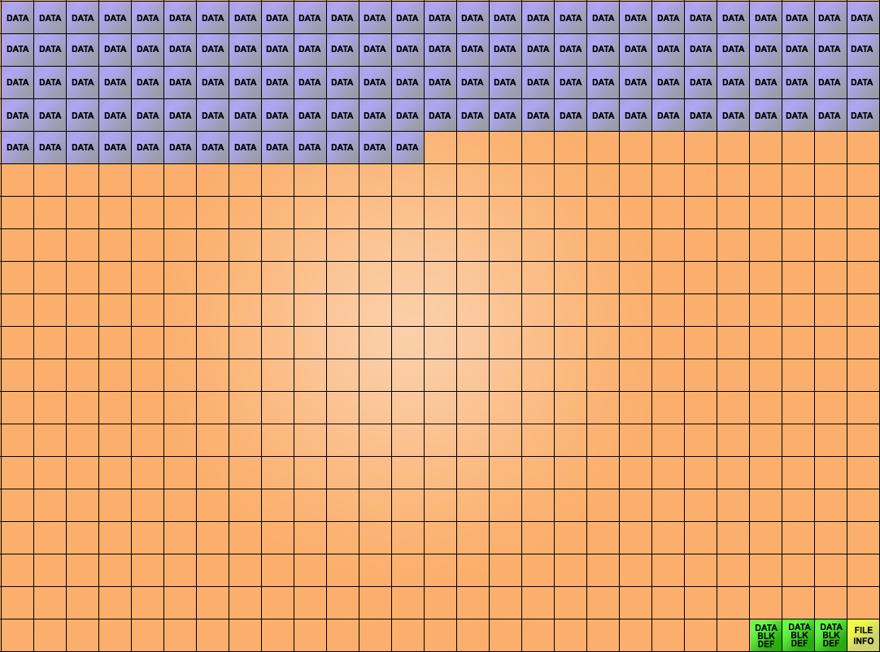
Version 1.0 File Format
Data blocks (8K typical) unique to a point ID and starting time. Data is 10 byte series of (time offset (msec), quality flags, 32 bit floating point value). Values in a data block are assumed to be written in monotonically increasing time offsets. Block Definition contains the pointID (Int32) and start time (milliseconds since 01/01/95). File Info holds file stop and end time as well as block count.
File sizes are typically about 1.5 GB.

Slide 5
System Components
Version 1.0
openHistorian 1.0 TVA DatAWare
Protocol Parsers
ARCHIVER
Web Services
Socket API
SERVER
Configuration
File API
Socket-based Applications
Mimic
App
DatAWare Client
Excel Plug-In
Extraction Tool
Trending Tool

Slide 6
TVA Method to Distribute Data
Version 1.0
A prepositioned messaging service approach
A DLL is created and compiled into both the openHistorian and all applications that consume this message.
Message delivery is via socket connection using serialized data
Data is pushed to the application (other methods used for request/reply, e.g., web services and the legacy socket API)
Server side configuration of points and message structure to be distributed via encapsulated DLL with associated XML configuration file

Slide 8
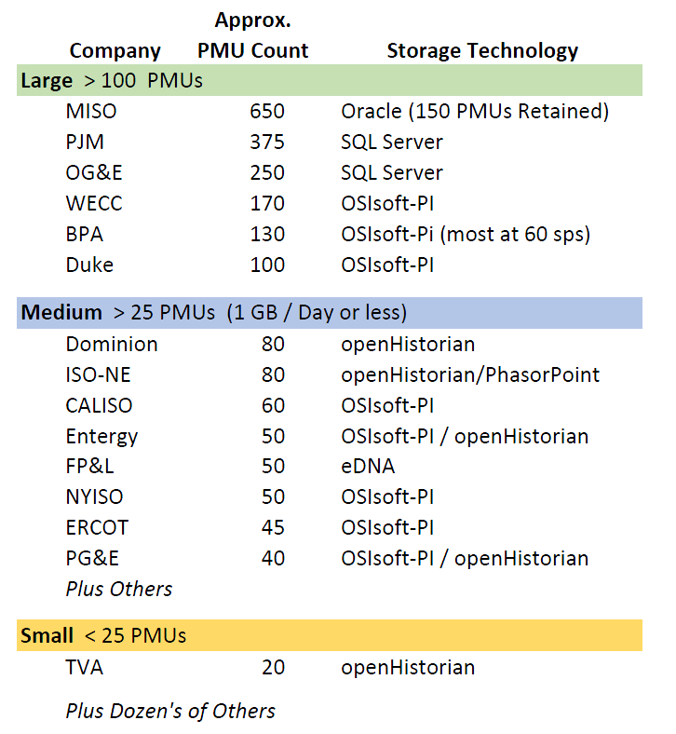
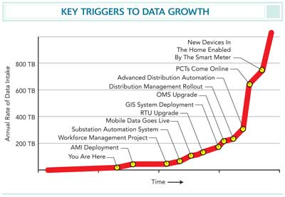
Case Study – Phasor Data One of “Big Data” Sources from the Grid
Grid data expected to grow rapidly in complexity and scale.
September 2014

Slide 9
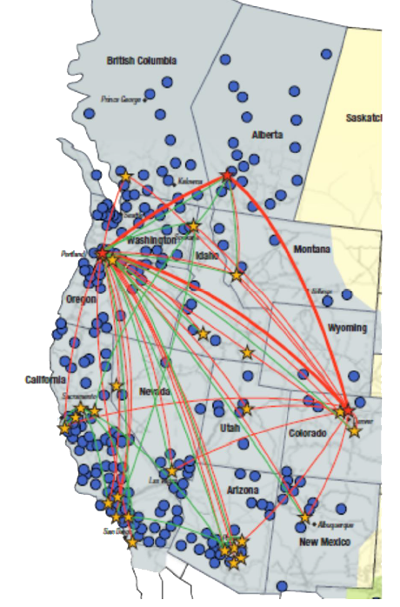
WISP Project Lessons Learned
Availability and accuracy of the data
Data mining tools for information extraction
Difficulty in deploying a common naming convention
Upgrading first releases of vendor products to CIP security standards
Applications unproven (finding and working out the bugs)
Integrating old PMUs and PDCs
Applications stressed by large data volumes

Slide 10
A new data layer must support:
High performance processing of time-series data
For both data archiving and retrieval modes
High frame rate application refresh / Quick app response time
Fast extraction of large data block – e.g., a day’s data
An expanded set data types (e.g., doubles, strings, complex values, etc.) while maintaining low storage requirements
GPS precision time stamping
Ability to insert data out of sequence
Lossless data compression
Improved Interfaces
High-speed socket-based API for data access
GEP based pub/sub real-time data subscription

Slide 11
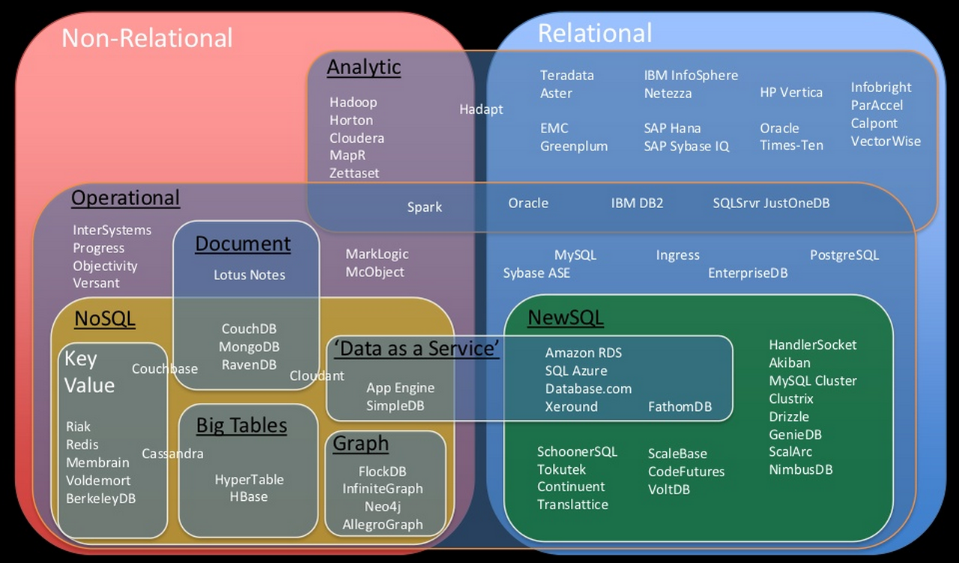
Big Data Problem – One Size Doesn’t Fill All
Source: Infochimps, May 2012
Notes:
GPA has experience in using Hadoop to manage and parallel processes Historian 1.0 data
Hadoop is a good solution to get quick results from analytics that span long time-periods, e.g., last year’s data.
However, this is not currently a common mode of utility analysis and Hadoop adds considerable overhead and complexity to support interfaces to current utility analytics.
Existing NoSQL do not have the continuous archiving performance necessary for synchrophasor data
Points per second of ingest
Data queries per second
Points per second of export
Repository size

Slide 12
The Solution – GPA’s SNAPdb Library
Serialized
NoSQL
ACID Compliant
Performant
Housed within GPA’s Grid Solutions Framework

Slide 13
What is ACID?
SNAPdb Implements ACID to protect data integrity.
Atomicity - requires that database modifications must follow an "all or nothing" rule. Each transaction is said to be atomic
Consistency - ensures that any transaction the database performs will take it from one consistent state to another
Isolation - refers to the requirement that no transaction should be able to interfere with another transaction at all
Durability - that once a transaction has been committed, it will remain so
Notes:
Brush over
Missing it

Slide 14
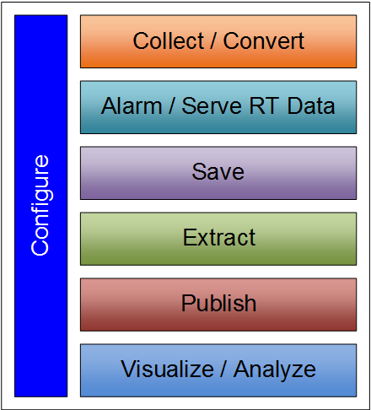
openHistorian 2.0 Components
API allows adapters to be developed for data inputs
Recent data served with very low latency from memory
High performance data storage with lossless data compression
Tools provided for historical data extraction
Both publish / subscribe and web services interfaces
Planned companion tools allow users to view and export data
Configuration is integrated across openHistorian processes and can itself be integrated other configuration information data sources.

Slide 15
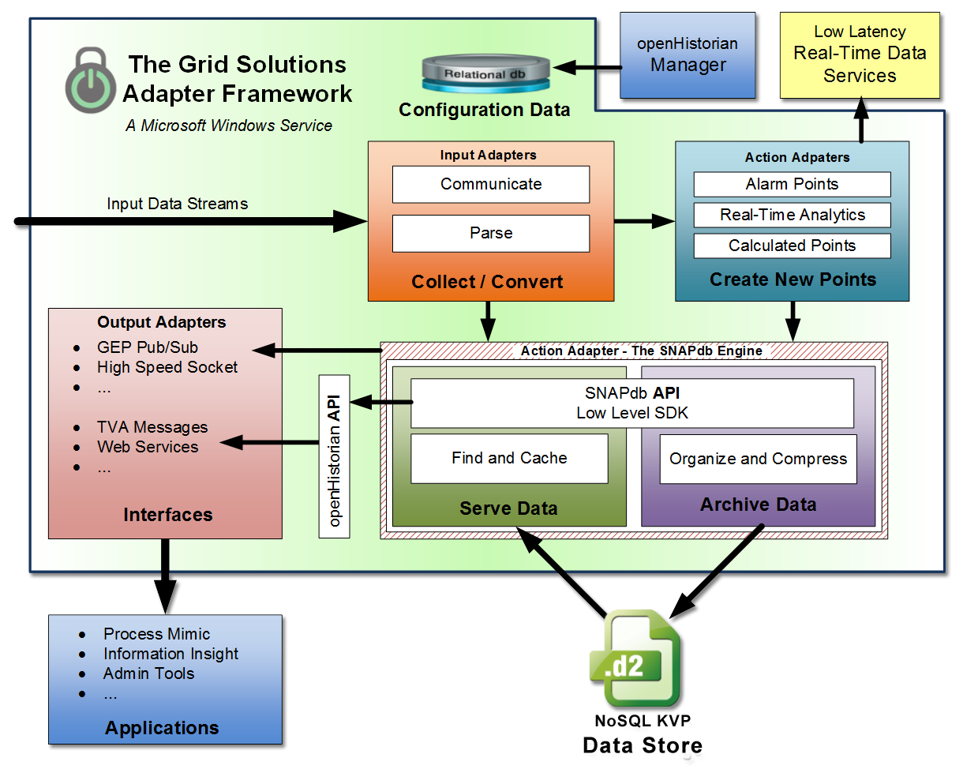
The openHistorian Leverages the GSF

Slide 16
System Components
Protocol Parsers
Intermediate Files
Action Adapter
GEP Pub/Sub
Write Cache
ARCHIVER
periodically
MongoDB API Mirror
SNAPdb SDK
SERVER
Read Cache
.d2 File Reader
Web Services
openHistorian API
Bulk Data Extraction
Custom Output Adapters
Interfaces
KVP Data Store
Configuration
Administrator's Console
openHistorian
Process Mimic
openHistorian
Information Insight
openHistorian Information Insight Excel Plug-In
openHistorian Manager
Enterprise User Client
Administrator’s Client

Slide 17
SNAPdb Data Structure
B+Tree based that supports out of sequence insertion
Time support to +/- 100 nanoseconds (ticks) (with extended time precision fields available)
Data can be of any type that can fit in 192-bits (for example, float32, float64, complex32, complex64, int32, int64, uint32, uint64, char and string16)
Data stored sequentially in compressed 4K structures
Tested and optimized for phasor data

Slide 18
SNAPdb’s Key-Value Pair
Key is a join of PointID and Time
Value can be up to 192-bits*
Example format for the openHistorian:
Key
Value
Time Flags
DATA
Quality Flags
10 Bytes V1
48 Bytes V2
Ticks**
Point ID
Ext Prec.
64 bits
64 bits
64 bits
64 bits
64 bits
64 bits
(unencoded)
* 192-bits is used by the openHistorian as the size of values and keys – this is not a restriction of the SNAPdb.
**1 Tick = 100 nanoseconds
Time Flags = duplicate entry counter (for DST), leap second, etc.
The 64-bit PointID is normally not referenced at the user level. Rather a GUID is assigned through configuration as well as primary and alias Tags.

Slide 19
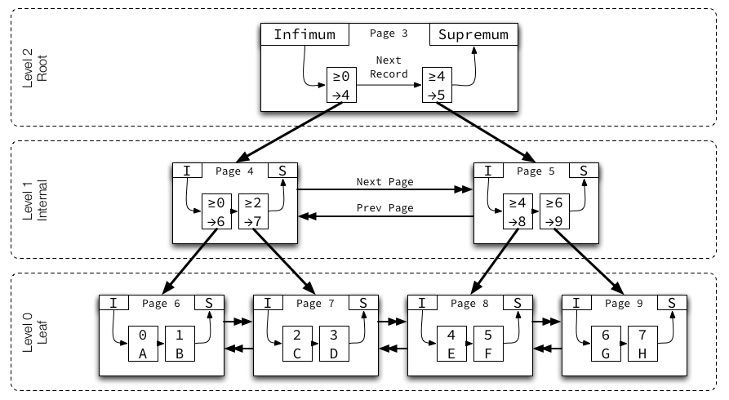
B+Tree Overview
Tree grows from the bottom up
Leaf-nodes contain blocks of sequential data
Nodes are doubly linked and point to previous and next node
Tree indices are unsigned 32-bit integers which require internal-nodes to support large trees

Slide 20
SNAPdb’s B+Tree
The leaf node of data is encoded and decoded dynamically to optimize memory and storage
Implementation operates directly from disk without requiring an in-memory data structure
The data encoding process is used to implement lossless data compression
Notes:
Not your normal B+Tree

Slide 21
.d2 File Format
The .d2 file contains a table of contents, a B+Tree header and nodes: a root node, internal nodes and leaf nodes
Node Structure
Version #
Node Level
Record Count
Bytes Used
Left Sibling
1 Byte
1 Byte
2 Bytes
2 Bytes
4 Bytes
Right Sibling
Lower Key
Upper Key
Data Block
Footer Block
4 Bytes
24 Bytes
24 Bytes
4000+ Bytes
32 Bytes
Notes:
* A .d2m metadata file is produced no more frequently than daily and at least once per month and saved along with the .d2 files to insure that the state of system configuration rides along with the data so that it can be easily incorporated with data migration and backup processes.

Slide 22
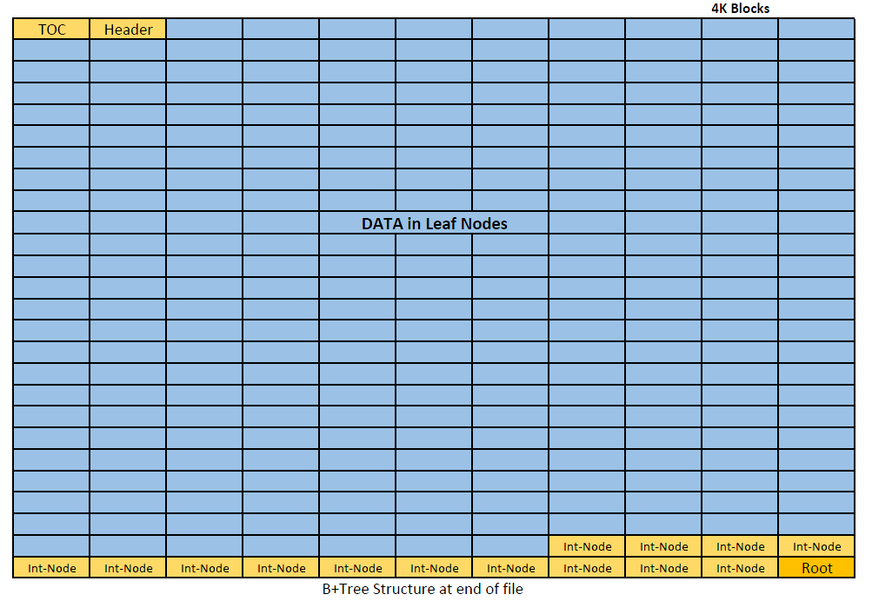
The .d2 file Data Block is a B+Tree Collection of 4K Leaf Nodes

Slide 23
.d2 File Creation Process
Real-time – Recent data cache
Stage 1 – Flushes real-time cache to disk (10 second default)
Stage 2 – Consolidates Stage 1 files (created based on either size or time constraints)
Stage 3 – Create final .d2 archive file (created based on size constraints)
LOCAL RESOURCES
________________
SHARED
Recommended size 2GB

Slide 24
System Metadata Files
Enables the .d2 files to be independent of master configuration systems
Association of .d2 and .d2m files provides meta-data versioning over time
Associates internal openHistorian 2.0 key (a long integer) with its configuration GUID
Contains the value’s fundamental meta data
Data Type
Measurement Units
Preferred Tag
Short Description

Slide 25
GSF Input Adapters / Protocol Parsers
GSF input protocol parsers are all included with the openHistorian as part of the SNAPdb’s integration with the framework
The supported protocols include:
DNP3
IEEE C37.118
IEC 61850-90-5
CSV
OSI-PI
IEEE 1344
BPA PDCstream
SEL FastMessage
UT F-NET
COMTRADE

Slide 26
Summary – Version 2.0 Improvements
Fast
In-memory cache for very high speed extraction of near-real time data
Low data insertion lag time
High-speed API for historical data extraction
Reliable
ACID-based system design objectives -- with emphasis on “durability”
File structure resistant to data corruption
Expanded Use Capability
Out-of-time-sequence inserts allowed
Transaction-like data updates allowed
Loss-less data compression
More data types
Better interfaces
Notes:
Why does fast matter – speaking points – reduces size of server-farm
Why does size matter – disk cost factors
Disk I/O improvements – cost savings

Slide 27
Version 2.0 - Current State
Early Beta version released (and in pre-production use at OG&E, TVA and by UT’s CURENT center)
Testing, Bug Fixes and Benchmarking in progress
Source code available from codeplex:
http://openhistorian.codeplex.com

Slide 28
openHistorian API
Archive and read support for data – historical and real-time with low latency – for point selection over time-range
Updates and deletes could be implemented – but are purposely not enabled for the historian use case
Multiple data types
Socket or local files implementations
Interval based data retrieval options – enables high-speed data zooming
Server-side data filtering

Slide 29
Data Read API
// Example:
var enumerator = GetHistorianData("127.0.0.1", "PPA", DateTime.UtcNow.AddMinutes(-1.0D), DateTime.UtcNow)
// API:
IEnumerable<HistorianMeasurement> GetHistorianData(
string historianServer,
string instanceName,
DateTime startTime,
DateTime stopTime,
string measurementIDs = null)

Slide 30
Data Write API
// Example:
WriteHistorianData("127.0.0.1", "PPA", measurements)
// API:
void WriteHistorianData(
string historianServer,
string instanceName, IEnumerable<HistorianMeasurement> measurements)

Slide 31
Also – SQL Server Adapter
Can query trending data from within SQL Server using SQL CLR adapter:

