Slide 1
What’s new at GPA?

Slide 2
GPA’s Open Source Products
PMU Connection Tester – Version 4.5.5
openPDC – Version 2.1.120 SP1
SIEGate – Version 1.1.147
openXDA – eXtensible Disturbance Analytics – Version 1.3
Synchrophasor Stream Splitter – Version 1.0.7
SubstationSBG – Version 1.0.126
openSEE – Disturbance waveform viewer
BrocolliSharp – .NET for the Bro Communications Library
Project Alpha (source code only)
EPRI open PQ Dashboard – Version 0.7 [Beta] Available - Release 2015
openHistorian 2.0 – Version 2.0.199 [early Beta] Available - Release 2016
PDQ Tracker – Version 0.8.11 [Beta] Available - Release 2016
ARMORE – Super IDS for Substations - Release 2016
MIDAS – Meter Information Data Acquisition System - Release 2016
Products actively under development …
August 5, 2015

Slide 3
So What’s Else Is New?
The Web Site

Slide 4
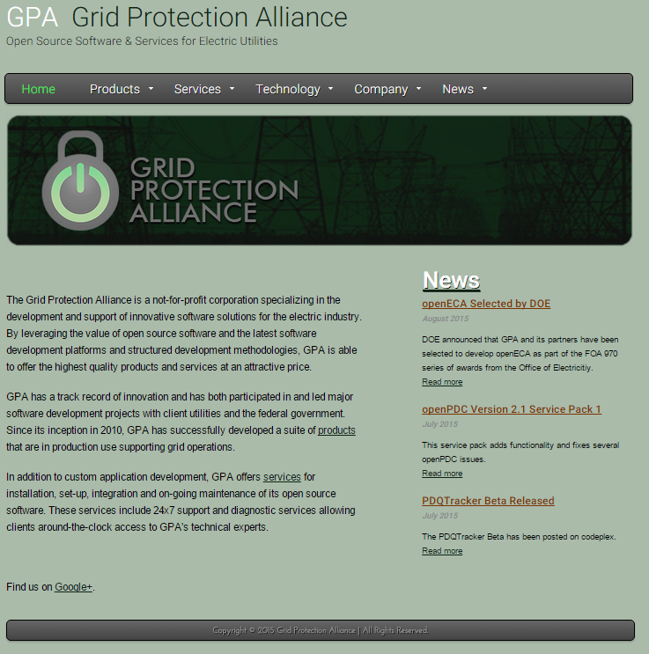
New GPA Web Site

Slide 5
So What’s Else Is New?
The Web Site
Use of MIT License / Moving to GitHub
Synchrophasor Product Roadmap

Slide 6
Planned Phasor Software Improvements
Version 2.2 openPDC March 2016
openHistorian 2.0 Support
C37.118.2 Protocol Production Tested
UI Improvements (esp. alarm config)
Version 3.0 openPDC Release Candidate Fall 2016
Restructuring of TSL / synchronization engine
Routing and management of abstract objects

Slide 7
So What’s Else Is New?
The Web Site
Use of MIT License / Moving to GitHub
Synchrophasor Product Roadmap
Leveraging ZeroMQ to standardize GEP
DOE Announcement of openECA Funding

Slide 8
DOE FOA 970

Slide 9
GPA’s Partners
Dominion Virginia Power
Southwest Power Pool
Oklahoma Gas and Electric
Virginia Tech
T&D Consulting Engineers (Montana Tech)
Bonneville Power Administration

Slide 10
Objective – Connecting Phasor Data to Tools
To significantly accelerate the production, use, and ongoing development of real-time decision support tools, automated control systems, and off-line planning systems that incorporate high-fidelity synchrophasor data.
Simplified implementation of end-to-end configuration and change management
Identification and management of bad data
Capability to easily integrate with existing legacy systems
Data management and storage designed for phasor data volume and speeds
Development of a “standard” analytics interface

Slide 11
Approach
Leverage GPA’s production-grade open-source code base to create an open source tool under a permissive license
Enable secure data exchange using SIEGate
Create a multi-tier bad data detection and correction system
Provide a “Common Analytics Interface” (CAI) that includes the concept of a Phasor Value Collection (PVC)
Assure generalization and test use of CAI and PVC at five utility partner locations – and seek more demo locations
Include full-featured alarming services
Provide an extensible set of platform displays

Slide 12
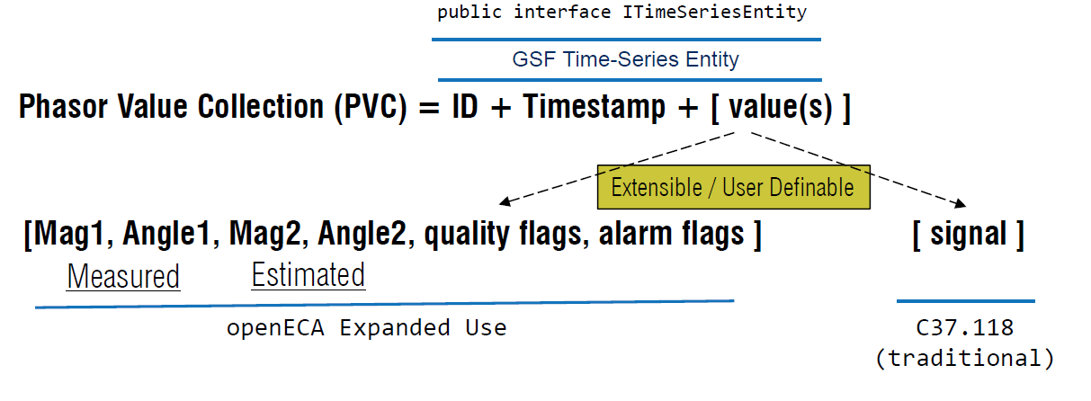
Configuration and Use Simplification
Phasor Value Collection
Enables publication/subscription of data of any type
Includes useful common types – e.g., a complex value (phasor)
Includes complex user defined types – an array of complex values

Slide 13
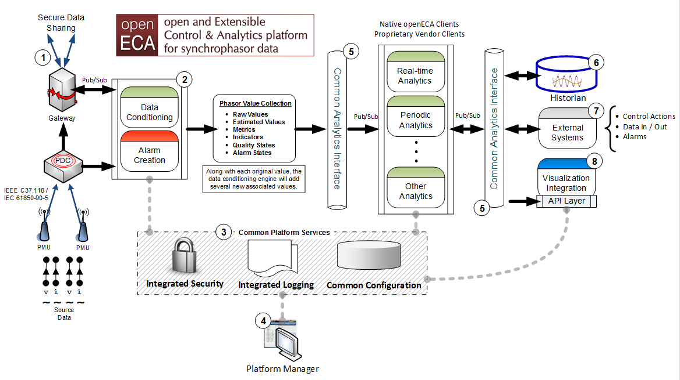
Architecture

Slide 14
Project Provided Analytics
Real-Time Analytics
Oscillation Detection Monitor (ODM)
Oscillation Mode Meter (OMM)
Topology Estimation
Control Analytics
Wide Area Volt-Ampere-Reactive (VAR) Control
Off-Line Analytics
Dynamic PMU Transducer Calibration (Automated, Periodic Use Case)
Line Parameter Estimation (Ad-Hoc Use Case)
Synchronous Machine Parameter Estimation (Automated, Periodic Use Case)
Acceleration Trend Relay (ATR) Improvement (Research Use Case)
Plus – Natively Included Linear State Estimation

Slide 15
Thanks !

