Slide 1
DFR Downloader
Theo Laughner, PE
Presented at GPA User Forum
August 5, 2015
Notes:
Tips:
Presentation title should be Arial font, 40 points
Title on this slide should be kept short and on a single line
All fonts throughout presentation should be Arial font
The TVA Color Palette theme color is already selected in TVA’s template

Slide 2
Overview
Background
Tool Overview
Questions
Notes:
Tips:
Slide title should be Arial font, 32 points
Title should be kept short and on a single line if at all possible

Slide 3
Background
~1300 Metering Devices
DFR
PQ Meter
Revenue Meter w/PQ Capability
Multiple Download Frequencies
Daily
Hourly
Sub-Hourly (every minute in some cases)

Slide 4
Data Quantity
DFR
251 Devices
~80 Channels / Dev
~3 MB / Event
1 Event / Day
> 750 MB / Day
> 20k Channels
PQ / Revenue Meter
1069 Devices
474 Trends / Dev
~3 MB / Day
144 Points / Day
> 3200 MB / Day
> 506k Trends / Day

Slide 5
Data Comes In Only When There Is An Event

Slide 6
Data Flow – State 1
Every stakeholder is downloading the data.
Every stakeholder needs connectivity to the monitor.
Every stakeholder needs the software to view the records.
Every record is duplicated on each stakeholder’s computer.
Notes:
Automated analysis of records impossible.
Low security.
Data duplication.
Redundant effort to download files.
Multiple tools to manage.

Slide 7
Data Flow – State 2
Single stakeholder is downloading the data.
Single stakeholder needs connectivity to the monitor.
Every stakeholder needs the software to view the records.
No records are duplicated on each stakeholders computer.
Notes:
Automated analysis of records difficult (multiple file formats).
Better security.
No data duplication.
Minimal redundant effort to download files.
Somewhat difficult to manage. (Multiple software tools to retrieve data).

Slide 8
Data Flow – State 3
Automated process is downloading the data.
Multiple users can queue out of band downloads.
Stakeholder needs only a COMTRADE file viewer to view the records.
No records are duplicated.
Automated processes can analyze files.
Notes:
Automated analysis of records easy(single file formats).
Better security.
No data duplication.
Minimal redundant effort to download files.
Somewhat difficult to manage. (Multiple software tools to retrieve data).

Slide 9
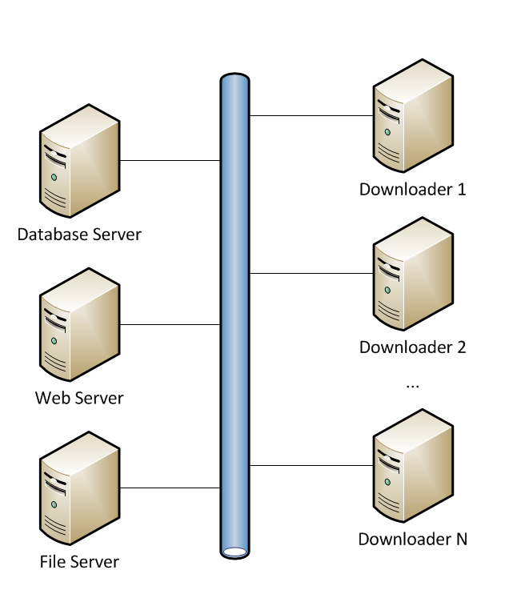
Tool Overview
4 Components
SQL Database
File server
Web based admin tool
Downloader (1 or more)

Slide 10
Tool Overview (Continued)
Connects to Devices via dialup or Ethernet
Once connected, the following occurs:
Downloads/Compares Configuration Files
Downloads new fault records
Converts files to COMTRADE
DFR Compatibility:
APP 501/601
BEN 5000
EMAX FAXTRAX

Slide 11
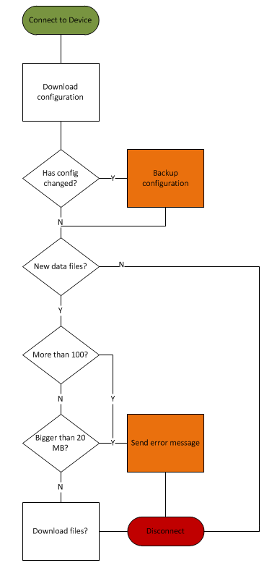
Back End Interface
Performs The Following:
Checks for new scheduled activities
Checks for manually entered activities
Connects to the devices
Downloads the files
Has watchdog to automatically restart, if necessary.

Slide 12
User Interface - Overview
Provides
Configuration Mgt
Sites
Schedules
Queue
Queue Status
Error Log
Quick Access To Files

Slide 13
User Interface - Sites
Users can add or
remove sites from
the list.
Users can add
sites to the queue
for download.

Slide 14
User Interface - Queue
Users can add or
remove sites from
the queue.
Users can modify the
priority of items in
the queue.

Slide 15
User Interface - Schedule
Users can create a
schedule.
Users can select
DFRs for one or more
schedules.

Slide 16
User Interface - Files
Users can navigate
to the file server
where downloaded
files are stored.

Slide 17
Future Work
Check clock synchronization
Turn back end into a service

Slide 18
Questions?

