Slide 1
openXDA at Dominion
Kyle Thomas, Robert Orndorff - Dominion
Ling Wu – University of Tennessee
Stephen Wills – Grid Protection Alliance
Presented at the
2015 Grid Protection Alliance
User’s Group
August 5, 2015

Slide 2
What is openXDA?
Open source analytics for COMTRADE files
Currently analyzes waveform data for fault location information
Architecture allows for other analytic “plug-ins”.

Slide 3
What is openXDA?
openXDA is an extensible platform that automatically processes and analyses event files from disturbance monitoring equipment such as DFRs and power quality monitors. openXDA runs as a back-office service watching for new event files (and/or changes in event data within meter polling databases). openXDA produces emails and raises alarms based on meter data quality and/or the nature of the system event that triggered the meter. Among the automated functions provided by openXDA is determination of fault type and location.

Slide 4
Why use openXDA?
We have automatic DFR record retrieval. Data is just waiting to be analyzed.
Field devices (DFRs and relays) typically use just one algorithm to determine fault location.
Independent fault location calculation, i.e. more diverse sources of fault locations.
Research into performance of various fault location methods for different fault types.

Slide 5
Dominion Traditional FL Method
Step 1
Download event records and fault summaries from DFRs, TWS, Digital Relays
Step 2
Check for lightning correlation
Step 3
Open event records in viewer and perform manual FL analysis
Step 4
Compare all results, use engineering judgment to determine best FL to provide to field personnel

Slide 6
Dominion Traditional FL Method
Step 3
Open event records in viewer and perform manual FL analysis
This step takes largest amount of time (assuming Step 1 is automated), but it is critical to getting good FL results, especially when:
DFRs and/or Relays fail to auto-calculate FLs
DFRs and/or Relays fail to auto-calculate FL in fault window
FL algorithms in the DFRs and/or Relays have significant errors under certain fault types or conditions

Slide 7
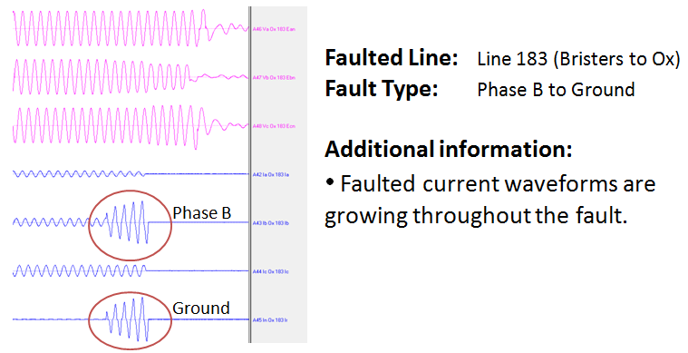
Dominion Traditional FL Method
openXDA can really help automate the manual process of Step 3
Here is our manual process for Step 3:
3A: Open event record(s) in viewer.
3B: Identify and select the faulted waveforms:

Slide 8
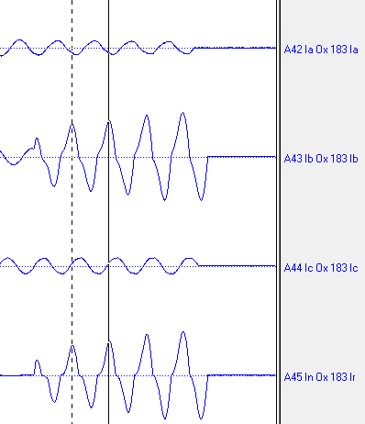
Dominion Traditional FL Method
3C: calculate a FL using one algorithm at a specific point in the fault window

Slide 9
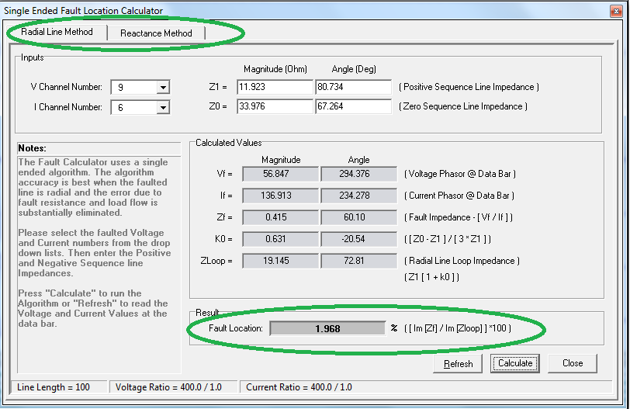
Dominion Traditional FL Method
3D: use all available algorithms to produce FLs at the same point
[Currently 3 algorithms available in WaveWin]
Ex: Reactance Algorithm 1 = 1.968% * 23.54 miles = 0.46 miles from Ox

Slide 10
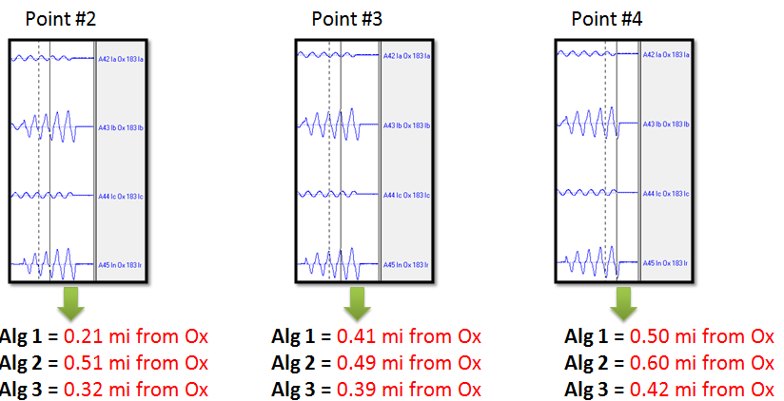
Dominion Traditional FL Method
3E: repeat steps 3C and 3D using different points along the fault

Slide 11
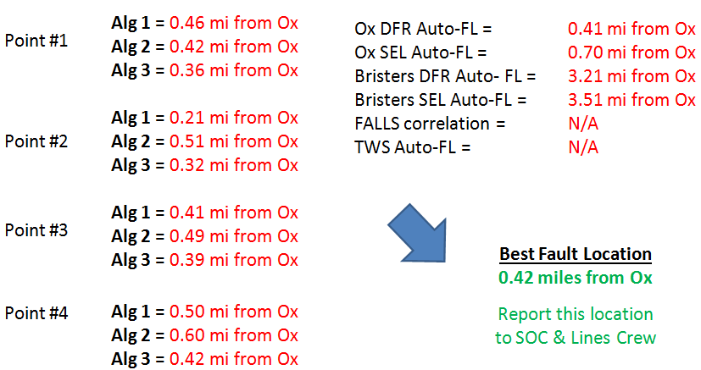
Dominion Traditional FL Method
3F: Use engineering judgment to compare all results and find the best FL

Slide 12
Dominion Traditional FL Method
Problems with this manual FL process:
Takes time, 15+ minutes, to collect all results for analysis
Small number of results
Only 3-5 algorithms used. We have identified 9+ FL algorithms
openXDA is designed to calculate fault locations across an entire event record with all available FL algorithms, automatically
Instead of spending time making results, spend that time (or save that time) by analyzing the fault with all the results

Slide 13
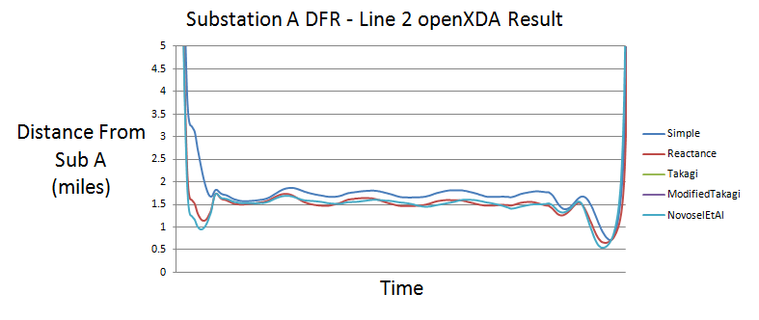
openXDA – FL across entire record
Fault Curves with all algorithms
Instead of picking a few points in the fault window, openXDA will calculate the FL (with all algorithms) across the entire fault window

Slide 14
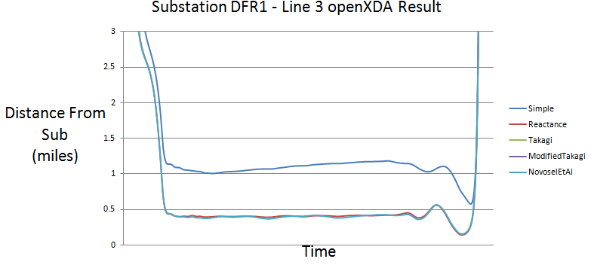
openXDA – FL across entire record
Provides as many FL results as possible
Can be used with all available algorithms, and any future algorithms developed
Can help identify when algorithms should and should not be used (or which algorithms should be avoided entirely)

Slide 15
openXDA – Automation
openXDA will produce these FL results automatically
The application watches a folder, and any new Comtrade file added to the folder or subfolder will be detected and processed by openXDA
It will go through all line groups in a file and look for a fault
If a fault is detected on any line, openXDA will run through the calculations on the faulted lines and produce the FL curves
Data is saved to a SQL database, so plots can be made with Excel
But that took time to plot in Excel…
So we dreamed up the idea of having an openXDA COMTRADE Results File
For any line that a fault is detected, take the original waveforms and the FL curves and create a new COMTRADE file

Slide 16
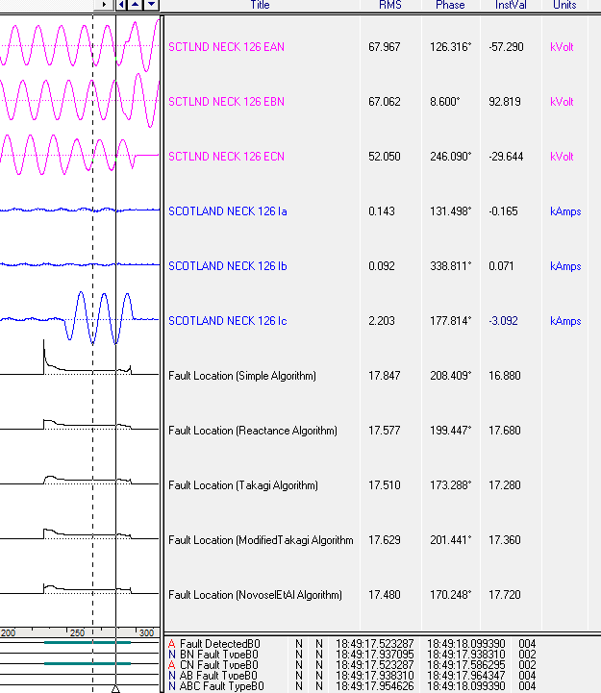
openXDA – Results
openXDA COMTRADE Results File

Slide 17
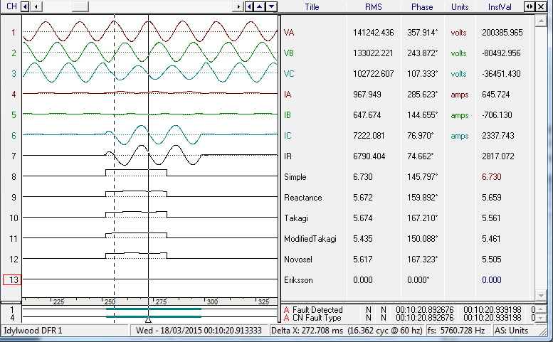
openXDA – Results

Slide 18
Evaluation Case 1 = Line 126
Fault Type = Phase C to Ground
Actual fault location = 18.50 miles from Earleys
Traditional FL result = 17.70 miles from Earleys
openXDA FL result = 17.75 miles from Earleys
Notes:
For my part of job in this program, the purpose is to evaluate openXDA performance on the fault location calculation. We use several COMTRADE data of real Dominion fault cases for openXDA calculation, and compare the openXDA results with the actual locations we found in the field. For example, in this first fault case, which occurred on line 126, phase C to ground fault. In this picture, it shows us the results of fault location calculation with openXDA. we use all 5 algorithms to calculate separately, y axis represents the distance fault from the substation. As the trend drops, and keeps flat for a specific period of time, the fault occurs around this area during this period. When breakers trip, fault current disappears, the curve goes up.
So in this picture, this area shows us a typical fault. The y axis value for the flat area is the result of calculation. The results of all 5 algorithms are close. The algorithms correlate very well. As shown in this pic, the average result of openXDA calculation is approximately 17.75 miles away from Earleys substation. To compare with the actual location 18.5 miles, and the result obtained using the traditional method, 17.7 miles, the result of openXDA is closer to the actual location, and it is more accurate.

Slide 19
Evaluation Case 2 = Line 247
Fault Type = Phase A to Ground
Actual fault location = 0.58 miles from Suffolk
Traditional FL result= 0.40 miles from Suffolk
openXDA FL result= 0.48 miles from Suffolk
Notes:
In the second fault case, on line 247, Phase A to ground fault, the results of different algorithms are very close. The result of openXDA is more reasonable than the traditional one.

Slide 20
Evaluation Case 3 = Line 271
Fault Type = Phase A to Phase B
Actual fault location = 0.83 miles from Fentress
Traditional FL result= 1.00 miles from Fentress
openXDA FL result = 0.70 miles from Fentress
Notes:
In the third fault case, Line 271, Phase A to Phase B fault, the plot shows us the result of openXDA is close to the real fault location, and it matches the result of traditional method.

Slide 21
Evaluation Case 4 = Line 2034
Fault Type = Phase B to Phase C
Actual fault location = 1.39 miles from Trowbridge
Traditional FL result= 1.56 miles from Trowbridge
openXDA FL result= 1.60 miles from Trowbridge
Notes:
In the fourth fault case, Line 271, Phase B to Phase C fault, the plot shows us the result of openXDA is also close to the real fault location, and it matches the result of traditional method.

Slide 22
Evaluation Case 5 = Line 2118
Fault Type = Phase C to Ground
Actual fault location = 4.24 miles from Landstown
Traditional FL result= 3.37miles from Landstown
openXDA FL result= 3.41miles from Landstown
Notes:
In the 5 fault case, Line 2118, Phase C to ground fault, the result of openXDA is closer to actual fault location, even better than the result of traditional method.

Slide 23
openXDA – Future
Work to do
Integrate results with the 6th Man reporting system
Research into best placement in waveform for accurate locations
Which part of the fault waveform is best for accurate results?
Statistical analysis over a window of measurements or pick one really good place to do the calculation
Research into best algorithms based on fault type and/or operating conditions
High impedance faults
Weak source
Radial / network conditions
Get other utilities participating in developing openXDA further
This work benefits everyone (that wants to take advantage of it)

Slide 24
openXDA – Future
Extensible is the key
Double-ended FL Algorithm
Any new algorithms identified/developed
Automatically choose only the best algorithms based on OE
Automatically read DFR config files for line groups
Create a report with screenshots and statistical analysis
Extend beyond just FL. Any triggered COMTRADE record could inform you of something significant, such as a pending failure
Harmonic analysis
Waveform recognition (ex: failing CCVT)
Transient analysis
Oscillations

Slide 25
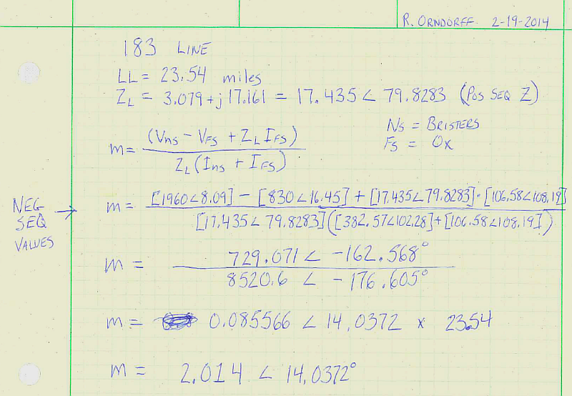
Manual calculation – easy example

Slide 26
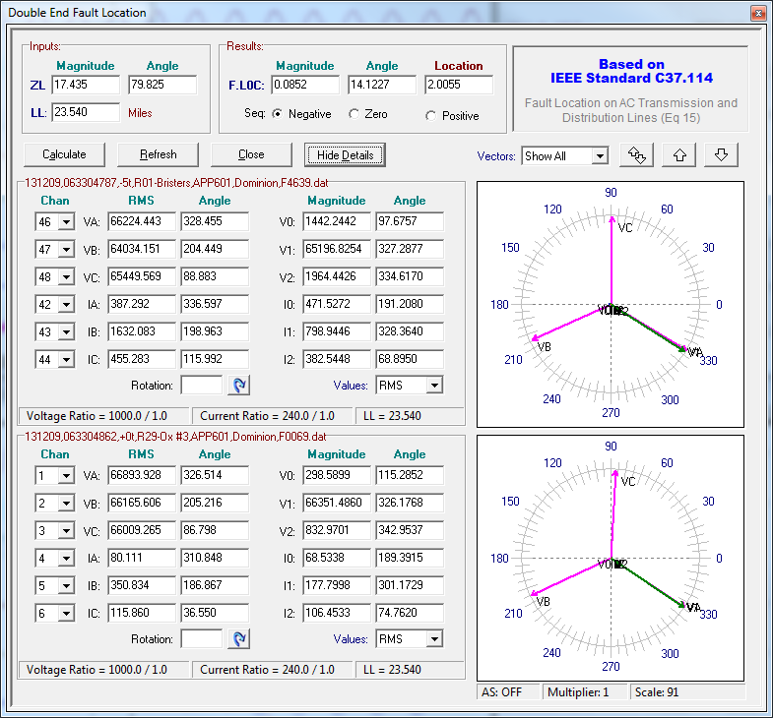

Slide 27
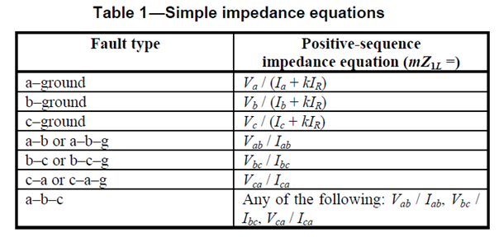
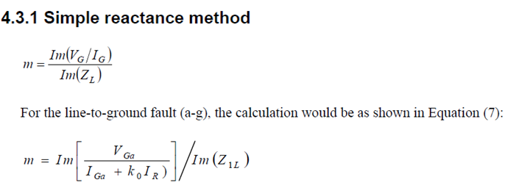
So many algorithms…
From
IEEE C37.114
From
IEEE C37.114

Slide 28
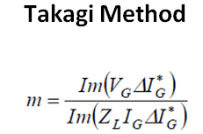
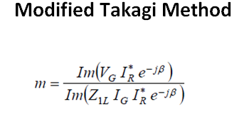
So many algorithms…
From
IEEE C37.114
From
IEEE C37.114

Slide 29
So many algorithms…
From
IEEE C37.114

Slide 30
So many algorithms…
From
IEEE C37.114

Slide 31
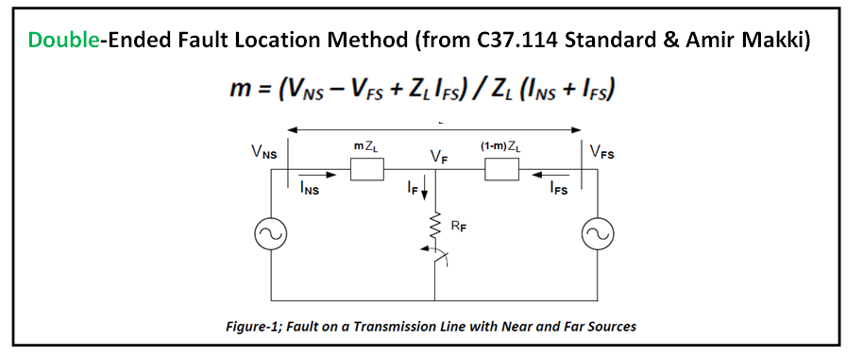
So many algorithms…

Slide 32
openXDA at Dominion
Kyle Thomas, Robert Orndorff - Dominion
Ling Wu – University of Tennessee
Stephen Wills – Grid Protection Alliance
Presented at the
2015 Grid Protection Alliance
User’s Group
August 5, 2015

