Slide 1
eTerra Phasor Analytics openHistorian Integration
Vijay Sukhavasi
Atlanta,Georgia
08/05/2015

Slide 2
MetaData and Actual Data
Gateway Exchange Protocol
Obtain MetaData(Configuration)
openHistorian API
Get Actual Data(Downsampled and Raw Data)

Slide 3
openHistorian API Features
Downsampled Data
Obtain Data at lower resolutions(1f/sec,1f/10sec etc)
Full Resolution data
30 or 60 frames per second
Contiguous Regions
Data Availabilty,Data gaps

Slide 4
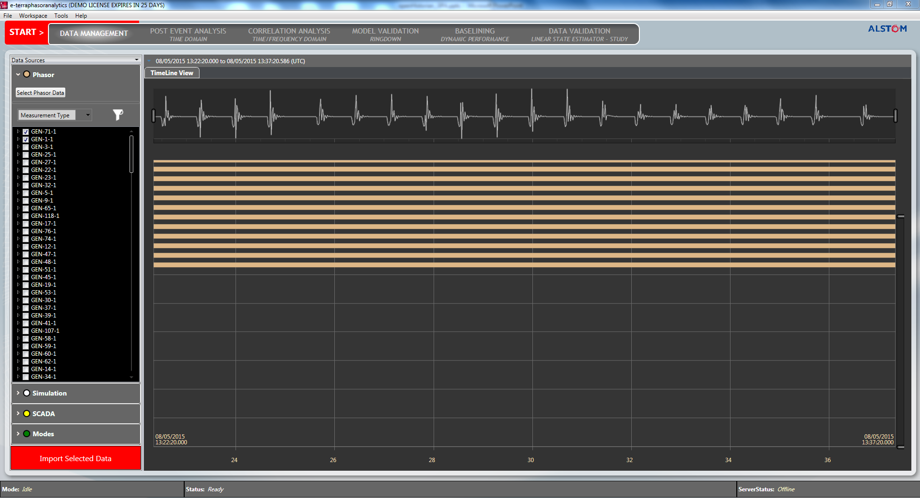
Data Availability and Preview

Slide 5
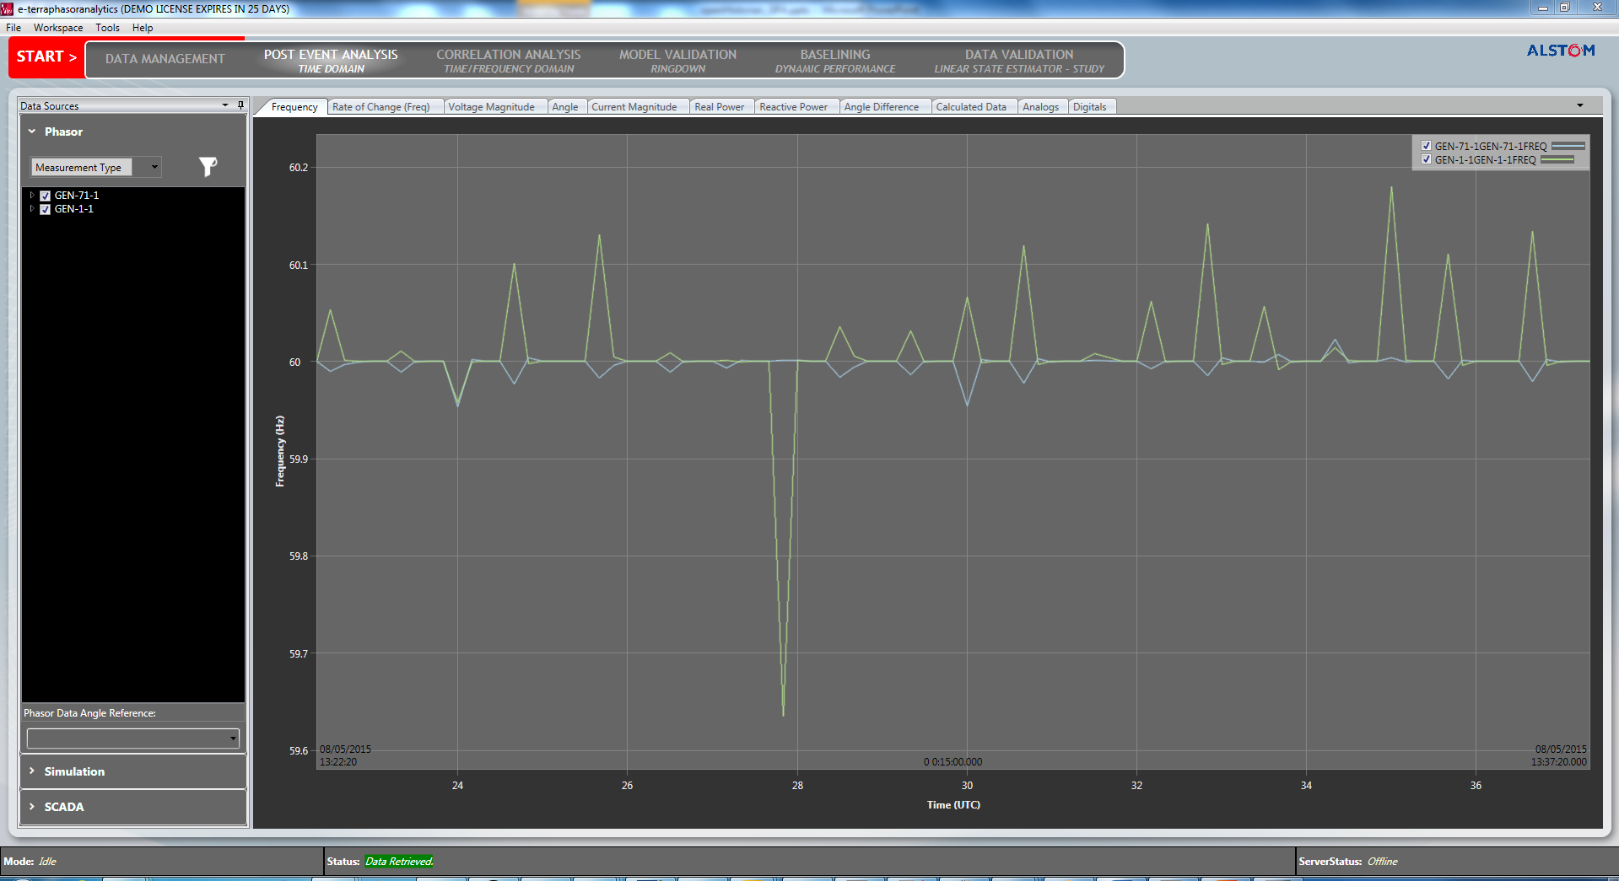
Downsampled Data

Slide 6
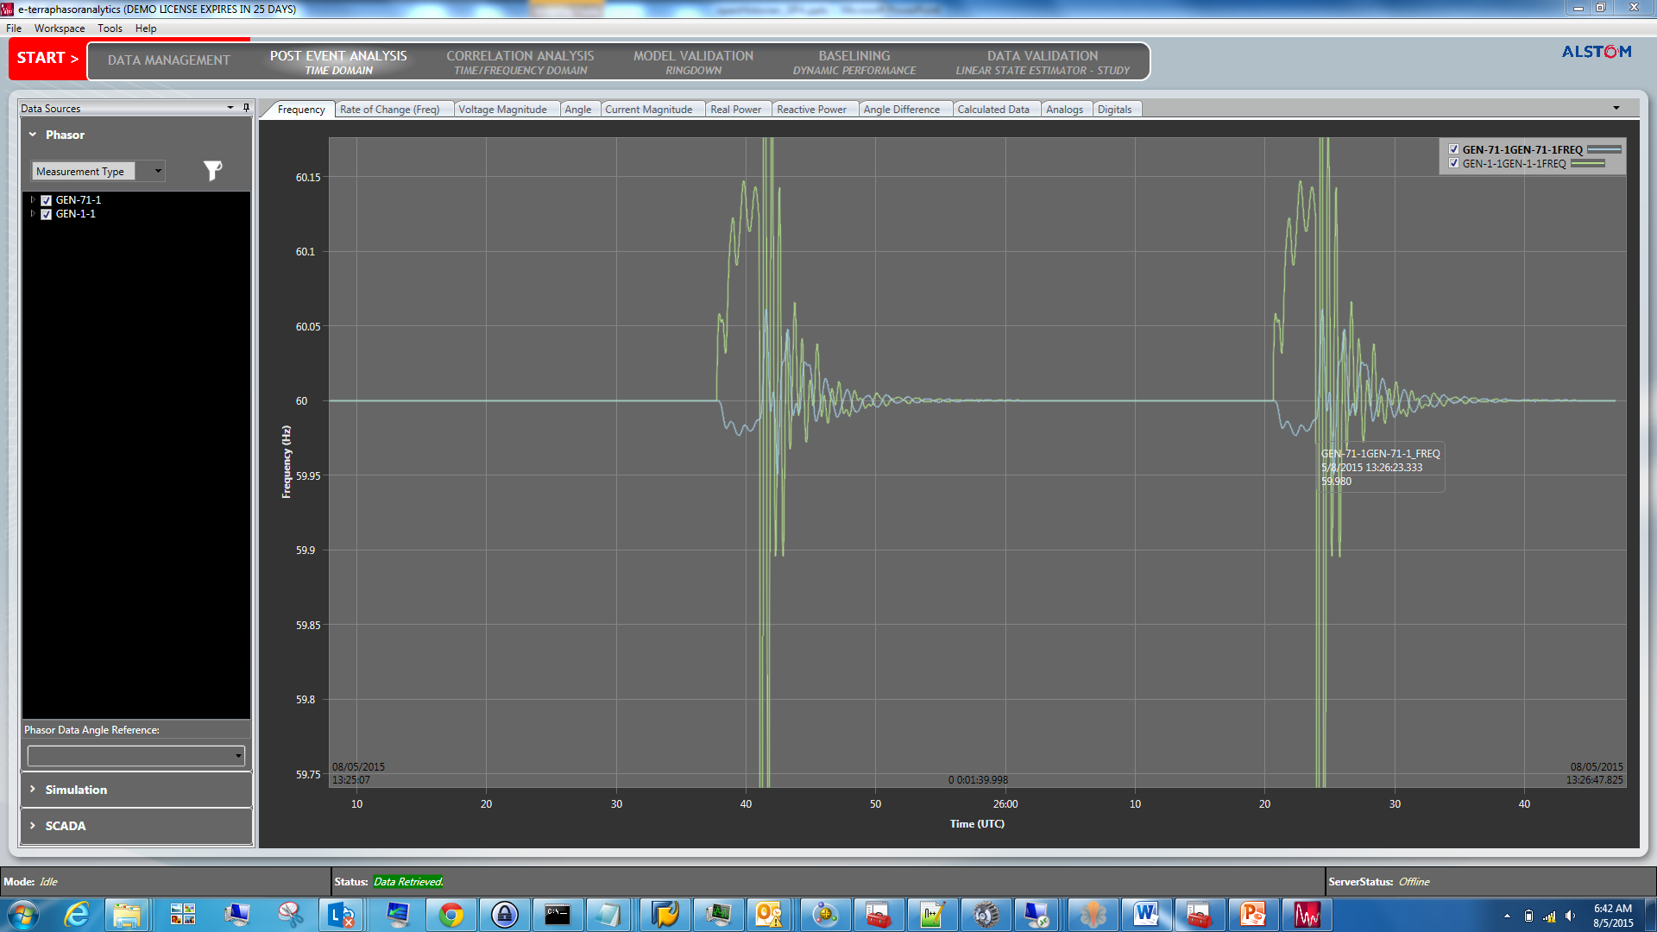
Full Resolution Data

Slide 7
openHistorian API Future Integration
Data Quality Information
Bad Data Detection
Time Quality Information
Digitals

