Slide 1
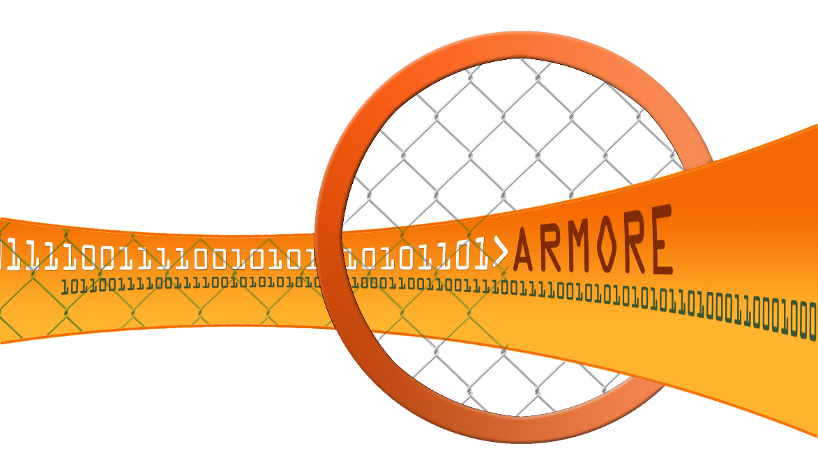
ARMORE
Applied Resiliency for More Trustworthy Grid Operation

Slide 2
Motivation for ARMORE
Industrial Control Systems (ICS) protocols lack security protection
Security bolt-ons are typically implemented via firewalls and VPNs
Little if any visibility as to what these systems are actually doing
Any security extensions have a long-tail implementation path (or never at all)
Deployments are often much more costly than the capital expenditures

Slide 3
ARMORE Design Objectives
Security appliance to
Increase visibility and awareness on ICS networks
Augment insecure protocols with security features
Inspect and (optionally) enforce defined policies
Minimize deployment costs while creating a feasible adoption path

Slide 4
Major Software Components
Design
Operating System – Linux
Debian Wheezy 7.8 x64 - Modified 3.12.0 Linux Kernel
Bro - INSPECTOR – Dynamic Traffic Analyzer
NetMap
Kernel Module for High Speed Packet I/O
MANAGER - Administrator’s Interface
Bro – ENFORCER - Policy Enforcement
PROXY (new GPA OSS)
Transparent data stream encapsulator
ZeroMQ with Curve security
Copious logging
Core Components
For Active Modes Only
Notes:
Here we basically explain what core software makes up an ARMORE Node
Wheezy is a vanilla installation with just a modified 3.12 Linux Kernel.
3.12 was the minimum we needed to make things work on the networking side with NetMap.
We right now support just Broccoli. Broker is being tested, but is mentioned in the future work slides

Slide 5
Implementation Options
Design
Passive Mode
Span port
Transparent Mode
Inline inspection, optional enforcement
Encapsulated Mode
Inline inspection, encapsulated transfer with optional encryption, optional enforcement

Slide 6
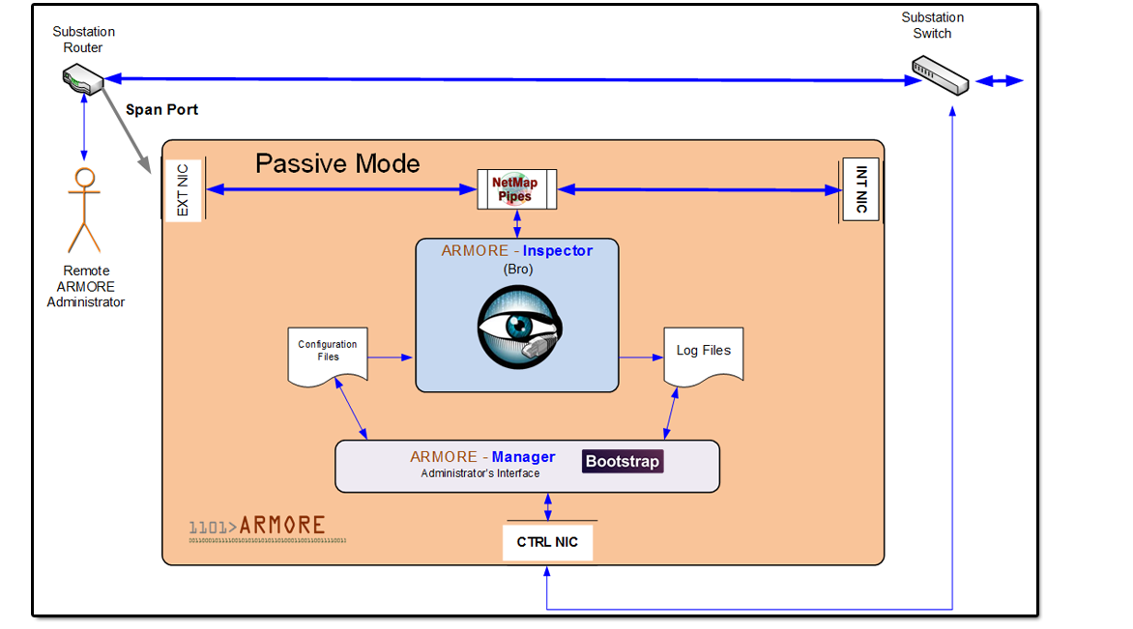
Passive Implementation
Design
Payload inspection
Network visibility and intelligence
Network analytics enablement

Slide 7
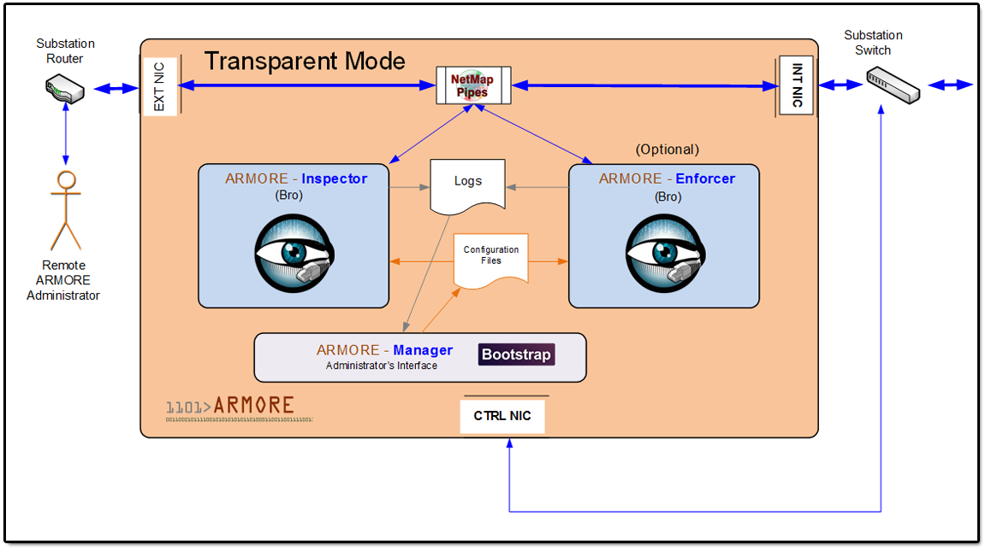
Transparent Implementation
Design
Passive plus…
Communication endpoints operate without any changes
Optional policy enforce- ment

Slide 8
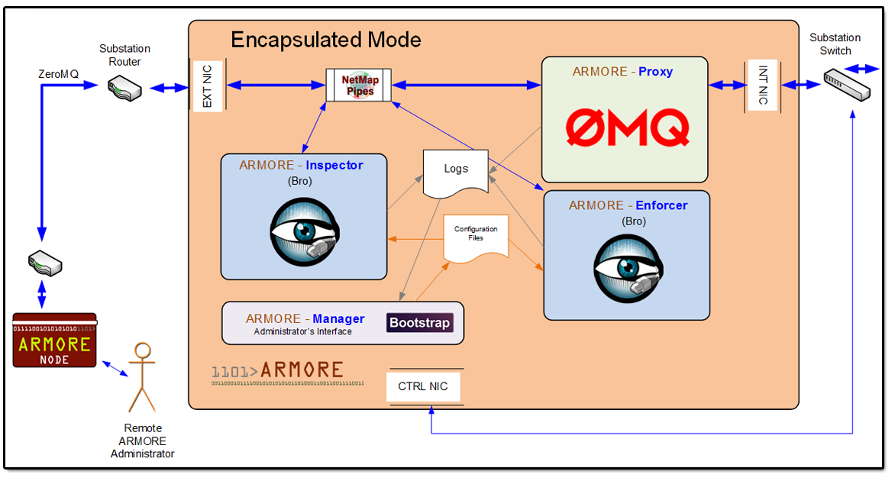
Encapsulated Implementation
Design
Transparent plus…
Encapsulation and encryption
Security augmentation (access filtering)
Optional policy enforce- ment
Fault tolerance and resiliency options

Slide 9
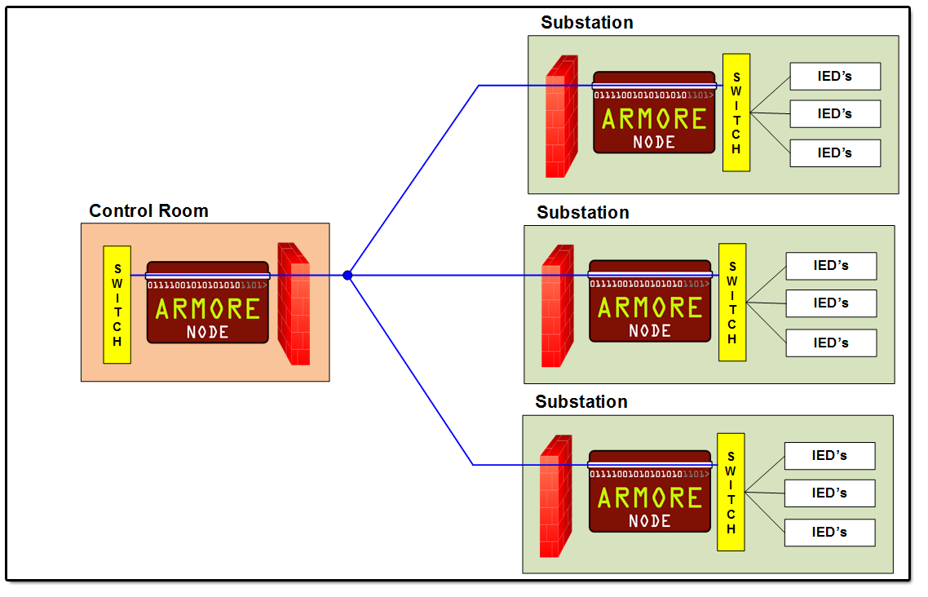
Full Implementation
Design
Encapsulated Mode

Slide 10
ARMORE Proxy
Abstract class for middleware library inclusion
ZeroMQ implemented with Curve security
DDS stubbed but not implemented
Abstract packet capture interface
PCAP
Netmap
Many options for logging
MAC address translation mode

Slide 11
DDS vs. ZeroMQ
PROXY
DDS
ZeroMQ
Commercial options
No open source security
Extensive functionality built in
Steep learning curve
Slightly more resource heavy
4 languages
Restricted to pub/sub
Exclusively open source
Sufficient features for ARMORE
Easy to learn
Lightweight
30+ languages
Multiple pattern flexibility
Notes:
-DDS
-Strengths lie mostly in its functionality
-Very capable and proven in various industries
-Complicated API and restricted to a few languages
-ZMQ
-Emphasizes simplicity and encourages users to write their own functionality
-Available in over 30 languages and is lightweight
-Ultimately we’d prefer to not be reliant on a specific middleware
-ZMQ is great for short term development and proving concepts with little development time
-DDS requires more care in setting up and writing but the functionality it provides is guaranteed by vendors who create the software

Slide 12
Zero MQ
PROXY
Asynchronous messaging library
Allows many types of communication from intra-process to WAN
Removes need for message broker
API values simplicity over functionality
Encourages user to implement functionality as needed
Available in over 30 languages on multiple platforms
Open source
Very active community provides extensive support for developing and debugging
Existing documentation provides extensive instruction on various communication patterns
Notes:
-ZeroMQ is an alternative middleware to DDS
-Will be used to communicate between ARMORE nodes
-Differs from DDS in that it values simplicity over functionality
-Still allows user to develop all the desired functionality
-Available on multiple platforms in over 30 languages
-Is free to use and has a very active community
-Support is plentiful and examples numerous

Slide 13
ZeroMQ Dealer/Router Pattern
PROXY

Slide 14
Administrator's Interface
MANAGER
Front end connects UI with ARMORE node internals. Based on Bootstrap.
Read/set configuration
Subsystem status
Node topology
Display data for user
Statistics
Logs
Alerts
Communicate with back end via JSON messages
Testing
Janus - Rest API server
Bottle - Python Web Framework
Notes:
-Develop a front end capable of accessing information in the ARMORE system
- Set configurations on individual nodes or entire subsystems
- Read statistics/settings on individual nodes or entire subsystems
-Using open source tools to create front end mockup
- Define interface early to help develop back end in parallel with front end

Slide 15
Dynamic Traffic Analyzer
INSPECTOR
What is it?
An analyzer that provides dynamic and intelligent analytics for SCADA protocols, increasing visibility into the system behavior
What is it using?
Bro's scripting engine
What protocols does it support at the moment?
DNP3
Modbus
Extensible to any other protocol
Notes:
This work’s purpose is to design and build an analyzer that provides dynamic and smart analytics for SCADA protocols. It’s dynamic because it can adapt its logging and analyzing frequency based on the traffic volume. It’s smart because it can recognize anomaly based on the normal behavior it learned from the traffic as well as identify the role of units in the network based on predefined traffic patterns.
We use the Bro’s scripting engine to build the analyzer. The Logging Framework, the Notice Framework, the Summary Statistics Framework and the Intelligence Framework is used.
Currently, this analyzer supports DNP3 and Modbus. But it can be extended later to support more.

Slide 16
Components
INSPECTOR
Network Traffic
Traffic Statistics Collector
Traffic Statistics Counter
Pattern-based Identity Recognition
Anomaly Detection Framework

Slide 17
Data Flow
INSPECTOR
Input: network traffic
Output: two kinds of events
item_seen: instantaneous, item contains incomplete information of the packet
item_gen: delayed, item contains complete information of the packet

Slide 18
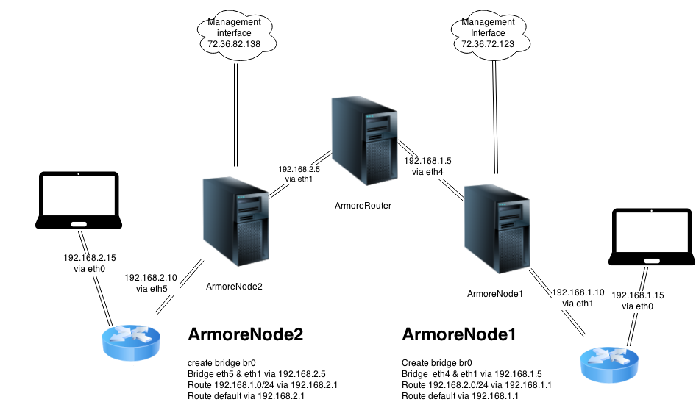
UIUC INSPECTOR (Bro) Test
Testing
Notes:
Why a physical setup instead of just a bunch of virtual machines?
-We use a physical test bed to benchmark performance of ARMORE with High End Intel 4 port NIC’s that are capable of sending 1.5 million packets per second at the moment across ARMORE nodes using the Netmap.ko and igxb.ko kernel modules.
-Virtual machines have reduced performance due to only being able to use netmap.ko as a software based card and aren’t able to create as much throughput.
ArmoreNode1 and Armorenode 2 are placed between an ArmoreRouter which turns the whole system into a WAN and allows us to simulate a real world setup.

Slide 19
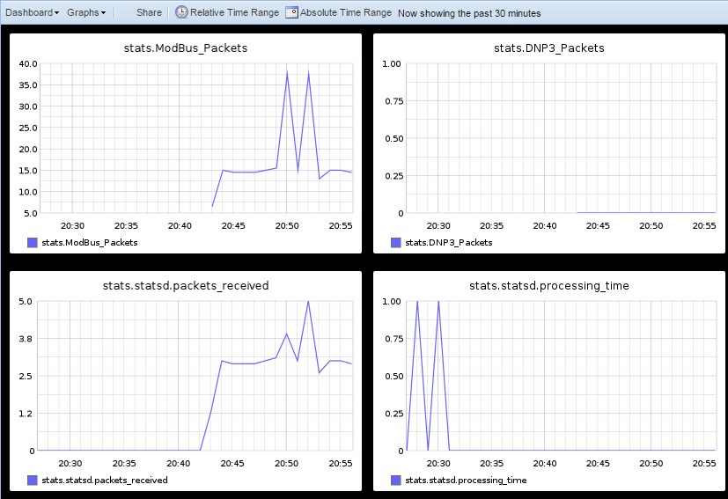
ModBus Traffic Visualization
Testing
Notes:
Testing out ModBus traffic being detected by bro and sent via bro-statsd to Carbon Listening Service which then is displayed by Graphite.

Slide 20
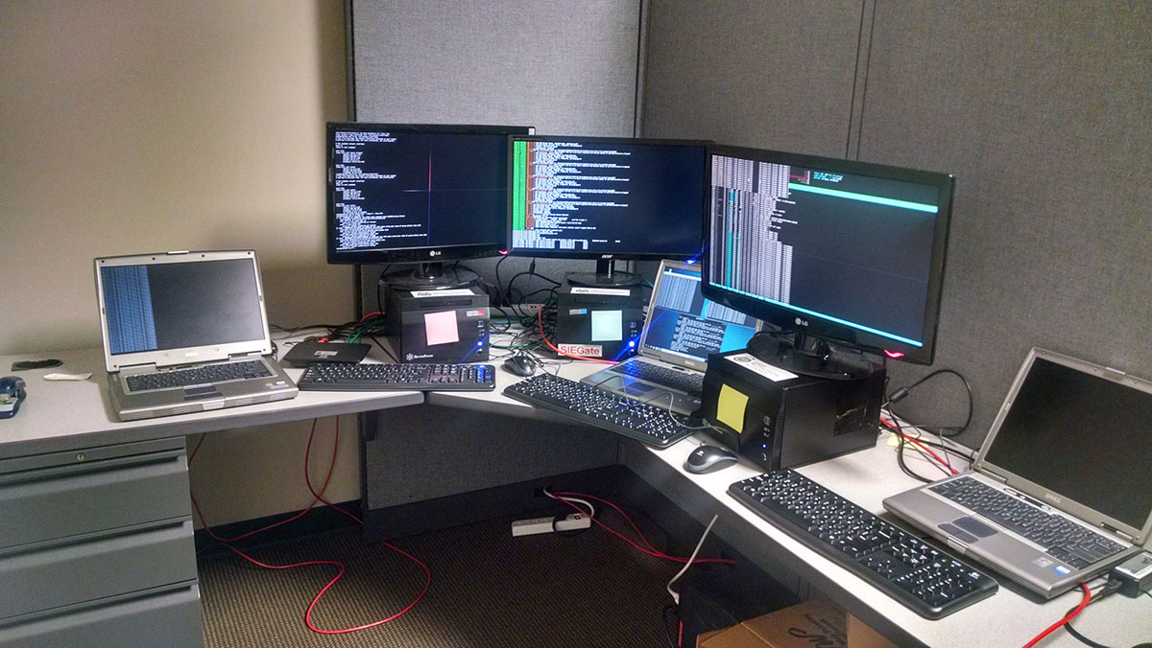
GPA PROXY Test
Testing

