Slide 1



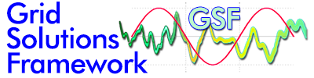







Synchrophasor Project Updates

Slide 2
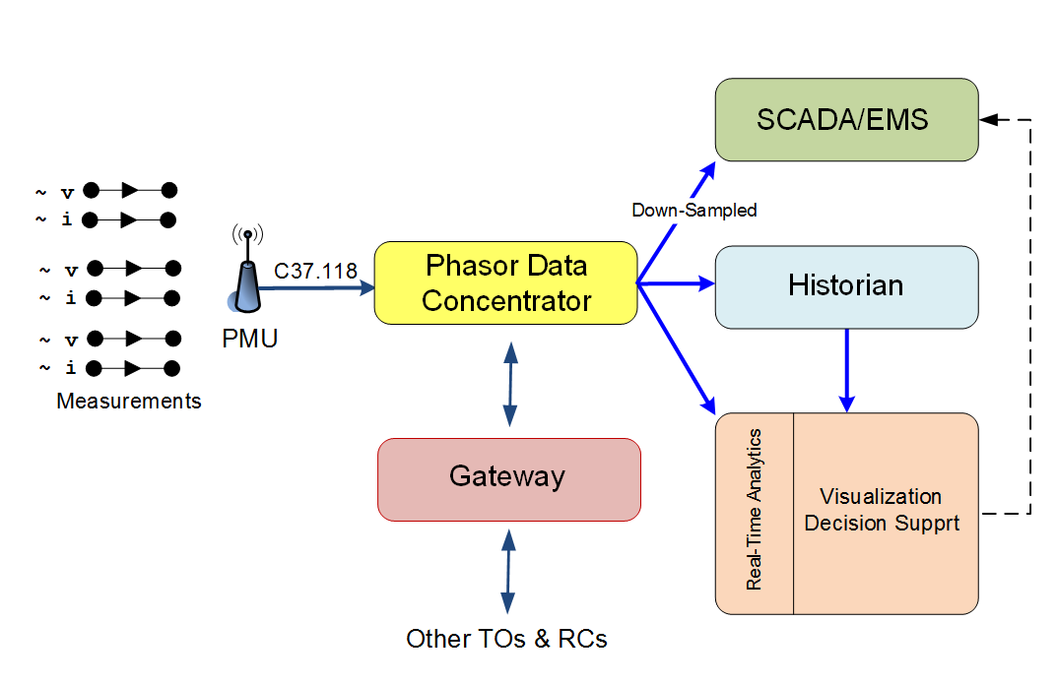
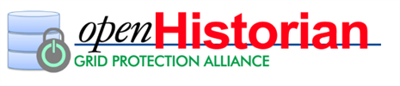
Typical Synchrophasor Data Architecture
Grid Protection Alliance Solutions
Notes:
.

Slide 3

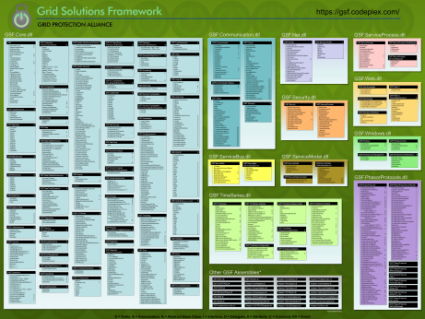
GSF
Grid Solutions Framework
http://gsf.codeplex.com/

Slide 4
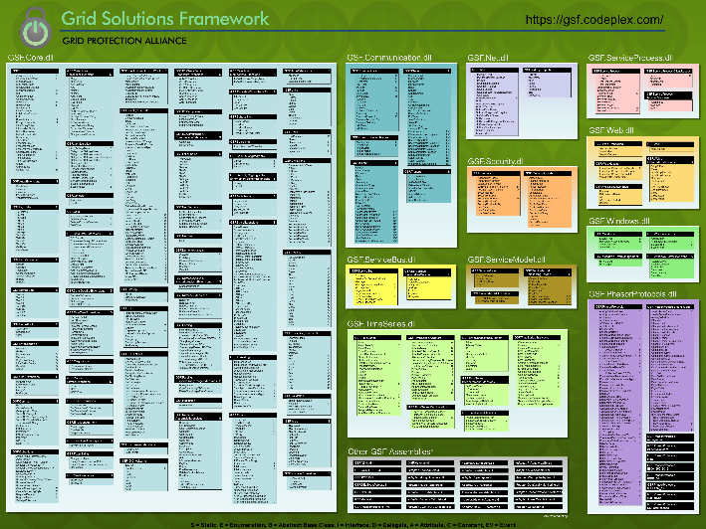

Grid Solutions Framework v2.1.90
The Grid Solutions Framework (GSF) is a comprehensive collection of classes and methods useful for any .NET project.
GSF is the foundational code library for all GPA products. It includes hundreds of class libraries that extend or expand the functionality included in the .NET Framework.
GSF has around a half-million lines of actual code and 148,000 lines of comments spanning more than 40 assemblies - reference the online documentation for complete class details:
  http://www.gridprotectionalliance.org/NightlyBuilds/GridSolutionsFramework/Help/
Download GSF from:
http://gsf.codeplex.com/
– or –
http://www.nuget.org/
Notes:
Although Grid Solutions Framework is not a “product” per-se – it is fundamental to the GPA synchrophasor based product suite and as such, I wanted to make sure to touch on expected changes coming to this technology, especially to the Gateway Exchange Protocol.

Slide 5
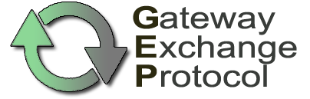
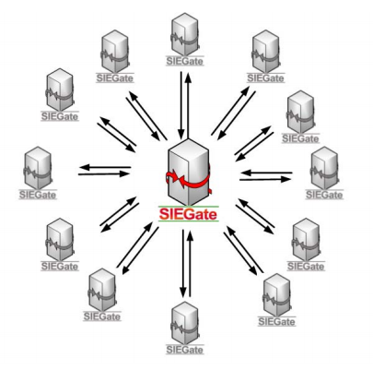
GEP
Gateway Exchange Protocol
http://gsf.codeplex.com/

Slide 6


GEP Features
Open and non-proprietary
True pub/sub, measurement-based protocol
Automated exchange of authorized metadata
Tightly-compressed, binary serialization of time-series values
  ID, time-stamp, value, flags
Adapters provided in .NET, C/C++ and Java for convenient native integration in other systems
Available transports include TLS, TCP, TCP with UDP, TLS with AES key-rotated UDP, or ZeroMQ
Lossless compression is also supported.

Slide 7
Typical GEP Payload Structure*
Serialized Measurement Structure – 9 Bytes:
Unique ID 2 Bytes
Timestamp 2 Bytes
Value 4 Bytes
Quality 1 Byte
128-bit Guid ID mapped to
16-bit runtime ID
64-bit full resolution timestamp
mapped to 16-bit offset
32-bit floating point value
8-bit quality flags
Several serialized measurements are grouped together
to create a message payload. Total size is adjusted to
reduce fragmentation.
* Free form payloads also supported.
Notes:
Generally the unique ID is a Guid globally unique identifier – a 128-bit random integer that is statistically unique in the world (hence “global”).
The other common name for these values is UUID, or universally unique identifier.
Microsoft was the one that coined the term “globally” unique identifier since they felt the computer generated values with likely to be unique on Earth by the odds of having a duplicate anywhere in the universe was too high.

Slide 8
What’s Coming for GEP
Looking to bring technology to wider industry adoption through standardization
New openECA development will bring architectural improvements to GEP by allowing new versions to accommodate robust data schemes, e.g., the Phasor Value Collection, through implementation of a generic key/value pair meta-data definition and transport
* Free form payloads also supported.

Slide 9
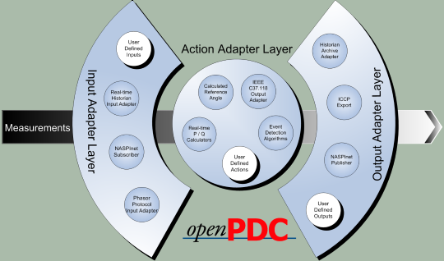
openPDC
Open Phasor Data Concentrator
http://openpdc.codeplex.com/

Slide 10
openPDC Features
Supports all phasor input protocols
Independently handles real-time and data archival functions
Incorporates pre-emptive, time-aligned data publication
Automated data availability reporting
Can alarm on phasor magnitudes and/or angles
All instances can be configured through an single application on an administrator’s workstation

Slide 11
openPDC Features
Future-proof adapter-based architecture
Proven high-performance that scales with hardware
Runs on multiple platforms and integrates with multiple configuration database types
Includes a data and performance historian
Output adapters included for the openHistorian, OSI-PI Historian and Hadoop
The openPDC remains on a steep improvement curve

Slide 12
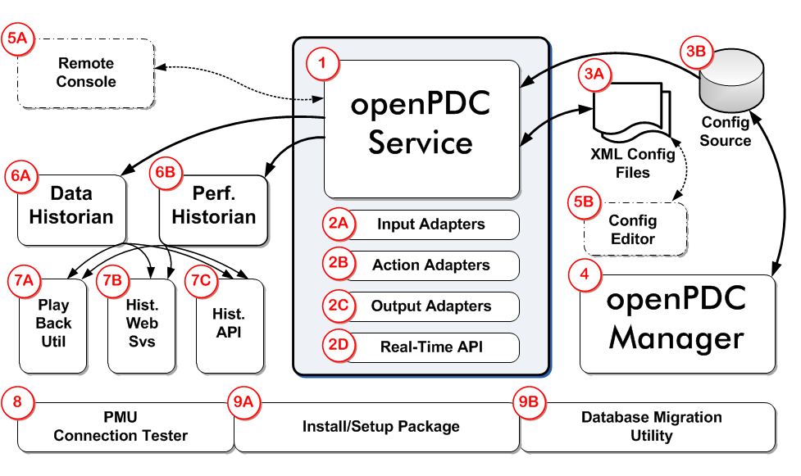
openPDC Components

Slide 13
Version 2.1 Improvements
Automated data gap recovery
Improved the “add new device” wizard
Supports Linux / Apple OSX deployments
Native OSI-PI adapter optimization with custom tag naming
Plus more than 30 other enhancements and bug fixes
Released February 2015

Slide 14
Version 2.1 Service Pack 1
Enhancements
  Change of installer license to MIT
  Support for GEP using ZeroMQ
  Improved alarm configuration
  DQ Report replaced by separate “data completeness” and “data correctness” reports
  Improved configuration for data gap filling in clustered deployments
  … as well as about 10 other significant enhancements

Slide 15
Version 2.1 Service Pack 1
Issue Resolution
  Slow memory leak when leaving the openPDC Manager running and connected
  OSI PI Adapter Fixes
  Better memory management for GEP after periods of stress
  TLS disconnection of unauthenticated clients
  …. and about 10 other major fixes.
http://openpdc.codeplex.com/releases/

Slide 16
Planned openPDC Improvements
Version 2.2 (March 2016)
  openHistorian 2.0 Support
  C37.118.2 Protocol Production Tested
  UI Improvements (e.g., alarm configuration)
Version 3.0 Release Candidate (Fall 2016)
  Restructuring of TSL / synchronization engine
    Routing and management of abstract objects
    Support for the openECA analytics interface

Slide 17
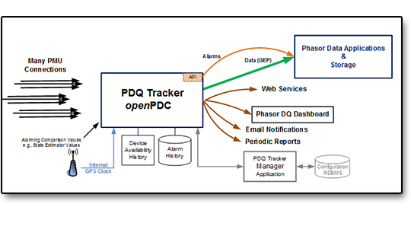
PDQTracker
Phasor Data Quality Tracker
http://pdqtracker.codeplex.com/

Slide 18
Phasor Data Quality Needs Attention
Data quality assurance is becoming increasingly important for successful integration of synchrophasor data into utility operations.
  Device (PMU) availability
  Time quality issues
  Value quality issues
Alarms are needed to alert real-time analytics and operators of bad or missing phasor data.
Reports are needed to support businesses processes to improve data availability and data quality

Slide 19
Phasor Data Quality Tracker
An open source project jointly funded by Dominion and PeakRC’s new synchrophasor project
Alpha Version now available which includes core functionality and two data quality reports
Final beta version with increased functionality planned for release Spring 2015

Slide 20
PDQTracker Features
Designed to raise alarms, track states, store statistics, and generate reports on both the availability and accuracy of streaming synchrophasor data.
Will work with any vendor’s PDC and synchrophasor data infrastructure
Automatically produces periodic reports on phasor data completeness and correctness

Slide 21
High Level Features
Focus is on the two major dimensions of quality
  Data Completeness (Availability)
  Data Correctness (Accuracy)
Stand alone product for use within any synchrophasor data architecture
Outputs to support:
  Business processes for correcting / improving data quality
  Integration with applications to flag incorrect data

Slide 22
Data Quality Tests
Completeness
Correctness
Bad CRC
Out-of-Order Frames
Missing Frames
Time
  Reasonableness
  Latency
Values
  Reasonableness
  Latched Value
  Comparison Tolerance
PDQ Tracker maintains statistics on data completeness
PDQ Tracker raises alarms to flag incorrect data

Slide 23
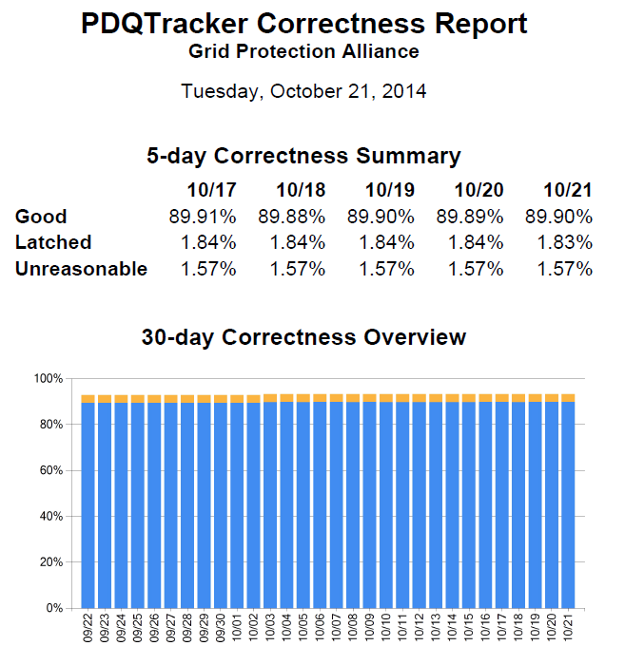
PDQTracker Example Report

Slide 24
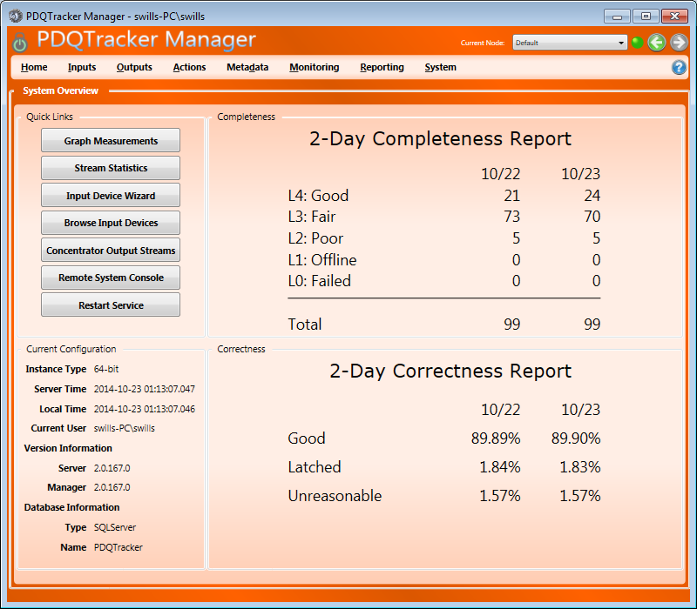
Beta Version Available
http://www.PDQTracker.com/

Slide 25
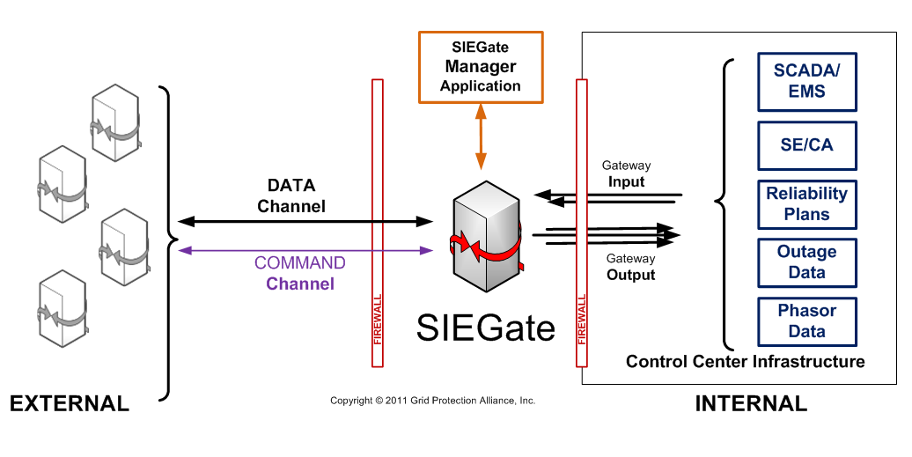
SIEGate
Secure Information Exchange Gateway
http://siegate.codeplex.com/

Slide 26
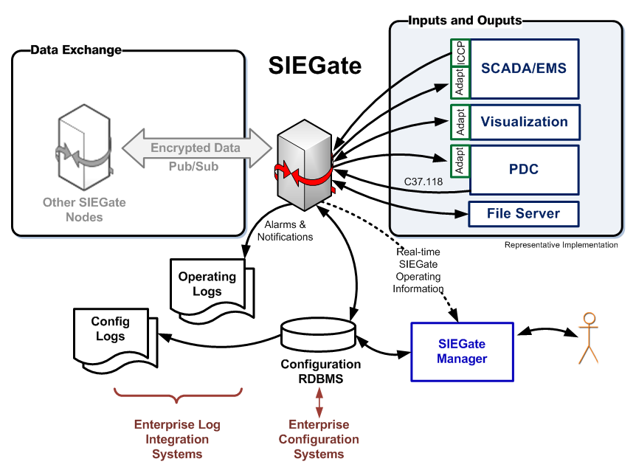
Technical Design Challenges
Performance given system complexity
  Support multiple data types efficiently and securely
  Support multiple priorities
  Minimize latency and maximize
  throughput
High availability assurance
  Horizontal and vertical scalability
  SIEGate stability and reliability
  Graceful performance degradation
Security assurance
  Maximize security performance
  Minimize security breach impact
  Configurable security levels
  Security versus simplicity/usability tradeoff

Slide 27
SIEGate Protocol Requirements
Highly Performant
  Really fast
  Really efficient
Scale to millions of points per second in a single stream
Leverage common IP transmission unit size to reduce datagram fragmentation
Non-fixed payload contents, i.e., points in one packet can be different than the next
The Solution:

Slide 28
SIEGate Implementation
Security-centric appliance designed to reliably exchange the information necessary to support real-time control room operations. SIEGate can exchange measurement data (ID, time, value, quality), alarm and notification data as well as batch or file-based data.
Based on pub/sub technology that exchanges data among devices (such as other SIEGate nodes) using GPA's Gateway Exchange Protocol.
GEP avoids being encumbered by IEEE C37.118 frame size issues and limitations. Single instance on common hardware can exchange around five million measurements points per second.

Slide 29
SIEGate v1.1 Release
http://siegate.codeplex.com/releases/
Usability enhancements
Updates and fixes included with service pack 1 of the openPDC
Bug fixes since 1.0 version
Includes “No Internet Fix Utility” to speed TLS connections when no Internet connection is available (common for SIEGate deployments)

Slide 30
Deployments In Progress
Southern Company
Entergy
OG&E
MISO
Dominion
Duke
PeakRC (2016 for testing and validation)

Slide 31
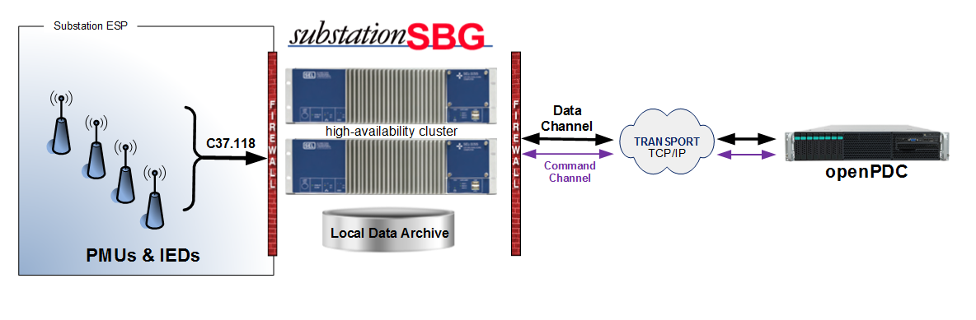
substationSBG
Substation Secure Buffered Gateway
http://substationsbg.codeplex.com/

Slide 32
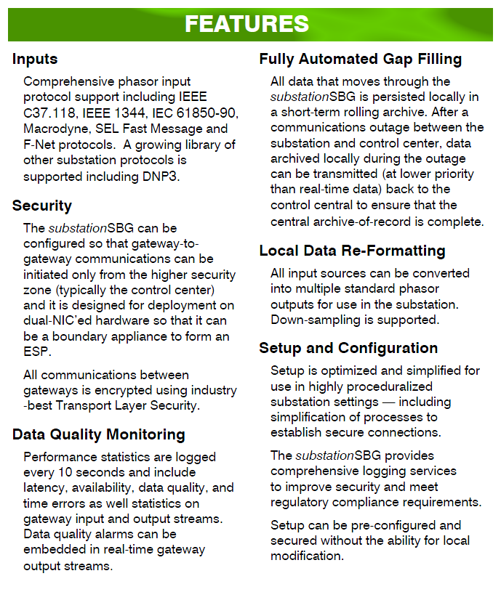

Feature Set at Conception
Many local inputs
Ability to capture
DQ stats at the substation level
Configuration optimized for substation use
Automated GAP filling
The security of SIEGate
Envisioned features have been
implemented and deployed

Slide 33
substationSBG Components
Windows Core Service – Installed on each SEL 3355 with the cluster and runs automatically when the system starts – if service fails, will fail over to other machine
Performance Historian – Installed on each SEL 3355 in the cluster and synchronized for statistics data generated by the substationSBG
Phasor Data Historian – Installed on each SEL 3355 in the cluster and synchronized which becomes the local rolling buffer archive
substationSBG Manager – GUI based management application installed locally on the SEL 3355
Remote Console – Console based administrative diagnostics tool installed on the administrator’s workstation – provides feedback from Windows Core Service

Slide 34
substationSBG Data Gap Recovery
The primary purpose of this feature is to recover data lost during communications interruptions:
  The substationSBG archives data locally for a configurable period – the default is 45 days (not to exceed 80% of available hard drive size).
  The central PDC keeps track of communications gaps (either from individual substationSBG’s or from central PDC failure) and requests data from the substationSBG that is missing – and then pushes this data into the long-term archive.

Slide 35
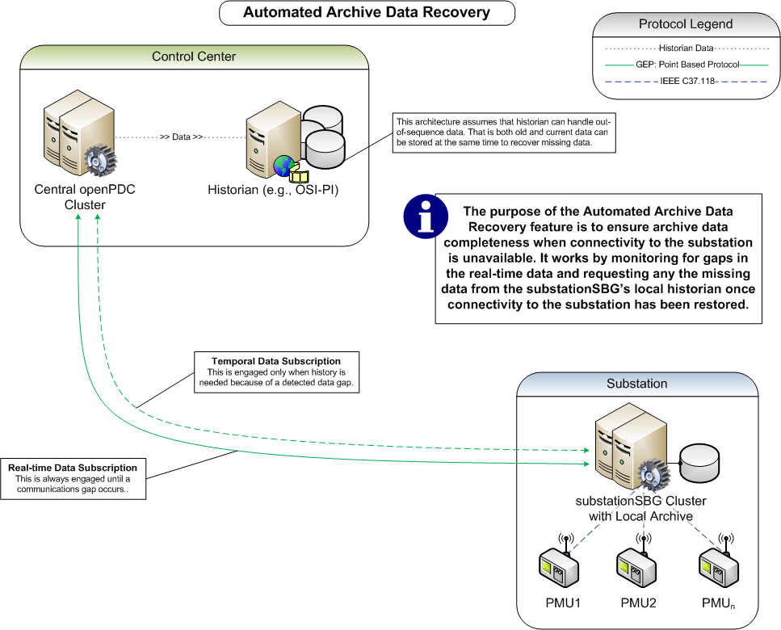
substationSBG

Slide 36
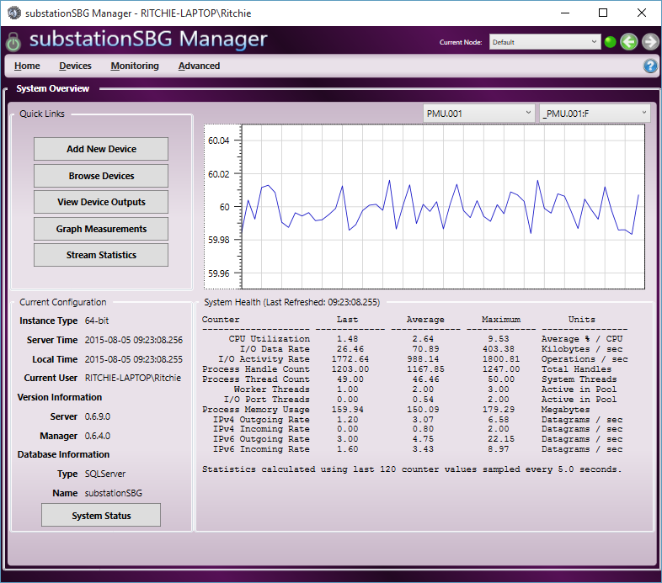
substationSBG

Slide 37
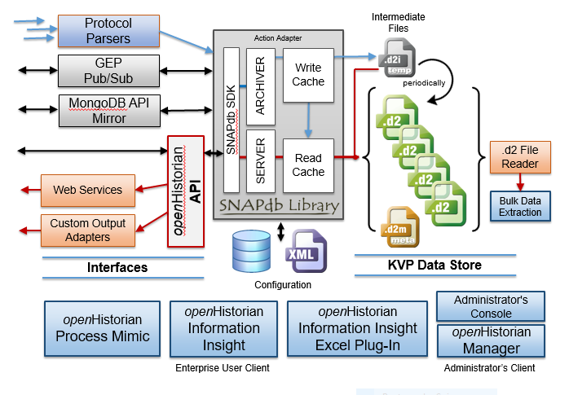
openHistorian
Open Source Time-series Data Historian
http://openhistorian.codeplex.com/

Slide 38

openHistorian
The openHistorian 2.0 has been optimized for:
  Assurance of archived data integrity / continuity
  Broad data source connectivity
  High performance data capture & retrieval
  Efficient, high-volume data storage
  High availability
Early beta has been released which focuses on synchrophasor deployments

Slide 39
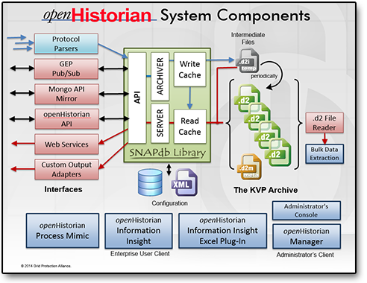
openHistorian

Slide 40
openHistorian Data Read API
// Example:
var enumerator = GetHistorianData("127.0.0.1", "PPA", DateTime.UtcNow.AddMinutes(-1.0D), DateTime.UtcNow)
// API:
IEnumerable<HistorianMeasurement> GetHistorianData(
string historianServer,
string instanceName,
DateTime startTime,
DateTime stopTime,
string measurementIDs = null)

Slide 41
openHistorian Data Write API
// Example:
WriteHistorianData("127.0.0.1", "PPA", measurements)
// API:
void WriteHistorianData(
string historianServer,
string instanceName, IEnumerable<HistorianMeasurement> measurements)

Slide 42
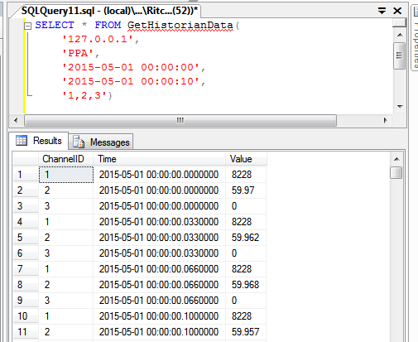
openHistorian SQL Server Integration
Can query trending data from within SQL Server using SQL CLR adapter:

Slide 43
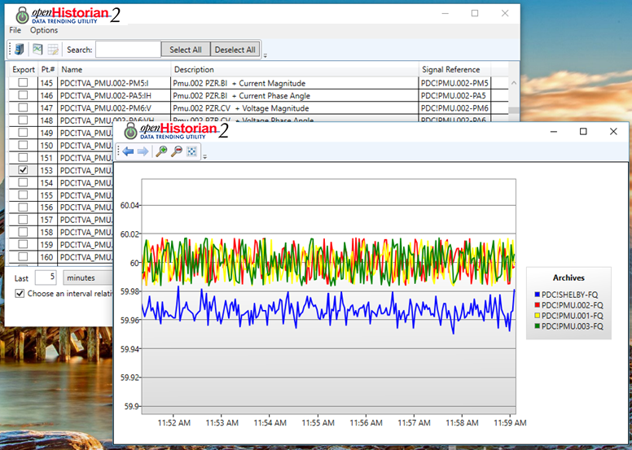
Data Trending Utility

Slide 44
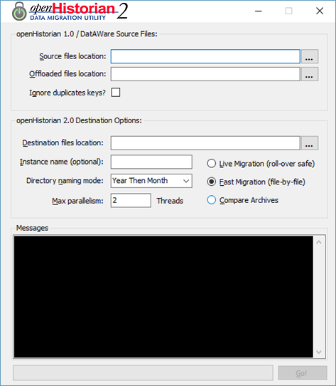
Data Migration Utility (1.0 to 2.0)

Slide 45
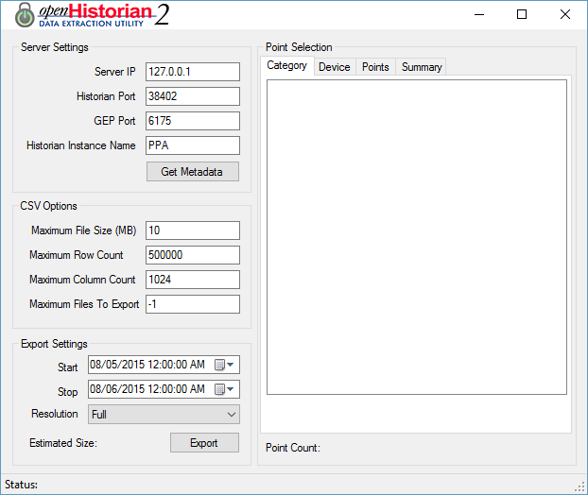
Data Extraction Utility

Slide 46
Synchrophasor Visualization
http://www.gridprotectionalliance.org/Products/openHistorian/Media/Demos/

