Slide 1
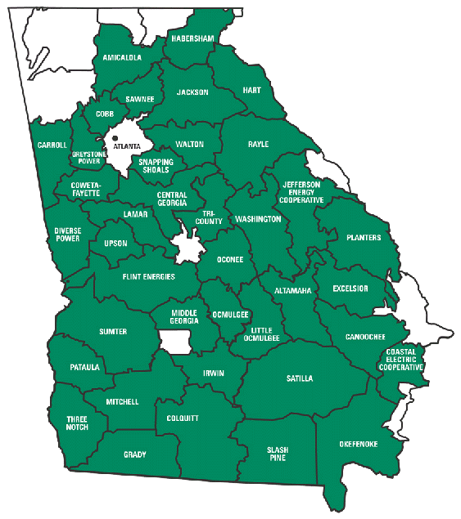
About Georgia Transmission Corporation (GTC)
Transmission-only, not-for-profit cooperative
Formed in March 1997 from the restructuring of Oglethorpe Power Corporation (OPC)
GTC provides network transmission services to 38 Member EMCs in Georgia
GTC provides point-to-point service to other customers

Slide 2
GTC Overview – System Assets
Transmission Lines
46 kV lines
69 kV lines
115 kV lines
230 kV lines
500 kV lines
Total lines
Substations
Transmission substations
Distribution substations
Total substations
275 miles
14 miles
1,132 miles
1,274 miles
477 miles
3,172 miles
91
569
660

Slide 3
Georgia ITS
GTC owns more than 3,100 miles of transmission lines
GTC has access to more than 17,000 miles of transmission lines in Georgia through the Georgia Integrated Transmission System (ITS)
Assets owned by GTC, Georgia Power, MEAG Power and Dalton Utilities

Slide 4
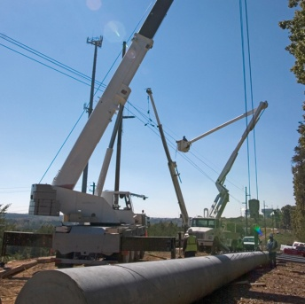
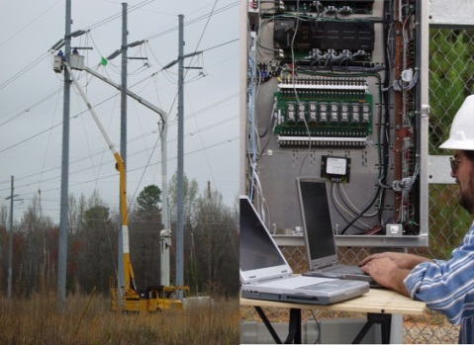
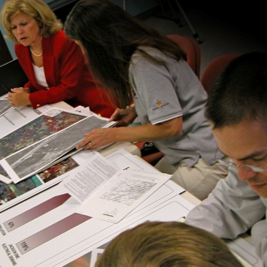
GTC Functional Areas
Engineering & Construction
Planning
Maintenance
Support
Bulk System Planning
Member Planning
Area Planning
System Protection & Control
Substation and T/L Design
Relay/Control Design
Transmission Projects
Land Services
Environmental
Construction Inspection
Substation Maintenance
Transmission Line Maintenance
Electronics Maintenance
Relay Maintenance
Cyber Operations
System Services
Reliability
Finance, Treasury, Administration, Legal
Procurement
External Affairs
Audit/Compliance
Human Resources
Safety/Training
Project Reporting

Slide 5
GTC Goals for the PQ Dashboard Project (DFR)
Use the PQ Dashboard, with records from the Digital Fault Recorders (DFR), to look at non-trip events that were recorded (Voltage and Current Sags and Swells)
Using DFR data to perform automatic double ended fault location calculations and send out email
Using the DFR data to monitor breaker trip times and send out notifications for slow operating breakers

Slide 6
openXDA/PQ Dashboard Server and Database Configuration
DFR Server
PQ Dashboard
Digital Fault Recorder data is pushed to the Web Server by PeerSync software
Event data and calculations are displayed in the PQ Dashboard which runs in a browser
Select group of individuals receive Fault notification emails
Web Server and Database Server
Contains all the pushed DFR Event data; COMTRADE and Line Configuration files
File Watcher program looks for new files to process
openXDA program analyzes the file data and updates the database with calculations
openXDA Database is Microsoft SQL Server

Slide 7
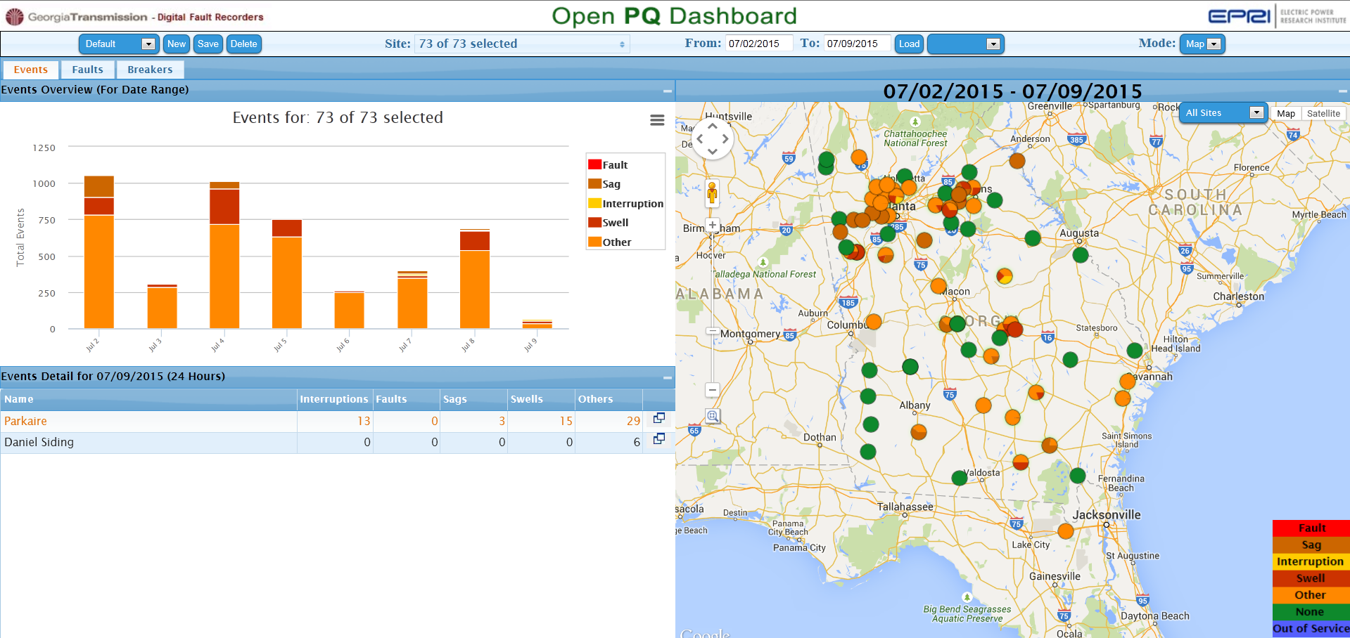
GTC - PQ Dashboard (DFR) Map View

Slide 8
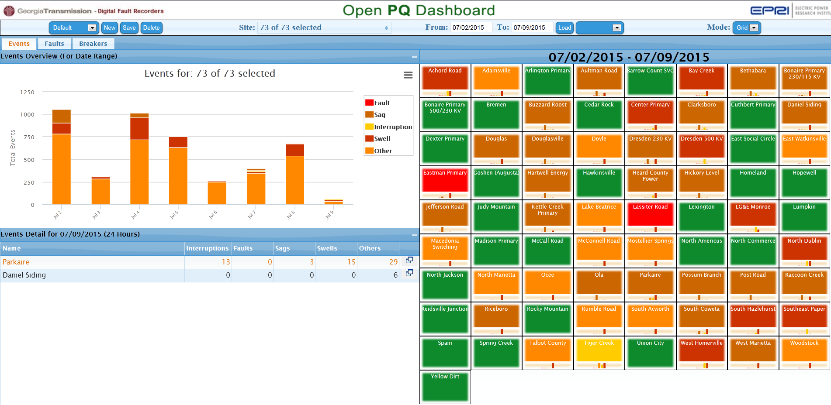
GTC - PQ Dashboard (DFR) Grid View

Slide 9
Non Fault Event – Voltage Sag

Slide 10
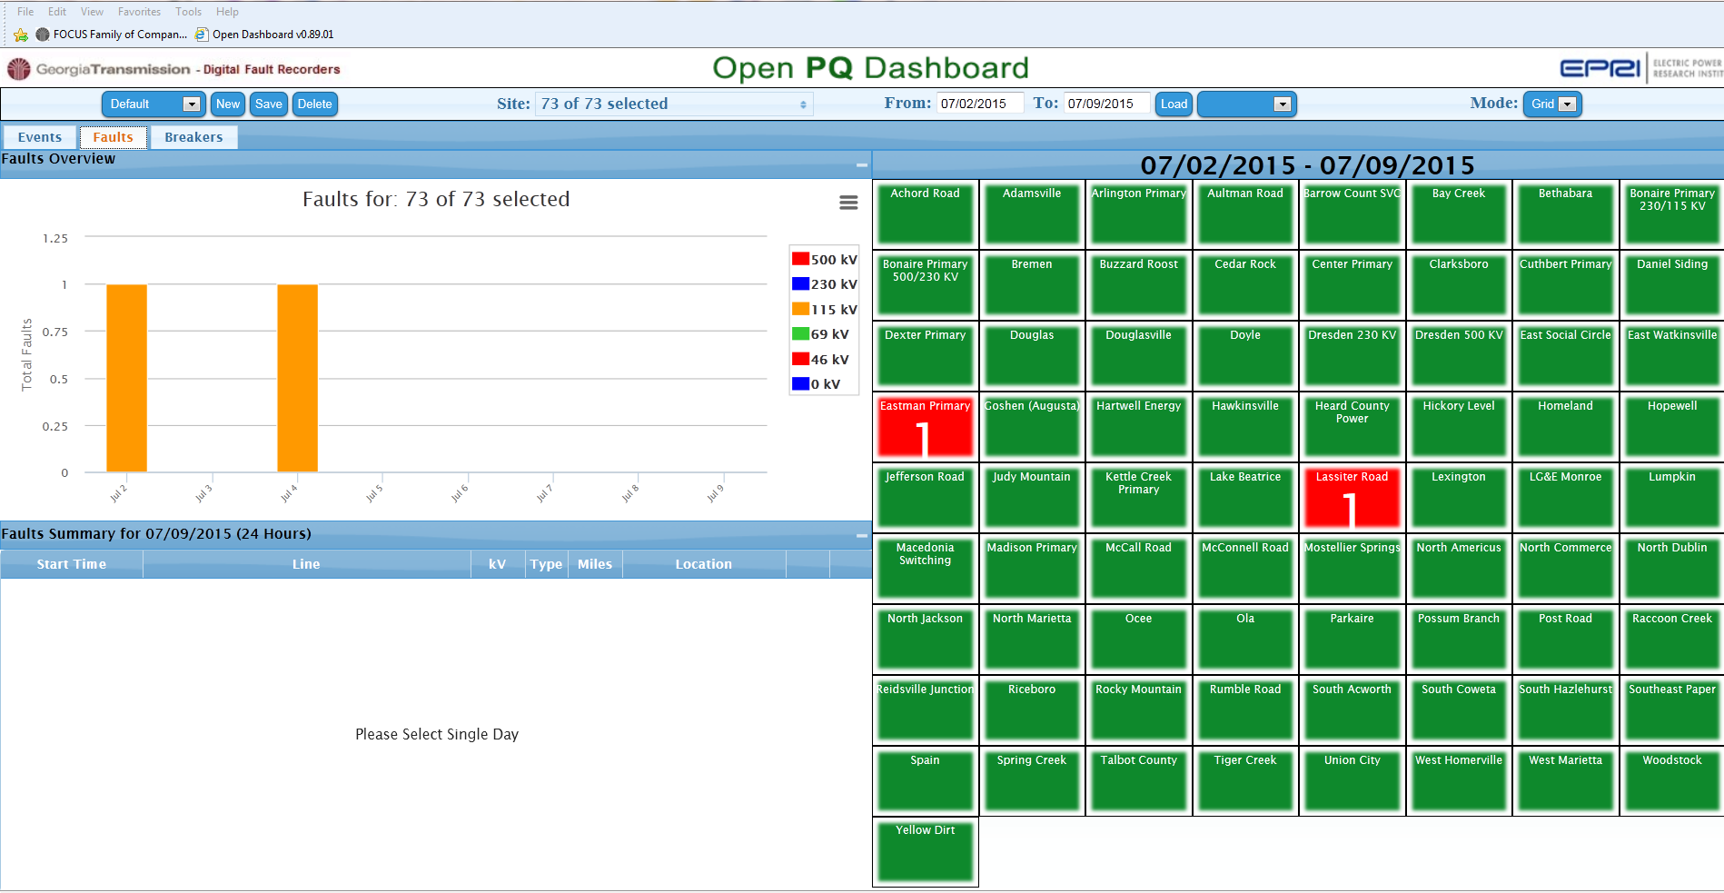
PQ Dashboard (DFR) Faults

Slide 11
Fault Event

Slide 12
Fault Details

Slide 13
Typical E-mail sent out by the PQ Dashboard

Slide 14
E-Mail Showing Double Ended Fault Distance

Slide 15
Fault Location from Lightning, DFR and PQ Dashboard

Slide 16
Accuracy of DFR and SEL Relays calculating Distance to Fault January 1, 2011 – September 30, 2014
A total of 1637 records from DFRs and from SEL Relays were compiled. There were 817 DFR records and 820 SEL Relay records.

Slide 17
Breaker Timing

Slide 18
Breaker Timing

Slide 19
Breaker Timing

Slide 20
Breaker Timing

Slide 21
Things we had to do to apply the PQ Dashboard
Worked with USI and APP to modify the line files. Added the breaker number in order to link to MAXIMO.
Cleaned up line file numbers in the DFRs to match the STOMP data base. Lots of files were brought up to date.
Added non-line breakers to the DFR line files for breaker timing.
Large data clean up effort with the MAXIMO data. Added breaker operate time to data base.
Created a database with thermal line rating for each line.

Slide 22
2016 and Beyond
1. Geographic enhancements and reporting (GIS) - Show T/L with fault location, lightning location, and other information
2. Event correlation with lightning
Incorporate Fault Indicator data
Add GTC Power Quality meters to the dashboard
Additional breaker analytics and reporting
Add functions to the PQ Dashboard such as Event Reclassification and Tagging
Identification and reporting of out of service DFRs and Power Quality meters

