Slide 1
Project Summary EPRI Program 1: Power Quality
April 2015

Slide 2
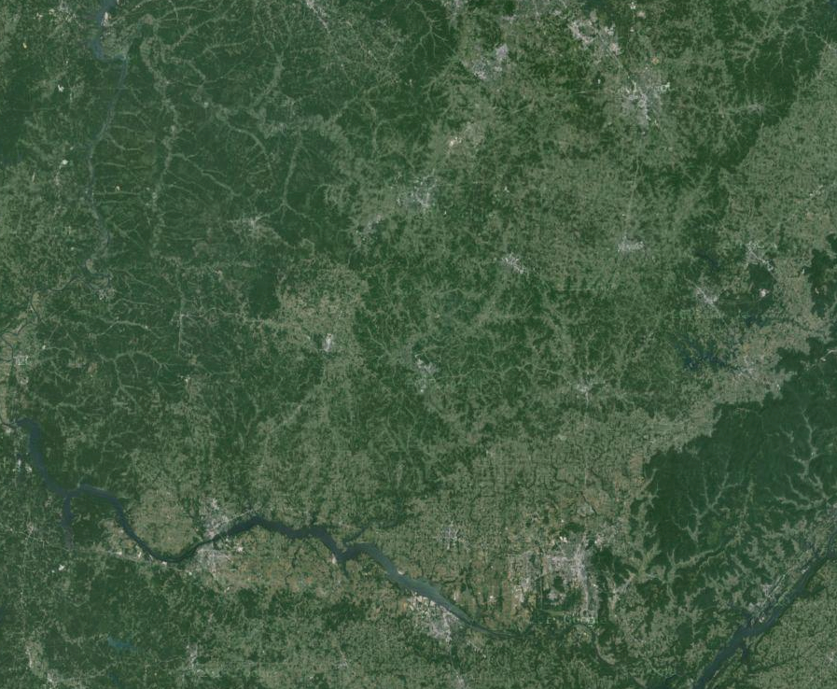
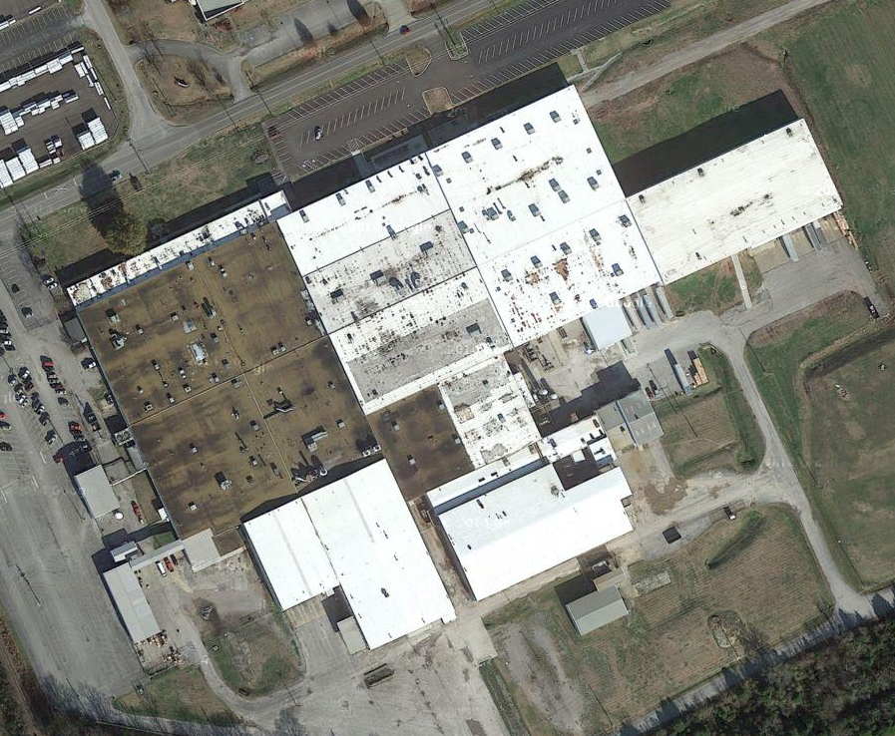
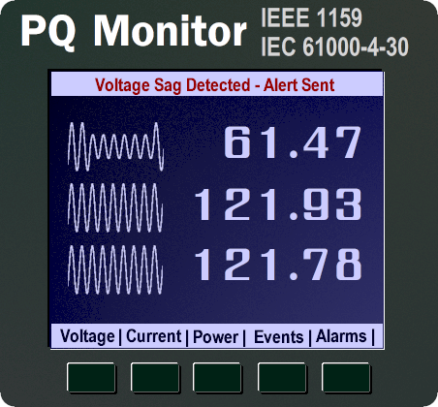
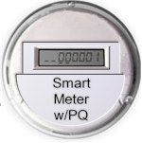
PQ Monitoring Evolving from Single-Site Investigations…
…. to Wide-Area PQ Monitoring Applications
DME w/PQ
Notes:
A point to add to this slide is the amount of data that PQ monitors create. High resolution waveform data, and dozens of parameters. Not only does this impact communications and IT infrastructure, it also impacts human ability to absorb all the information and interpret meaningful information quickly. Some utilities have over 2,000 meters that provide PQ data. Their department do not have the time or resources to view and interpret every event as they come in. DME = Distribution Management Equipment (Digital Fault Recorders, Relays, Cap Bank Controllers, etc)

Slide 3
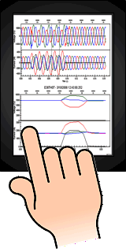
Equating to large amounts of PQ data to both communicate and interpret.
Notes:
A point to add to this slide is the amount of data that PQ monitors create. High resolution waveform data, and dozens of parameters. Not only does this impact communications and IT infrastructure, it also impacts human ability to absorb all the information and interpret meaningful information quickly. Some utilities have over 2,000 meters that provide PQ data. Their department do not have the time or resources to view and interpret every event as they come in. DME = Distribution Management Equipment (Digital Fault Recorders, Relays, Cap Bank Controllers, etc)

Slide 4
EPRI PQ Program Project for Data Visualization
Problem
No current method of quickly and efficiently identifying/reporting PQ data and events from a large amount of resources that reports PQ information.
From PQ Strategic Plan
Need to integrate GIS and PQ data
Need tools for automatic data management
Need alarming on system problems
Need to extract and disseminate information from monitoring data
Objective
A visual dashboard approach that has the flexibility to automatically integrate, correlate, and communicate meaningful PQ information to varying personnel, departments and customers.
Benefits
Proactive and increased response to PQ sensitive personnel and customers
Preventive services to strengthen quality and reliability

Slide 5
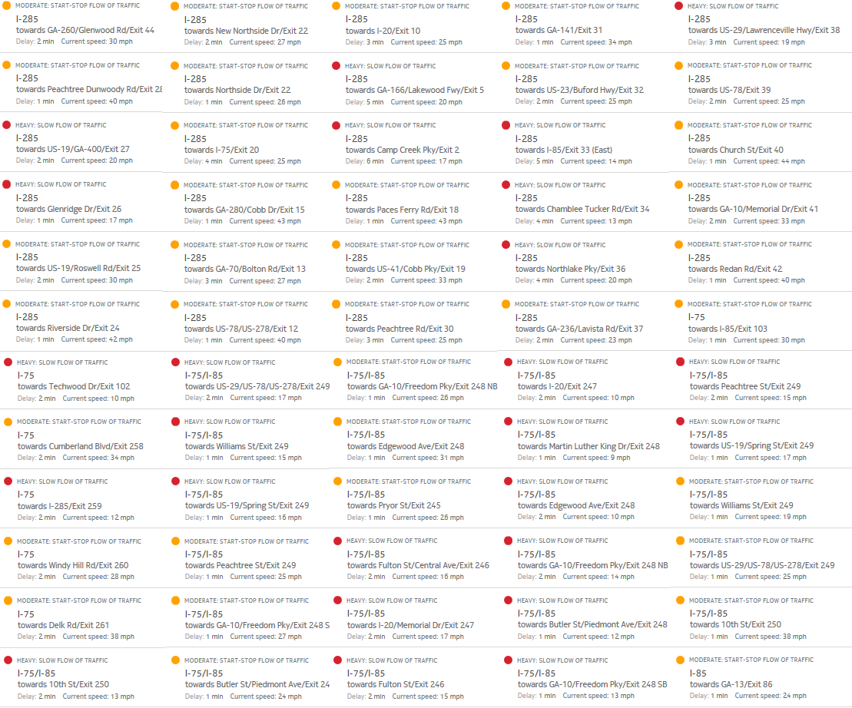
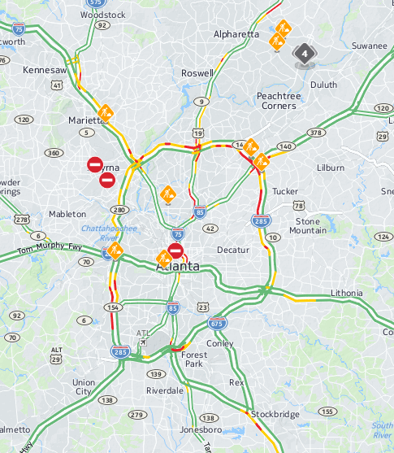
Example: Visualizing Atlanta Traffic Data

Slide 6
Opportunities using Data Visualization for Reporting Quick and Interpretable PQ Information
9
8
7
6
5
V_{THD}
4
3
2
1
Notes:
A point to add to this slide is the amount of data that PQ monitors create. High resolution waveform data, and dozens of parameters. Not only does this impact communications and IT infrastructure, it also impacts human ability to absorb all the information and interpret meaningful information quickly. Some utilities have over 2,000 meters that provide PQ data. Their department do not have the time or resources to view and interpret every event as they come in. DME = Distribution Management Equipment (Digital Fault Recorders, Relays, Cap Bank Controllers, etc)

Slide 7
Voltage Sag Severity from a Fault
100%
90%
80%
70%
60%
V_{Sag}
50%
40%
30%
20%
Notes:
A point to add to this slide is the amount of data that PQ monitors create. High resolution waveform data, and dozens of parameters. Not only does this impact communications and IT infrastructure, it also impacts human ability to absorb all the information and interpret meaningful information quickly. Some utilities have over 2,000 meters that provide PQ data. Their department do not have the time or resources to view and interpret every event as they come in. DME = Distribution Management Equipment (Digital Fault Recorders, Relays, Cap Bank Controllers, etc)

Slide 8
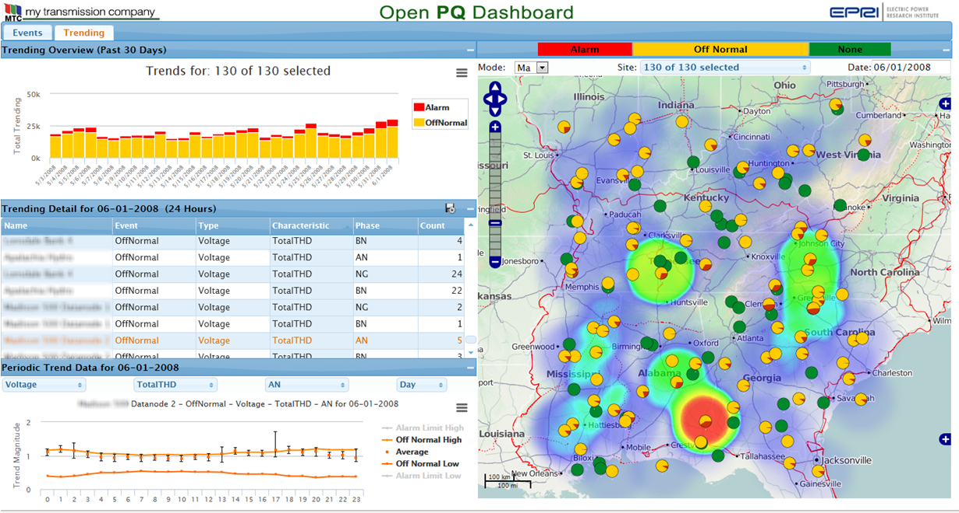
2014: OpenPQDashboard Beta Ver. 0.7 POC
Geographic Spatial Analysis
Historical and Statistical Process Control Visualizations for Automated Alerts of Trend Deviations

Slide 9
2015 Work
Production-Grade Deployment & Configuration Enhancements
Configuration and installer improvements to automate setup and deployment; addition of security features
PQView Data Integration
One-line GIS layer import capability. Shape-file (Esri) and/or KML (Google)?
Apply New Visualizations Research
Parameter and Event Magnitude GIS heat-map for geospatial relationship
Animating Steps for Visual Sequence Analysis

Slide 11
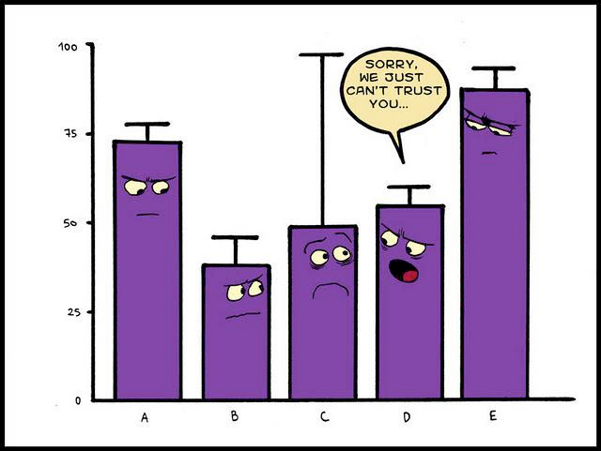
Bad Data

Slide 12
EPRI PQ Program Project for Data Validation
Problem
No current method of detecting defective PQ data caused from faulty monitors, sensors, or other sources to which can cause misrepresentation of actual PQ conditions. (Bad Data)
From PQ Strategic Plan
Need tools for automatic data management
We need alarming on data unavailability
Objective
Integrate data validation techniques into the openPQDashboard to which includes automatic characterization and statistical visualizations for alarming and management of defective PQ data.
Benefits
Defective data is not passed to and unnecessarily alarming PQ sensitive personnel and customers
Efficiency in monitoring operations, with less man-hours used in detecting and explaining data that is false-positive PQ.

Slide 13
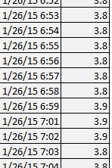
Data Validation (Example #1 of Bad Data)
7:00
3.9

Slide 14
Data Validation (Example #2 of Bad Data)
Suppose averaging one “glitch” with 1-min-res steady 3 % V_{THD} :
Hourly Average = 19.6 % V_{THD}
Daily Average = 3.7 % V_{THD}

Slide 15
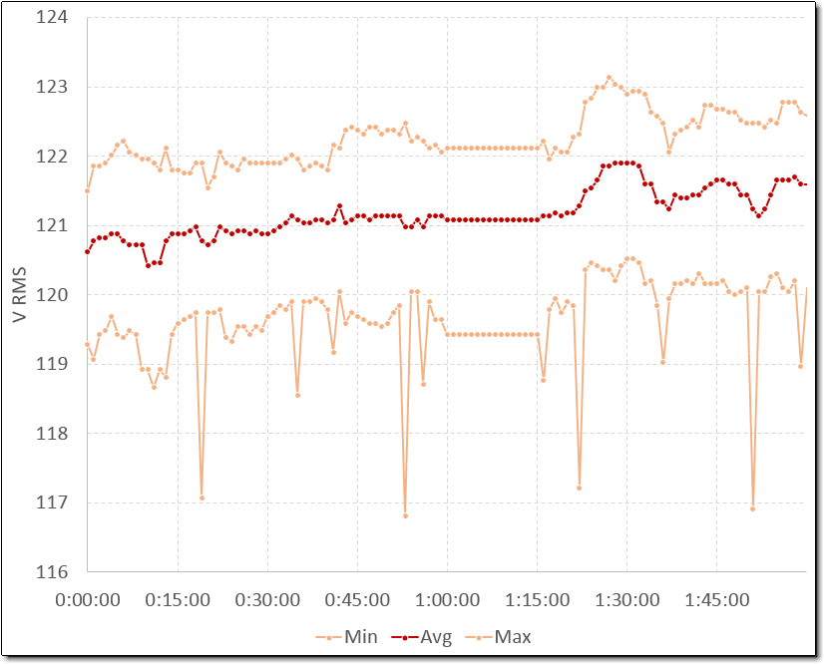
Data Validation (Example #3 of Bad Data)

Slide 16
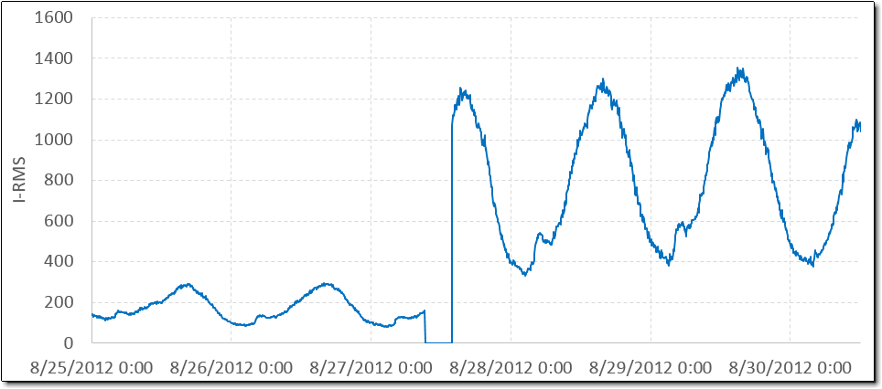
Data Validation (Example #4 of Bad Data)

Slide 17
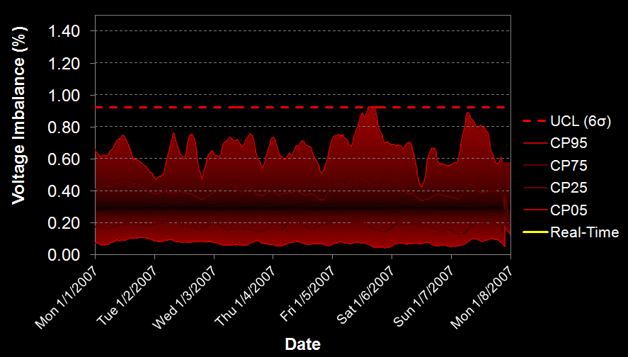
More on Trending with Statistical Process Control Techniques for Increased Situational Awareness
Comparing real-time to historical trends for a given site
Presents the capability for soft alarms (below regulatory limit) that are triggered when real-time exceeds historical norms.
This abnormality of 1.2% voltage imbalance is due to a capacitor bank fuse opening on one phase. Conventional triggers are set to 5% and would have missed this event.
Notes:
The notes below the graphic explains this slide.

Slide 18
Example Data Validation Process
Automated Data Screening
Input: Screen all data for potential erroneous values.
Trend Availability (configuration periodicity)
Time correctness
Bad data, Events (saturated?, flat top / latched, reversed CT) and Trend
Output: Data validation report (Dashboard Screen)
List includes suspect parameter, date & time of occurrence, failed criteria.
Data Verification
Qualified personnel are alerted and checks each incident, logs assignable cause, and either retains, rejects, or replaces suspect value(s).

Slide 19
Supporting EPRI Research: Waveform Analysis
MATLAB DLL
Extended Analytics Service Template(EAS)
EAS DB
Data Source (e.g. PQDIF)
OpenXDA Service
OpenXDA DB
Open PQ Dashboard

Slide 20
Supplemental Project: PQ Investigator – Open PQ Dashboard Integration
If you have PQI, a web service will provide information on equipment/customers effected by voltage sag events to the dashboard.
Release with openPQDashboard Ver. 1.0

Slide 21
Future EPRI Research Contributions to the Dashboard
Continuous Power Quality Benchmarking - Automated management of EPRI hosted PQ data from multiple utilities.
Waveform characterization (statistical probability of cause)
External Data Layers for PQ Correlation (e.g. Sunburst, Weather)
Visualizing continuous waveform data

Slide 22
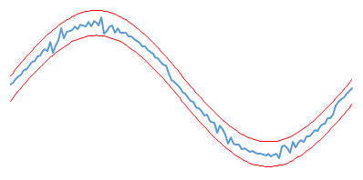
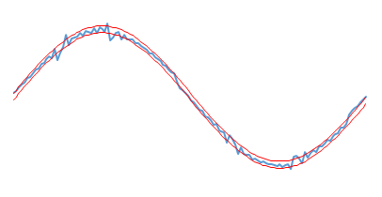
What are we missing with present triggering methods?
If the thresholds are not sensitive enough, anomalies can be missed. (High Impedance Fault Deviations)
If the sensitivities of thresholds are set too low, the user is inundated with a large amount of data sets to parse and zoom through

Slide 23
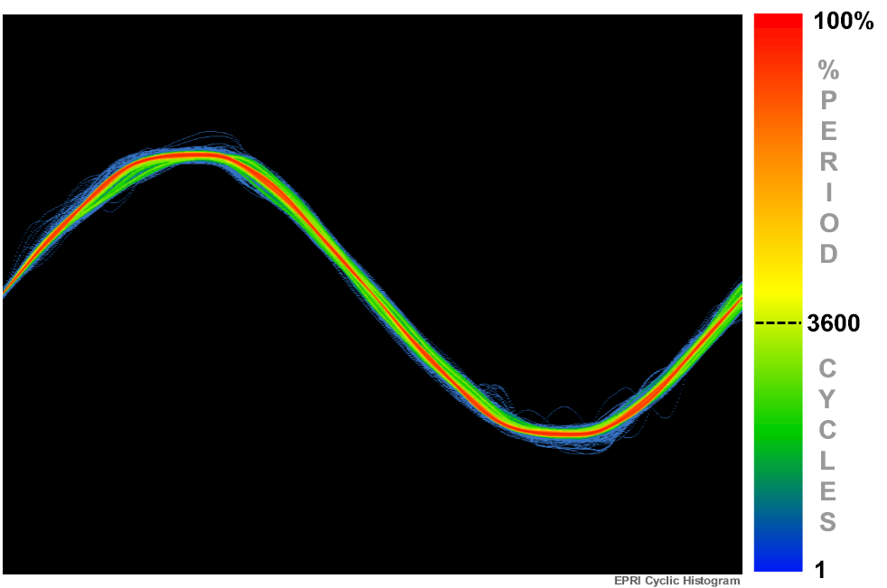
EPRI Cyclic Histogram
Open Conceptual Design Guide
Tom Cooke
April 2015

Slide 24
Background
In the electric power industry, the voltage and current waveforms are the rawest forms of data that are analyzed for power system anomalies. To capture these anomalies, digital signal processors sample amplitude values from 128 to 1024 times per waveform cycle in order to deliver an interpretable anomalous event cause. Historically, it is not efficient to collect and store this type of data continuously because such data storage is impractical, nor is it preferable to sort through this amount of data to find the anomalies that have occurred in one 60-hertz cycle out of millions of cycles recorded in a given day.
Today, power quality monitors are configured to record data only when the waveform exceeds preset boundaries as predetermined by input variables. If the waveform is not changing significantly, the data-acquisition system does not record that data, therefore reducing the size of stored data. The problem with this method is often anomalies are not captured because the threshold triggers are not preset correctly. If the thresholds are not sensitive enough, anomalies can be missed. Conversely, if the sensitivity of thresholds are set too low, the user is inundated with a large amount of data sets to parse and zoom through, requiring a significant amount of time for analysis.
The new Cyclic Histogram method reduces the impact of large amounts of waveform data and resolves the issues associated with the current methods mentioned above. Note that this method is meant to enhance current methods, rather than replace it.

Slide 25
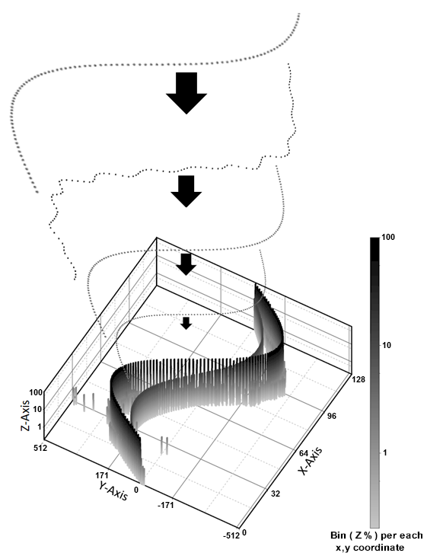
Basic Cyclic Histogram Structure
This Cyclic Histogram method is a three-dimensional representation of many continuous cycles of historical current or voltage waveforms in a one-cycle view.
The X and Y axes make up a given matrix of bins for a stack of Z values to be established. As a given X sample is selected, the Y value is measured and placed in the corresponding bin. The number of bins is determined by horizontal and vertical resolution.

Slide 26
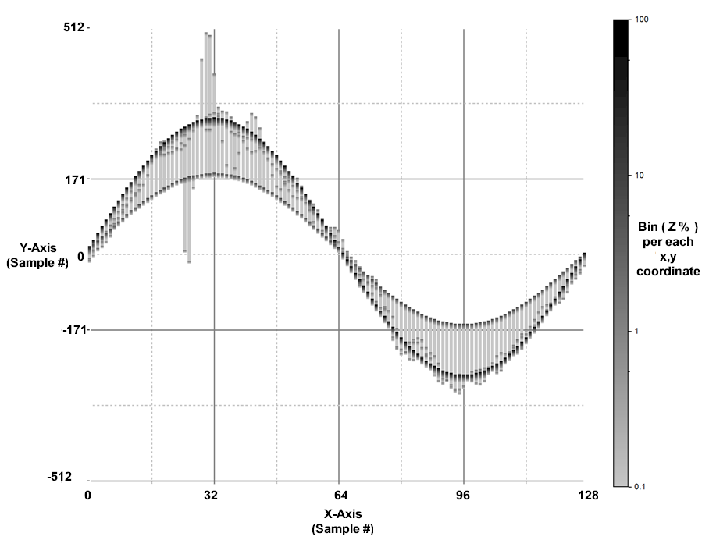
Cyclic Histogram (X and Y Axis)
The X axes should represent the number of points per cycle, with each sample having a delta-t that is the inverse-frequency divided by the number of points.
For visual needs, the Y axis will not need the same vertical resolution as the source data. Most meters record 16 bit (65536) resolution. 10 bit (1024) may suffice which in this case would aggregate 64 vertical value levels into 1 bin.

Slide 27
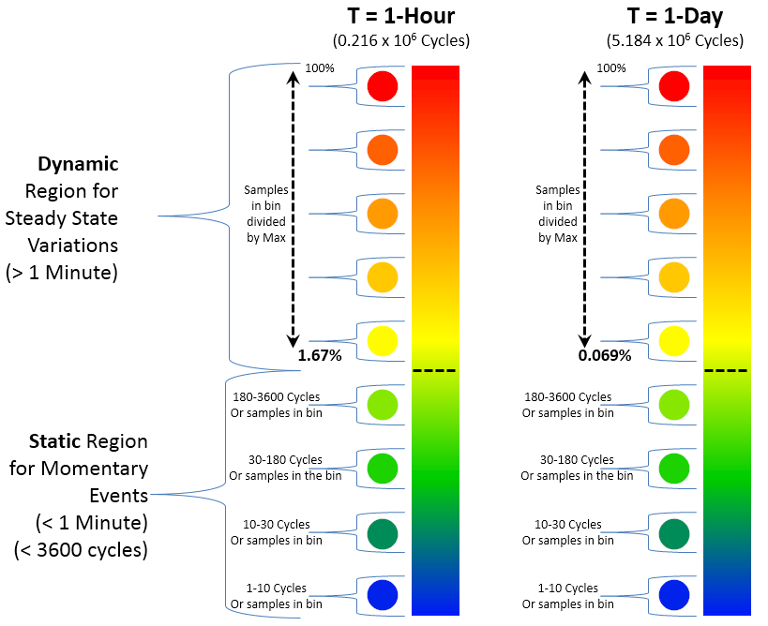
Z axis Coloring
For power quality phenomena we have two distinct variations in waveforms…. steady state variations, and event variations. And each have their typical range as defined in PQ standard IEEE 1159. For events, we typically see variations from 1 to ~180 cycles. A series of events are typically less than one minute (3600 cycles). Steady state variations are greater than one minute. As shown in the graphic, events have a color region that presents static duration (1 to 3600 cycles) regardless of the cyclic histograms total period (T). For the static algorithm one pass by a bin equals 1 cycle. Counting the number of samples in a bin establishes what color of blue to green is presented.
For steady state, values in this color region (yellow to red) will be percentage values and the representative color will be dynamic depending on the total period (T) of the cyclic histogram. For this algorithm, the value will be stored as a percent, which is derived from one sample divided by total samples in the T measurement period. If one or more values already exists in this bin, the percent value is mathematically added to the previous value(s). The minimum percentage will depend on the total period selected, but it will always be based on 1 minute.
(1 minute / 1 hour = 1.67%) or (1 minute / 1 day = 0.069%)
This method gives us some visual distinction between events and steady state variations.

Slide 28
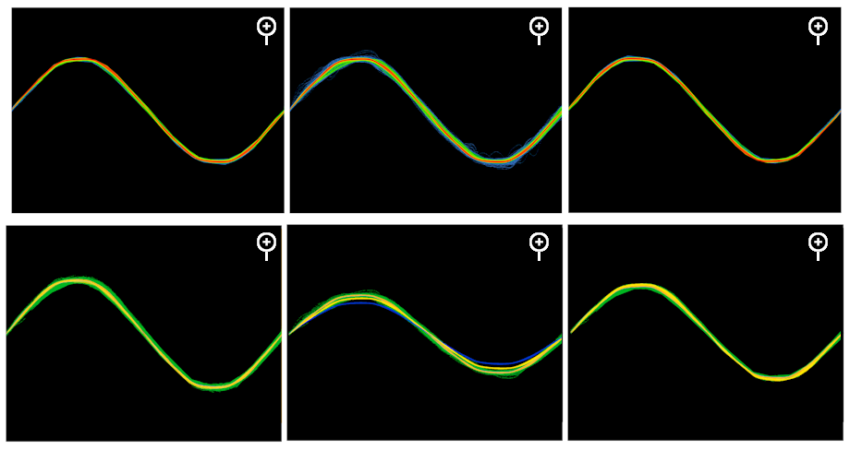
Format and Display
To ease storage, transfer, and display of the cyclic histogram, it can be distributed as a static image (gif, png, etc).
There can be multiple images for each phase, voltage and current. Furthermore, there may be multiple pages of images representing different time periods (i.e. 1 hour, 1 day, or maybe 1 week)

Slide 29
For more information on the Cyclic Histogram, contact…..
_____________________________________________________
Thomas Cooke
Project Manager
Power Quality Monitoring and Analytics, Power Delivery
Electric Power Research Institute (EPRI)
942 Corridor Park Blvd., Knoxville, TN 37932
Office: 865-218-8010
Fax: 865-218-8001
tcooke@epri.com
www.epri.com
“Together . . . Shaping the Future of Electricity”
_____________________________________________________

Slide 30
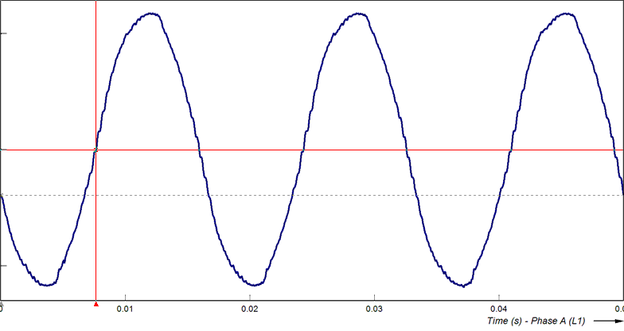
Subtle Waveform Deviation from Arcing
Animation

Slide 31
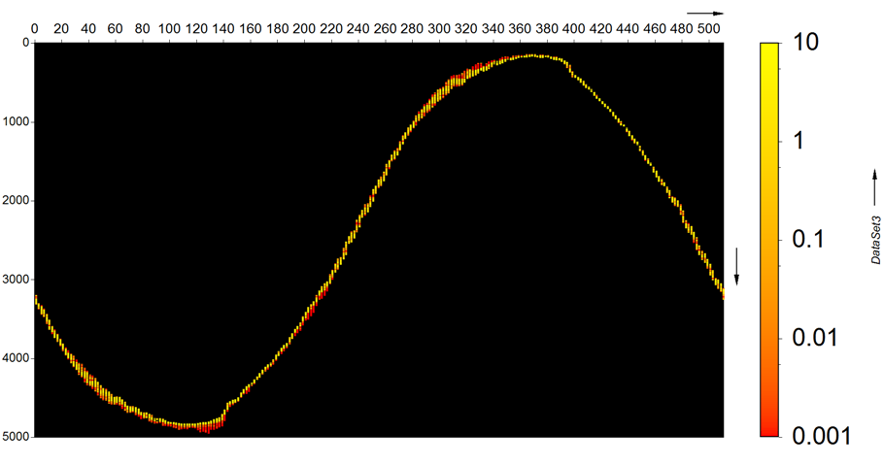
Cyclic Histogram Highlights Deviations

Slide 32
Together…Shaping the Future of Electricity

