Slide 1
Clustering Algorithms FOR
Streaming openPDC Data Sets
Anupam Mukherjee & Ranganath Vallakati
Department of Electrical Engineering
University of north Dakota
Advisor: Dr. Prakash Ranganathan
2015 GPA User’s Forum and Tutorial, August 4 & 5, 2015

Slide 2
Outline of the Presentation
Introduction : Need for Situational Awareness of Smart-grid
Proposed Situational Awareness Framework
Development of User Interface for openPDC
Data Visualization
Data Clustering
  DBSCAN Clustering
  k-means Clustering
  Multi-Tier k-means Clustering
Results and Discussions
Conclusion

Slide 3
Need for Situational Awareness of Smart Grid
Blackout Events | Affected Areas | Cause
August 14, 2003 – Northeast Blackout. | Northeastern and Mid-western United States and Canadian province of Ontario. People affected – 55 million. | Software bug in the alarm system.
July 31, 2012 – Blackout in India. | 22 states and union territories. People affected – 600 million. | Collapse of Northern and Eastern grids.
December 22, 2013 – Major ice-storm caused power failure. | Ontario to the maritime province in the far east and Michigan People affected – 1.1 million. | Ice storm
March 31, 2015 – Black-out, caused by technical failure, affected about 90% of Turkey. | 90% of Turkey. People affected – 70 million. | Probable cyber attack.

Slide 4
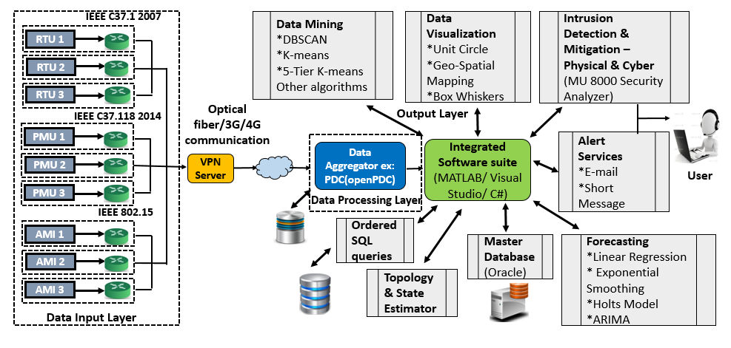
Integrated Software Suite (ISS)
Figure 1: Integrated Software
Suite

Slide 5
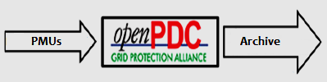
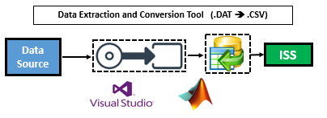
Development of user interface
OpenPDC functions by receiving data broadcasted by a PMU and concentrating it, enabling archiving, rebroadcasting, and analysis of the phasor data. It provides around 30 samples per second.
Functionalities:
E-mail Alarm
Short Message Service alarm
Location based monitoring
Methodologies
C# used for all coding
Visual Studio 2012 IDE used for development
External libraries utilized:
  Grid Solutions Framework
  Google Static Maps API
  .NET Framework 4.5
Figure 2: Data Processing Layer
Notes:
Generally, openPDC archives the data as it receives. Synchrophasor Data that is stored in openPDC can be mined by extracting the archived data. . For this task, a C# code using Microsoft Visual Studio [42] has been developed . OpenPDC is a virtual software that has PMU data generator developed on Microsoft Visual C# platform. A SQL database have been set up for the Open PDC environment that produces PMU data using a PDC connection tester file. The data is produced as per the Grid Protection Alliance directives. The generated data gets stored in an Archives folder as ‘.dat’ files, namely ‘ppa_archive.dat’.

Slide 6
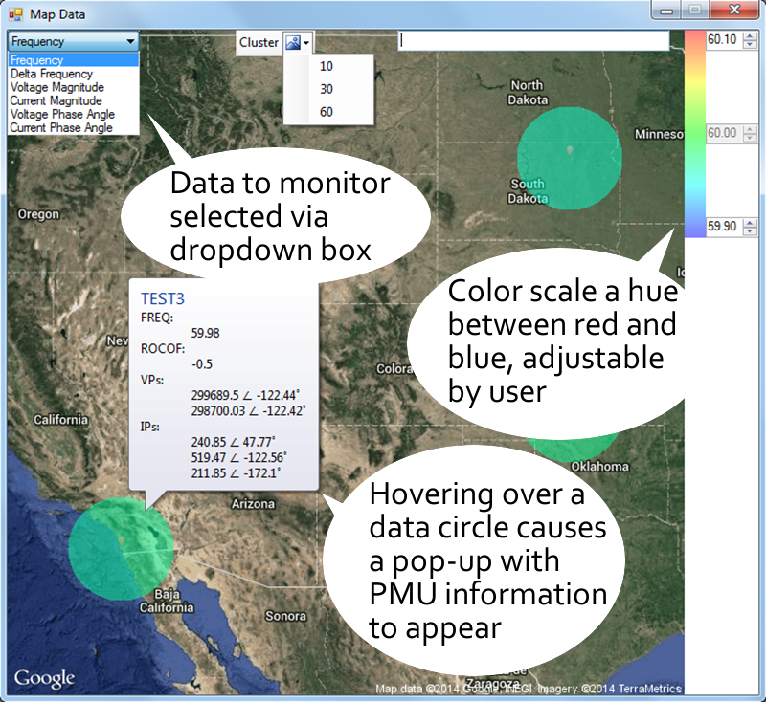
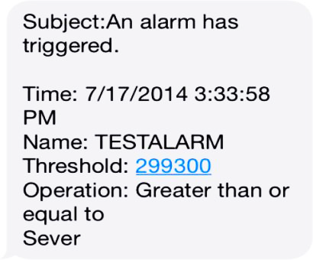
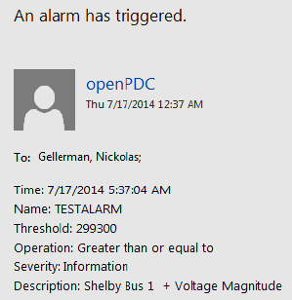
Alert Systems developed for openpdc
Figure 3: Short Message Service Alarm
Figure 4: E-mail Alarm
Figure 5: Location Based Monitoring System
Notes:
Action Adapter add-on to openPDC. Uses SMTP protocol. Gmail SMTP server used during testing.
Send email/s to specified addresses, whenever any selected alarm is triggered.If service providers is known, email can be sent directly to cell phone as well.
Windows Forms application.Uses the Google Static Maps API as basis for location mapping.Individual PMUs placed on top of Static Map map using Mercator Projection

Slide 7
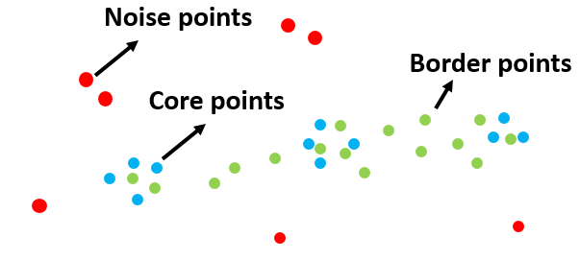
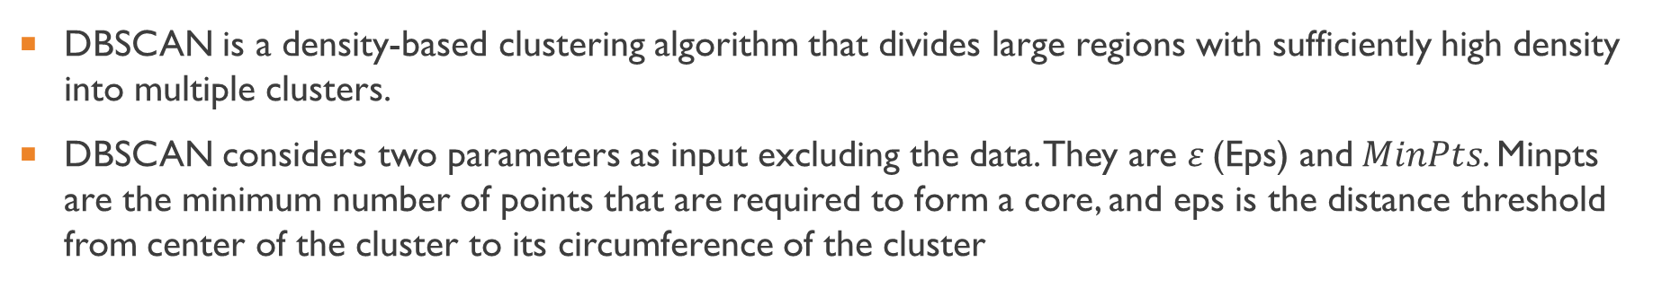
DBSCAN Clustering Scheme
DBSCAN is a density-based clustering algorithm that divides large regions with sufficiently high density into multiple clusters.
DBSCAN considers two parameters as input excluding the data. They are $ε$(Eps) and$MinPts$. Minpts are the minimum number of points that are required to form a core, and eps is the distance threshold from center of the cluster to its circumference of the cluster
Figure 6: DBSCAN Cluster Formation
Notes:
A point $p$ become a $core$ point if it has more than a specified number of points ($MinPts$) within a radius $Eps$ (these points are the interior of a cluster). A $border$ point $p$ has fewer than $MinPts$ within $Eps$, but is in the neighborhood of a core point. A $noise$ point $p$ is any point that is not a $core$ point or a $border$ point. In general, an $Eps$ - neighborhood of a $border$ point contains significantly less points than an Eps-neighborhood of a $core$ point. The advantages of DBSCAN are that this method is resistant to $noise$ and can handle clusters of different sizes and shapes. The limitation lie with right selection of $Eps$ and $MinPts$ parameters.

Slide 8
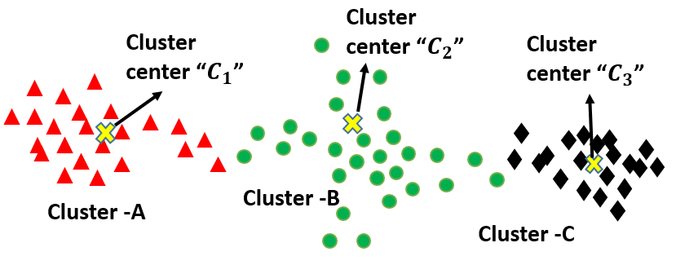
K-means Clustering Scheme
The k-means technique is a well-known and popular algorithm which was first proposed by Lloyd.
Here, each cluster is represented by an adaptively changing centroid (also called a cluster center), starting from some initial values
Figure 7: k-means Clustering

Slide 9
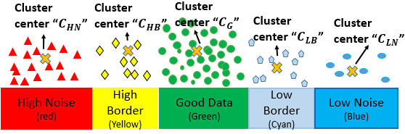
Multi-tier k-means Clustering Scheme
This paper presents a different version of k-means which we refer as multi-tier k-means clustering tailored for power system data sets.
The proposed approach dynamically forms clusters from 1 to 5 clusters depending on the data thresholds and fault type. They are : High Noise, High Border, Good Data, Low Border, and Low Noise points
Capable of clearly distinguish the good, bad and the noisy data with the threshold inputs from the operator.
Figure 8: Multi-tier k-means Cluster Formation

Slide 10
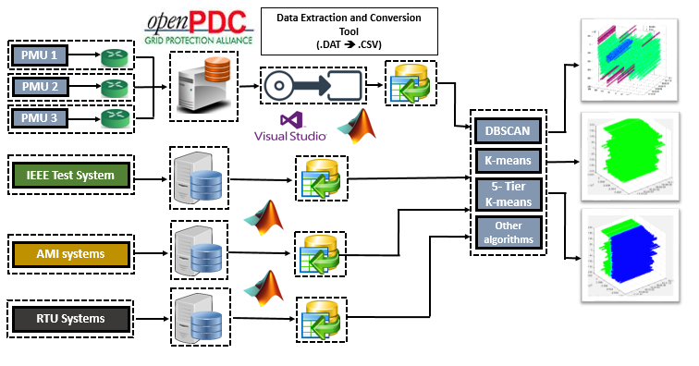
Data Clustering scheme
Figure 9: Smart Grid Data Management
Framework (SGDMF)

Slide 11
Results and Discussions
Data Visualization
  Box Plot
  Circle Representation
Data Clustering
  DBSCAN Clustering
  k-means Clustering
  Multi-Tier k-means Clustering

Slide 12
Data Visualization
As phase angle varies between -π to +π (0 to 360 degrees) and the magnitudes are above 0 for the electric signals, unit circle representation is ideal smart-grid data
The "Box Whiskers" is a statistical tool that allows observing a time-series data with minimum and maximum values in the series, standard deviations, mean and median values.
Figure 11: Circle Representation of openPDC Voltage Data
Figure 10: Box Whisker Representation of openPDC Voltage Data
Notes:
Data visualization (DV) is the study of the visual representation of data.
Power system data with high sampling rate, flood the data concentrators. It is neither possible to neither monitor each data point nor leave any data unmonitored.

Slide 13
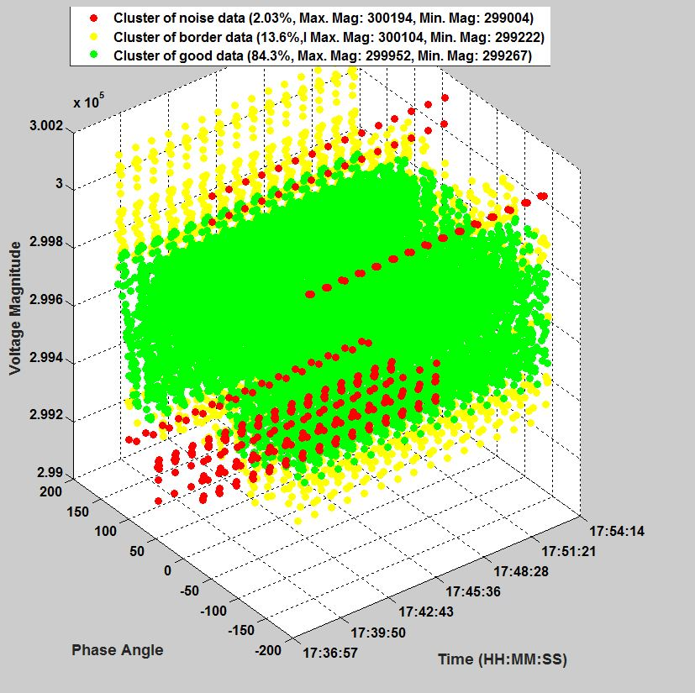
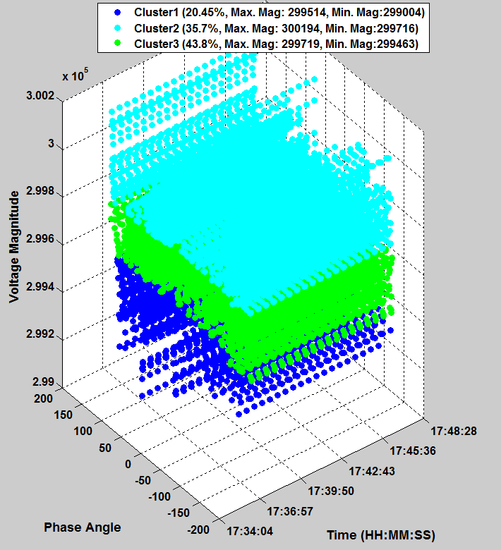
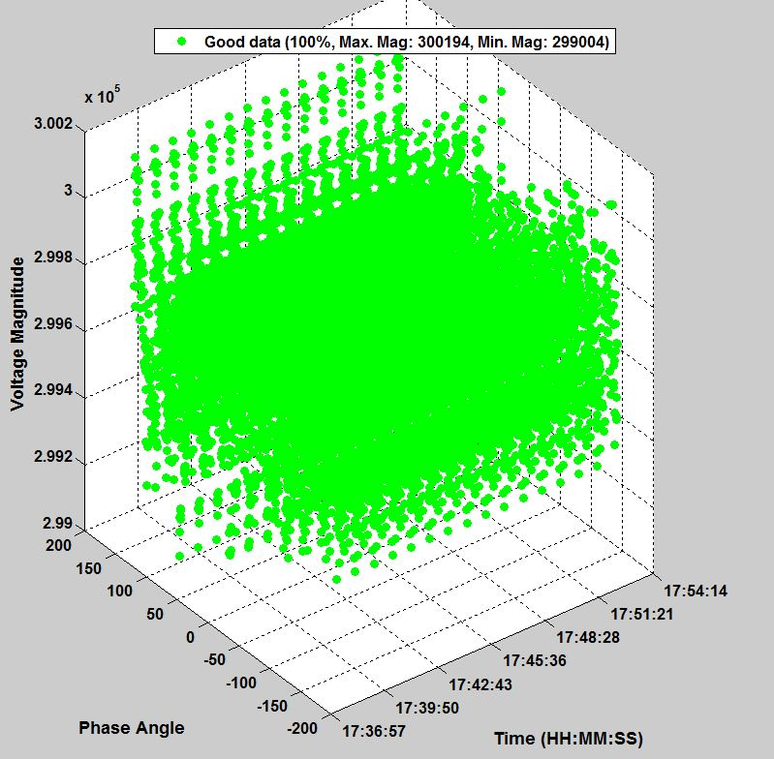
Test Scenario: Steady-State Condition
(a)
(b)
(c)
Figure 12: Clustering Schemes Applied on openPDC data under steady state condition
(a) DBSCAN, (b) k-means, (c) Multi-Tier

Slide 14
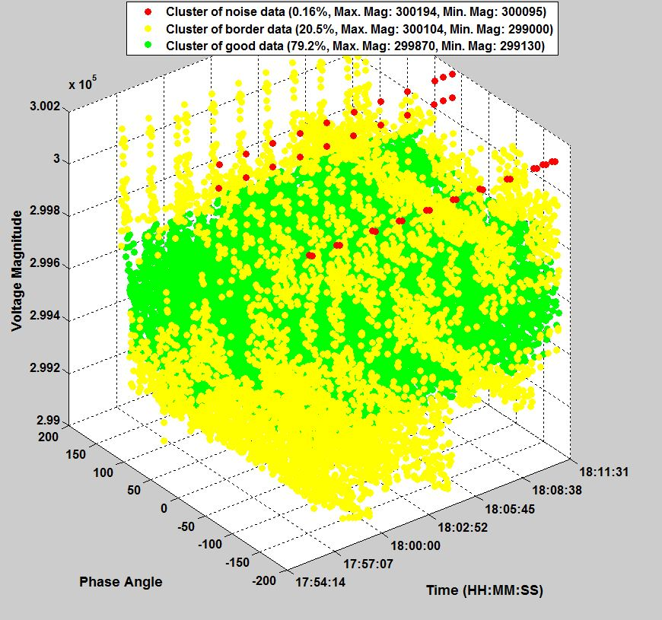
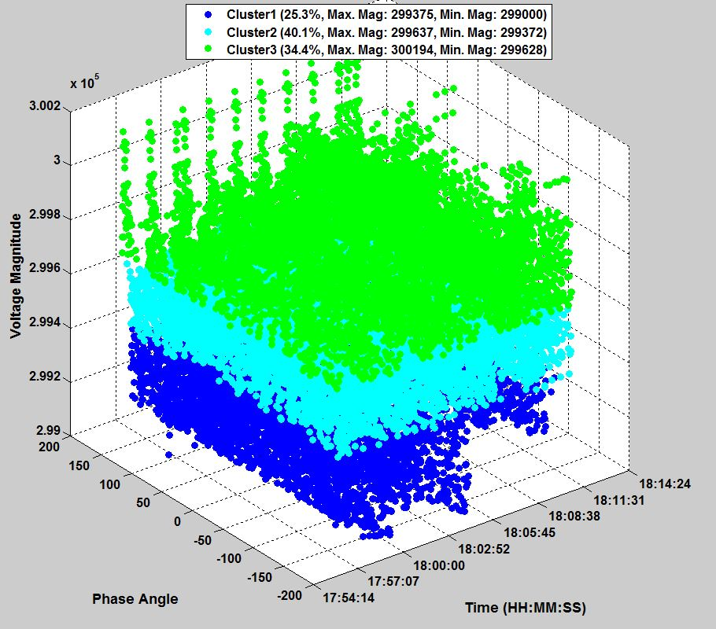
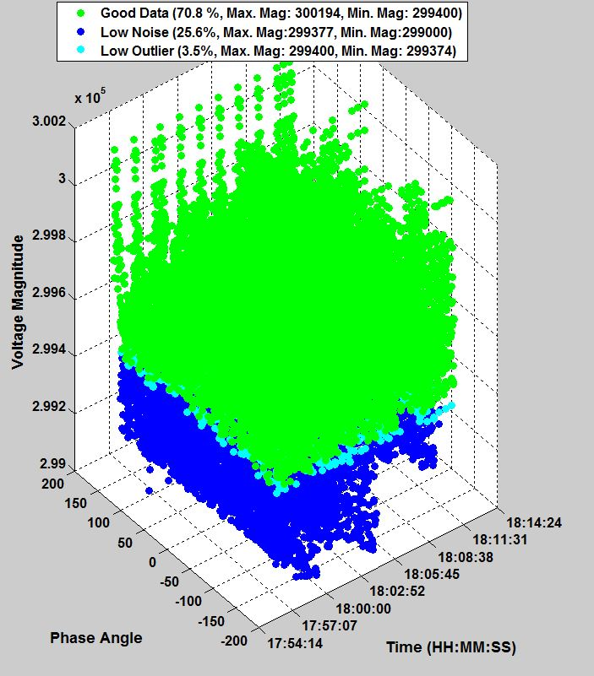
Test Scenario: Heavy load (High demand) Condition
(a)
(b)
(c)
Figure 13: Clustering Schemes Applied on openPDC data under Heavy Load Conditions
(a) DBSCAN, (b) k-means, (c) Multi-Tier

Slide 15
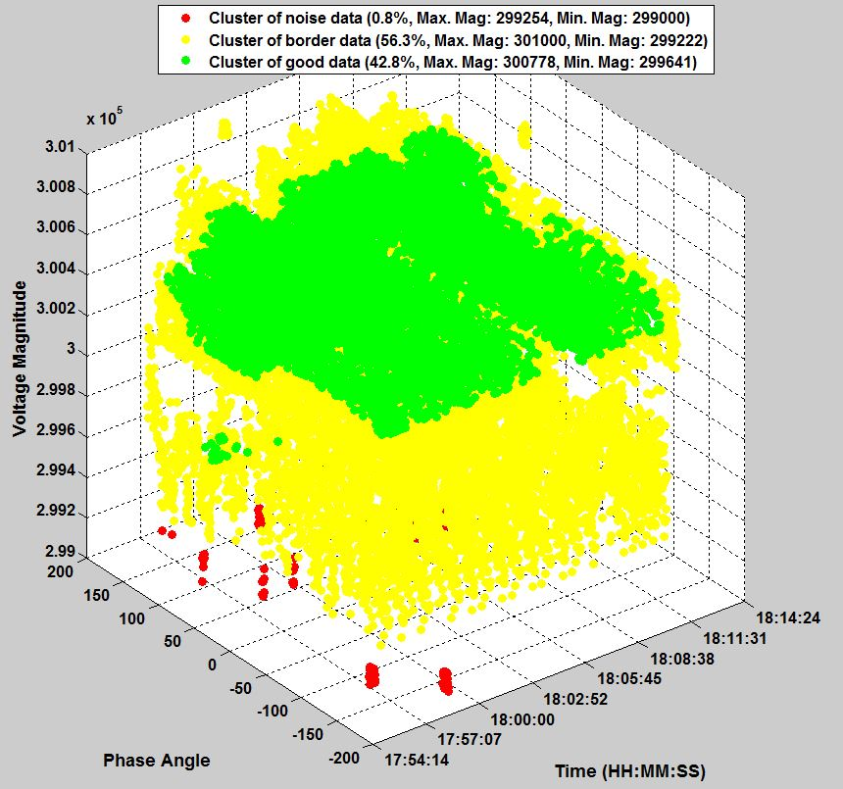
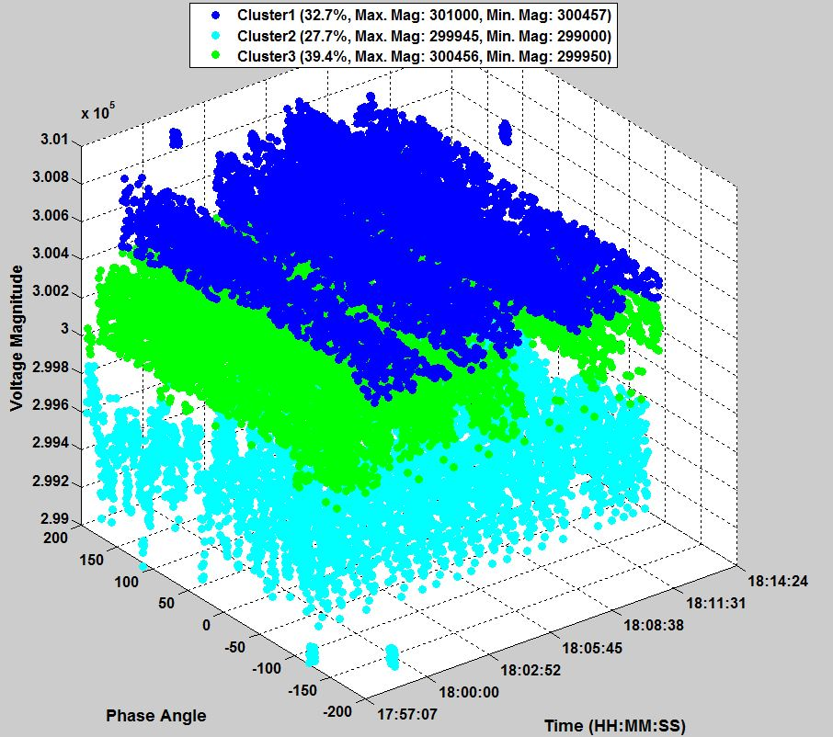
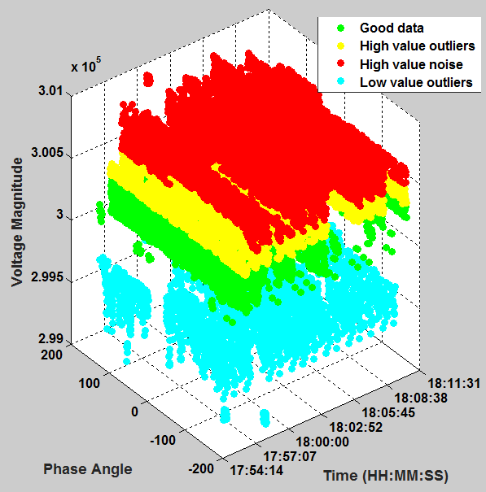
Test Scenario: Light load (Low demand) Condition
(a)
(b)
(c)
Figure 14: Clustering Schemes Applied on openPDC data under Light Load Conditions
(a) DBSCAN, (b) k-means, (c) Multi-Tier

Slide 16
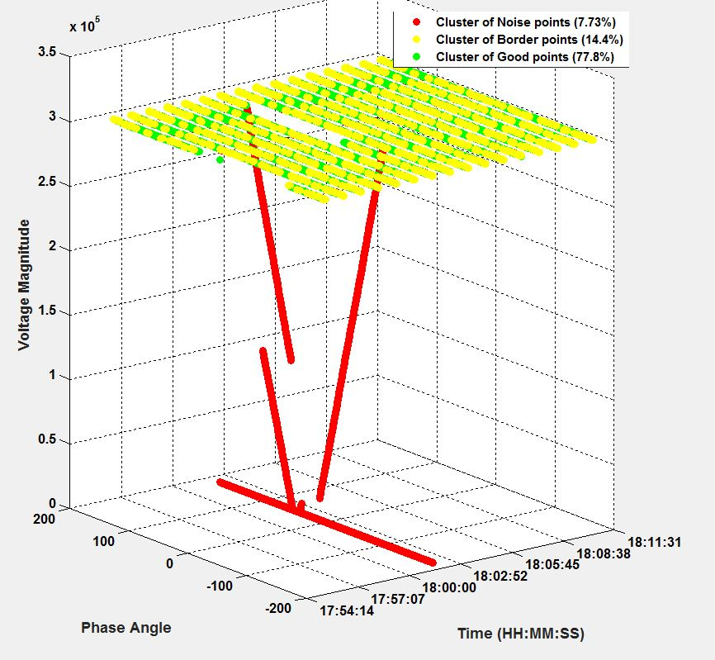
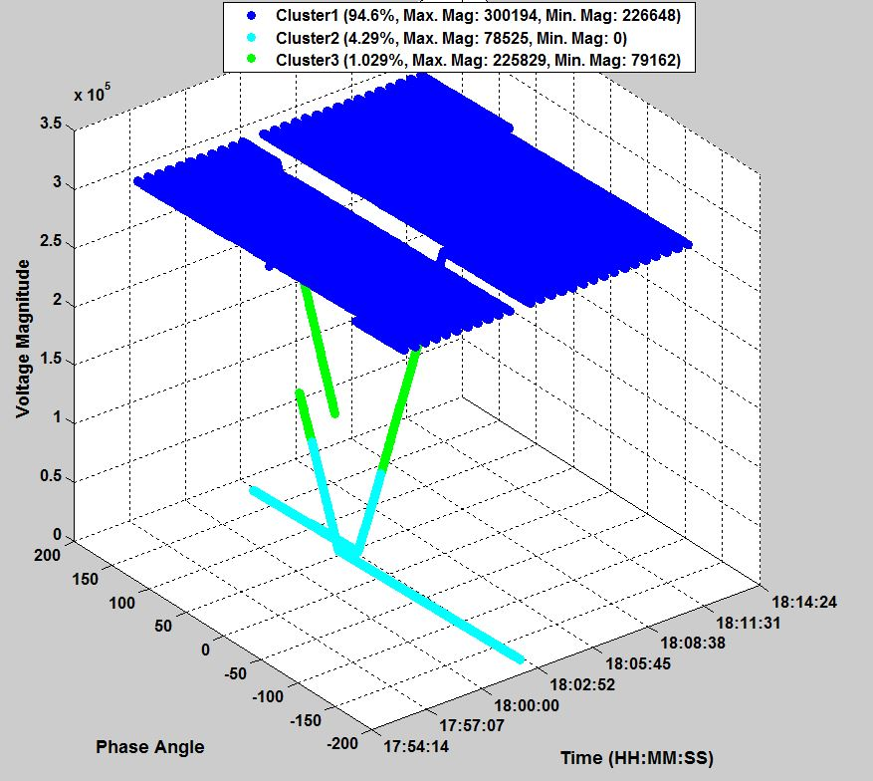
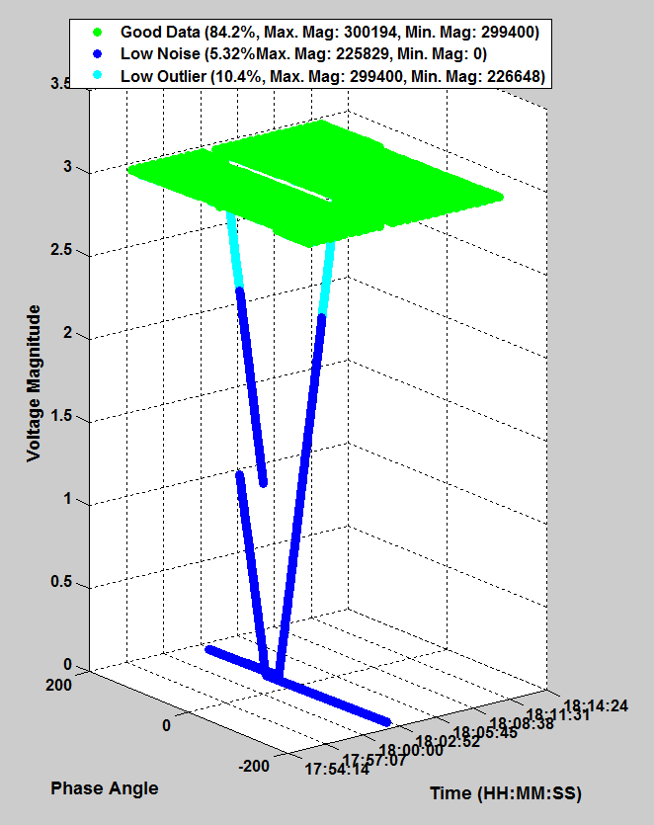
Test Scenario: SLG Fault Condition (Short-Circuit)
(a)
(b)
(c)
Figure 15: Clustering Schemes Applied on openPDC data Under SLG Fault Conditions
(a) DBSCAN, (b) k-means, (c) Multi-Tier

Slide 17
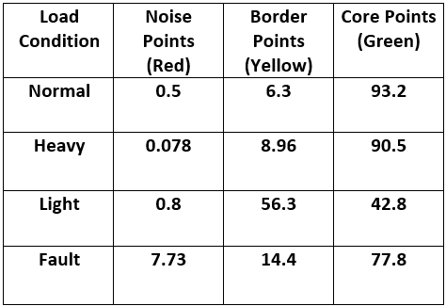
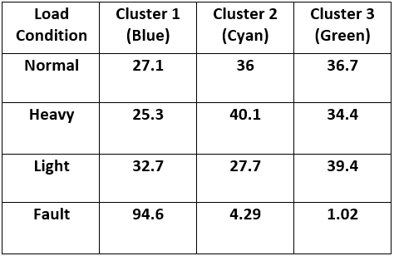
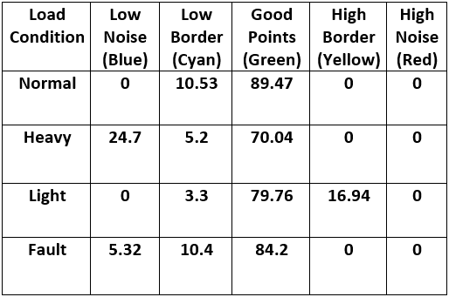
Distribution of data points
Table 1: % distribution of data points with DBSCAN
Table 2: % distribution of data points with
k-means
Table 3: % distribution of data points with multi-tier k-means
Steady-state condition: Multi-tier k-means performs best.
Heavy-load condition: DBSCAN performs best.
Light-load condition: DBSCAN performs best.
Fault condition: Multi-tier performs the best.

Slide 18
Conclusion
An Integrated Software Suite (ISS) has been developed to apply decision-making data-mining algorithms on time-synchronized synchrophasor data.
A novel, Multi-Tier variation of the k-means algorithm is presented, and its performance metrics are studied against common clustering techniques to classify and detect bad data, event detection, and alarm service applications.
A comparative analysis has been carried out between the three data clustering algorithms, DBSCAN, k-means and the Multi-Tier k-means.
It is believed that such a framework will enable the grid’s system operators to utilize novel algorithms in order to enhance situational awareness about the grid. The framework is scalable and suitable for streaming time-series data sets.
Notes:
The capability and portability to handle different data sizes and to suit various algorithms are tested to run in near-real time.

Slide 19
Future work
Study application of forecasting algorithms like:
  Time Series Data Analysis
  Linear Regression
  Exponential Smoothing
  Holt’s Model
Topology based State Estimator
Intrusion Detection and Mitigation Systems

Slide 20
References:
[1] M. Panteli and D. S. Kirschen, “Situation awareness in power systems: Theory, challenges and applications,” Electr. Power Syst. Res., vol. 122, pp. 140–151, May 2015.
[2] A. G. Phadke, “Synchronized phasor measurements in power systems,” IEEE Comput. Appl. Power, vol. 6, no. 2, pp. 10–15, Apr. 1993.
[3] A. J.Phadke, A.G., Thorp, Synchronized Phasor Measurements and Their Applications. 2008.
[4] J. Chen and A. Abur, “Placement of PMUs to Enable Bad Data Detection in State Estimation,” IEEE Trans. Power Syst., vol. 21, no. 4, pp. 1608–1615, Nov. 2006.
[5] J. Quintero and V. M. Venkatasubramanian, “Oscillation monitoring system based on wide area synchrophasors in power systems,” in 2007, iREP Symposium - Bulk Power System Dynamics and Control - VII. Revitalizing Operational Reliability, 2007, pp. 1–13.
[6] A. Pal, I. Singh, and B. Bhargava, “Stress assessment in power systems and its visualization using synchrophasor based metrics,” in 2014 North American Power Symposium (NAPS), 2014, pp. 1–6.
[7] A. Pal, J. S. Thorp, T. Khan, and S. S. Young, “Classification Trees for Complex Synchrophasor Data,” Electr. Power Components Syst., vol. 41, no. 14, pp. 1381–1396, Oct. 2013.[19]
[8] Z. Li and W. Wu, “Phasor Measurements-Aided Decision Trees for Power System Security Assessment,” in 2009 Second International Conference on Information and Computing Science, 2009, vol. 1, pp. 358–361.
[9] “IEEE Guide for Phasor Data Concentrator Requirements for Power System Protection, Control, and Monitoring,” 2013.
[10] S. Ma and J. L. Hellerstein, “Ordering categorical data to improve visualization,” Infovis-99, no. 1, pp. 1–4, 1999.
[11] T. J. Overbye, D. A. Wiegmann, and A. M. Rich, “Human factors aspects of power system voltage contour visualizations,” IEEE Trans. Power Syst., vol. 18, no. 1, pp. 76–82, Feb. 2003.
[12] K. R. Žalik, “An efficient k′-means clustering algorithm,” Pattern Recognit. Lett., vol. 29, pp. 1385–1391, 2008.
[13] R. Cordeiro de Amorim and B. Mirkin, “Minkowski metric, feature weighting and anomalous cluster initializing in K-Means clustering,” Pattern Recognit., vol. 45, no. 3, pp. 1061–1075, Mar. 2012.

Slide 21
Thank you…
Questions???

Slide 22
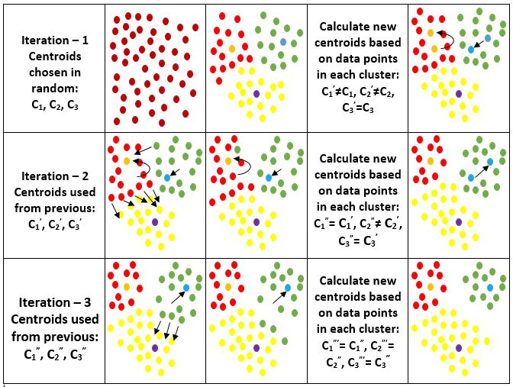
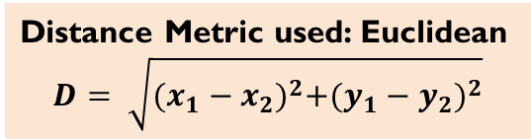
K Means Clustering
Scheme
C₁’
C₂
22
C₂
C₁
C₁
C₂’
C₃
C₃^{’=} C₃
C₁^{”=} C₁’
C₂”
C₁’
C₂’
C₂’
C₃’
C₂^{”=} C₂’
Distance Metric used: Euclidean
$$D= \sqrt{{(x_{1}−x_{2})}^{2}+{(y_{1}−y_{2})}^{2}}$$
C₁”
C₂”
C₁^{”’=} C₁”
C₂^{”’=} C₂”
C₃”
C₃^{”’=} C₃”
Figure : k-means Cluster formation

Slide 23
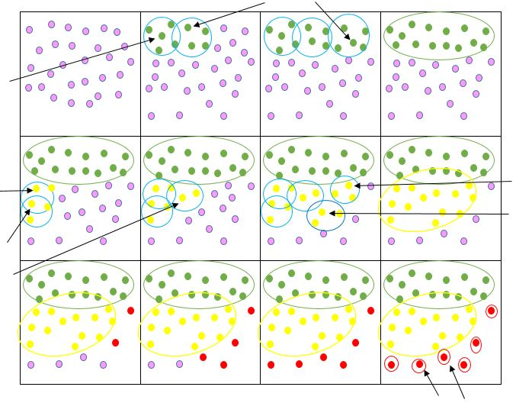
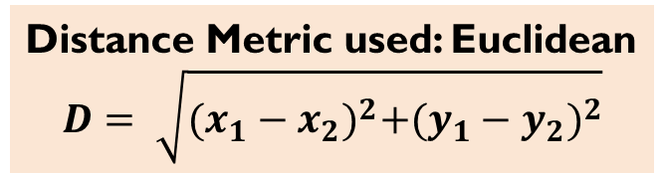
Dbscan Clustering scheme
C2
C3
23
Core
C1
Distance Metric used: Euclidean
$$D= \sqrt{{(x_{1}−x_{2})}^{2}+{(y_{1}−y_{2})}^{2}}$$
B1
B4
B5
Border
Inputs for the Algorithm
X = Dataset
Eps = Min. distance between two points
D = Min. number of points required to make core
B2
B3
23
Noise
N1
N2

Slide 24
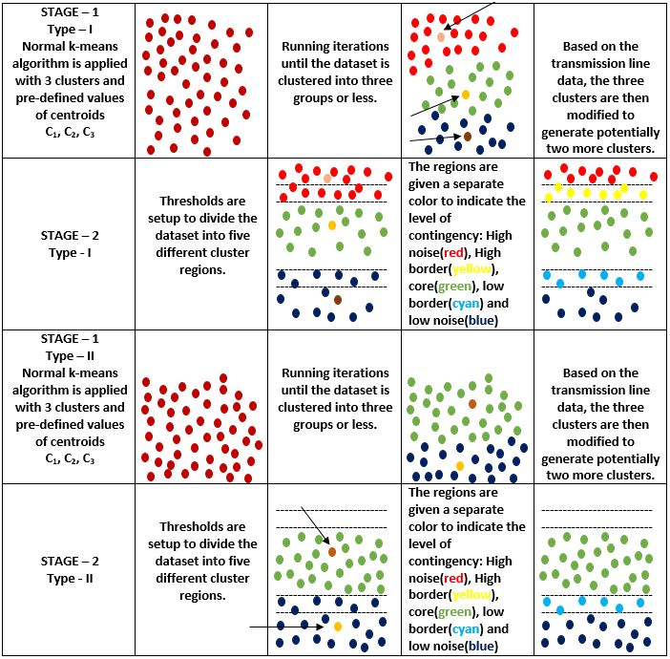
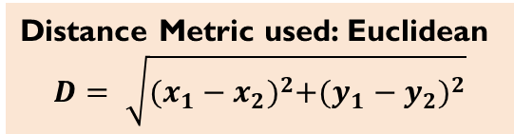
Multi-tier k-means clustering scheme
C₁
C₂
C₃
Noise
Region
Inputs for the Algorithm
X = Dataset
V = Expected voltage of Transmission line
S = Allowable range for the line voltage to fluctuate
Normal
Region
Border
Region
Distance Metric used: Euclidean
$$D= \sqrt{{(x_{1}−x_{2})}^{2}+{(y_{1}−y_{2})}^{2}}$$
C₁
Noise
Region
Normal
Region
Border
Region
C₂

