Slide 1



Transitioning to IEEE Standard
Streaming Telemetry Transport Protocol
SMWG Meeting
J. Ritchie Carroll
April 6, 2023
P2664

Slide 2
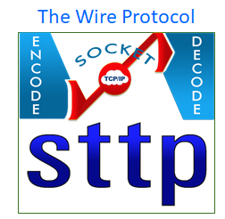
STTP Difference: IP Level Security
Security at IP Layer
  TCP: Primary security is added at the socket using industry standard Transport Layer Security (TLS or SSL). X.509 certificates are used to authenticate connections and provide encryption through public key infrastructure.
  UDP (optional): When existing command channel is secured with TLS, UDP uses AES symmetric encryption with keys exchanged over the TLS secure channel.

Slide 3
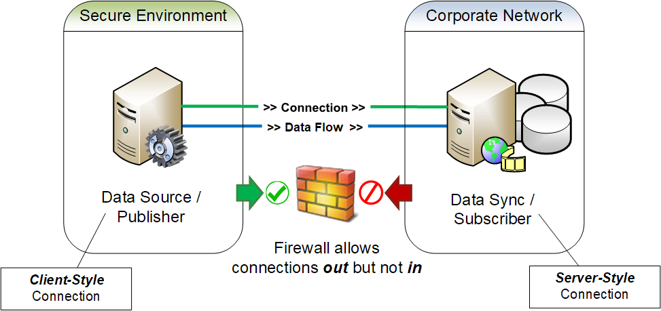
STTP Difference: Configurable Connection Origin
Publisher and Subscriber operations are “functions” in STTP – not “objects”
As such, a publisher “sends” data and a subscriber “receives” data – always
Crossing Security Zone with Reverse Connection

Slide 4

IEEE Updates
P2664
Atomic Measurement Packets
Reduced Data Loss
Lossless Compression
Scalability (to hardware limits)
Publish / Subscribe Model
Publisher Data Access Control
IP Level Security
Configurable Connection Origin
Plan is to go to ballot in May!

Slide 5
Changes Coming in the IEEE Standard
Added higher time precision options
Some commands simplified / key words changed / unused options dropped
Define Operational Modes now requires a publisher success response to accept proposed subscriber options. Options now include:
  Custom compression algorithms selection for data packet, buffer block, signal index cache and metadata
  Custom UDP cipher encryption algorithm selection
New commands:
  Get Primary Metadata Schema
  Get Signal Selection Metadata Schema
  Confirm Update Cipher Keys
Suggested Metadata for synchrophasors has been improved / standardized.
Includes a recommended Publisher and Subscriber API

Slide 6


API Status -- see: https://sttp.info
 | Subscriber | TSCC | Filter Expressions | Reverse Subscriber | Publisher | Reverse Publisher | TLS
GSF
C++ / C#
Go
Python
Rust
Ongoing progress on STTP API language targets…
All API language targets expected to be function complete by end of year in time for IEEE release
However, no need to wait, start integrating now!

Slide 7
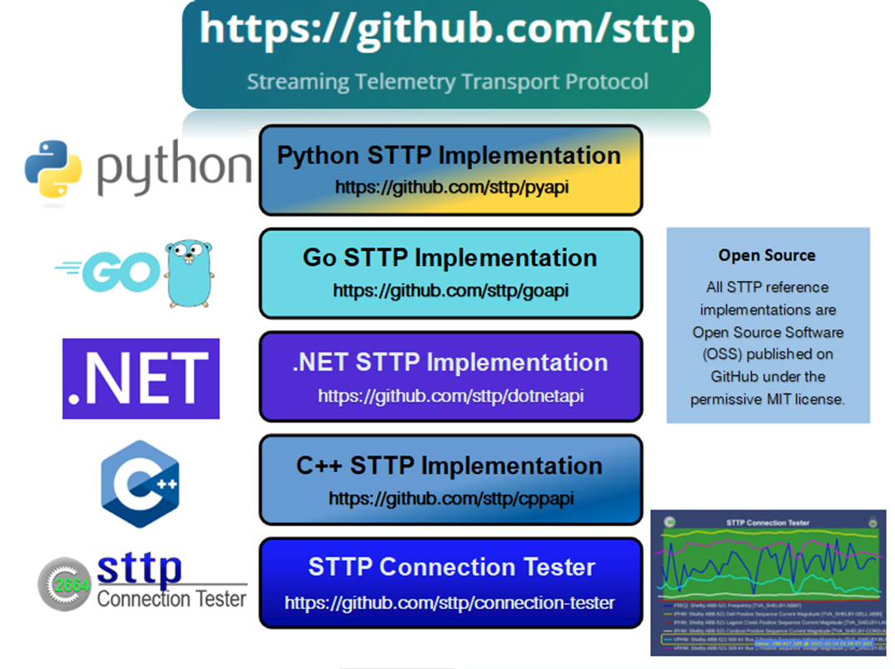
Chose one and go!

